Slide 1




Mathematics in Industry
Hotel Industry
hem@ctkacademy.co.uk

Slide 2

What mathematics do you use in a hotel?
Think about these departments:
Kitchen
Reception
Housekeeping
Sales and bookings
Notes:
Ask groups to come up with ideas of what areas of maths might be needed (see additional sheet for list of possible answers although groups might come up with more)

Slide 3
Kitchen
What mathematics might you need to use when working
in a hotel kitchen?
Notes:
Think specifically about the kitchen now, when might the team need to use maths (see next slide for possible responses again not all may be listed and some are specific to a certain type of hotel)

Slide 4
Reading scales for ingredients for making things from fresh.
Stock Take; counting and recording quantities.
Ordering food quantities and costings.
Starters and desserts how many are needed if guests can have unlimited amounts and help themselves?
Main course options, how much food to prepare in advance to minimize waste based on amount of guests in hotel.
Percentage of wastage.
Buying in bulk (if you buy in bulk to make things cheaper but you then have to consider storage of items)
Which dishes need more products that can be in higher demand and also cost more e.g. eggs, scrambled vs fried.
Notes:
There could be some rich mathematical discussions around each or some of these bullet points depending on time.

Slide 5
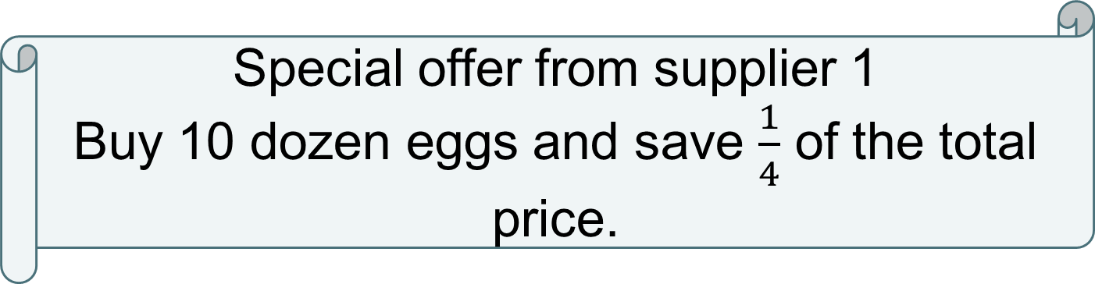
Head chef Ben needs to decide which deal is best for the kitchen…..
Special offer from supplier 1
Buy 10 dozen eggs and save $\frac{1}{4}$ of the total price.
Special offer from supplier 2
Buy 10 dozen eggs and save 30% of the total price.

Slide 6
Initial thoughts…..
Special offer from supplier 1
Buy 10 dozen eggs and save $\frac{1}{4}$ of the total price.
Special offer from supplier 2
Buy 10 dozen eggs and save 30% of the total price.
Notes:
Take initial thoughts from the group about the two offers, which is likely to be better? What things do we need to consider? Which areas of mathematics are we likely to need? Have we seen any mathematical problems like this before?

Slide 7
What is the same and what is different about the two offers?
Special offer from supplier 1
Buy 10 dozen eggs and save $\frac{1}{4}$ of the total price.
Special offer from supplier 2
Buy 10 dozen eggs and save 30% of the total price.
Notes:
What is the same and what is different is a powerful question to focus in on the mathematics and what the question is asking
Ask the group to look at what is the same about the two offers (both involve buying quantities of 10 dozen eggs to get the offer)
What is different? (One reduces the amount by a quarter and one by a percentage, which is the greatest amount of money off? What is a quarter equivalent to as a % and how would we write 30% as a fraction?)

Slide 8
What you need to know before you can solve the problem?
How many eggs are in a dozen.
Cost per dozen.
How many eggs per week the kitchen are going to need.
Notes:
Key facts needed; There are 12 eggs in a dozen
Other facts needed are on the next slide

Slide 9
Key Facts
Cost of eggs at the suppliers…..
£4.60 per dozen from supplier 1
£4.90 per dozen from supplier 2
The kitchen needs 3000 eggs per week.
Notes:
Again there is room for mathematical discussion here – does the kitchen need exactly 3000 eggs per week (unlikely to be exact but a rough estimate) what happens if they run out? What if there are any left over?
£4.60 per dozen is current price but food costs are rising and this would need taking into account by the kitchen team and potentially look for an alternative supplier

Slide 10
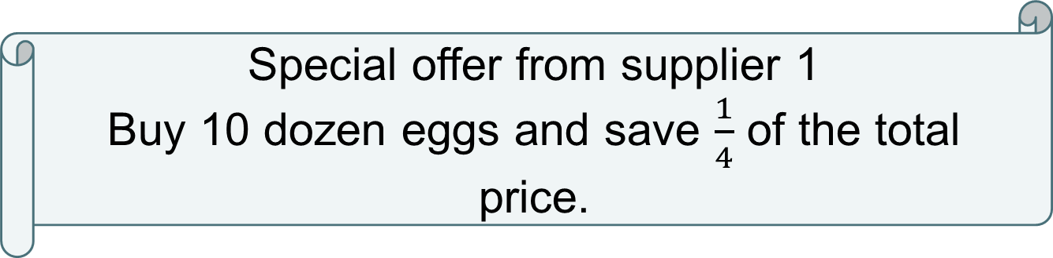
Special offer from supplier 1
Buy 10 dozen eggs and save $\frac{1}{4}$ of the total price.
Calculate
Notes:
Give the group opportunity to calculate for themselves, initial thoughts on special offer 1.
Look out for those who have a starting point (what step needs to come first?)
Look out for those who are using the most efficient mathematical strategies (mental methods, jottings or more formal written methods)

Slide 11
Special offer from supplier 1
Buy 10 dozen eggs and save $\frac{1}{4}$ of the total price.
Working
Calculate how many dozen eggs you will need to buy
How many lots of 10 dozen can you buy?
3. How much are you saving on each 10 dozen?
4. How much are you spending on each 10 dozen?
5. How much are you spending on 3000 eggs?
Notes:
Total number needed divided by how many eggs in a dozen (3000 ÷ 12) (30 ÷ 10 then 30 ÷ 2 then multiply by 100 as 3000 is 100 times larger than 30, do not just get the group to add zeros!)
250 ÷ 10 = 25 (same strategy as above)
Find 1 quarter of the price of 10 dozen eggs £4.60 x 10 = £46 then £46 shared into 4 equal parts (see bar model on next slide)
£46 - £11.50 (should do mentally) = £34.50
£34.50 x 25 = £862.50

Slide 12
£46
£11.50
£11.50
£11.50
£11.50
Quarters mean the whole amount is split into 4 equal parts.
Notes:
Showing quarters if needed

Slide 13

Special offer from supplier 2
Buy 10 dozen eggs and save 30% of the total price.
Calculate

Slide 14
Special offer from supplier 2
Buy 10 dozen eggs and save 30% of the total price.
Calculate how many dozen eggs you will need to buy
How many lots of 10 dozen can you buy?
3. How much are you saving on each 10 dozen?
4. How much are you spending on each 10 dozen?
5. How much are you spending on 3000 eggs?
Notes:
Which of these steps do you already have the information for and therefore do not need to calculate again? (You already have steps 1 and 2 from supplier 1)
3. Find 30% of £49 (£49 is the amount of money per 10 dozen) Find 10% then multiply by 3 = £14.70
4. £49 - £14.70 = £34.30
5. £34.30 x 25 = £857.50

Slide 15
Extension
Cost of eggs at each supplier goes up by 10% per dozen
what is the impact of this on each of the offers?
Notes:
Option additional question.
- How do you work out 10% (divide cost per dozen by 10 and then add that on to the cost per dozen as the price has risen)

Slide 16
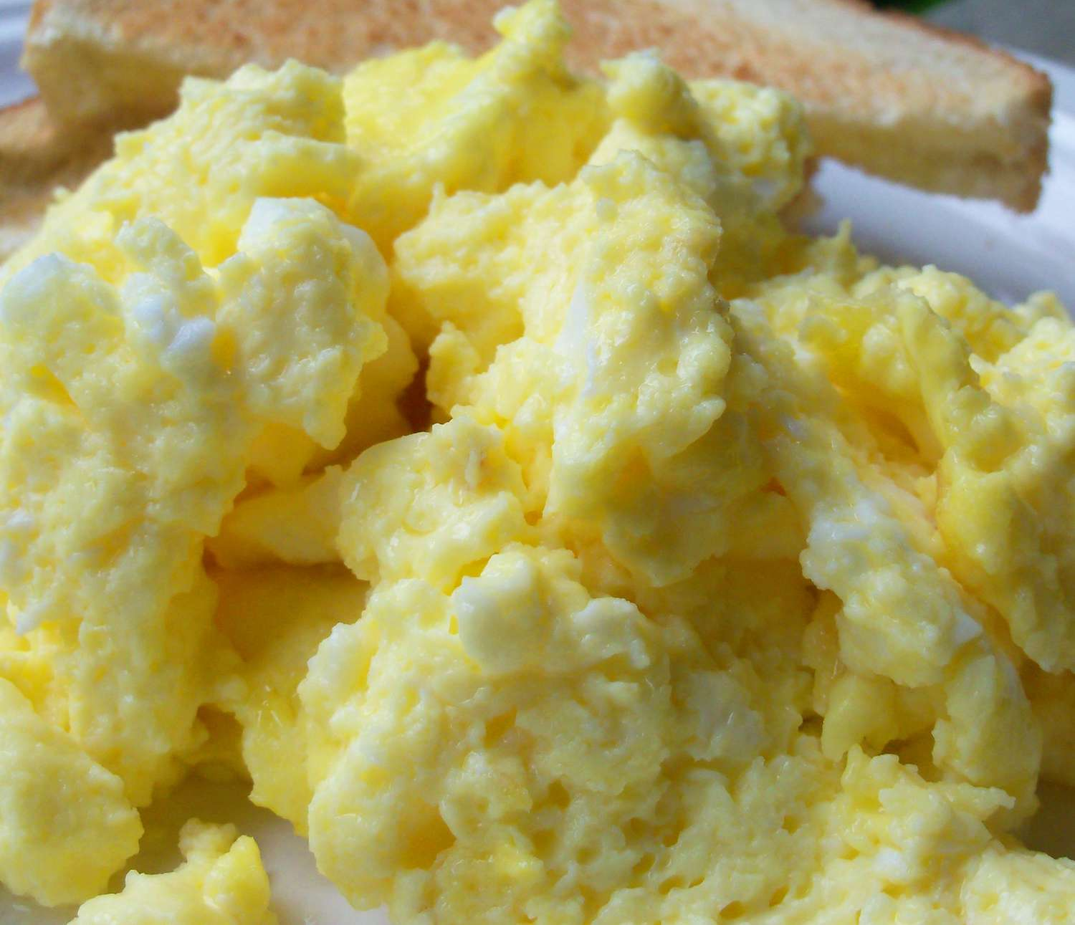
How many eggs?
Scrambled eggs are popular at the breakfast buffet.
Each portion of scrambled egg for breakfast uses approximately 2 eggs.

Slide 17
The hotel has 420 guests in a particular week.
If 60% of the guests have scrambled eggs for breakfast over a 4 night stay are the following statements true or false?
*If false say what mistake has been made and what the correct answer is.
Notes:
Which facts would be useful to know before you start?
- What 60% of 420 is (find 10% first)

Slide 18
True or False?
You will need 252 eggs each morning to make the scrambled eggs.
Notes:
False…252 is the number of guests eating scrambled eggs but each portion is 2 eggs so you would need 504 eggs

Slide 19

True or False?
You will need 2520 eggs for the duration of the stay to make the scrambled eggs for breakfast
Notes:
False…2520 is the number of eggs for 5 nights for 60% of the guests but they are staying 4 nights so total is 2016

Slide 20
Optional additional activity – Toad in the Hole
Shopping list:
400g sausages, £2
1 litre vegetable oil, £1.45
500g plain flour, 48p
6 eggs, £1.46
1 litre milk, 48p
Activity taken from Nrich
Notes:
Original activity can be found here https://nrich.maths.org/8422

Slide 21
Optional additional activity – Toad in the Hole
Ingredients required to make Toad in the Hole for three people:
400g sausages
15ml vegetable oil
100g plain flour
1 egg
250ml milk

Slide 22
Optional additional activity – Toad in the Hole
How much would it cost to make toad in the hole for 3 people?

Slide 23
Optional additional activity – Toad in the Hole
What about if you needed to make it for 300 people?

