Slide 1
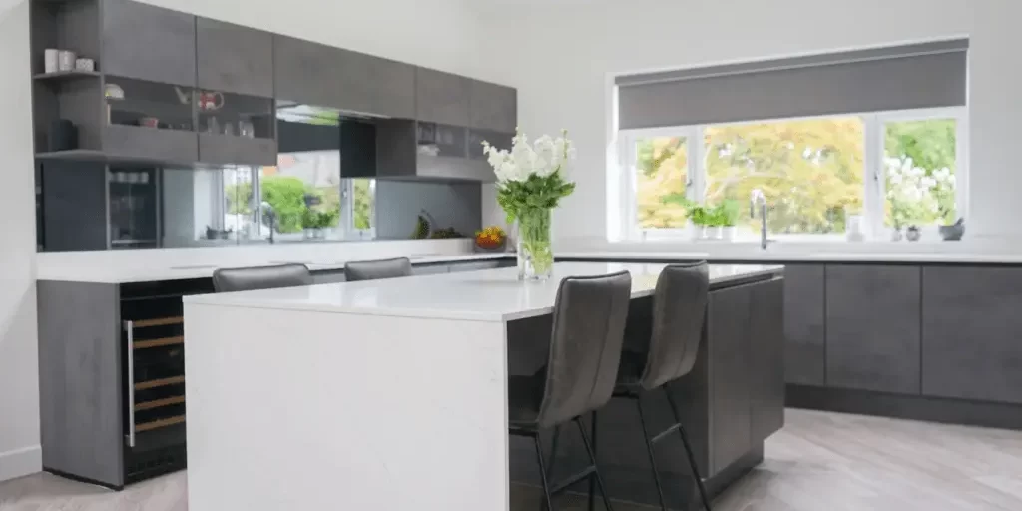



Granite house preston
Maths in the making! By Susan Bennett, Penwortham girls high

Slide 2
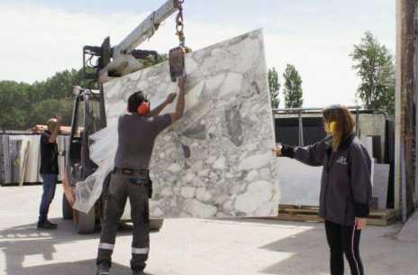
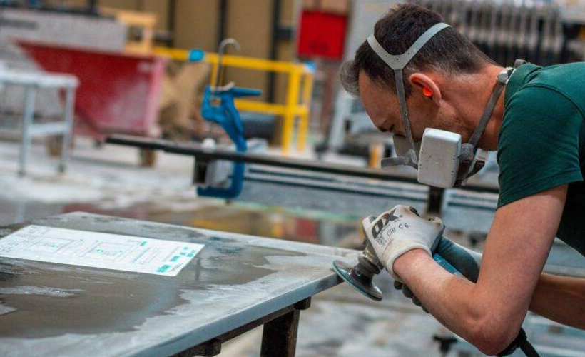
History
Granite House began in Preston, 2005. They are now in their 18th year with 1000s of satisfied clients and completed projects. They are still delivering the best bespoke worktops and services both nationwide and throughout their local area of Preston. They offer a range of service options to suit everyone's needs and preferences. This includes a complete template and installs service or supply only; whereby working to client-supplied template or drawing.

Slide 3

Facts
Area of a rectangle.
3 m
Area = length x width
= 3 m x 2 m
= 6 m
2 m
2
The rectangle is not drawn to scale.

Slide 4
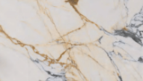
Facts
Your turn: Calculate the area of a rectangle.
4 cm
Area = length x width
= 4 cm x 3 cm
= 12 cm
3 cm
2
The rectangle is not drawn to scale.

Slide 5

Facts
Your turn: Calculate the area of a rectangle.
10 mm
Area = length x width
= 10 mm x 8 mm
= 80 mm
2
8 mm
The rectangle is not drawn to scale.

Slide 6

Facts
Your turn: Calculate the area of the compound rectangle.
1200 mm
1400 mm
800 mm
700 mm
The rectangle is not drawn to scale.

Slide 7
Facts
Your turn: Calculate the area of the compound rectangle.
1200 mm
1200 mm
600 mm
1400 mm
1400 mm
800 mm
800 mm
700 mm
Area = length x width
= 1200 mm x 600 mm
= 720000 mm
2
The rectangle is not drawn to scale.

Slide 8
Facts
Your turn: Calculate the area of the compound rectangle.
1200 mm
1400 mm
800 mm
800 mm
700 mm
700 mm
Area = length x width
= 800 mm x 700 mm
= 560000 mm
2
The rectangle is not drawn to scale.

Slide 9
Facts
Your turn: Calculate the area of the compound rectangle.
1200 mm
2
720000 mm
1400 mm
2
560000 mm
800 mm
700 mm
Total Area = 720000 + 560000
= 1280000 mm
2
The rectangle is not drawn to scale.

Slide 10

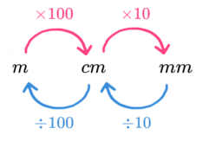
Facts
Converting units of length
1 m is 100 cm
1 cm is 10 mm
Convert 400 cm into metres.
400 ÷ 100 = 4 m

Slide 11
Facts
Converting units of length
1 m is 100 cm
1 cm is 10 mm
Convert 4 cm into millimetres.
4 x 10 = 40 mm

Slide 12
Facts
Converting units of length
1 m is 100 cm
1 cm is 10 mm
Convert 4 m into millimetres.
4 x 100 x 10 = 4000 mm

Slide 13
Facts
Converting units of length
1 m is 100 cm
1 cm is 10 mm
Convert 400 mm into metres
4000 ÷ 10 ÷ 100 = 0.4 m

Slide 14
Warm-up
Convert these metric units of lengths
400 cm to m
40 cm to m
400 mm to m
40 mm to m
3.5 m to mm
3.5 m to cm
0.35 m to cm
0.04 m to cm
0.04 m to mm
0.045 m to cm

Slide 15
Warm-up
Convert these metric units of lengths
400 cm is 4 m
40 cm is 0.4 m
400 mm is 0.4 m
40 mm is 0.04 m
3.5 m is 3500 mm
3.5 m is 350 cm
0.35 m is 35 cm
0.04 m is 4 cm
0.04 m is 40 mm
0.045 m is 4.5 cm

Slide 16
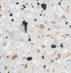


Warm-up
Calculate the areas of the shapes below and give your answer in $m^{2}$
1.2 m
130 cm
1500 mm
7 m
3 m
0.8 m
1.2 m
1.6 m
85 cm
70 cm
These shapes are not drawn to scale.

Slide 17



Warm-up
Calculate the areas of the shapes below and give your answer in $m^{2}$.
1.3 m
1.2 m
130 cm
1500 mm
7 m
3 m
0.8 m
1.2 m
120 cm
1.6 m
85 cm
$$7×3=21{ m}^{2}$$
$$1.2×0.8=0.96{ m}^{2}$$
$$1.3×1.2=1.56{ m}^{2}$$
70 cm
These shapes are not drawn to scale.

Slide 18
Warm-up
1.5 m
1500 mm
1.5 m
0.75 m
0.75 m
1.6 m
1.6 m
0.8 m
0.8 m
85 cm
0.85 m
0.85 m
70 cm
0.7 m
0.7 m
These shapes are not drawn to scale.

Slide 19


Warm-up
1.5 m
$$1.5×0.75=1.125$$
$0.85×0.7 =0.595$
0.75 m
1.6 m
0.8 m
Total Area = 1.125 + 0.595 = 1.72${ m}^{2}$
0.85 m
0.7 m
These shapes are not drawn to scale.

Slide 20


Warm-up
1.5 m
$$0.8×0.75=0.6$$
$1.6×0.7=1.12$
0.75 m
1.6 m
0.8 m
Total Area = 1.12 + 0.6 = 1.72${ m}^{2}$
0.85 m
0.7 m
These shapes are not drawn to scale.

Slide 21


Warm-up
1.5 m
$$1.5×1.6=2.4$$
$0.8×0.85=0.68$
0.75 m
1.6 m
0.8 m
Total Area = 2.4 - 0.68 = 1.72${ m}^{2}$
0.85 m
0.7 m
These shapes are not drawn to scale.

Slide 22
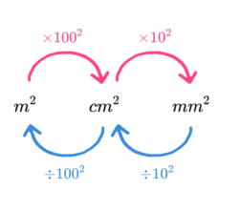
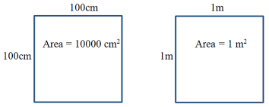

Facts
Converting units of area
E.g.
Convert 4000 ${cm}^{2}$ into $m^{2}$
4000 $÷ {100}^{2}$
4000 $÷10000$= 0.4 $m^{2}$

Slide 23
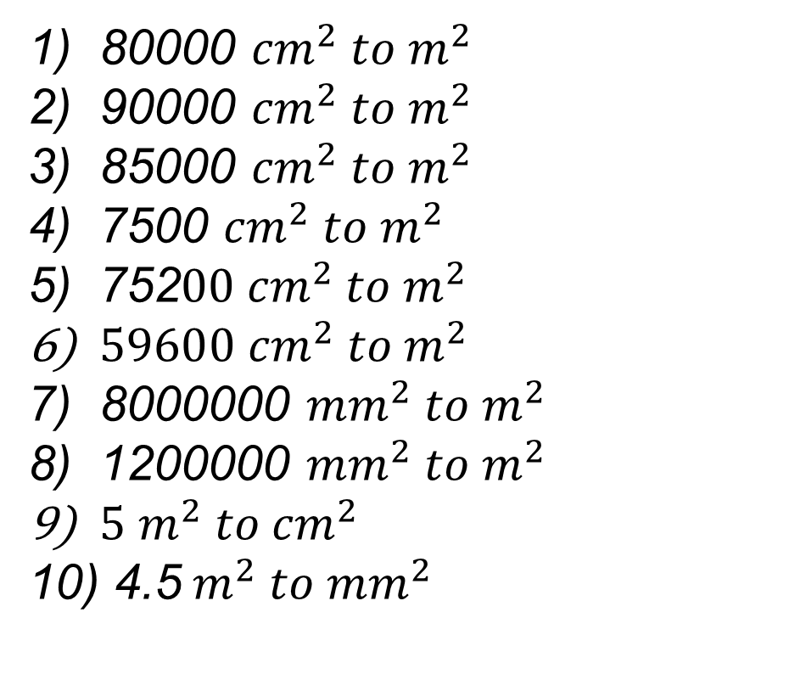
Warm-up
Convert these metric units of area
80000 ${cm}^{2} to m^{2}$
90000 ${cm}^{2} to m^{2}$
85000 ${cm}^{2} to m^{2}$
7500 ${cm}^{2} to m^{2}$
752$00{ cm}^{2} to m^{2}$
$59600 {cm}^{2} to m^{2}$
8000000 ${mm}^{2} to m^{2}$
1200000 ${mm}^{2} to m^{2}$
${5 m}^{2} to {cm}^{2}$
4.5$m^{2} to {mm}^{2}$

Slide 24
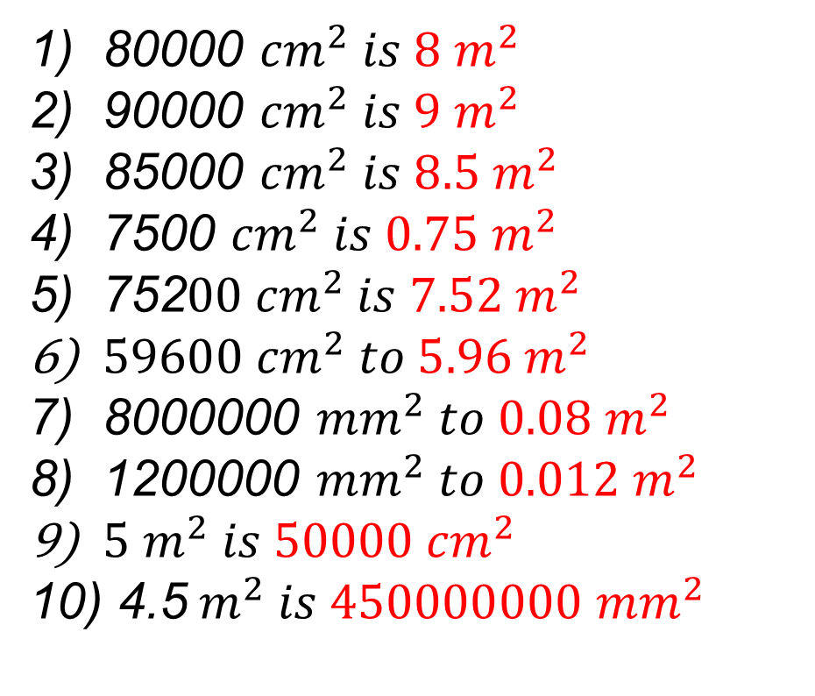
Warm-up
Convert these metric units of area
80000 ${cm}^{2} is 8 m^{2}$
90000 ${cm}^{2} is 9 m^{2}$
85000 ${cm}^{2} is 8.5 m^{2}$
7500 ${cm}^{2} is 0.75 m^{2}$
752$00{ cm}^{2} is 7.52 m^{2}$
$59600 {cm}^{2} to {5.96 m}^{2}$
8000000 ${mm}^{2} to {0.08 m}^{2}$
1200000 ${mm}^{2} to {0.012 m}^{2}$
${5 m}^{2} is 50000 {cm}^{2}$
4.5$m^{2} is 450000000 {mm}^{2}$

Slide 25
What sizes do granite pieces come in?

Slide 26
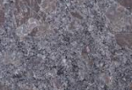
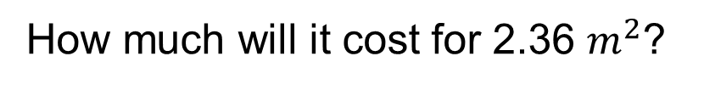
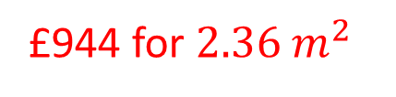
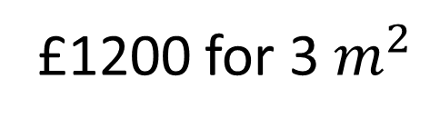
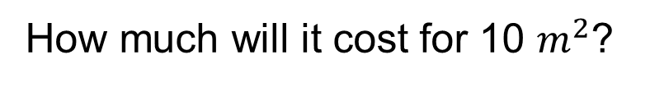
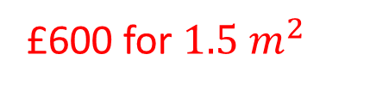
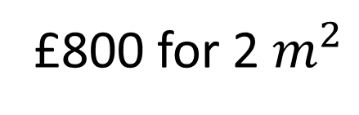
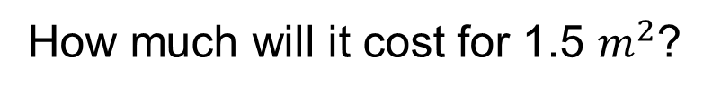
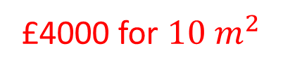
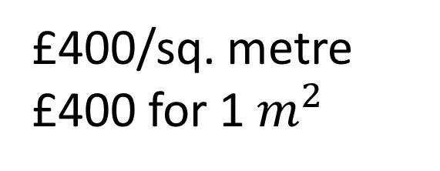
3200 mm
Steel Grey Aligato Granite
£400/sq. metre
£400 for 1$m^{2}$
1800 mm
£800 for 2$m^{2}$
£1200 for 3$m^{2}$
How much will it cost for 10 $m^{2}$?
£4000 for $10 m^{2}$
How much will it cost for 1.5 $m^{2}$?
£600 for $1.5 m^{2}$
How much will it cost for 2.36 $m^{2}$?
£944 for $2.36 m^{2}$
Cost = Area in metres x Price per square metre

Slide 27
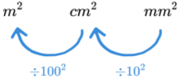
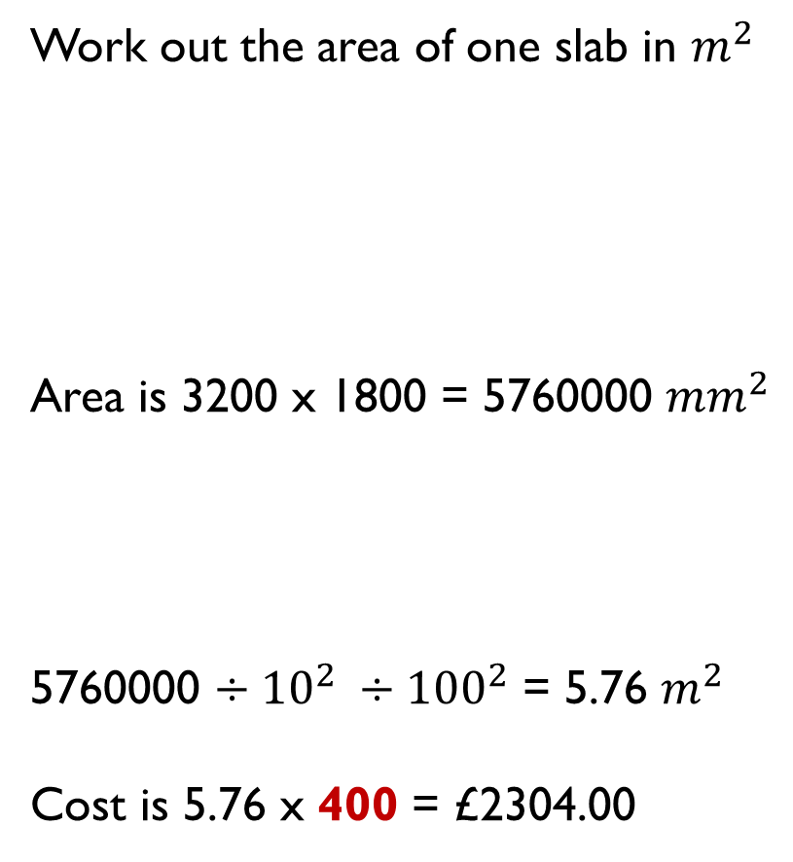
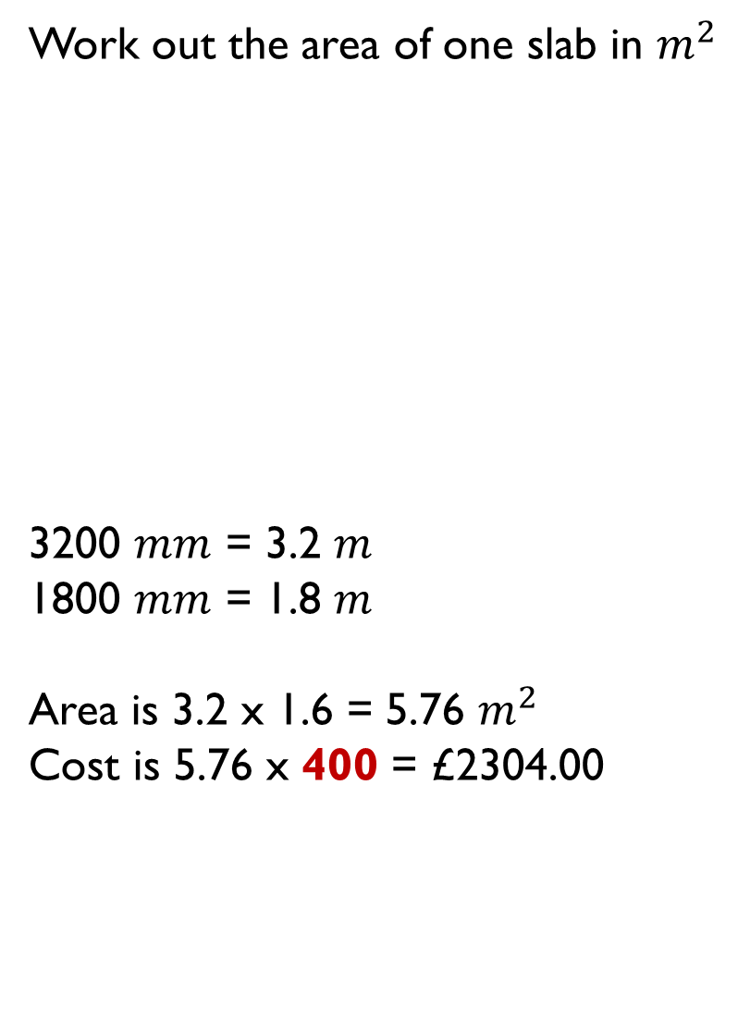
Method 1
Method 2
Work out the area of one slab in $m^{2}$
Area is 3200 x 1800 = 5760000 ${mm}^{2}$
5760000 $÷{10}^{2} ÷{100}^{2}$ = 5.76 $m^{2}$
Cost is 5.76 x 400 = £2304.00
Work out the area of one slab in $m^{2}$
3200 $mm$ = 3.2 $m$
1800 $mm$ = 1.8 $m$
Area is 3.2 x 1.6 = 5.76 $m^{2}$
Cost is 5.76 x 400 = £2304.00
3200 mm
3200 mm
3.2 m
£400/sq. metre
1800 mm
1800 mm
1.8 m
£400/sq. metre

Slide 28
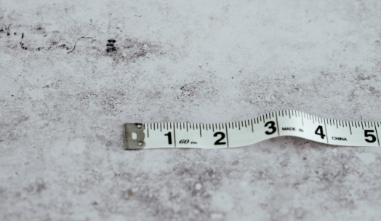
Builders Code of Practice
“Measure twice, cut once.” In other words, it’s extremely important to get measurements right the first time in order to avoid costly errors! Determining how much granite you need for a countertop is no exception. In fact, just measure again!!!

Slide 29
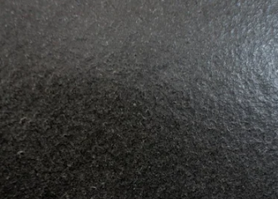
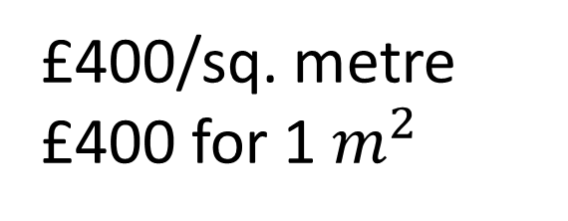
3200 mm
Absolute Black Leather Granite
1850 mm
£400/sq. metre
£400 for 1$m^{2}$
Cost = Area in metres x Price per square metre
Without any additional costs how much would one slab cost?

Slide 30
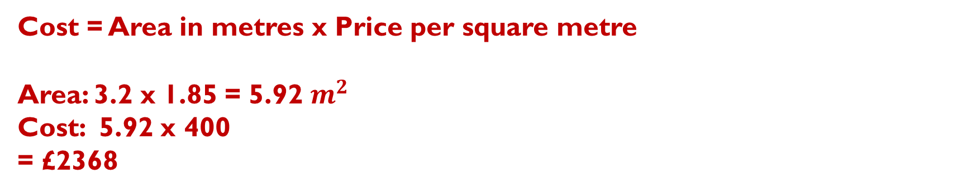
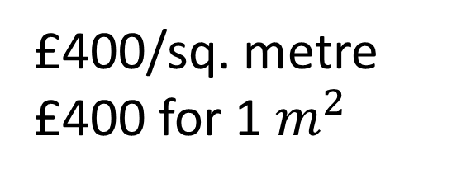
3200 mm
Absolute Black Leather Granite
£400/sq. metre
£400 for 1$m^{2}$
1850 mm
Cost = Area in metres x Price per square metre
Area: 3.2 x 1.85 = 5.92 $m^{2}$
Cost: 5.92 x 400
= £2368

Slide 31
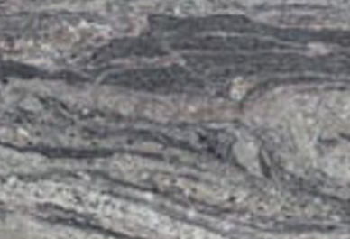
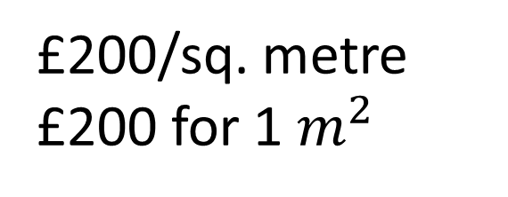
3155 mm
Bianco Kinawa Polished Granite
1990 mm
£200/sq. metre
£200 for 1$m^{2}$
Cost = Area in metres x Price per square metre
Without any additional costs how much would one slab cost?

Slide 32
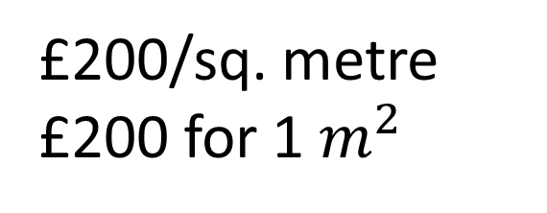
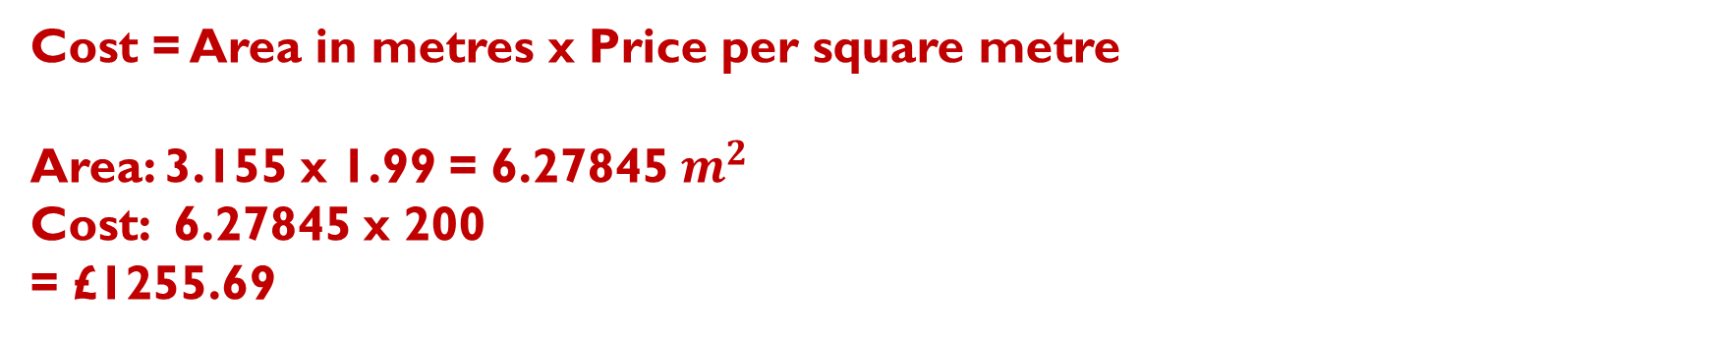
3155 mm
Bianco Kinawa Polished Granite
£200/sq. metre
£200 for 1$m^{2}$
1990 mm
Cost = Area in metres x Price per square metre
Area: 3.155 x 1.99 = 6.27845 $m^{2}$
Cost: 6.27845 x 200
= £1255.69

Slide 33
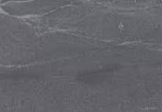
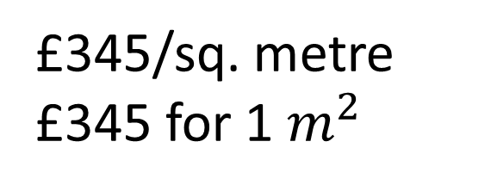
3315 mm
Jurassic Grey Leather Polished Granite
1750 mm
£345/sq. metre
£345 for 1$m^{2}$
Cost = Area in metres x Price per square metre
Without any additional costs how much would one slab cost?

Slide 34
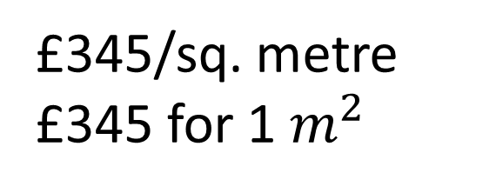
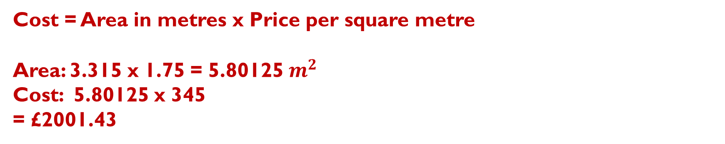
3315 mm
Jurassic Grey Leather Polished Granite
£345/sq. metre
£345 for 1$m^{2}$
1750 mm
Cost = Area in metres x Price per square metre
Area: 3.315 x 1.75 = 5.80125 $m^{2}$
Cost: 5.80125 x 345
= £2001.43

Slide 35
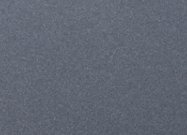
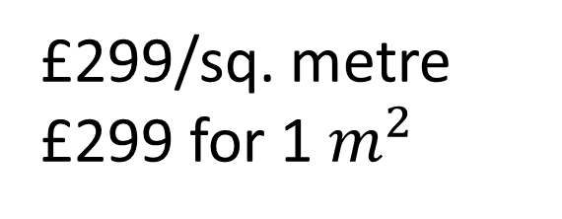
3320 mm
Manatee Leather Granite
1990 mm
£299/sq. metre
£299 for 1$m^{2}$
Cost = Area in metres x Price per square metre
Without any additional costs how much would one slab cost?

Slide 36
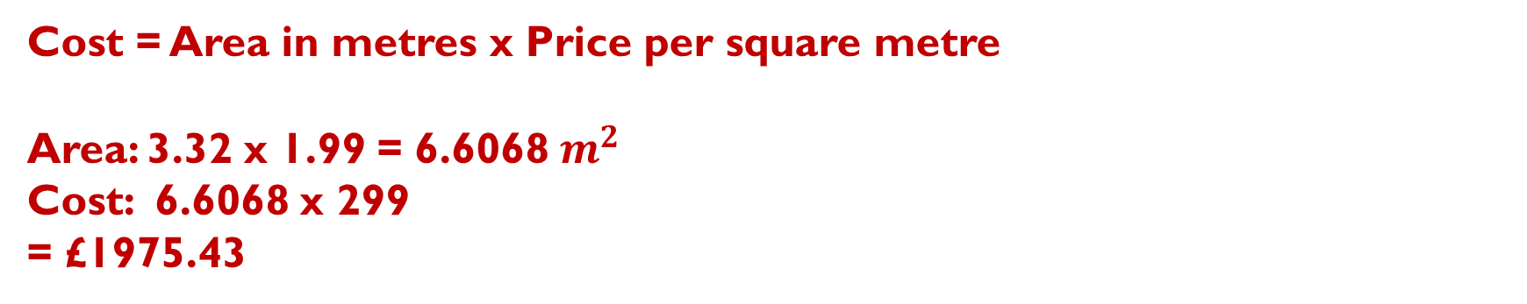
3320 mm
Manatee Leather Granite
1990 mm
£299/sq. metre
£299 for 1$m^{2}$
Cost = Area in metres x Price per square metre
Area: 3.32 x 1.99 = 6.6068 $m^{2}$
Cost: 6.6068 x 299
= £1975.43

Slide 37
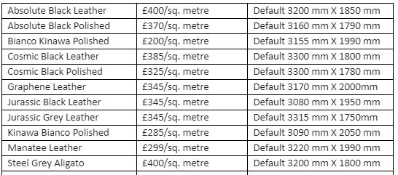
Cost and sizing of granite slabs

Slide 38
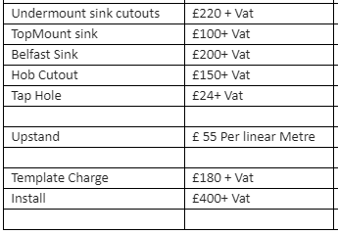
Additional costs to consider
VAT is 20%
What are the costs including VAT?

Slide 39
Additional costs to consider
VAT is 20%
What are the costs including VAT?

Slide 40
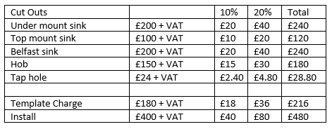
Additional costs to consider

Slide 41
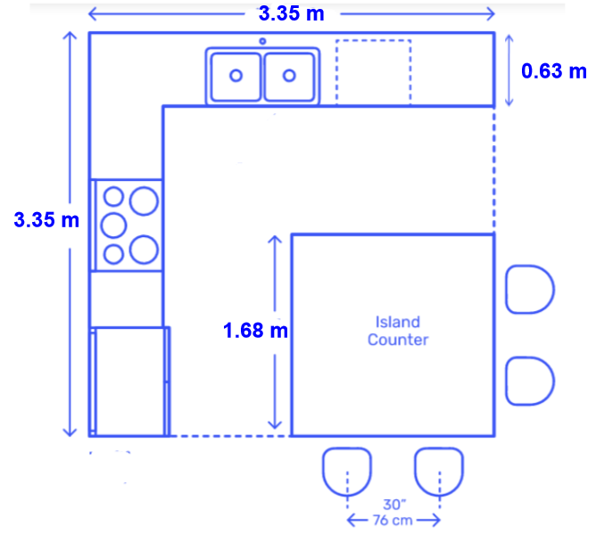
Work out the total cost of fitting Absolute Black Polished Granite kitchen counters.
Tap hole
Hob
Belfast sink
American Fridge Freezer (900 mm wide)
Remember to add in the template charge and fitting charge!

Slide 42
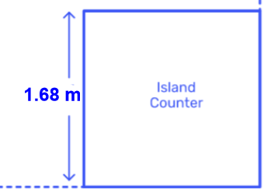



Work out the total cost of fitting Absolute Black Polished Granite kitchen counters.
The Island Counter is square
Cost = Area in metres x Price per square metre
$$1.68×1.68=2.8224$$
$$m^{2}$$
$$2.8224×370=£1044.29$$

Slide 43
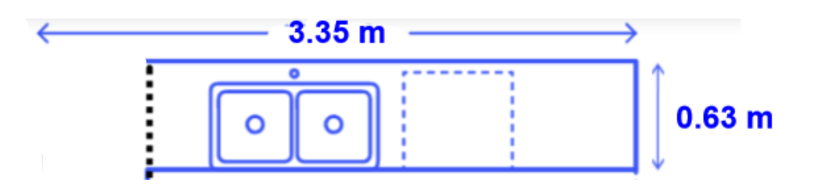
Work out the cost of fitting Absolute Black Polished Granite to this Kitchen counter
Tap hole
Belfast sink
Remember to add in the template charge and fitting charge!

Slide 44



Work out the cost of fitting Absolute Black Polished Granite to this Kitchen counter
Tap hole
Belfast sink
Cost = Area in metres x Price per square metre
$$\left(3.35 −0.63\right)×0.63=1.7136$$
$m^{2}$
$$1.7136×370=£634.03$$
Total Cost is £634.03 + £240 + £28.80 = £902.83

Slide 45
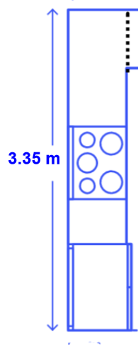
Work out the total cost of fitting Absolute Black Polished Granite kitchen counters.
Hob
American Fridge Freezer
(900 mm wide)

Slide 46
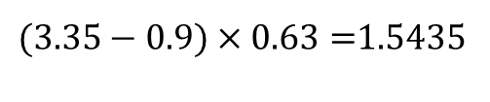
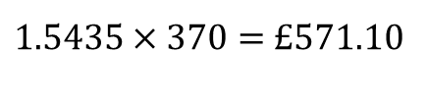

Work out the total cost of fitting Absolute Black Polished Granite kitchen counters.
Cost = Area in metres x Price per square metre
$(3.35−0.9)×0.63=$1.5435
$$m^{2}$$
$1.5435×370=$ £571.10
Hob
Total Cost is £571.10 + £180 = £751.10
American Fridge Freezer
(900 mm wide)

Slide 47
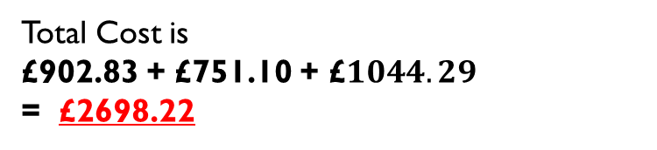
Work out the total cost of fitting Absolute Black Polished Granite kitchen counters.
Total Cost is
£902.83 + £751.10 + £$1044.29$
= £2698.22
Remember to add in the template charge and fitting charge!

Slide 48


Extension Task
Work out the total cost of fitting Cosmic Black Leather kitchen counters?

