Slide 1


Maths in the workplace
Adecco and Leyland Trucks case studies by Rob Hosker, Bishop Rawstorne

Slide 2


When will I ever use this again?

Slide 3
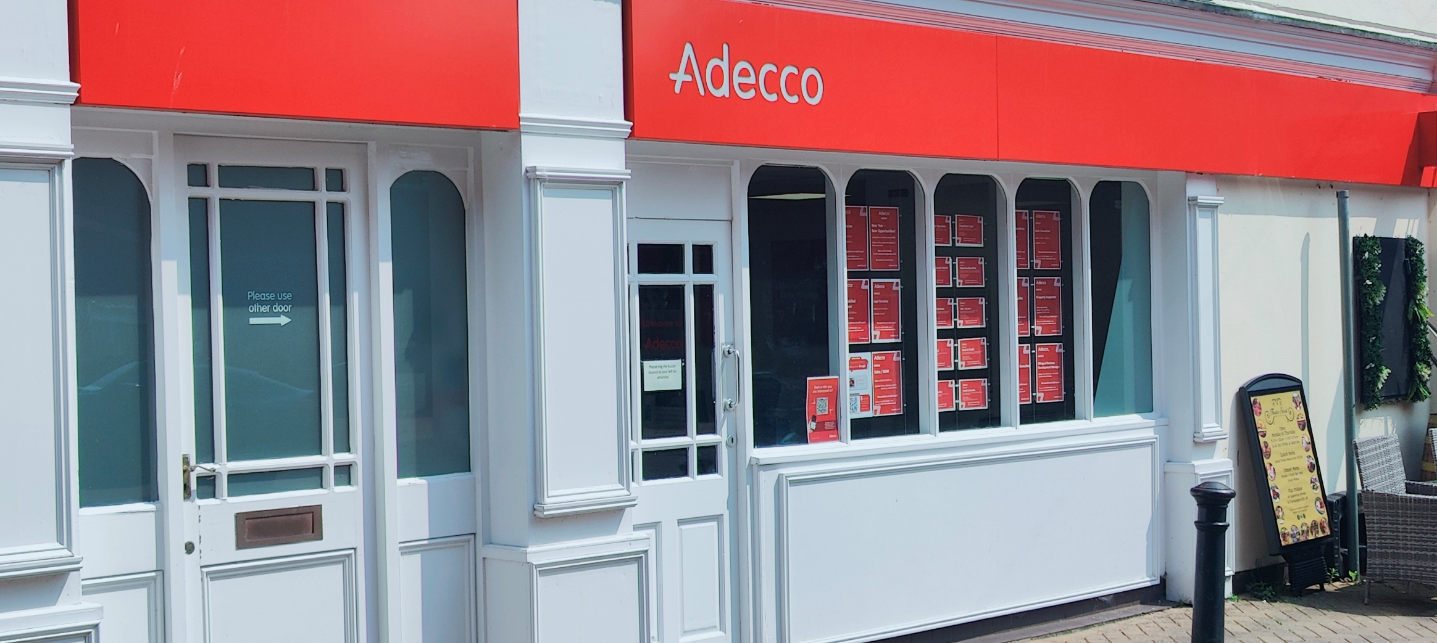
Adecco

Slide 4
Who are Adecco?
Adecco are a nationwide employment agency
They recruit staff for organisations both big and small
Examples are Walkers, Amazon, Uber & Serco
In the North-West Leyland Trucks are a big client
60% of the roles they fulfil are manufacturing, and 40% office-based
They recruits directors and senior managers in addition to junior positions
Over 1000 UCLAN students are registered with Adecco to earn money to subsidise their education
There are currently a team of 6 working in the Preston office

Slide 5

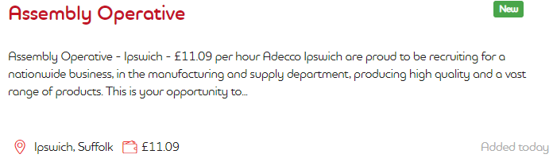
Case study – two roles that Adecco fulfil
Chefs - restaurants & hotels
Assembly line workers – manufacturing

Slide 6
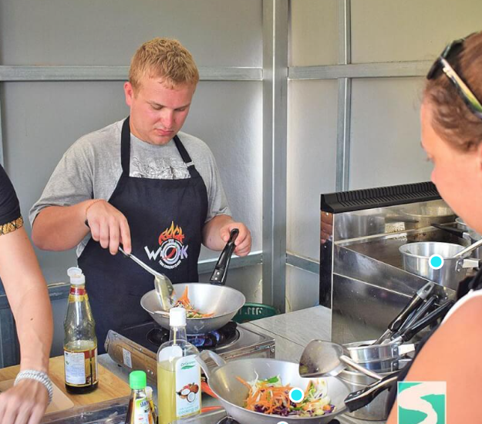

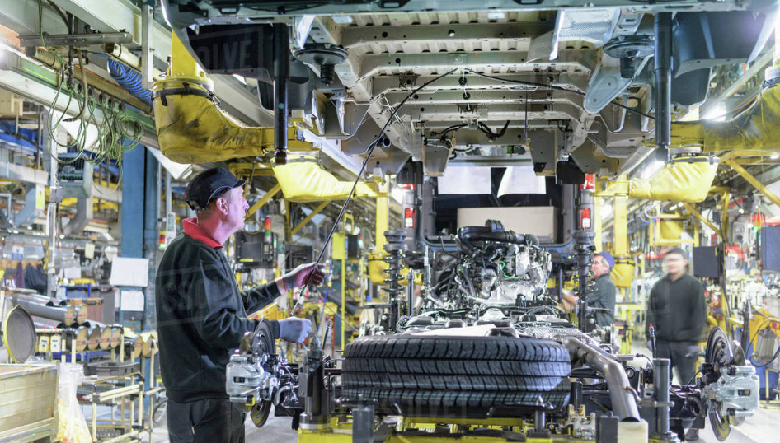
What Maths will I use in these roles?
Chef
Assembly line worker

Slide 7
Maths in the workplace
Chef
Estimation - stock ordering and bulk catering
Measures & conversion – correct ratios of ingredients
Profit/Loss – managing functions including pricing, ordering of products
Time – managing a function as a project including timely delivery of products
YOUR performance reflects the reputation of the hotel/restaurant
Assembly Line Worker
Estimation – timely ordering of parts to fulfil your section of the line
Time – working out optimum time to replenish
Multiplication – for example you are fitting wheels. Each wheel requires 8 nuts and bolts. How many will you need for the next 100 vehicles
YOU are jointly responsible for keeping the line running. If it stops because you run out of stock or are late for your shift, you cost the company money

Slide 8
Did you know?
Agencies pay weekly based on an hourly rate.
Tax and National Insurance is deducted weekly and you claim back what you are owed at the end of the financial year
You may need to factor in fuel bills and car maintenance, or public transport costs
Overtime is often an option
Adecco employees are often surprised that they don’t get ALL of the money they earned!

Slide 9

Case Study
John works on the Leyland Trucks assembly plant and is employed by Adecco.
Last week he worked 43 hours.
39 $\frac{2}{3}$ were paid at standard rate of £14.39 per hour
2 hours were paid at time and a half
1$\frac{1}{3}$ hours were paid at double time
John travelled 15 miles each way to work on 7 days
Diesel costs £1.41 per gallon
John spends £1000 per year on car maintenance
John pays 23% of his wage in tax and National Insurance, some of which he will be able to claim back after the tax year ends
John pays £1200 a year on car insurance
John pays £185 a year on car tax
How much will he earn for the week before his expenses are deducted?
John sets aside money weekly to cover fuel, insurance and maintenance
How much of his pay is left?

Slide 10

The Maths!
Deductions
Tax & NI
  0.23 x £652.35 = £150.04
Fuel
  30 x 7 = 210 miles
  Car can travel 54 miles per gallon
  3.89 gallons = 17.66 litres
  £1.41 x 17.66 = £24.89
Car insurance
  £1200 ÷ 52 = £23.08
Car Tax
  £185 ÷ 52 = £3.56
Car maintenance
  £1000 ÷ 52 = £19.23
TOTAL = £220.80
Pay (before deductions)
39$\frac{2}{3}$ × £14.39 = £570.80
2 x £21.59 = £43.18
1$\frac{1}{3}$ x £28.78 = £38.37
TOTAL = £652.35
BALANCE = £431.55
(and we haven’t talked about accommodation, food or fun yet!)

Slide 11
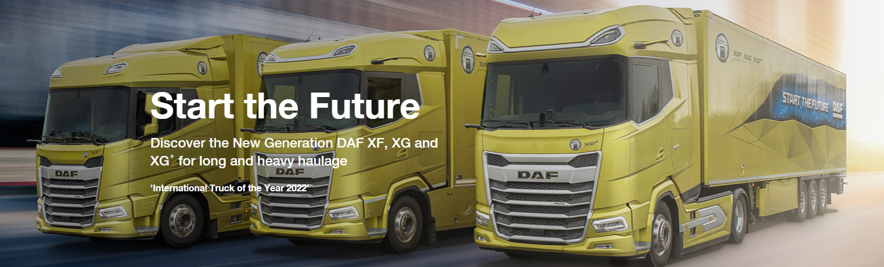
Leyland DAF

Slide 12
Who are Leyland Trucks?
One in every three trucks you see on the road in the UK are built at Leyland Trucks, whose manufacturing facility is based in Leyland
40% of their trucks are exported to Europe and the rest of the world
Origins of the company can be traced back to 1896
1000 employees
24 apprenticeships were offered in 2023

Slide 13
Sam G – Design Engineer in Power-Unit Installation Team
‘I was the guy who thought I’d never use Maths again after high school. Now I use it every day which is kind of ironic’
Sam designs, tests and produces truck components such as engines and radiators based on the needs of his customers. Write down the areas of Maths you think Sam uses on a regular basis
Re-arranging equations
Using formulae
Substitution
Indices
Trigonometry
Collecting data
Statistical modelling

Slide 14
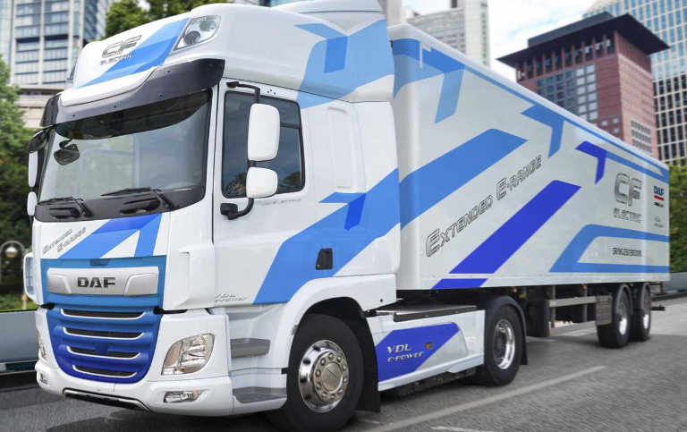
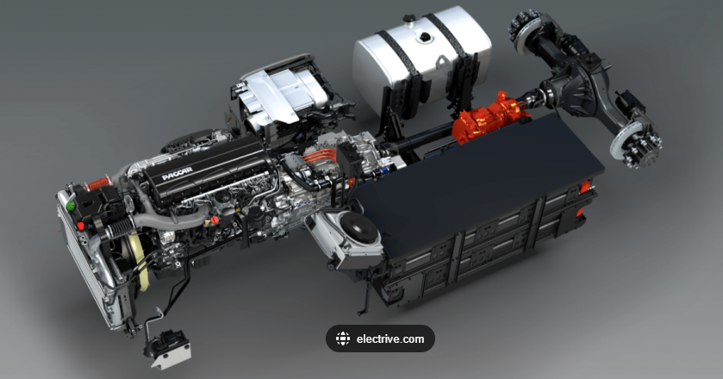
There are three phases to Sam’s projects
    Conceptual
    Modelling
    Prototype
Sam’s areas of responsibility are associated with engine design – for example air intake systems, vehicle cooling systems and turbo chargers
Customers will dictate what they want, it’s Sam’s job to make it happen
Step one – conceptualizing the engine using thermodynamics and fluid dynamics. For example they want an energy efficient electric engine within a specified budget

Slide 15
Conceptualizing
A client wants a bigger electric engine than the one they currently use. They want the costs to be within an agreed parameter. They have specified how efficient they want it to be, and how powerful it needs to be
Computer programs are used to establish whether the design is achievable at the cost required. Different variables are used, often with minute differences
Why is there a growing demand for electric engine?
Why is there a need for the concept phase, rather than proceeding to design and build the engine they need?
3) What areas of maths is Sam using in the concept phase?

Slide 16
Conceptualising
Why is there a growing demand for electric engine?
The government is phasing out environmentally unsound diesel engines by 2035. They will be replaced by hybrid and fully electric vehicles
Why is there a need for the concept phase, rather then proceeding to design and build the engine they need?
Testing physical product costs a lot of money. Maths can be used to predict how changes will affect the performance of an engine
What areas of maths is Sam using in the concept phase?
Re-arranging equations
Laws of Indices
Using formulae
Substitution

Slide 17
Modelling
The electric engine has passed the concept stage. Sam is now ready for the next stage – modelling. This stage will focus on putting the concept into practice. Can the concept deliver the customer’s requirements? Cost is a massive consideration – will the product come in under budget? What could go wrong, have all possible scenarios been taken into account?
1) Has anything been physically built yet?
2) What would happen if the modelling suggest the engine cannot be built within the budget the customer has specified?
3) What areas of maths is Sam using in the concept phase?

Slide 18
Modelling
Has anything been physically built yet?
No, the concept is being tested for viability using mathematical modelling software
What would happen if the modelling suggest the engine cannot be built within the budget the customer has specified?
Sam will need to refine – for example using cheaper materials
What areas of maths is Sam using in the modelling phase?
Statistics (six sigma) to improve manufacturing quality
Trigonometry (sine waves are used to improve the functionality of control systems)
Fourier analysis combines both statistical data and trigonometric functions

Slide 19
Prototyping/Vehicle development
The engine can now be built and tested. Testing must consider extremes in vehicle performances. Leyland Trucks use climactic wind tunnels to simulate variations in air flow
Sam’s team get to test the electric engine in its newly assembled truck in the Sierra Nevada desert, and in Kiruna, Sweden, near the arctic circle
1) Why does prototype testing take place in Sierra Nevada and Sweden?
2) After all the work that has gone on prior to this stage are Sam & his team likely to encounter any more problems?
3) Is that it for the Maths?
4) Typically, how long will Sam be working on a project for?

Slide 20
Prototyping/Vehicle development
Why does prototype testing take place in Sierra Nevada and Sweden?
The Sierra Nevada desert offers extremes of temperature whilst Kiruna offers the very coldest conditions the engine will need to perform in
After all the work that has gone on prior to this stage are Sam & his team likely to encounter any more problems?
Almost always. Modelling cannot predict everything. Problems will crop up, that need to be resolved. The maths used in the previous design stages will have minimized them
Is that it for the Maths?
The problems that crop up will need resolving. Back to the modelling and prototyping
Typically, how long will Sam be working on a project for?
Between 2 and 5 years. 2 years for a small project (for example a refinement of an existing product) and 5 years for a new product or design

Slide 21
Maths in the workplace
Adecco and Leyland Trucks case studies

