Slide 1






Quantity Surveyor Lesson
By CierAn Henshaw – Penwortham Priory Academy

Slide 2
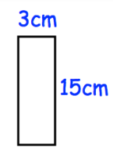
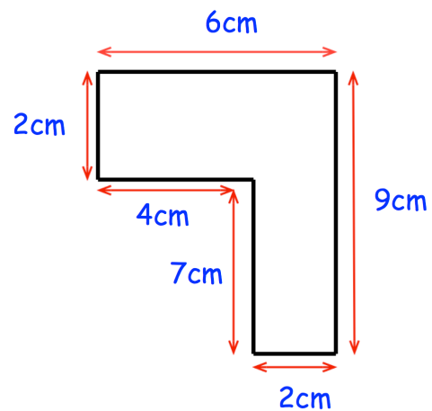
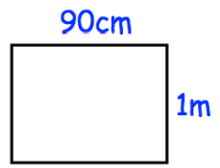
Starter task – Calculate the area of the following shapes
8 cm²
18 cm²
0.9 m² or 9000 cm²
45 cm²
26 cm²

Slide 3
What is a Quantity Surveyor?
Known in the industry as a Construction Cost Consultant or Commercial Manager, their role is to keep a close eye on project finances.
They advise on the potential of a site and help work out what a client or customer can afford and ensure the project doesn’t go over the initial budget.

Slide 4
What makes a good Quantity Surveyor?
Quantity Surveyors are the financial whiz-kids of the industry! They are highly numerate and typically control an entire project budget.
To put that into context, on a new build secondary school the Senior Quantity Surveyor could be responsible for over £20 million of spend.
They also know a great deal about building legislation, building materials, design etc. They are highly organized, very accurate and great negotiators.

Slide 5
Your brief:
A flat has recently been acquired by your company and you are going to work out the cost of refurbishing it.
You must use the floor plan along with the cost sheet to plan and cost your refurbishment.
The owner of the house is very specific about how the house should be refurbished so stick to the brief and work out your costings as accurately as possible.

Slide 6
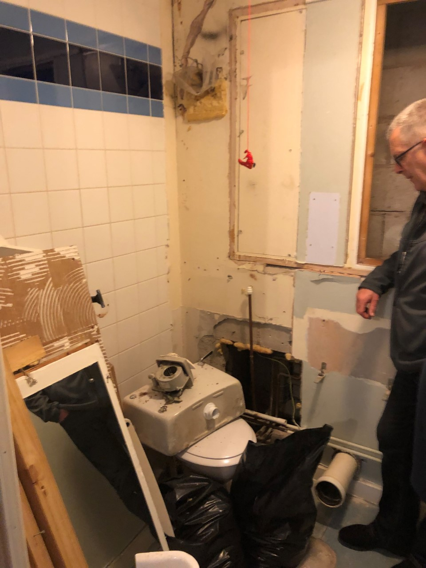

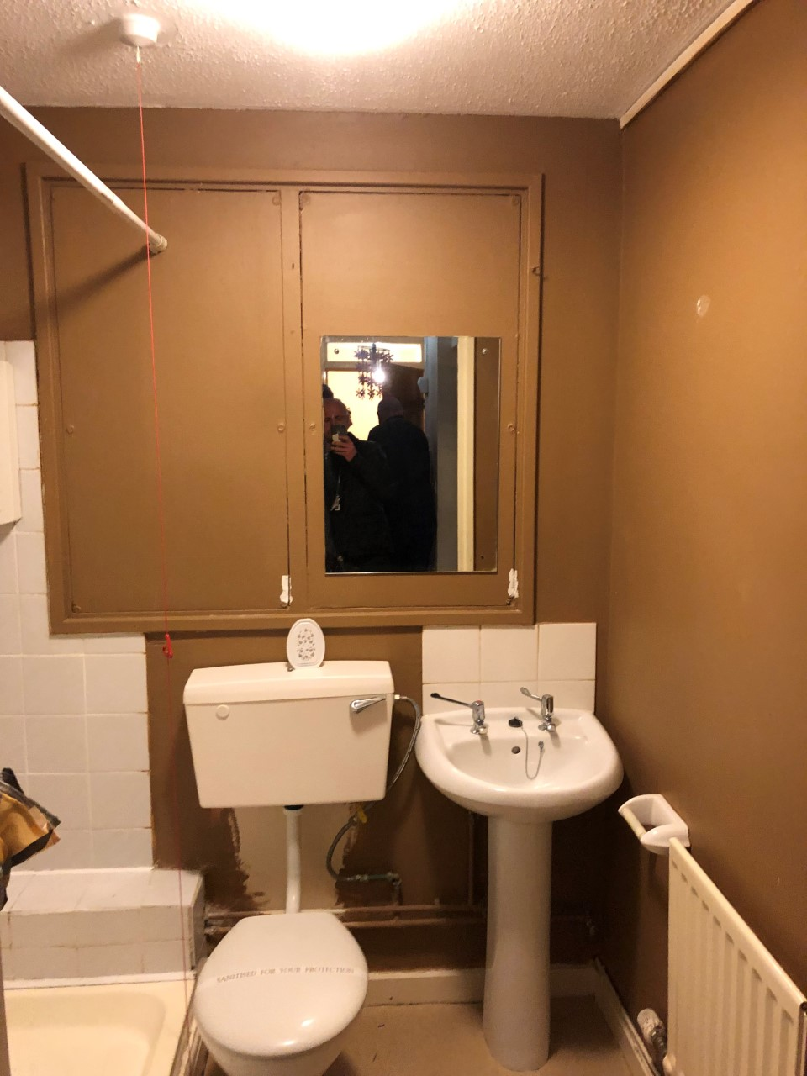
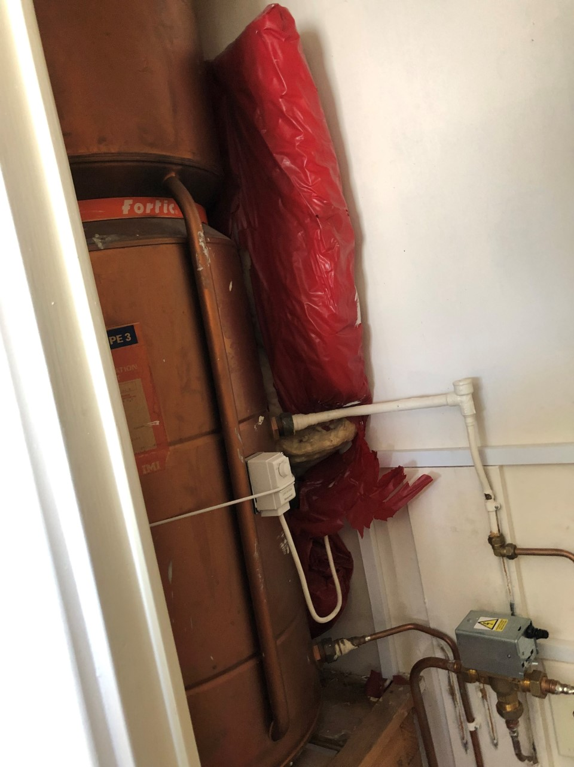
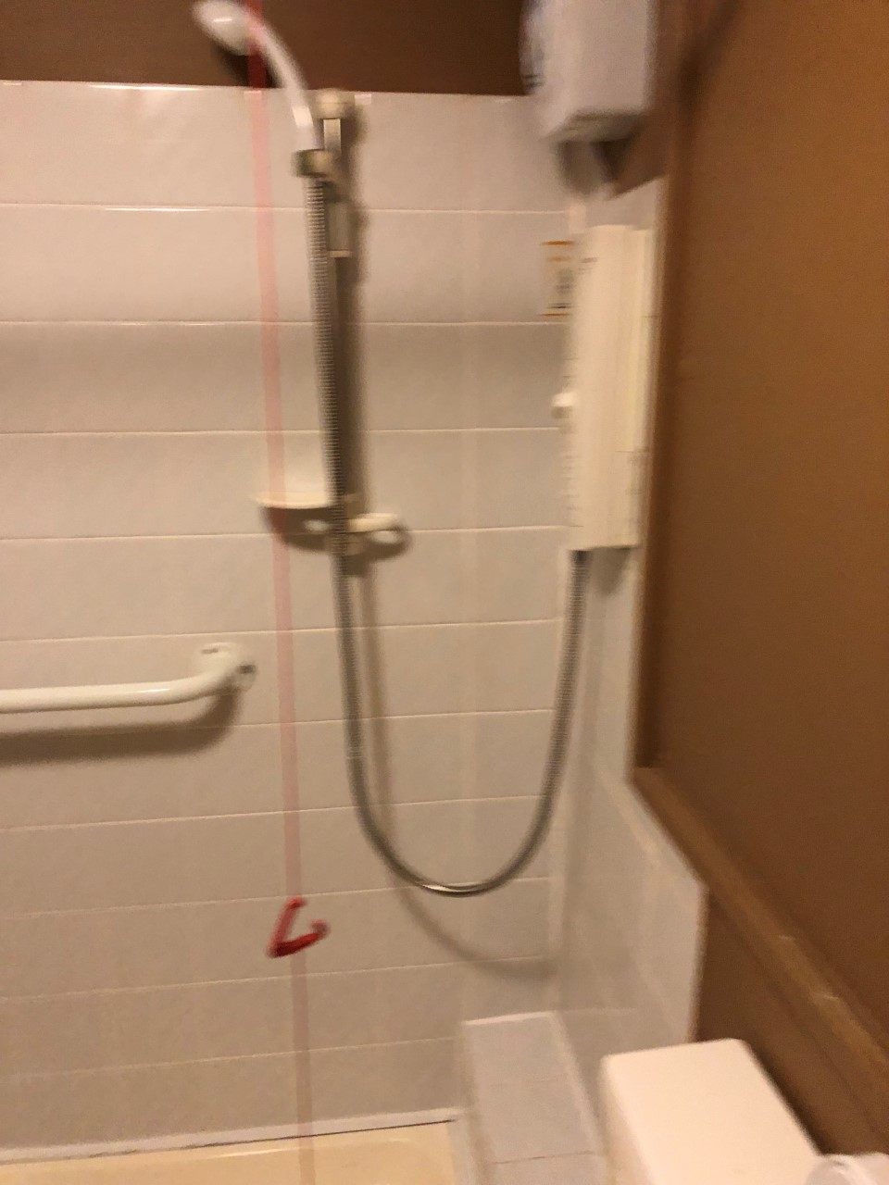
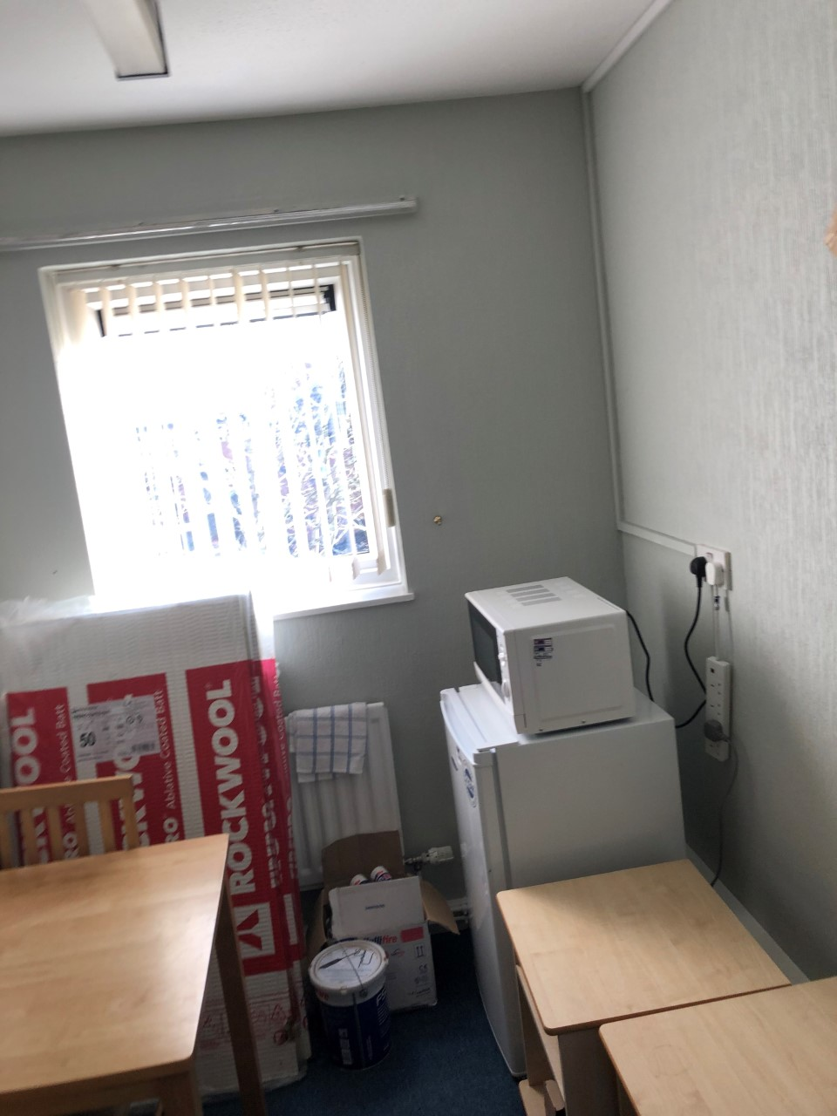
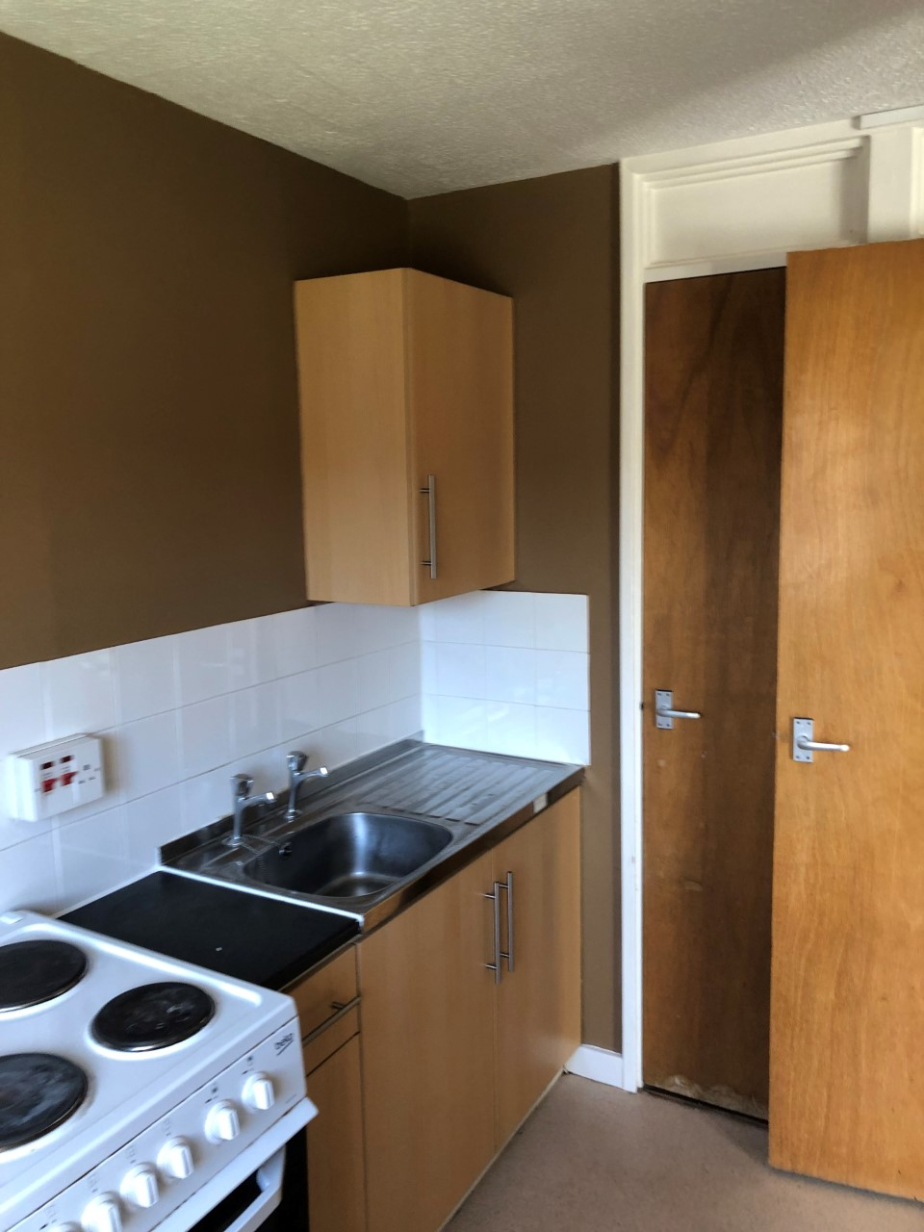

Slide 7
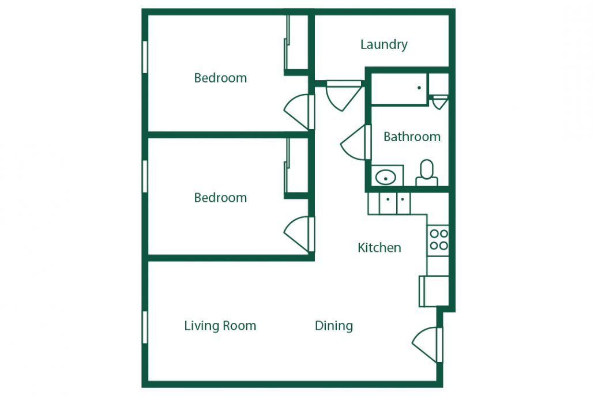

Slide 8
J
I
In your booklet you have 3 tasks and an extension challenge
G
F
A
Task 1 – Figure out some missing lengths
E
Task 2 – Cost of Appliances
H
Task 3 – Cost of flooring
A
C
K
Challenge – Cost of paint
D
To help you with this you have been given the job specification and a cost sheet
A
B

Slide 9
Solutions
These solutions rely on certain assumptions so make sure you write those down either at the end or whilst you are going.
Also your solutions would be the invoice that goes straight to the customer so make sure your working out is really clear so the customer can clearly see where they are spending their money!

Slide 10
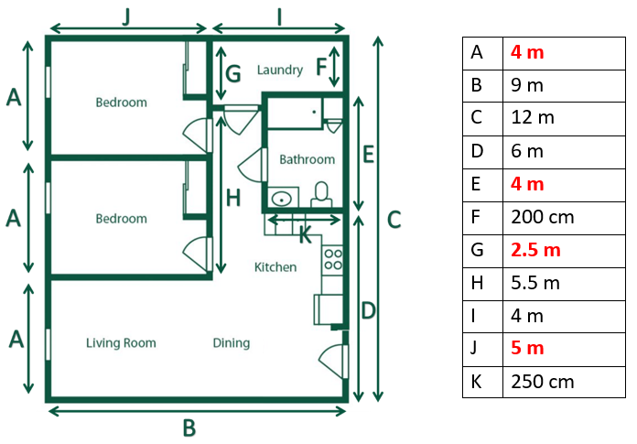
Click to remove
Click to remove
Click to remove
Click to remove

Slide 11
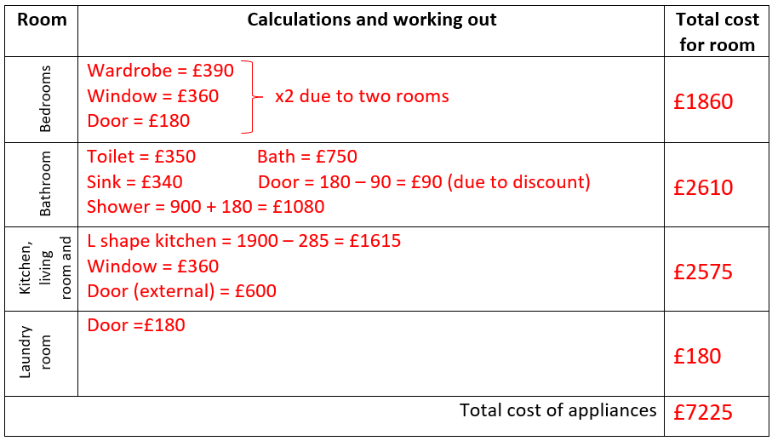
Click to remove
Click to remove
Click to remove
Click to remove
Click to remove
Click to remove
Click to remove
Click to remove
Click to remove

Slide 12
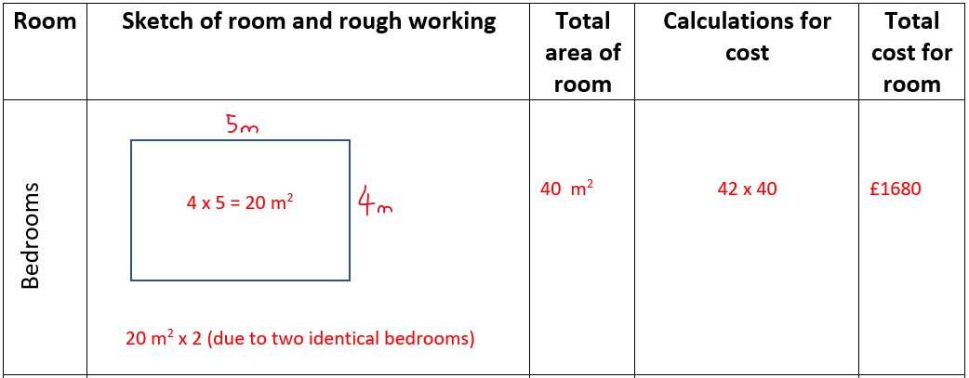
Click to remove
Click to remove
Click to remove
Click to remove
Click to remove
Click to remove

Slide 13
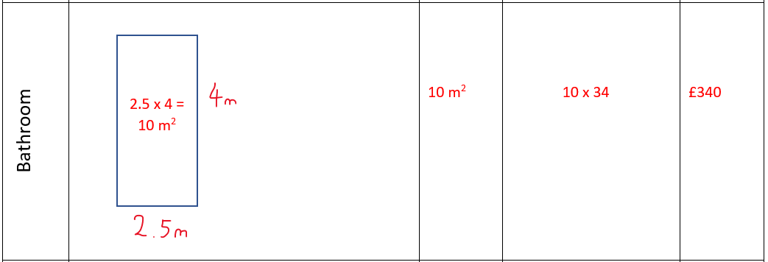
Click to remove
Click to remove
Click to remove
Click to remove
Click to remove

Slide 14
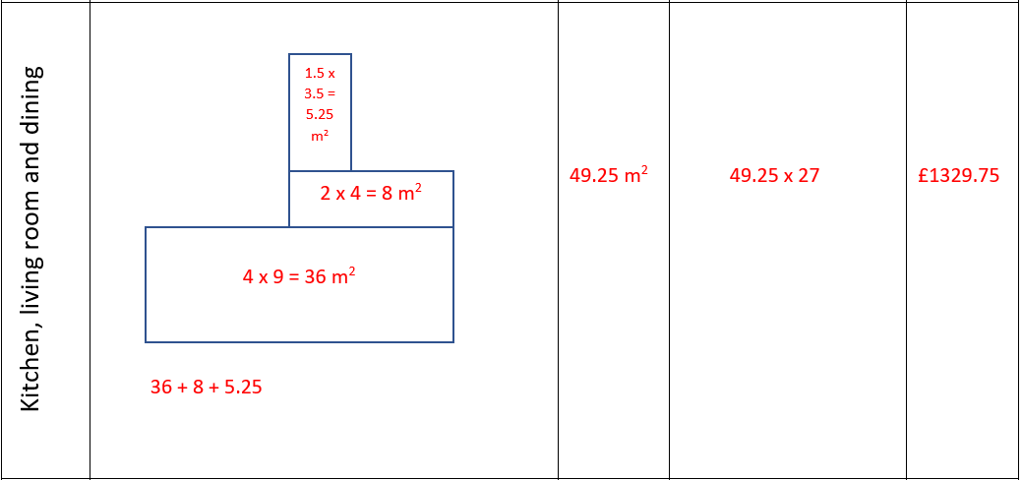
Click to remove
Click to remove
Click to remove
Click to remove
Click to remove
Click to remove
Click to remove
Click to remove

Slide 15
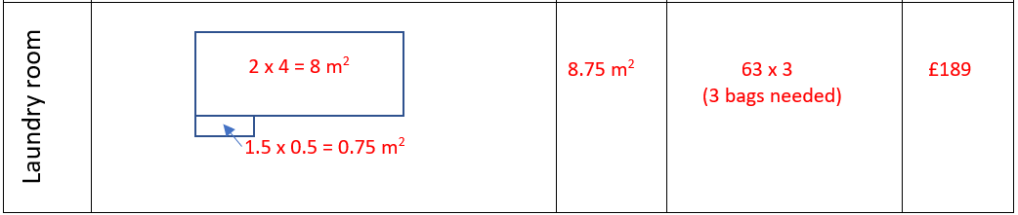

Click to remove
Click to remove
Click to remove
Click to remove
Click to remove
Click to remove
Click to remove

Slide 16
What is the total cost of your refurbishment?
£7225 + £3538.75 = £10,763.75

Slide 17
Write down any assumptions you have made along the way.
The walls were a negligible thickness
The flooring is fitted under all the appliances
All walls are at right-angles to each other
Packets of flooring purchased to exact sizes (no offcuts etc)

Slide 18
Was it always the most efficient way to calculate a room at a time? Explain why?
Debateable, interested to hear students’ thoughts
Was handy having a clear structure
Worked well because all the flooring was different for each room
Was a little difficult to apply discounts to doors.

Slide 19
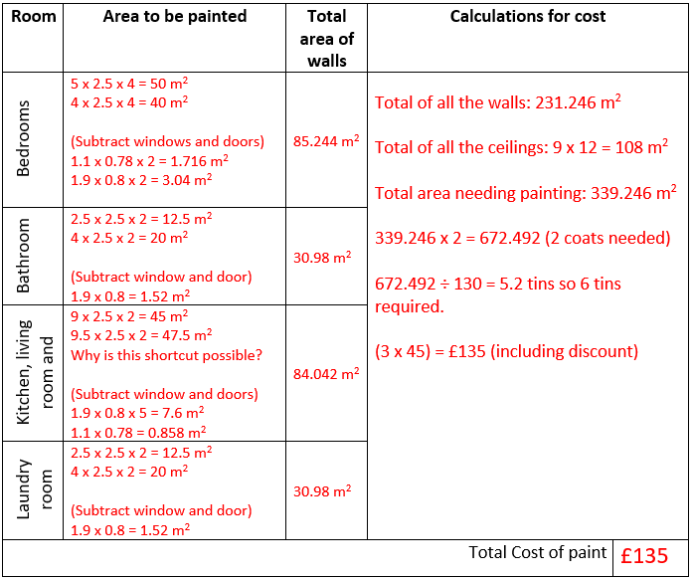

Click to remove
Click to remove
Click to remove
Click to remove
Click to remove
Click to remove
Click to remove
Click to remove
Click to remove
Click to remove
Click to remove
Click to remove
Click to remove
Click to remove

Slide 20
What is the total cost of your refurbishment now?
£10,763.75 + £135 = £10,898.75

Slide 21
Write down any assumptions you have made along the way.
The walls are still a negligible thickness
The paint is applied behind the appliances
Nothing else covering ceilings or walls (skylights etc)
Cost of brushes and labour included in price (is this likely?)

Slide 22
Was it always the most efficient way to calculate a room at a time? Explain why?
Debateable, interested to hear students’ thoughts.
Was handy having a clear structure.
Since paint was the same price throughout the house we didn’t need to calculate cost per room.
Certain walls are the same throughout the house so could have been paired up more efficiently.

