Slide 1



The Lancashire Careers Hub

Slide 2
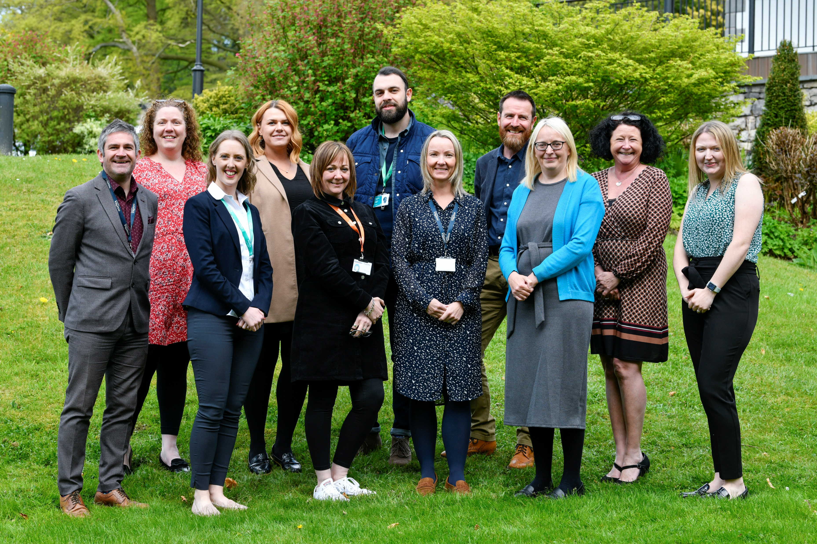
Who are we?
LANCASHIRE CAREERS HUB is a collaboration of 162 SECONDARY SCHOOLS AND COLLEGES, including SEND schools and Alternative Providers across wider Lancashire who work together to deliver the very best careers provision. Collaborating with business partners, education and voluntary sectors, we strive to improve careers outcomes for all young people, ensuring every child can take their BEST NEXT STEP.
Lancashire Careers Hub is part of a National Hub network driven by the Careers and Enterprise Company and locally through Lancashire Skills and Employment Hub and Inspira, we strengthen the relationship between education and business to ensure Lancashire has the future skilled workforce it needs to support its growing economy.
All the schools and colleges within Lancashire Carers Hub have a shared vision of how they will work together to improve outcomes for the young people in their area.
Your Enterprise Coordinator
We are not student facing – as Enterprise Coordinators, our main point of contact within schools/colleges are the Career Leaders / Careers Support Officers. We work with you to develop your careers programmes in-line with the Gatsby Benchmarks.

Slide 3
Meet the Team
Kay Vaughan
Hub Lead
Daniel Barry
Deputy Hub Lead
Chris Maddock
Deputy Hub Lead
Notes:
Meet the Team
Kay, Danny and Chris

Slide 4
Meet the Team
Tina Milner
John Hooper
Kim Helm
Trudi Wilkinson
Notes:
Meet the Team

Slide 5
Meet the Team
Hannah Thurston
Sarah Yarrow
Sam Bates
Michelle Fox
Michelle Billington
Notes:
Meet the Team

Slide 6


Gatsby Benchmarks
What are the Gatsby Benchmarks?
The eight benchmarks are a framework for good career guidance developed to support secondary schools and colleges in providing students with the best possible careers education, information, advice, and guidance.
The benchmarks are enshrined in statutory guidance, and it is a Careers Leaders responsibility to oversee the implementation of the benchmarks in their education setting.
​The 8 Gatsby Benchmarks are:
A stable careers programme ​
Learning from careers and labour market information ​
Addressing the needs of each student
Linking curriculum learning to careers
Encounters with employers and employees
Experiences of workplaces
Encounters with further and higher education
Personal guidance

Slide 7
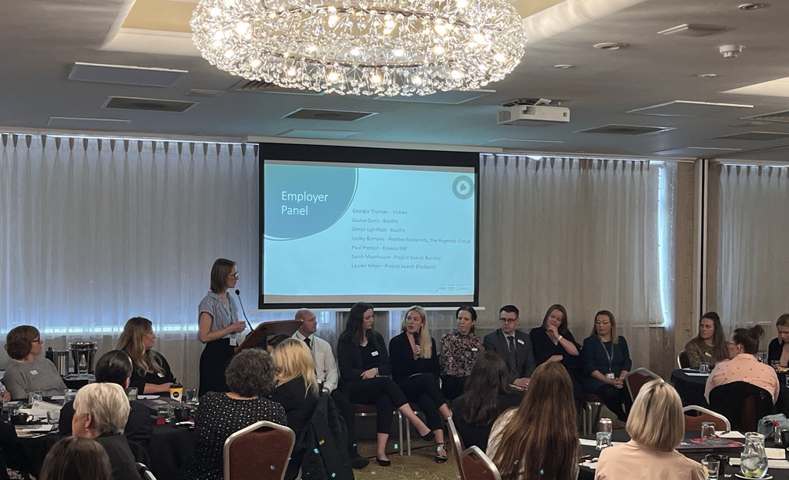
Enterprise Adviser Network
The Network connects schools, academies and colleges with employers and careers programme providers to work together to create meaningful encounters with the world of work for young people.
The role of an Enterprise Adviser is to support and work with an individual school and their senior leadership teams in shaping the schools’ career strategy, they are there to provide an external voice and to be the schools’ critical and supportive adviser. A strategic best friend!
A young person who has four or more encounters with an employer is 86% less likely to be unemployed or not in education or training and can earn up to 18% more during their career.
In Lancashire we also have the SKILLS PLEDGE which provides one place to find out more about employer facing skills and training initiatives. Pledging gives a business recognition for the things it does to upskill, recruit and inspire the people of Lancashire.
We have 157 Enterprise Advisers in Lancashire. 155 are currently matched to schools/colleges.
Notes:
Lancashire’s Enterprise Advisers are individuals who represent our wide and diverse economy and range from Chief Executives, senior leaders, managers, business owners and consultants from both private and public sector who collectively share a passion to ensure all our young people are provided with and have the opportunity to be the best they can be.
An Enterprise Adviser uses their own network and contacts to support a school’s career activities, or some even chose to be directly involved in supporting career activities.
Our Enterprise Advisers are fully supported by our team. This includes a full induction, regular Enterprise Adviser networking meetings and an opportunity to represent the network at regional and national level to help influence and shape Government strategy.
In Lancashire we also have the SKILLS PLEDGE which provides one place to find out more about employer facing skills and training initiatives. Pledging gives a business recognition for the things it does to upskill, recruit and inspire the people of Lancashire.
We won’t match an EA with you until you’re fully set up and ready to go!

Slide 8

Features:
Benchmark & Internal Leadership Evaluations
Activity Reporting
Interest & Destination Tracking
Future Skills Questionnaires to evaluate and Inform you provision.
Careers Contacts and Network
Notes:
Intro to Compass+ and FSQ
Info on any training

Slide 9

USEFUL RESOURCES
The Lancashire Careers Hub Careers Resources
CEC Resource Directory
CEC resource directory - Resources for Parental Engagement
Lancashire LMI (formerly known as Start)
Education choices and future planning tools for young people with SEND
2022/23 Careers Information Advice and Guidance Resources by Travel to Work Area
Sorted - Lancashire Work Based Learning Guide
Notes:
Quick overview of each of the links
Lancashire Careers Hub – meet the team / access careers resources / find out about how employers can support / Work Ready Lancashire.
CEC Resources Directory – an A-Z list of hundreds of careers resources, with a SEND specific section
They have several resources around parental engagement, including 'Talking Futures' and 'Careermag for parents' - a termly publication with information for parents offering support and information on careers and qualifications.
Lancashire LMI (Start) – providing information on LMI / exploring pathways / industries
Portal resources, which we'll explain in more detail in a moment (information from 22/23 but great videos to use
Sorted – the Lancashire Work Based Learning Guide – filter by college or study program and see what is available in Lancashire.
Moving on Transitions Booklet and Vocational Profiling toolkit

Slide 10
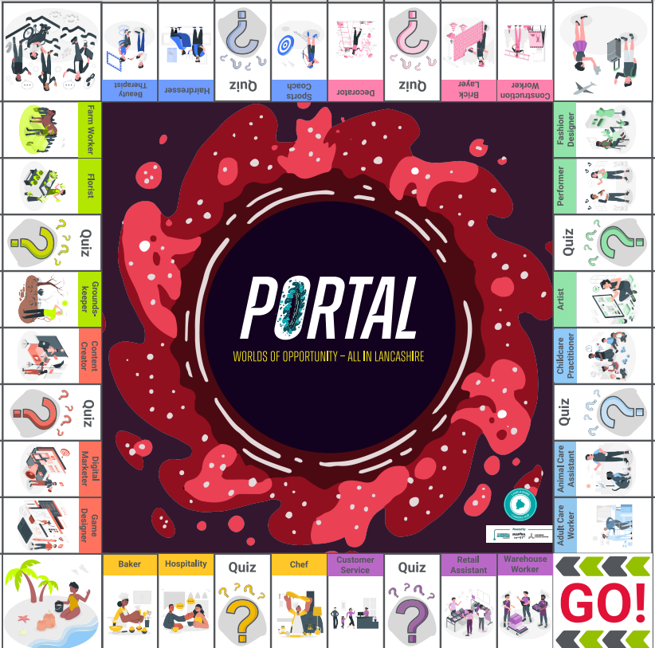
The Portal Package
Online elements
x6 travel to work area slide decks (in different formats)
x3 animations
  Energy and Low Carbon
  Cyber and Creative
  LMI for All
Teacher resources / glossary / speaker notes
Links to the online resources:
NEW! Portal boardgame for SEND/AP
Lancashire LMI - Careers and Education Pathways

Slide 11
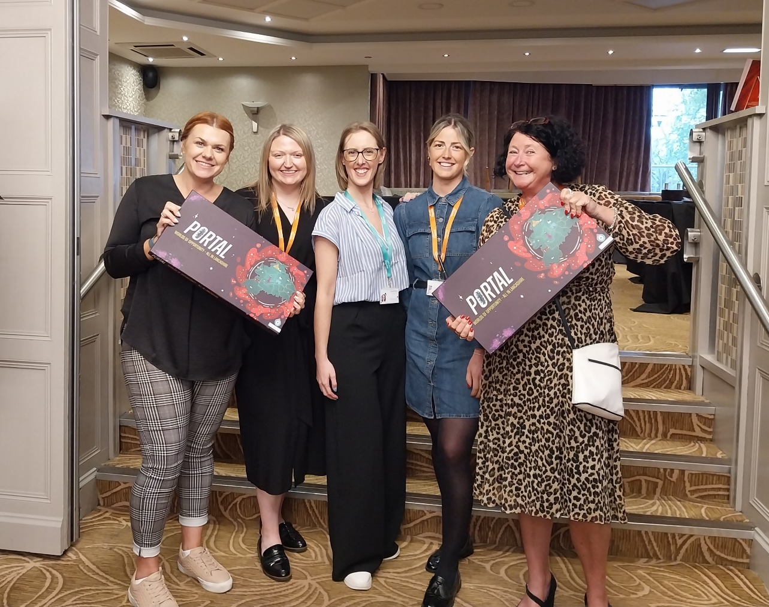
The Inclusion Team
The Careers Hub leads an Inclusion Community of Practice, which is a collaboration of our Career Leaders from 41 (soon to be 48) SEND/AP/PRU institutions across wider Lancashire.
The Inclusion CoP aim to meet at least 3 times per academic term, to share best practice, insights and hear from providers and employers who are actively supporting young people with SEND.
Focus:
Support Career Leaders to ENGAGE WITH PARENTS to remove barriers (i.e. myth bust around benefits; loss of EHCP when working)
Continue to ENGAGE WITH EMPLOYERS to ensure ALL students can have meaningful employer encounters and workplace opportunities.
Focus on POSITIVE TRANSITIONS – (i.e. The increase in Supported Internships – where and how to access)
Kimberley Helm
Kimberley.helm@inspira.org.uk
Trudi Wilkinson
Trudi.Wilkinson@inspira.org.uk
Notes:
Potential to link in with your SENDCOs

Slide 12


Career Leader Training
Lancashire delivered Non-Accredited Career Leader Training with the University of Derby
We are looking to host the days at County Hall in Preston.
Next steps if interested: Register via the CEC website here Careers Leader Training Portal
You will use your Compass login to sign in. The course code will be: P55 and should appear in the options as you register. Once this is done Derby will send out the CL learner agreements which set out the dates for the programme etc.
Proposed delivery dates:
If you are looking for a different Career Leader course, provider, delivery method or an accredited version that can provide credits towards a possible MA the link to the CEC training webpage is here: CEC Career Leader Training
Activity | Date and time
Introductory webinar | 22/10/2024 16:00-17:00
Workshop1 | Day 1: 5/11/2024 10:00-16:00 Day 2: 6/11/2024 10:00-16:00
Middle webinar | 10/12/2024 16:00-17:00
Workshop 2 | Day 1: 21/1/2025 10:00-16:00 Day 2: 22/1/2025 10:00-16:00
Final Webinar | 11/2/2025 16:00-17:00
Portfolio hand in | 28/2/2025
The proposed delivery schedule is to the right, and the course information will be shared with slides following today’s meeting.

Slide 13









Career Leader Training
https://www.careersandenterprise.co.uk/careers-leaders/careers-leader-training/training-providers/
Notes:
CL Training – other providers
Info from CEC

Slide 14
Key dates for the diary
Compass Training Sign Up Here Parental Engagement Course Sign Up Here | In Person County Hall Preston In Person County Hall Preston | Friday 8th November Friday 22nd November
Virtual Inclusion CoP (SEND/AP CLs + mainstream SENCOs) Autumn Term | Virtual Teams invite to follow | Tuesday 19th November 2025 15:30-16:30
Virtual Inclusion CoP (SEND/AP CLs + mainstream SENCOs) Spring Term | Virtual Teams invite to follow | Wednesday 5th February 2025 15:30-16:30
Inclusion Summit Spring Term | Venue TBC | Wednesday 7th May 2025 08:45-15:00
Lancashire Careers Hub Annual Conference Summer Term | UCLAN TBC | Tuesday 24th June 2025 08:45-15:00

Slide 15

Thank you so much for your time
Are there any questions?

