Slide 1

Careers Impact System
Internal Leadership & Peer-to-peer reviews

Slide 2
To understand the Maturity Model, which underpins the Careers Impact System
To understand the value & purpose of engaging with a Careers Impact peer-to-peer review
To understand the process and commitment to engage in a Careers Impact peer-to-peer review
To gain insight into what to expect from a Careers Impact peer-to-peer review
Session Aims

Slide 3
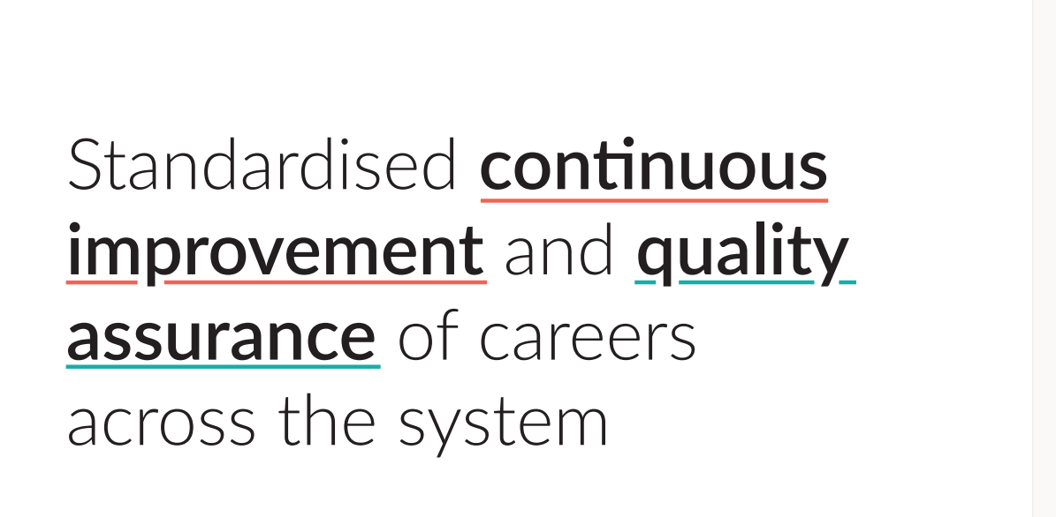
Notes:
This slide captures the ambition and aim of the entire Careers Impact System
This is the overarching ambition for the system, and we are now really focusing on the core elements and how they actually allow us to standardise continuous improvement and provide quality assurance of practice
Rooted in the Gatsby Benchmarks and other evidence about best practice in careers, the Careers Impact System aims to:
Provide assurance of quality of careers provision
Improve careers provision across the country
Elevate the status of Careers Leadership.
Peer-to-peer reviews are core elements of the system

Slide 4
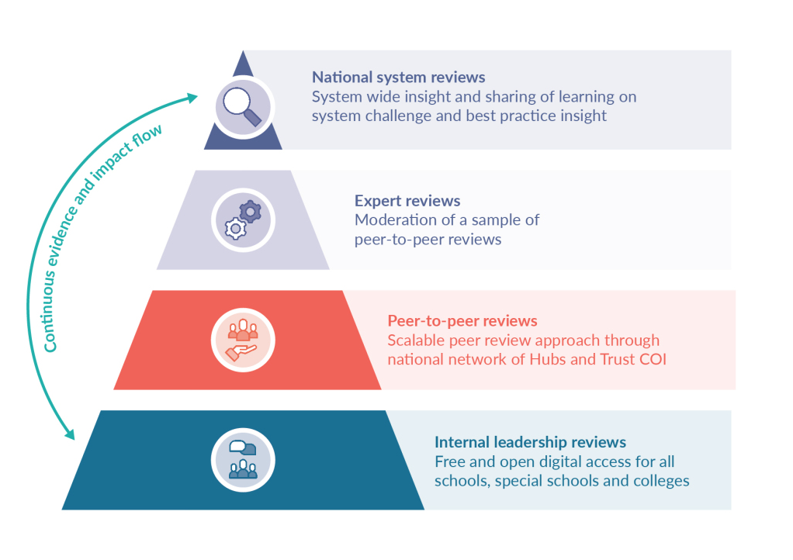
Notes:
This slide highlights the peer-to-peer reviews as well as showing other core elements of the Careers Impact System and how all the elements interconnect
This session focuses on the bottom two tiers of the pyramid as our approach to accelerating meaningful achievement of BMs across the system to drive outcomes for institutions, for Hubs and for young people.

Slide 5
What does the Careers Impact System give us?
“A different way of talking about careers & careers leadership: in the realm of overall improvement”
“An opportunity to identify the actions that will create a more sustainable and embedded approach where leadership is distributed and careers is considered to be everyone’s responsibility”
“A strategic focus on the impact and outcomes of careers provision, when the temptation can be to focus on the operational inputs and activities”
Notes:
The system overall provides us with a different way of talking about careers and careers leadership, specifically through the lens of wider school, special school and college improvement
The reviews within the system allow us all to reflect on practice and to identify actions that will create a more sustainable and strategic approach to careers leadership
The reviews give you a safe space to focus on the strategic leadership of careers and to step back from the to-do list to re-calibrate
The structure starts with the maturity model itself so let’s look at this element of the system in more detail

Slide 6
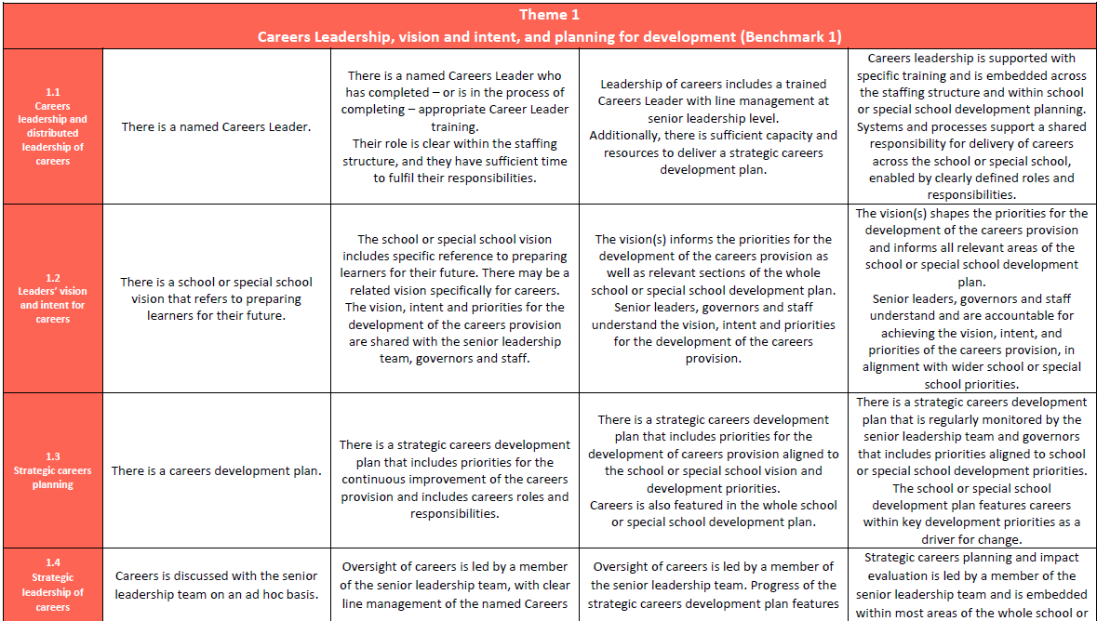
Careers Impact Maturity Model: Layout
Notes:
You can see in relief the layout of the maturity model that underpins and encapsulates the entire system
It is the only tool in the sector that unpacks careers leadership and the language and functionality to understand how careers can be positioned within school, special school and college improvement
The language of the BMs is embedded in a way that is future proofed in preparation for next 10 years review
The description of quality within each component improves from left to right – on a continuum of increasing maturity – it articulates a journey for an institution of what good looks like within careers leadership, specifically what it looks like in the context of school and college improvement
This model is the basis for the internal leadership and the peer-to-peer reviews
Maturity Model for Schools and Special Schools
Maturity Model for FE

Slide 7

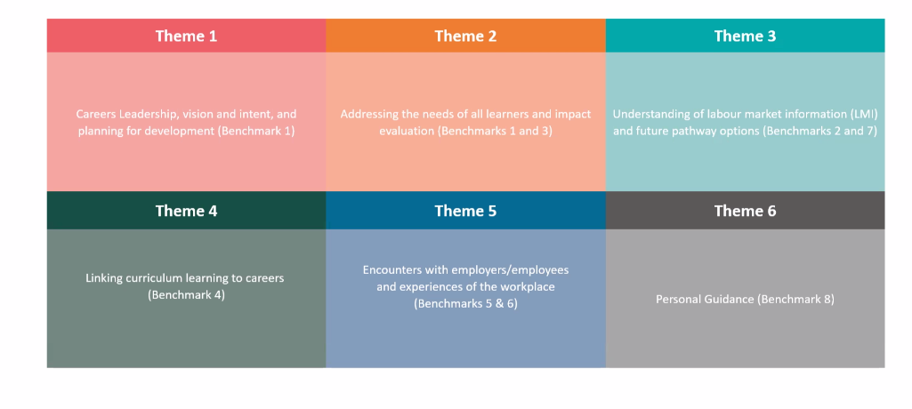

Slide 9
A Focus on Improved Outcomes for Young People
Conditions of Success – How have things been allowed to happen?
Identification and Removal of Barriers – What will enable progress through the Maturity Model?
Explore the Solutions – Who can support? What is realistic and achievable?
Strategic, Embedded and Sustainable – Ensuring these foundations are in place (Theme 1)
A Focus on Each and Every Young Person – Considering outcomes and evaluation of impact (Theme 2)

Slide 10

  ​
  “Careers is the cornerstone of education, and the internal leadership review showed us how much we haven’t thought about yet.
  The maturity model takes a lot of that thinking work away – it enables us to work out where we are and what we need to do next because it’s written down for us – so we can focus on strategy and implementation.”
  Senior Leader, (May 2024)
  Careers Impact P2P Early Roll-out
Notes:
The model gives us a language and it is also a key tool within every review in the Careers Impact system
This quote captures how the maturity model and the opportunity to internally review careers leadership practice has been so well received
The internal leadership and the peer-to-peer reviews means that consideration of the maturity model and key questions about planned intent and impact for young people are on the right people’s agenda in an appropriate way

Slide 11
Engage Leaders through informed and impactful SLT and governor engagement in and vision for sustainable and strategic careers leadership
Align priorities through intentional distributed leadership of careers as a driver for whole institution improvement
Embed best practice through improved understanding of best practice in careers leadership and of meaningful; and sustained achievement of the Gatsby Benchmarks
Celebrate Success through recognitions of strengths in and impact of careers leadership and provision
Sustain quality and impact through internal quality assurance and impact evaluation of carers leadership and provision
By participating in a Careers Impact peer-to-peer review institutions will:
Notes:
These are some of the key and proven ways that the Careers Impact peer to peer reviews can add value to schools, special schools and FE provisions

Slide 12

  ​
  “We didn't previously have major buy in from the SLT.
  This has been such a powerful experience that has highlighted the importance of careers to overall improvement.
  The Careers Impact System peer-to-peer review is the vehicle that moved it on.
  It has enabled us to discuss careers at strategic level and established the and positioning of careers in whole school development planning
  Careers Leader, (June 2024)
  Careers Impact P2P Early Roll-out
Notes:
Other colleagues have describe the maturity model and the peer to peer review process as the power drill of change
I love this quote as it is one of many testimonies about the power of peer to peer reviews to expertly engage the right people in a safe space to focus on highest leverage actinos to devekop careers provision in direct correlation of raising standards and outcomes for young people

Slide 13
Internal Leadership Review
Digital Tool, now live in the Compass system under the evaluation tab.

Slide 14
Preparing to complete a Careers Impact Internal leadership review
A Careers Impact internal leadership review needs a collaborative approach and is a reflection on the maturity of careers leadership across a school, special school or college
Who should take part? All those involved in the distributed leadership of careers should be involved in the review process e.g.
Headteacher/Principal | Careers Leader
Link Governor | Careers Coordinator
Enterprise Adviser | Careers Adviser
SLT; Pastoral, Personal Development, Curriculum, Progress, Teaching & Learning | SENCo/Head of SEND
SLT; Vice Principal/Assistant Principal | Head of Inclusion
Head(s) of Year/Head(s) of Department | PSHE Lead
Central Strategic Careers Leader | Student Support/Student Services

Slide 15

The Process:
Download the maturity model within Compass +
Circulate with key staff whose roles contribute to your careers provision
Meet to agree your institutions position against the statements on the model
Input your agreed results within Compass. The visualisations will highlight development and strength areas.
It is a suggested annual review.

Slide 16
Cumulative Added Value of Careers Impact Reviews
Internal Leadership
Review
Collaboration - Wider SLT engagement in Careers
Awareness of current ‘best-fit’ related to different themes underpinned by the Gatsby Benchmarks
Peer-to-Peer Review
Support and challenge from peers
Expert guidance from a trained facilitator using standardised methodology
Summary of Review,
Action Planning and Post-Review Stages
A summary of discussions, celebrations of strengths and agreed highest leverage actions to inform SLT and Governors
Collaborative action planning to ensure sustainable, strategic, impact-driven improvement
Stimulates initial thoughts around how to achieve progress through the Maturity Model
Output: Collaboratively agreed highest leverage actions prompted by the Maturity Model language
A mechanism to enable long-term student and institution level impact when careers is leveraged as a vehicle for overall improvement
Notes:
As a summary here is the cumulative value and the discrete value of internal and peer-to-peer reviews
Column 1 shows the value to institutions of engaging fully in the internal leadership review process
Column 2 captures the key benefits of participating in a standardised Careers Impact System peer-to-peer review
Column 3 shows the added value of the post-review stages – the ‘so what’ and ‘what next’ of a peer-to-peer review

Slide 17
  “I enjoyed lifting my head above it all, stepping back and reflecting – it’s made me think about things like this (at a more strategic level) and has forced me to step away from the to do list.”
  Careers Leader, (March 2024)
  Careers Impact P2P Early Roll-out

Slide 18
Peer to Peer Review
A trio of schools use the Internal Leadership Review alongside their school context to participate in an externally facilitated review day alongside two other institutions.

Slide 19
Careers Impact peer-to-peer reviews
Participant view
Internal leadership review
Engagement. trio formation, preparation
&
commitment
Review
Action Plan
&
Act
Careers Impact
Self-evaluation tool
Notes:
First thing to say is that for simplicity these overviews are in arrows and seem finite…in truth this process is cyclical and is about standard ways of working and evaluation and planning cycles
For participating schools, special schools and colleges the peer-to-peer review process is straightforward
It starts with the internal leadership review – we talk about this as being ‘always on’ as a pipeline for you – you may also use the data and insight from internal leadership reviews to inform your strategic approach
Engagement in peer-to-peer is the next step – you will all be considering your own approach to this and I know a number of Hubs are going top down on this to engage Headteacher forums or MAT CEOs to get SLT and executive buy in – other Hubs re supporting ECs to engage institutions individually
It will look and feel different in each Hub and will depend on what success looks like for you and how you have linked this to wider strategic aims
Once institutions are engaged then comes trio formation and again this will look and feel different in each hub
Generally institutions have been grouped by type in testing phases but we have had a few cross sector trios with a mix of FE, SEND and mainstream, etc.
That preparation for participants includes a handbook and participant learning that supports maximising the value for them of the review
The review is the most significant commitment of the process and is usually at a neutral venue
The methodology and agenda is a core part of the standardisation of the process and the training focuses on this to achieve that equity of experience and to keep the conversation focused on highest leverage actions
For participants the review is followed with action planning and presenting to SLT/Govs on highest leverage actions and ambition
If this is the participant view, lets focus now on your view before thinking about it from the perspective of your chosen facilitators

Slide 20
Careers Impact System
peer-to-peer Review
Questioning
Why?
How can practice be elevated?
What does wiring look like?
How do you know it works?
Ask questions to understand why things are done in the way they are.
Structures, systems and processes which allow things to happen in the way they do.
What is the impact on young people? How do they have confidence in their approach?
What's next? How can already good provision be made even better? What needs to happen?
Notes:
In teal are the questions of enquiry within a Careers Impact peer-to-peer review
Why do you do what you do? What does the wiring look like? How do you know it works? How can practice be elevated?

Slide 21
What to expect in a Careers Impact peer-to-peer review:
Example Agenda
9:30 to 10:00 | Welcome, Ice breaker, reminder of purpose and agreement of norms of engagement
10:00 to 11:05 | Participating institution A
11:05 to 11:20 | Comfort break
11:20 to 12:25 | Participating institution B
12:25 to 13.55 | Lunch
13:55 to 15:00 | Participating institution C
15:00 to 15:30 | Summary of key collaborative themes and agreement of next steps including plans to support SLT, Governing Body presentations and Reconvening

Slide 22
Breakdown of agenda per institution (75 minutes)
Duration (mins)
15 | Section 1: Context
15 | Section 2: Celebrating and elevating strengths
10 | Facilitator led reflection
45 | Section 3: Strategic improvement priorities and high leverage actions
(15) | Guided reflection and agreement of strategic improvement priorities
(25) | Priority Area One and Highest Leverage Actions
 | Priority Area Two and Highest Leverage Actions
 | Priority Area Three and Highest Leverage Actions
(5) | Reflections and next steps
75 mins

Slide 23
You receive a summary document highlighting the strengths, areas of development and 3 agreed highest leverage action steps to develop.
The CL then forms an actions to support the development and shares with SLT & Governors.
There is an opportunity to reconvene the group at a set period to share developments.
Post Review

Slide 24
  ​
  “We didn't previously have major buy in from the SLT.
  This has been such a powerful experience that has highlighted the importance of careers to overall improvement.
  The Careers Impact System peer-to-peer review is the vehicle that moved it on.
  It has enabled us to discuss careers at strategic level and established the and positioning of careers in whole school development planning
  Careers Leader, (June 2024)
  Careers Impact P2P Early Roll-out

Slide 25
Q&A

