Slide 1

Inclusion Community of Practice
Tuesday 19th November 2024
15:30-16:30

Slide 2
Agenda and Welcome
Time | Session
3.30 | Welcome and Introductions Kimberley Helm, Enterprise Coordinator Trudi Wilkinson, Enterprise Coordinator
3.35 | SEND Future Skills Questionnaire Review Frances Jenkins, Customer Content Manager (Careers and Enterprise Company) The SEND FSQ is currently undergoing a full review and CEC’s primary objective will be to evaluate the relevance, effectiveness, flexibility and inclusivity of the FSQ for learners with SEND. We want our Lancashire colleagues to be part of that conversation. This will be your opportunity to discuss your thoughts and solutions.
4.05 | Teacher Encounters Chris Maddock, Deputy Careers Hub Lead (Lancashire Careers Hub)
4.20 | AOB / Close Kimberley Helm, Enterprise Coordinator
4.30 | End of meeting

Slide 3
Future Skills Questionnaire
SEND Review
Frances Jenkins
Customer Content Manager
Careers and Enterprise Company

Slide 4

Future Skills Questionnaire
SEND FSQ review 2024/2025
Notes:
Holding slide

Slide 5
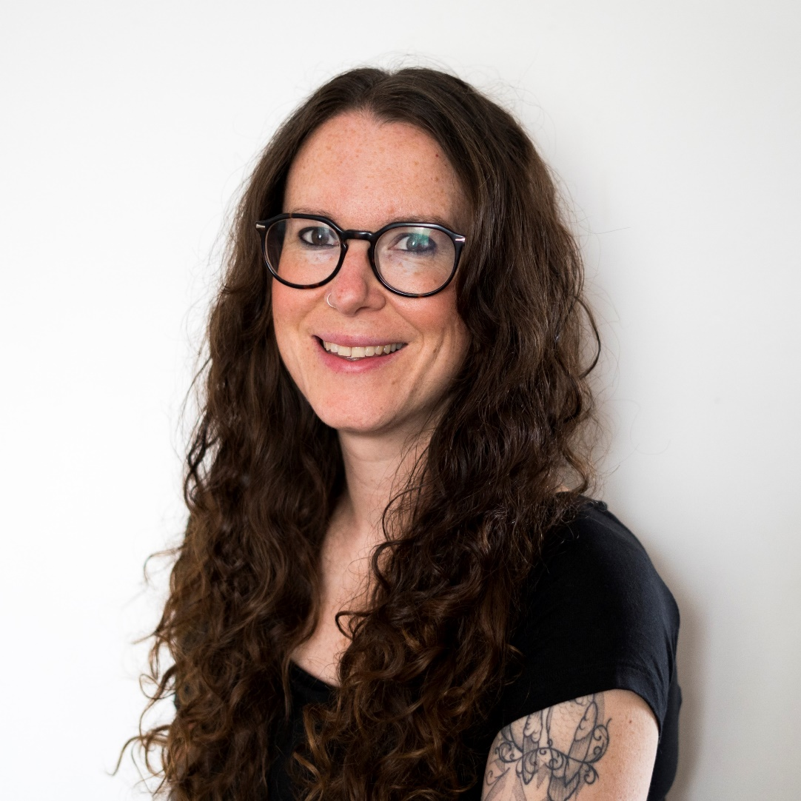
  Hello!
Frances Jenkins – Customer Content Manager
Customer Management Team - Digital Products
Managing and developing content for our suite of digital products
CMT SEND Champion
Catherine Glasper - Costas Leontis - Rossina Goitom
Fjenkins@careersandenterprise.co.uk​
Notes:
Catherine – Senior Customer Engagement Manager
Costas – Customer Success Manager
Rossina – Customer Service Manager

Slide 6

The SEND FSQ is currently undergoing a
full review and CEC’s primary objective will
be to evaluate the relevance, effectiveness, flexibility and inclusivity of the FSQ for learners with SEND.
Notes:
SEND FSQ review main objective

Slide 7

Feedback on the current SEND version of FSQ
Suggested solutions
and improvements
Go..!!!

Slide 8
Teacher Encounters
Chris Maddock
Deputy Careers Hub Lead
Lancashire Careers Hub

Slide 9

Teacher Encounters: Lancashire
11 employers hosted 82 teachers across our programme last academic year.
Support given to employers to ensure meaningful and quality outcomes, with examples of curriculum outcomes

Slide 10
What is a teacher encounter?
A teacher encounter provides an opportunity for teachers to engage directly with employers to see and learn about the different career pathways relevant to their subjects. It enables them to observe how their subject is applied practically in business. Teacher encounters can take many forms, from two hours to multiple days, face-to-face, virtual or a mix of both.
The programme will help teachers to:
Develop relationships with local employers.
Understand changes in recruitment practices.
Deepen knowledge about skill demands of employers.
Hold careers conversations with students and parents.
Bring to life their curriculum by relating it to real world examples.

Slide 11





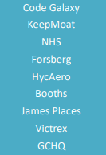





WHO WE WORKED WITH LAST YEAR

Slide 12
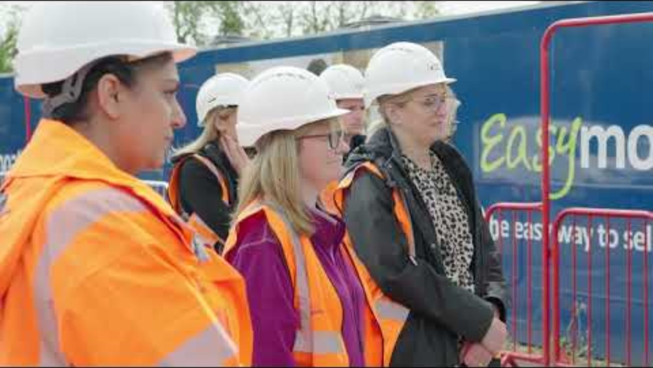
https://youtu.be/MZlVkp1Fo-k?si=DGZGNpTLPQA9fPjF

Slide 13
WHO WE WILL WORK WITH THIS YEAR
SHOUT! Network: 13th January 2025
Keepmoat Homes: 23rd January 2025
James’ Place: 24th February 2025
GCHQ: Date TBC
HycAero: Date TBC
Lancashire County Council: 14th March 2025
Victrex: 24th April 2025
…and more to come.

Slide 14
To register
SHOUT – https://forms.office.com/Pages/ResponsePage.aspx?id=tg9-kMK9aUmvhMdQkO9MnAYPMoluBENEshH1BTrKehJUQzI5REdBMktPVzFNQ1Y5NkE0WkUzM1BXRS4u
Keepmoat - https://forms.office.com/Pages/ResponsePage.aspx?id=tg9-kMK9aUmvhMdQkO9MnAYPMoluBENEshH1BTrKehJUMTdBSzUwT01QV1lNVldXTTBEWUhGV1hUNi4u
James’ Place - https://forms.office.com/Pages/ResponsePage.aspx?id=tg9-kMK9aUmvhMdQkO9MnAYPMoluBENEshH1BTrKehJUMzBQSlkwWE9KQzlMQTFXMk1GTkw5NFVBVi4u
Lancashire County Council - https://forms.office.com/Pages/ResponsePage.aspx?id=tg9-kMK9aUmvhMdQkO9MnAYPMoluBENEshH1BTrKehJUOVdTSlU1UjlMVUlPTFk1MDRFMlUySFpWNS4u
Victrex - https://forms.office.com/Pages/ResponsePage.aspx?id=tg9-kMK9aUmvhMdQkO9MnAYPMoluBENEshH1BTrKehJURjRNWUozTzIwS1EzOVZDUlBHTVdNMjVQNS4u
Feel free to contact chris.maddock@inspira.org.uk with any questions.

Slide 15
Key Dates
24-25
Event | Location | Date/time
Virtual Inclusion CoP Spring Term | Virtual Teams invite to follow | Wednesday 5th Feb 2025 15:30-16:30
Inclusion Summit Spring Term | Impact Conferencing (Burnley) Invite to follow | Wednesday 7th May 2025 08:45-15:00
Lancashire Careers Hub Annual Conference Summer Term | UCLAN Invite to follow | Tuesday 24th June 2025 08:45-15:00

Slide 16
AOB and Close

