Slide 1



Inclusion Community of Practice
Theme: Meaningful and varied encounters and experiences
Thursday 13th March 2025
15:30-16:30
Notes:
Kim to welcome

Slide 2
Agenda
Time | Activity
15:30-15:35 | Welcome
15:35-15:50 | Gatsby Benchmark CPD – emerging theme 3 Meaningful and varied encounters and experiences Kimberley Helm, Trudi Wilkinson and Michelle Billington
15:50-16:10 | Working alongside an employer to develop a meaningful workplace encounter Vicky Clegg, Blackpool Transport
16:10-16:20 | Breakout rooms
16:20-16:30 | Feedback, AOB and Key Dates
Notes:
Kim to go through agenda

Slide 3
5 Emerging Themes
The Gatsby Foundation’s decision to assess and review the impact of the Gatsby Benchmarks has ensured that both this government and the wider sector can trust the ongoing relevance of the benchmarks. The extensive research carried out suggests overwhelmingly that the framework, with careers leaders at the helm, has a positive impact on young people.
Careers at the heart of education and leadership
Inclusion and impact for each and every young person
Meaningful and varied encounters and experiences
Focusing on the use of information and data
Engagement of parents and carers
Notes:
EC – Kim
Might be aware of the Gatsby next 10 report which has considered the framework for careers; they have been updated and modernised to reflect the current educational landscape.
The Changes will most likely be statutory from September and the focus of any careers provision in all educational settings should be focussed around these 5 emerging themes.
We’ll focus on a different theme for each Inclusion CoP moving forwards into the new academic year, and for this meeting we are going to focus on theme 3 - Meaningful and varied encounters and experiences

Slide 4
Gatsby Good Career Guidance: The Next 10 Years
What are the changes?
Meaningful and varied encounters and experiences
We have emphasised the focus on flexible delivery and the impact of encounters and experiences of education and work. We have expanded the definitions of 'meaningful' in Benchmarks 5 and 7 and added one to Benchmark 6. They specify the importance of offering a variety of encounters and experiences, of giving young people time to prepare and reflect and of using *technology alongside, but not instead of, in-person activity.
*technology (i.e. virtual)
Notes:
EC – Kim
During this meeting today, we’ll discuss:
What is different?
What is the value in the change?
How will you position this within your setting?
What ‘tools’ do you as CLs have at your disposal, and how will you use them?
A specific focus in the definition of ‘meaningful’ for Benchmark 5 is that young people experience employers of different sizes and specialisms throughout the careers programme.
Additional or different support may be needed for vulnerable and disadvantaged young people and for young people with SEND.

Slide 5
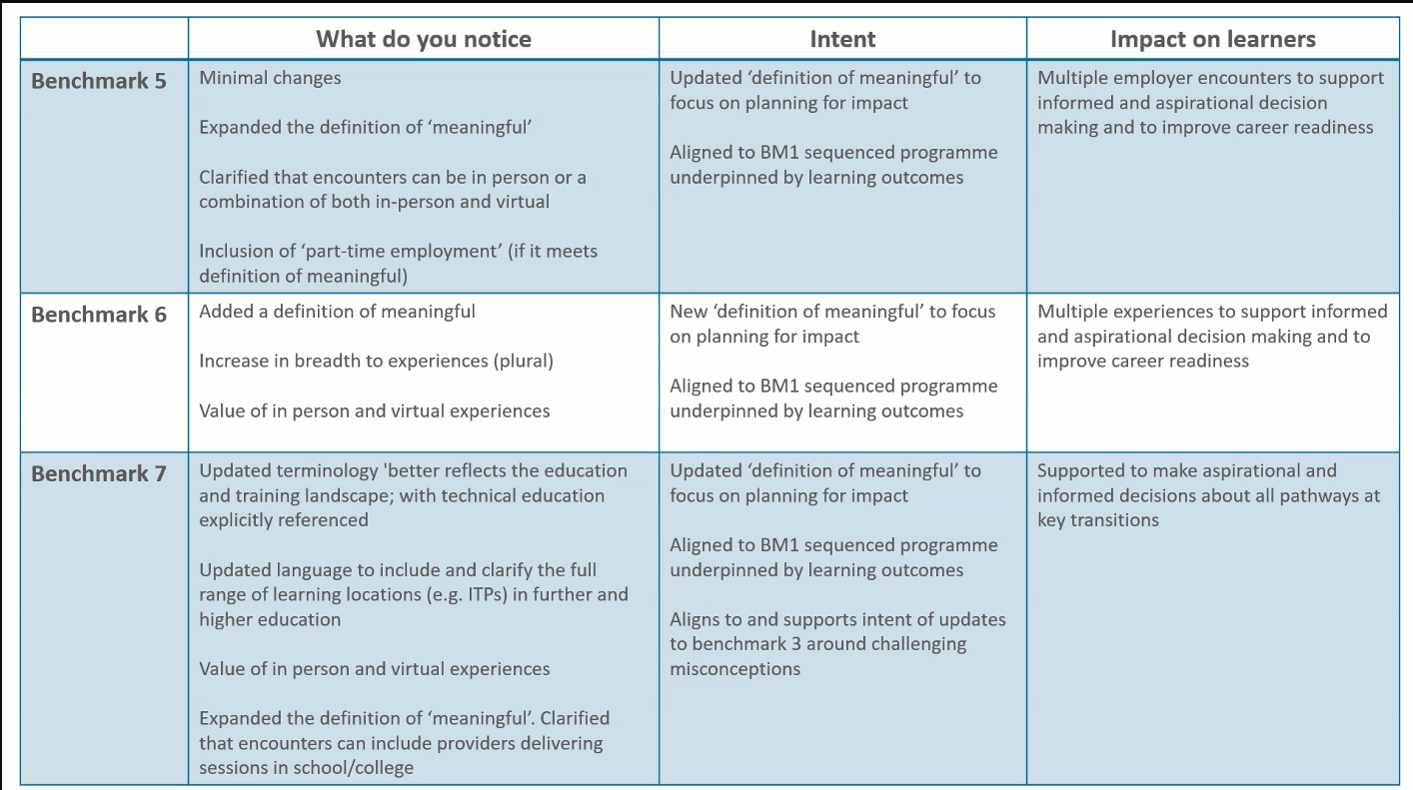
Notes:
EC – Michelle
There are three benchmarks that cover Theme 3. You can see where and how the benchmarks have been updated. Notice that there are definitions of the term ‘meaningful’ as well as recognition that encounters can be in-person and virtual.
We want to highlight the end column which is the impact on learners – I’m not going to read it out, I’ll give you a second to read. We want careers programs to be ambitious and for workplace encounters to build year on year.
There is a clear criteria for what meaningful is – this makes it easier for Career leaders and EA’s to plan for encounters or experiences of the workplace, and we'll hear more from one of our Cornerstones shortly, about how this can be successfully achieved.
You have tools at hand to help you monitor and record the impact of workplace experiences, such as Compass+ 'Activities Report' and Future Skills Questionnaires (SEND update coming soon)
Next slide

Slide 6
A meaningful experience will:
have a clear purpose, which is shared with the employer and the young person
be underpinned by learning outcomes that are appropriate to the needs of the young person
involve extensive two-way interactions between the young person and employees
include opportunities for young people to meet a range of different people from the workplace
include opportunities for young people to perform a task set by the employer or to produce a piece of work relevant to that workplace
include the employer providing feedback to the young person about their work
be followed by opportunities for the young person to reflect on the insights, knowledge, or skills gained through their experience
Notes:
EC – Michelle
Criteria for a meaningful experience is shown on slide – give you a moment to read
Some encounters, such as an awareness-raising talk by an employer, might be planned in such a way that it can be meaningful for all, while other encounters will need to be tailored to most benefit the individual.
There are many approaches to providing meaningful encounters. Schools and colleges are best placed to decide what will work best for them and what will benefit their young people most.
It's important to design the workplace encounter alongside the employer to ensure maximum impact.

Slide 7
A meaningful experience...gives the young person the opportunity to explore what it is like to work in that environment, what skills are valued in the workplace, their recruitment processes and what it takes to be successful.
This could be achieved through visits to workplaces, work shadowing and/or work experience.
Throughout the careers programme these experiences could be in person or a combination of in person and virtual, where appropriate. Both the young person and employers should be supported to prepare for the experience.
Additional or different support may be needed for vulnerable and disadvantaged young people and for young people with SEND.
equalex - A work experience guarantee for every young person
Notes:
EC – Trudi
I’ll just give you a minute to read through the slide about what a meaningful experience might look like.
A specific focus in the definition of ‘meaningful’ for Benchmark 5 is that young people experience employers of different sizes and specialisms throughout the careers programme.
Additional or different support may be needed for vulnerable and disadvantaged young people and for young people with SEND.
The equalex approach is currently being piloted in partnership with four Mayoral Combined Authorities. The ambition is to see this adopted across the country.
Key features of equalex:
Quality: A multi-experience model that uses learning objectives to join activity together during a young person’s time at school
Equity: A minimum of 10 days' worth of work experience - tailored days, blocked time periods etc.
Flexibility: Structured to support all types of school and business, including smaller employers - hybrid, virtual etc
The model offers structure, rather than prescription about when and how the 10 days' worth of experiences of the workplace should be delivered.
The flexibility – asked for by employers and schools – will help develop innovative and impactful approaches.

Slide 8
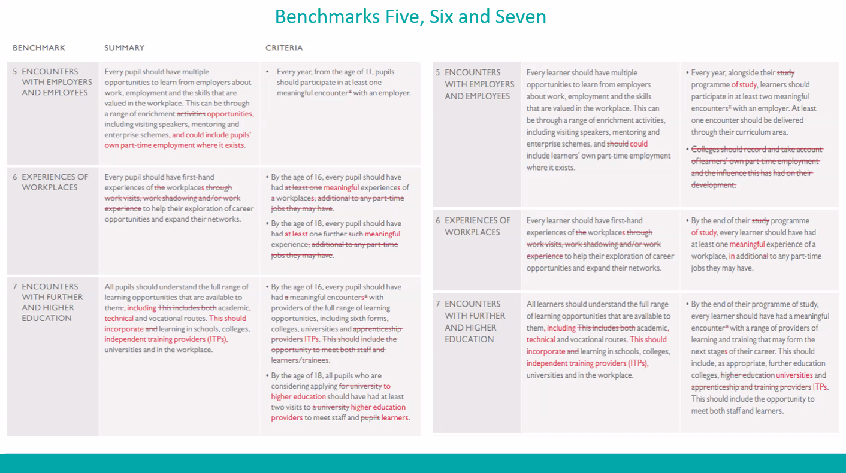
Notes:
EC – Trudi
The Gatsby 10 Year Report includes a clear guide to highlight the change in wording.
Appendix 9 - link included in resource slide at end of presentation.

Slide 9
Vicky Clegg
People Development Manager
Blackpool Transport
Working alongside an employer to develop a meaningful workplace encounter
Notes:
Kim to intro

Slide 10

Workplace Encounters
Vicky Clegg – Learning and Development Manager

Slide 11

How it all began..
Proud to be a Cornerstone
Invited to be a part of the Workplace Encounter project
Notes:
We started our school engagement with an ulterior motive which was to engage with young people to try and reduce anti social behaviour on our public transport network, we soon started to build relationships with school leaders and young people. We allowed some employees to become Enterprise Advisers and this allowed us to evolve and start to engage with young people about different jobs they could do at Blackpool Transport and at the same time we could support with independent travel and build relationships with parents. Over time this has grown legs and we now have amazing connections with many local schools and within the community in general.
BTS are recognised for our active community engagement and we were approached in 2024 by Business in the Community to host a work place encounter for Park Academy a SEN school, for KS3 students. This was a new project that was being piloted and what the expectations of the encounter were, it was over to BTS to develop a plan, however, I was reassured that the team at BITC were on hand to support at any time.
Not a tick box

Slide 12
Planning
Right people in the room
Skills builder
Utilise what we have
Notes:
I identified different activities that would bring the skills builder essential skills to life along with other skills such as math's and writing. I developed a plan and got the right people in the room to bring it to life.
The right people do not necessarily have to be the people that complete the task day to day, I can use the paying in machine as a bus driver would, our learning rep is also a bus outweighs so she drove the bus. We created a vision, it doesn’t matter who plays out the vision, the children do not care, we are there to inspire and from a business perspective keep the cost minimal using minimal resources but creating maximum impact.
In house we have access to buses, trams, live offices, our live bus and tram network, the ever so popular bus wash and much more. The actual physical cost was the price of lunch and a few biscuits! We can argue the time and people are a cost but the return on investment, I believe out weighs this. More on that in a bit.
Listening
Speaking
Problem Solving
Creativity
Staying Positive
Aiming High
Leadership
Teamwork

Slide 13
Encounter Plan
Time | Activity | Department | Skills builder
09:30-11:00 | Welcome | Organisational Development | Listening
09:30-11:00 | Interviews | Human Resources | Listening Speaking Staying positive Aiming higher
09:30-11:00 | Design a picture for the screens that are on our buses | Marketing | Creativity
09:30-11:00 | Break | All
11:00-12:30 | Board bus and pay for ticket | Finance | Problem solving
11:00-12:30 | Find lost property | Customer Experience | Problem solving
12:30-13:00 | Lunch on the bus | Organisational Development
13:00-14:00 | Go through the bus wash | Organisational Development | A little bit of fun!
13:00-14:00 | First user bus check | Engineering | Problem Solving Team work
14:00-14:30 | Pay in takings | Finance | Maths
14:00-14:30 | Log lost property | Customer Experience | Computer skills
14:00-14:30 | Close
Notes:
Explain that I went into school with application forms then talk through the day

Slide 14
Benefits
Improved attraction
Improved brand
Employer of choice
Attract better talent
Social value
Support being Disability confident
Encourages businesses collaboration
Notes:
The ROI mentioned earlier not only is the business supporting the school with Gatsby BM6, they will also, read the list out. That is without the emotional connections that are made and the sense of pride those involved get out of it. It is a nice to do and makes the day job feel that little bit better! We have been and are fully support by Business in the Community and we are also supported by BBC youth workers, so another tick box as this supports their development.

Slide 15
Further information
Research docs: You can read more about our research, in our research summary document here
Process doc: The individual steps can be found in the process doc here.
Skills builder guide: You can read more about skills builder in our guide here.
Example projects: A link to the two example projects from the pilot can be found here.
Contact - Matthew.Allen@bitc.org.uk

Slide 16
Contact details
Contact – Vicky.clegg@blackpooltransport.com
Tel – 07896 280 777
Thank you for listening!

Slide 17
Breakout rooms
As Career Leaders, how might you begin to map your current delivery and reflect on changes required?
How can moving conversations to ‘individual needs’ help you in addressing equitable and quality provision?
Thinking about the recent CEC Education Insights Survey – how has this made you think differently about the structure of workplace encounters, and have you thought about integrating the equalex framework?
Notes:
Kim to intro
Michelle / Trudi to split attendees into breakout rooms (Kim to give permission on Teams chat)

Slide 18
Resources / links to support
Appendix 9: Comparing the original and updated Benchmarks - A quick reference guide for practitioners
equalex - A work experience guarantee for every young person
Work Ready Lancashire
Employer Standards
Notes:
EC - TBC

Slide 19
AOB / Key Dates
If you haven’t arranged your spring term Compass meeting with your Enterprise Coordinator, please schedule before the end of March
Final tickets remaining / add your name to the waiting list!
BOOK NOW – EMPOWER – THRIVE – ACHIEVE - Wider Lancashire Inclusion Summit 2025 – Impact Conferencing
Date/Time | Event
Wednesday 7th May 8:45-15:00 | Wider Lancashire Inclusion Summit Burnley Impact Conferencing
Tuesday 24th June 08:45-15:00 | Lancashire Careers Hub Annual Conference UCLan
Notes:
Kim to close

