Slide 1




Launch The Term
Spring Term 24-25
Notes:
Please add your name and institution in the chat.

Slide 2

Agenda
  Key Areas from the Benchmark Review
  Support for planning and quality assurance
  Inclusion
  Work Experience & Employer Engagement
  Using data to inform provision
  Parental Engagement
Notes:
Highlight the areas we can support with and what we have happening in the hub and the key areas of focus.

Slide 3

The Gatsby Foundation's report on the next ten years of career guidance emphasises the continued importance of the Gatsby Benchmarks, which have significantly improved career readiness and outcomes for young people.

Slide 4





Impact – the power of careers
94%
6.8
x2
£150m
of secondary schools and colleges in Careers Hubs
Average Gatsby Benchmark score (with higher performance in established Hubs)
young people twice as likely to report awareness of apprenticeships by Year 11
£150m saved each year due to reduction in NEET young people

Slide 5
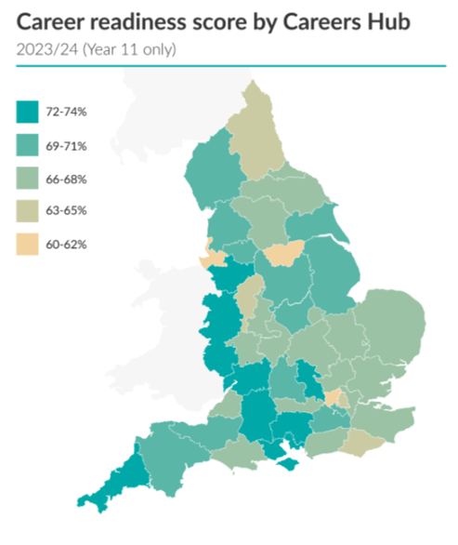

Notes:
National picture from FSQ data helps advocate for funding and support. Lancashire at 69-71% Career Readiness

Slide 6

Five prominent themes emerged from the evidence used during the review of the benchmarks:
Careers at the heart of education and leadership
Inclusion and impact for each and every young person
Meaningful and varied encounters and experiences
Focusing on the use of information and data
Engagement of parents and carers
Notes:
Five key themes from the review which is shaping provision going forward. As we go through feel free to add any questions or comments on these areas or support needs you may have.

Slide 7
CAREERS AT THE HEART OF EDUCATION AND LEADERSHIP
Careers provision is most effective when it is embraced by leadership, written into institutions’ wider strategies, and embedded into the practice of all staff.
Highlighted Roles of different staff members.
Education leadership and governors’ responsibilities are specified,
Roles of careers leaders and careers advisers are clearly distinguished, highlighting the need for careers advisers to be connected with relevant colleagues—especially specialists in Special Educational Needs and Disabilities (SEND).
Every subject teacher should embed careers into their curriculum. As careers guidance is a whole-staff endeavour.
Action point: What CPD needs do your wider staff have?
Notes:
Mention engagement ICOP and SENDCOs. How can we help you with devolved careers.

Slide 8
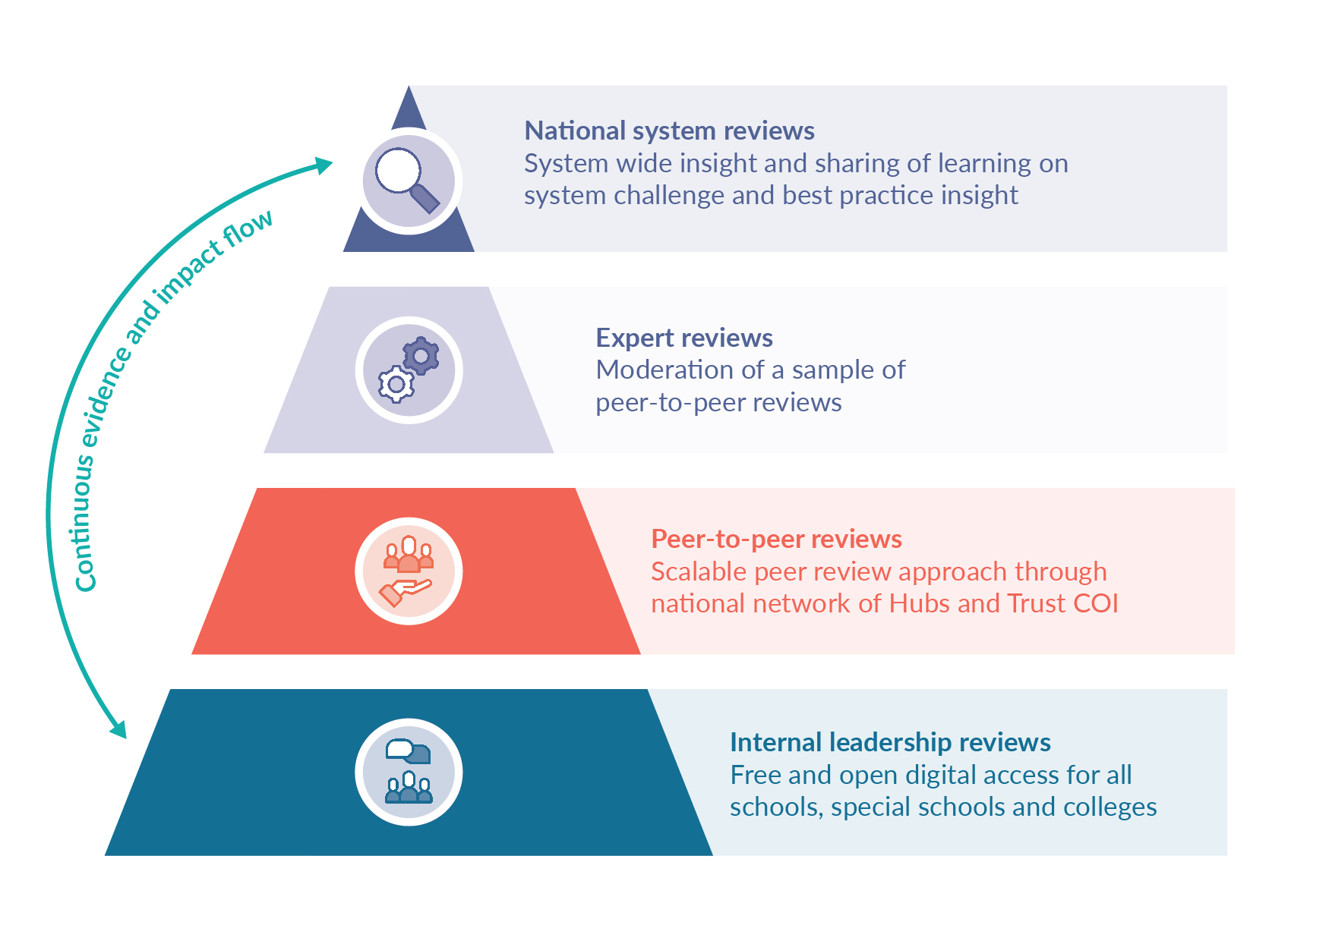
Support Available
Careers Impact System for Quality Assurance and supporting conversations with wider staff.

Slide 9
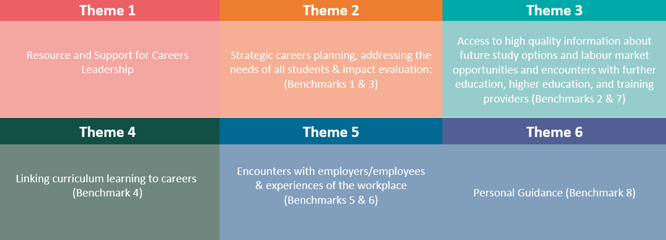

Raising standards, supporting planning and quality assurance
March 12th County Hall Preston Trio opportunities.
Notes:
Use the QR code to register interest in the CIS Peer to Peer Reviews.

Slide 10
INCLUSION AND IMPACT FOR EACH AND EVERY YOUNG PERSON
Good careers guidance is important for every young person, regardless of their background, interests, or ambitions.
This principle has always been central to the benchmarks, but its importance has been re-emphasised, particularly in designing activities that meet the individual needs of each person.
Amendments have been integrated into the framework;
Benchmark 1 specifically references the planning, sequencing, and tailoring of careers programs.
Benchmark 3 addresses young people’s concerns about potential barriers to their career development and highlights the importance of offering a diverse range of role models.
It is acknowledged that some vulnerable and disadvantaged young people, including those with Special Educational Needs and Disabilities (SEND), may require additional, different, or adapted information and support.
The practitioners who are most familiar with these young people are best positioned to assess and address their needs.
Notes:
Looking at planning and differentiating provision. Supporting equity and social mobility. What are the barriers, who can you engage to be a role model?

Slide 11
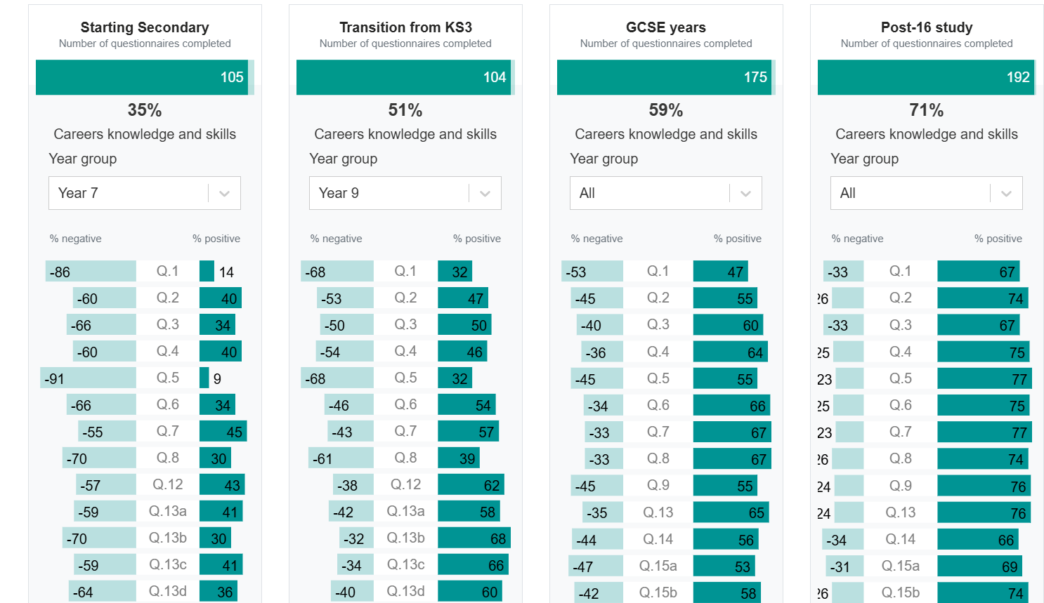
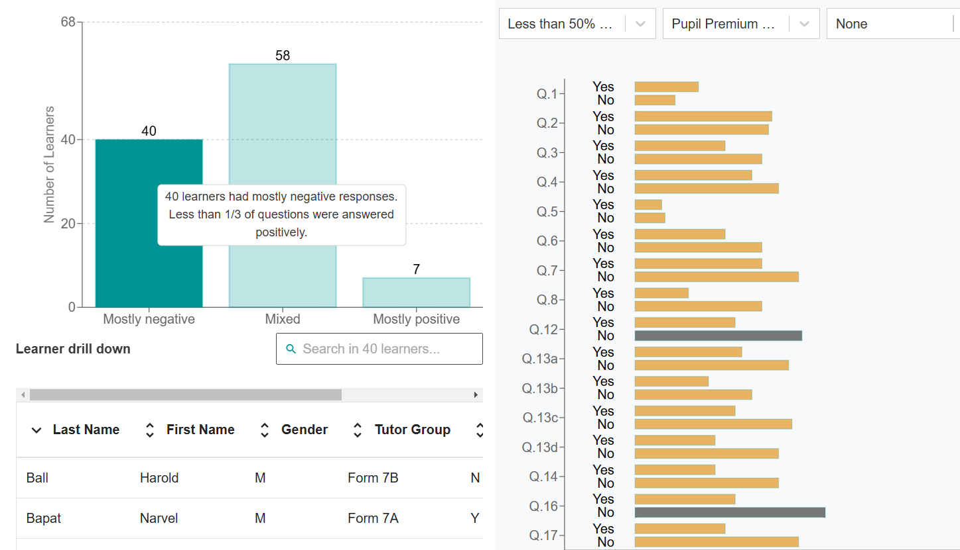
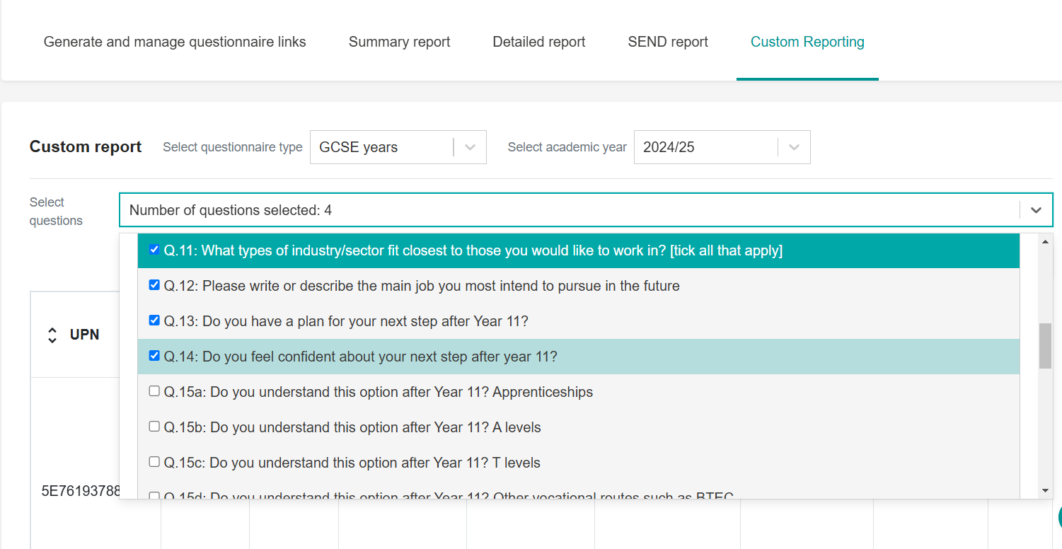
Support FSQ:
Notes:
FSQ can help you drill down one career knowledge and readiness and skill confidence. Can be used to triage for guidance. Custom reporting allows you to select key questions to check what sectors pupils are interested in to help plan activities. Can be shared with wider staff. Can help dispel myths around aspiration of more challenging pupils. A tool to engage curriculum staff.
We have an offer from CEC for one to one support with FSQ set up and analysis: You can book a Teams session with Peter who delivers our training.

Slide 12
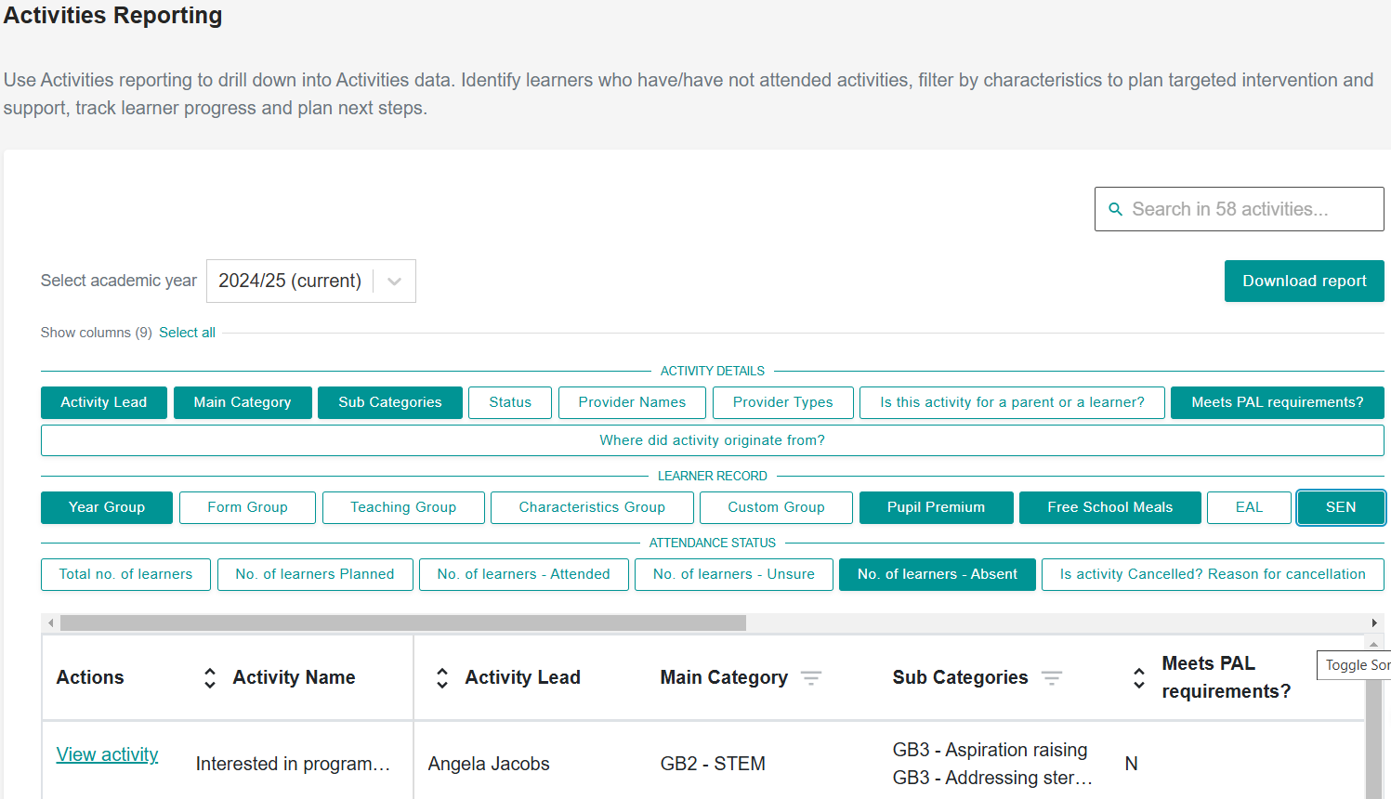
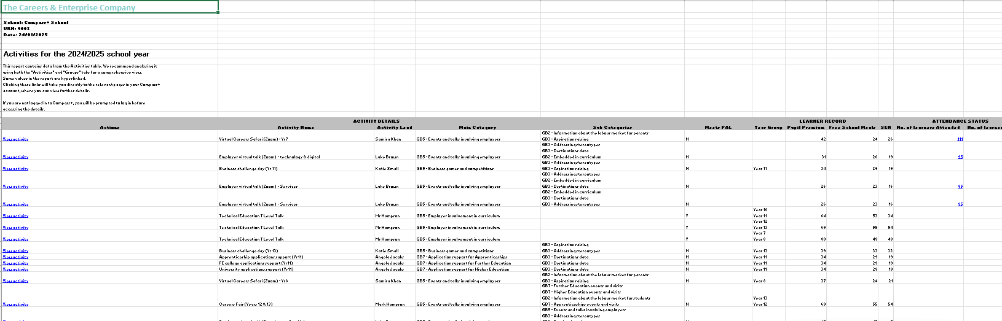
Activity Reporting in Compass +
Notes:
. Capturing activities allow tracking of attendance right down to pupil level. Useful for CLA and EHCP pupil reviews. Can se up custom groups to track maybe RON or PA pupils. HAP
Involve additional users to capture what they are doing. Set up Custom reports for groups.

Slide 13
MEANINGFUL AND VARIED ENCOUNTERS AND EXPERIENCES
The most impactful careers guidance balances the number and variety of encounters and experiences in education and work, while also providing time for young people to prepare and reflect. This principle has been recognised by expanding the definitions of ‘meaningful’ in Benchmarks 5 and 7 and adding one to Benchmark 6. The updated definitions encourage variation and flexibility in how educational institutions and employers work with young people, with a focus on ensuring the activity has a real impact and benefits their decision-making.
Planning encounters and experiences as part of a progressive and sequenced careers program for each student will also help ensure the greatest impact.
That encounters should offer young people the opportunity to experience what study or work is truly like in that setting:
The recruitment and application process.
Importance of sharing the purpose of the activity with all involved parties.
The activity is underpinned by learning outcomes.
Promoting two-way interaction between young people and employers or education institutions.
Supporting young people to prepare for their interactions and reflect on what they have learned.
For a meaningful workplace experience, the importance of students being assigned tasks by the employer and receiving feedback on their work has also been highlighted.

Slide 14
Support:
Enterprise Advisors Network
Teacher Encounters to build knowledge and Contacts
Skills Pledge supporters
Industry Days.
Teen Tech

Slide 15
Michelle Fox- Employer Engagement Enterprise Coordinator
What is Employer Engagement
EA Recruitment
Work Ready Lancashire
Cornerstone Group

Slide 16
Work Experience Project Officer
Introducing a new role with the Lancashire Careers Hub & a new team member, Lisa Struthers.
The introduction of this new role is to lead pilot projects supporting the development and implementation of innovative approaches to work experience with a particular focus on Health and Social Care and Advanced Manufacturing.
I have a background in Health & Social Care and working for Lancashire & South Cumbria Social Care Training hub working along side the Lancashire & South Cumbria Integrated Care Board and the NHS Careers North West Team.
Contact: Lisa.Struthers@inspira.org.uk

Slide 17

Key features of equalex
Quality: A multi-experience model that uses learning objectives to join activity together during a young person’s time at school.
Equity: A minimum of 10 days (two weeks’ worth) of work experience - tailored days, blocked periods etc. - tracked at the learner and school level.
Flexibility: Structured to support all types of school and business, including smaller employers.
A work experience guarantee for every young person.
High quality work experience helps young people get ready for the world of work.
When integrated into a structured careers programme- as defined by the Gatsby Benchmarks, work experience:
Increases awareness of jobs and pathways.
Builds confidence in key skills.
Reduces the likelihood of a young person becoming NEET.
Notes:
Too many young people are missing out on work experience. Disadvantaged young people are more likely to miss out than others. This matters.

Slide 18
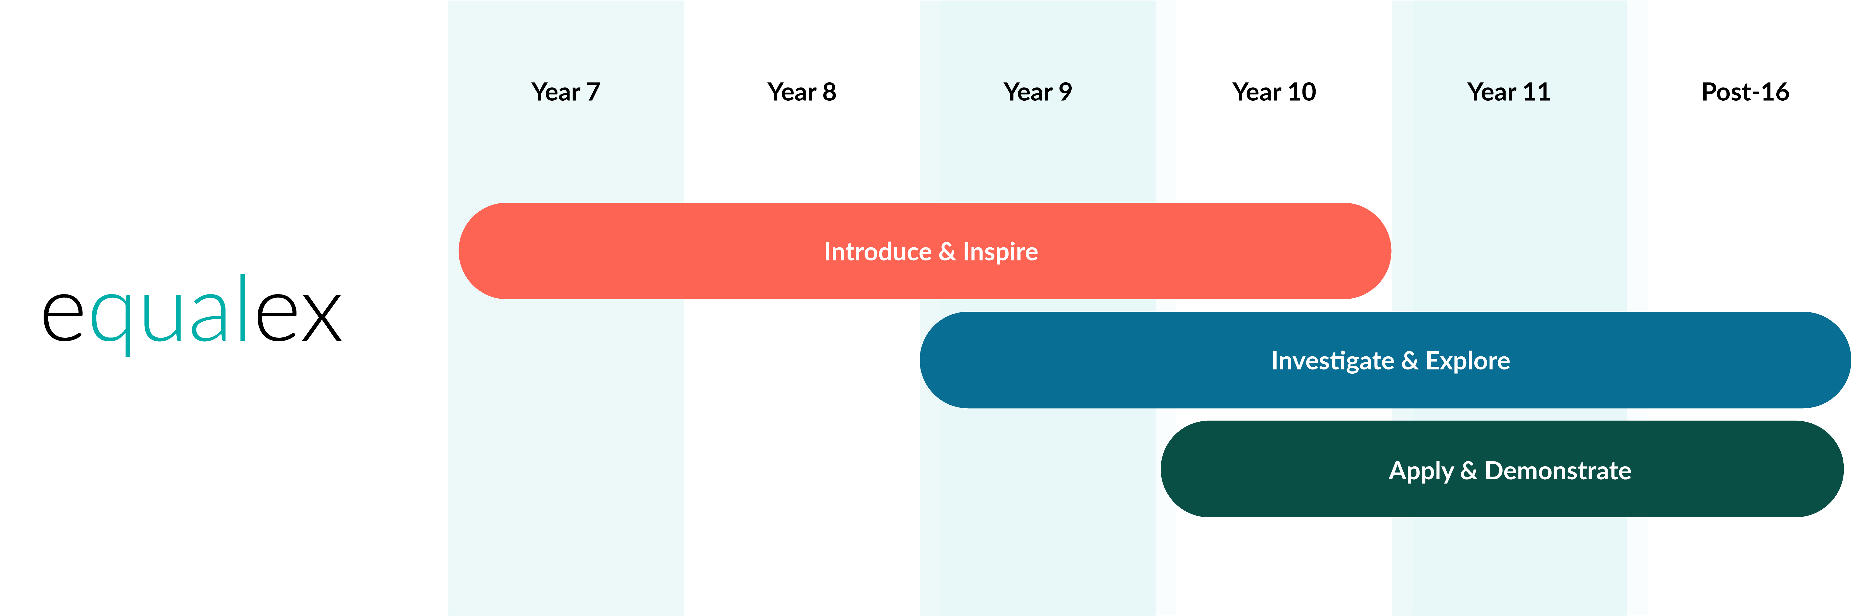
50 hours of Modern Work Experience (two-weeks worth) – a pilot with Greater Manchester Combined Authority (and elsewhere)
Notes:
Education Insight Survey to collect a national picture of the current provision.

Slide 19
What it may look like:
No of days | 2 | 3 | 5
Experience | 2 x work experience days | 3 x work experience days (One day per term, 3 different workplace experiences in smaller groups) | 1-weeks' worth with variety of experiences (Two days + three days, split over two different terms OR 1 block week )
equalex tier | 1 | 1 & 2 | 3
Learning focus | Inspiration | Explore roles & responsibilities in growth sectors | Apply skills & knowledge in the workplace

Slide 20
FOCUSING ON THE USE OF INFORMATION AND DATA
Access to high-quality, up-to-date information about further education, training options, and the labour market has always been a key component of the benchmarks.
The focus now shifts to ensuring that information sharing is inclusive, allowing young people to explore all pathways equitably. This is especially important given the recent reforms to technical education. The need to support young people and others in using this information and data to inform their decision-making is now emphasised.
Significant feedback was received regarding the resource-intensive nature of collecting destination data for three years after a young person left school. This process often prevented institutions from making effective use of the insights this data could provide.
focus has now shifted to using sustained and longer-term destination data.
Institutions are now encouraged to focus on recording and using data on young people’s participation in the careers program, as well as their aspirations,
intended destinations, and immediate next steps.
This approach will help institutions offer timely support based on individual needs and shifts the focus to current learners and recent leavers, particularly those without a secure next step, who may be at risk of becoming NEET
Notes:
Duty to track for 3 years replaced with use of sustained destinations.
Focus on intended destination and first destination on leaving.
Capturing participation data and aspiration data. More focus on the narrative from this and how it helps inform your programme.

Slide 21
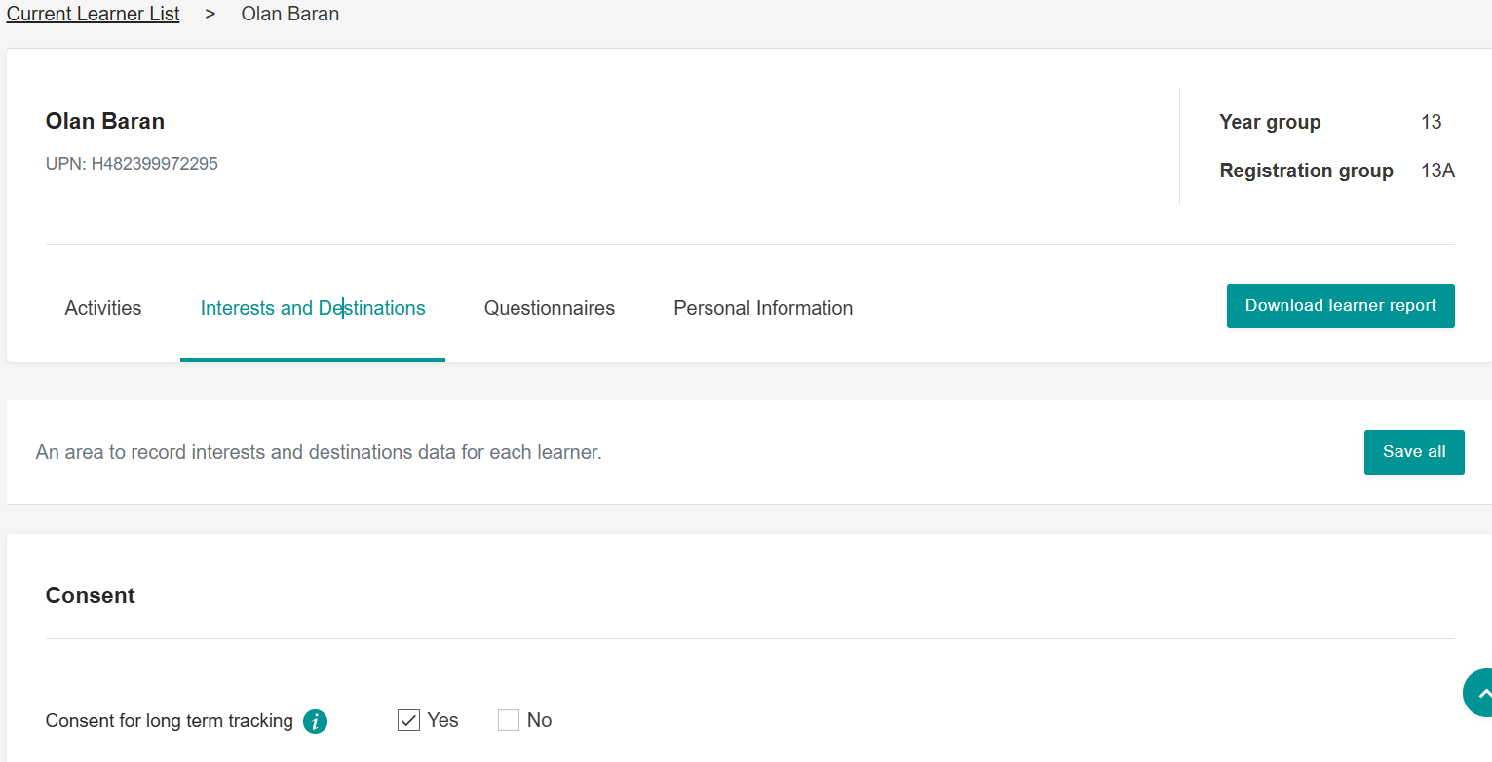
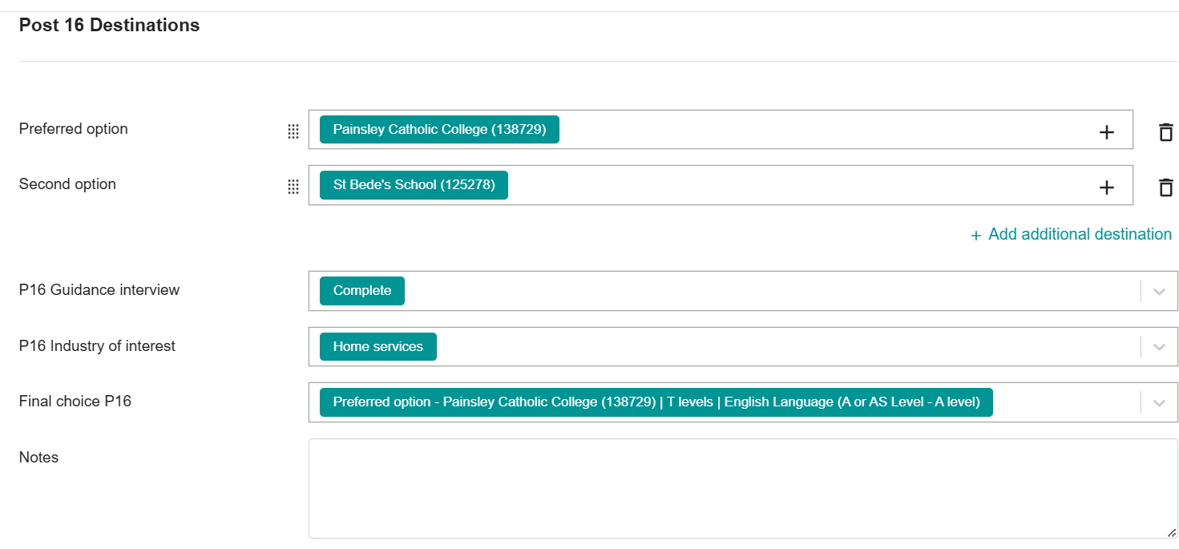
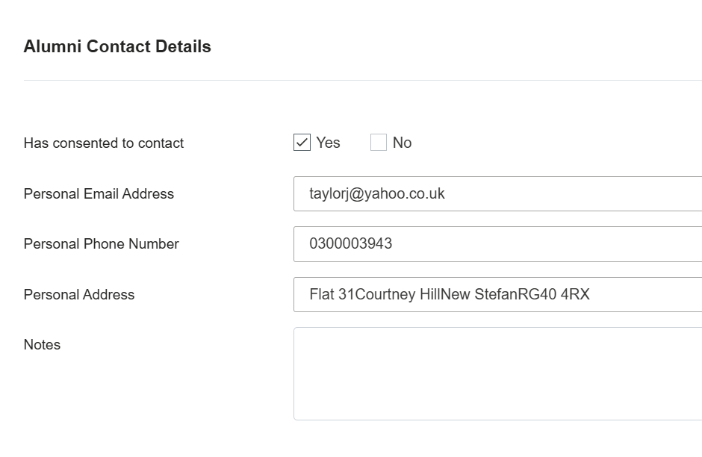
Support Available Learner Records & Reporting
Notes:
Learner records. Guidance can be captures to track. Alumni recorded.

Slide 22
ENGAGEMENT OF PARENTS AND CARERS
Parents and carers continue to play a significant role in the decision-making of their children, but they often struggle to feel confident or knowledgeable enough to fully embrace this role. Many rely on their own personal experiences or the knowledge of their social networks. It is crucial that young people receive consistent guidance about their future choices from both their educational institution and their home.
The benchmarks have been updated to strengthen the relationship between careers programs and parents and carers.
Engagement with parents and carers is now included in Benchmark 1 as part of the strategic planning of careers programs.
An emphasis on not only sharing information about education and career options with parents and carers
Also supporting them in accessing and utilising this information in conversations with their children.
Notes:
Supporting parents and carers different groups. Supporting them to access the information and being able to use it in conversations with their child.

Slide 23
Careers Hub Support
Parents and Carers are a key influence, and we want to help equip Career Leaders to support them. Ensuring that influence is well informed and that it contributes in a positive way to what your programme is looking to achieve.
Parental Engagement Modules
Using the Talking Futures resource

Slide 24
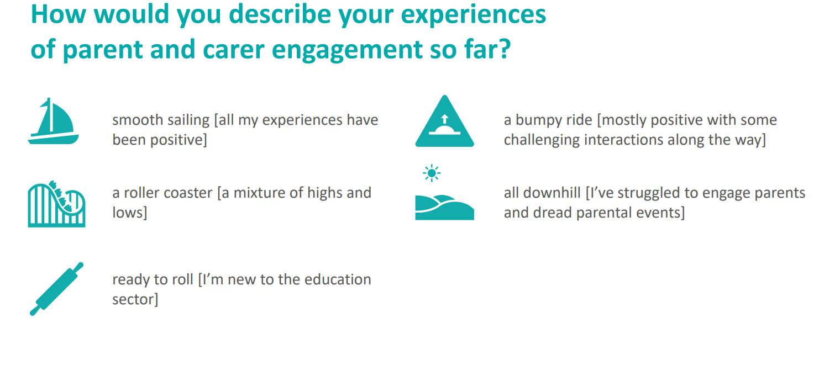
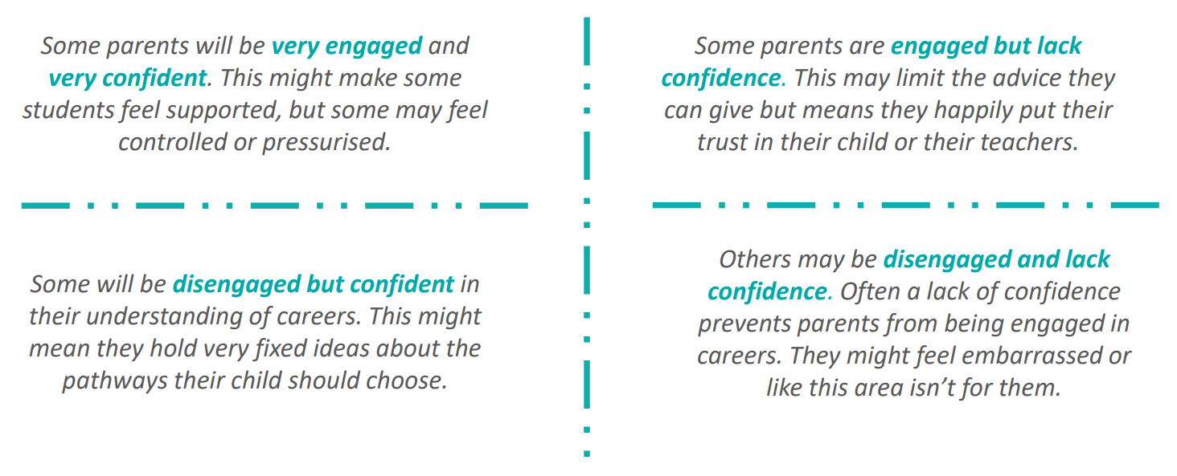
Notes:
Talking futures resource.

Slide 25
CEC Support Available:
Resources for this month, to help you engage parents and carers in apprenticeships and technical education (ATE).
1️⃣ If you have 5 minutes... Get inspired by watching one of our new video resources for parents and carers to help them gain a better understanding of ATE pathways.
🔗 https://bit.ly/49PxbyE
2️⃣ If you have 30 minutes... Read the accompanying guide to our new videos and consider how you could embed these resources into NationalApprenticeshipWeek and beyond.
🔗 https://bit.ly/3P7W4fM
3️⃣ If you have more than one hour... Consider what parents need to know, understand and be able to do to support their child at each stage of their careers learning journey and use one of our parent/carer journey templates to help you map out the available support.
🔗 https://bit.ly/407ohIL
Notes:
Recent links shared by CEC to support parent knowledge Apprenticeship and Technical Education pathways.

Slide 26

The Careers & Enterprise Academy
This new and improved digital platform is for Career Leaders and all those who work with them to plan and deliver strategic, progressive career programmes.
For Careers Leaders, bespoke learning content is available to build foundational knowledge, then develop deeper skills including learning how to effectively engage parents/carers and using our digital tools to drive impact
For Education Leaders, Governors, SENCOs or the wider teaching workforce, tailored content is available to help everyone effectively play their part in helping young people find their best next step
For previous users of our Digital Hub ‘schools, special schools, colleges and ITPs track’ the same courses will be available on The Careers & Enterprise Academy, plus two NEW courses:
  Understanding the updates to the Gatsby Benchmarks
  Understanding the Careers Impact internal leadership review
Any courses previously completed on the Digital Hub will be shown on The Careers & Enterprise Academy.
With our single sign-on, users can easily switch between the new platform and their account on Compass+/Compass, meaning they will only need to log in once.
From now until September 2025, the site will regularly be updated with extra features to help prepare for the new academic year, and users will be updated about these developments.
To access The Careers & Enterprise Academy, find out more on our website.
Notes:
New Replacing the CEC Digital hub for CL if you;ve accessed that previously. You register with your Compass log in so easy to switch between it will link to resources suggested. Will be updated to support areas of focus.

Slide 27
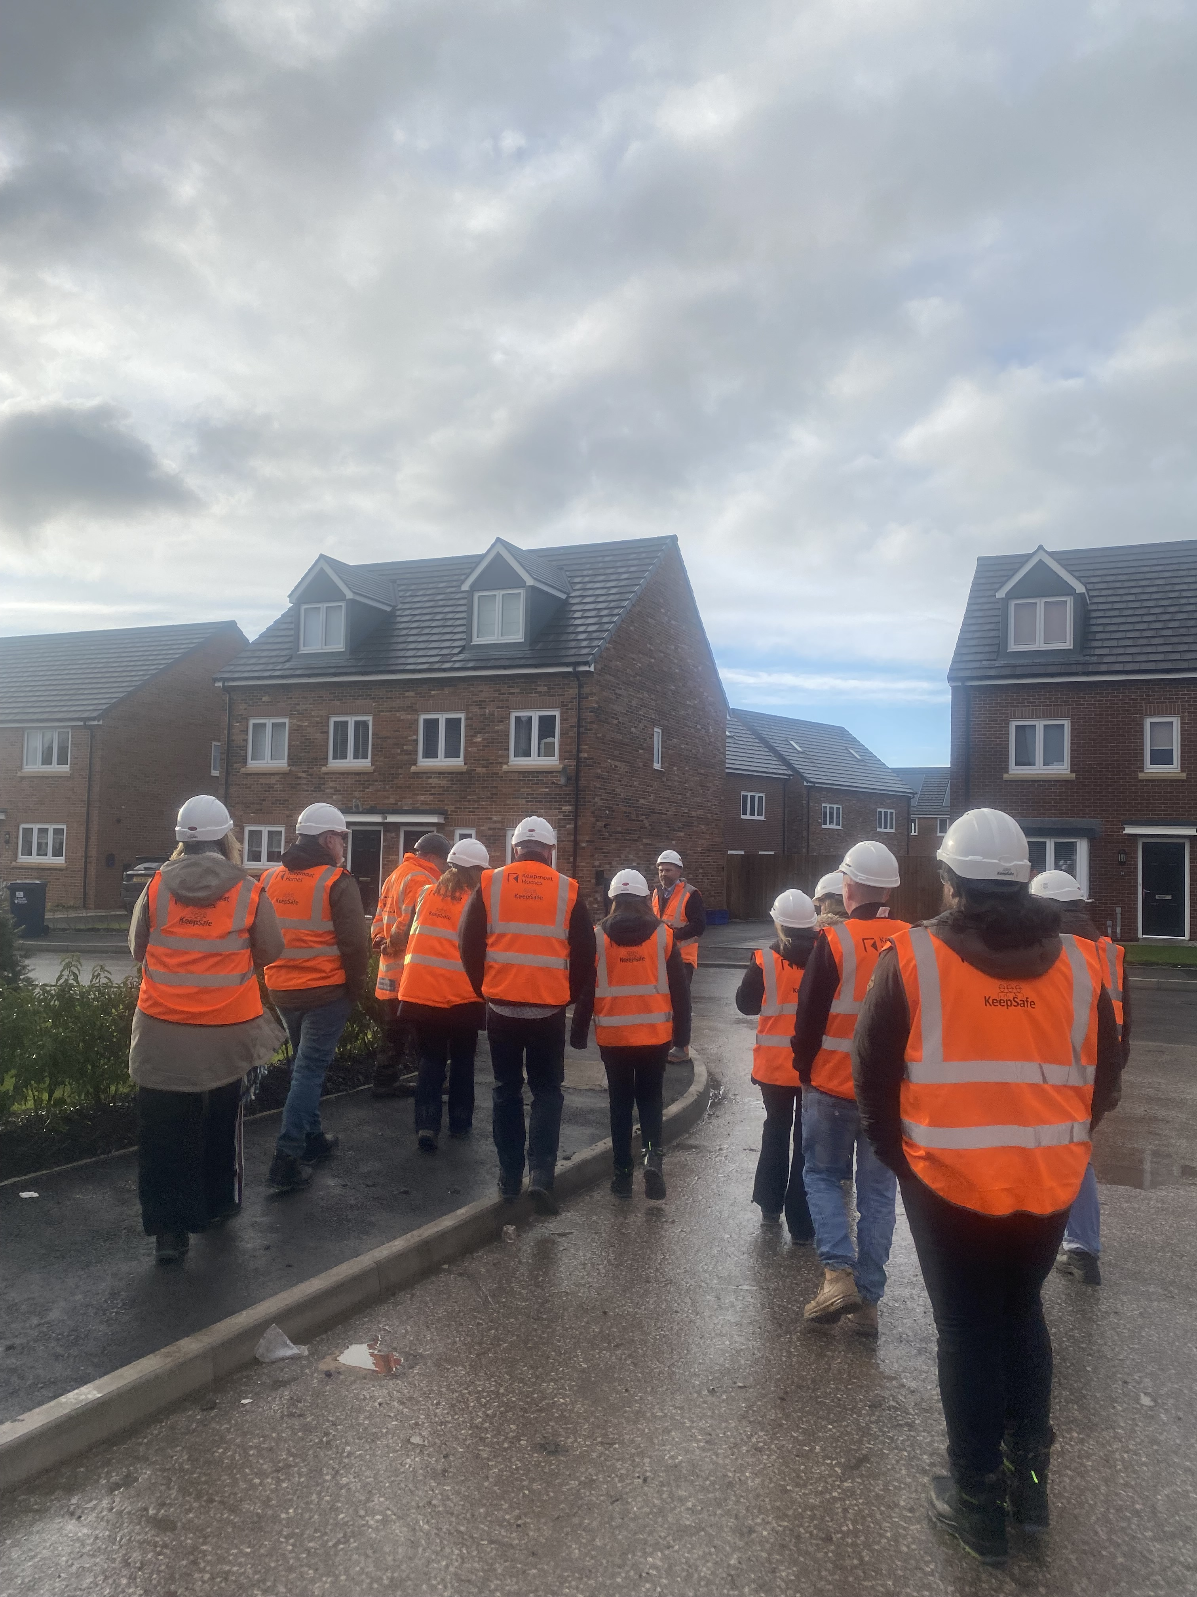
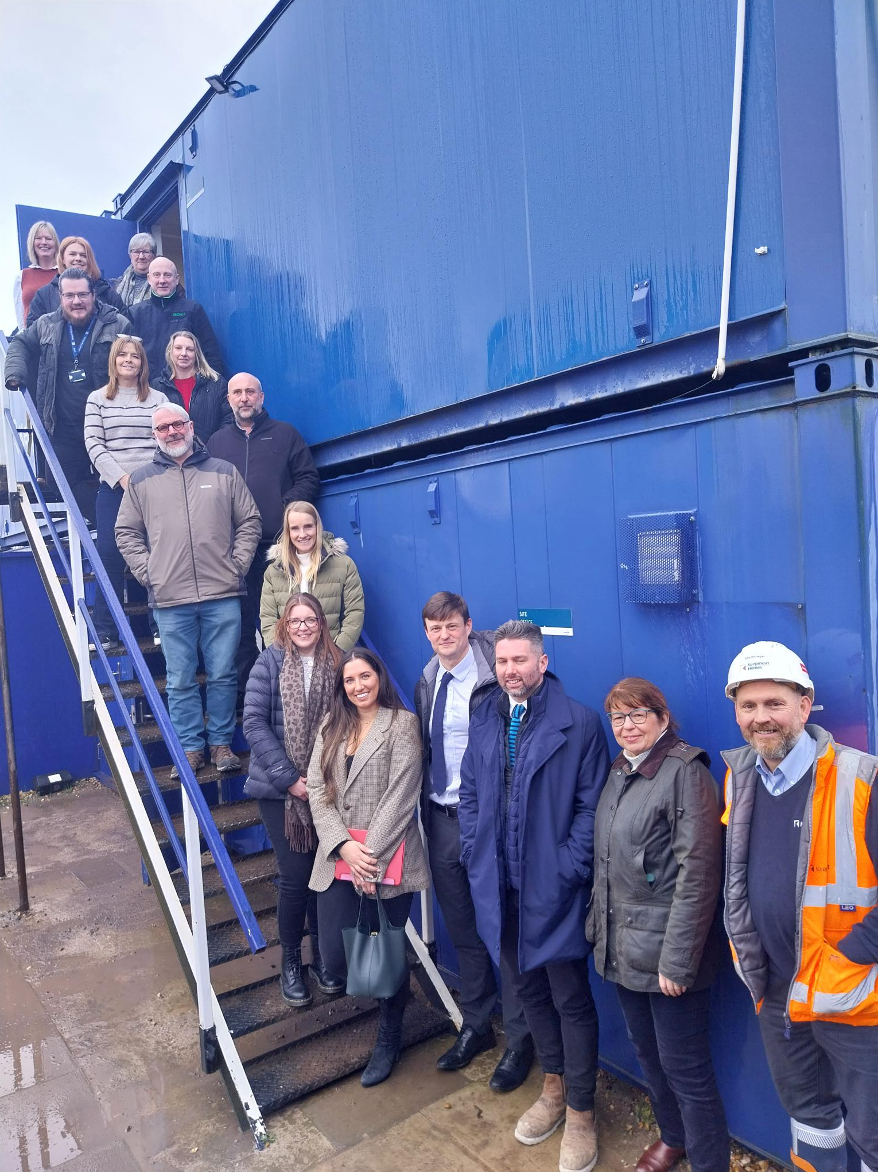
Teacher Encounters
VISIT TO JAMES PLACES (Clitheroe) on Monday 24th February 2025 from 9.30-12pm
Learn about opportunities in the HOSPITALITY and LEISURE SECTOR
James Places are a group of hospitality businesses in the Ribble Valley, Yorkshire Dales and South Lakes which includes 5 wedding venues, dining and hotel venues such as Holmes Mill, Mitton Hall and Waddington Arms. They even have their own brewery - Bowland Brewery. They employ people in all aspects of the hospitality and leisure sector from Housekeeping, Wedding and Events Coordinators, Chefs and Front of House.
REGISTER HERE
VISIT TO LANCASHIRE COUNTY COUNCIL (COUNTY HALL, PRESTON) on Friday 14th March 2025 from 9 - 1pm
Learn about the wide range of opportunities in a large LOCAL AUTHORITY and the PUBLIC SECTOR
From digital, artificial intelligence, environmental, social care and legal to careers in business, HR and highways the range of opportunities open to young people is vast and include routes in through Apprenticeships and Graduate programmes.
REGISTER HERE
VISIT TO VICTREX (THORNTON,CLEVELEYS) on Thursday 24th April 2025 9-12.30pm
Learn about opportunities in STEM and the POLYMERS SECTOR
Victrex are a world leader in the Polymers industry - polymer solutions are used worldwide in a vast range of products from mobile phones, aircraft and cars to medical devices. The use of Polymers has revolutionised our lives over the past 50+ years from everyday plastics and textiles to specialist high performance products used in for example aircraft. Early careers opportunities include Apprenticeships and Graduate schemes for roles as a Scientist, Development Engineer, Technologist, Project Management and Business Administration.
REGISTER HERE
Notes:
Teacher Encounters more will be added. Keepmoat was last week and feedback was great. Ideal opportunity to involve wider staff and build their knowledge.

