Slide 1

Karen Hodgson
HLTA & Careers Leader at Bleasdale School
Bleasdale School is a generic special school catering for children and young adults with PMLD, SLD and or ASC.

Slide 2
Innovative Workplaces:
Bleasdale School’s hairdressing salon
&
hospital room

Slide 3
Our Core Aims and Values:
We place students at the heart of everything we do.
We prioritise inquiry and reflection as essential aspects of our practice.
We provide a curriculum designed to prepare our pupils for adulthood.
We offer person-centered learning tailored to each pupil’s individual needs.
We equip learners with the skills needed to maximise their full potential, both now and in the future.
All learners at Bleasdale School have access to a careers programme depending on their curriculum pathway, this is through our Citizenship and Employment curriculum, which is underpinned by the Preparing for Adulthood Framework.
I would like to share a short video with you which explains why we are developing innovative workspaces at Bleasdale School https://youtu.be/2-oiMsUIZX8

Slide 4
What was our approach and why?
As mentioned in the video, we were fortunate to receive help from Booths Supermarket a Cornerstone Employer to set up our first employment room, this is already proving to be a fantastic workplace encounter for learners as well as an area for Real World Play.
BUT we didn’t want to stop there. So, we made the decision to develop a hairdressing salon and a hospital room.
Why choose these spaces?
We asked ourselves where do our learners need to visit on a regular basis, which environments are most challenging, which environments could we reciprocate to make learning outcomes fun?
Transition to different environments can be challenging, add unfamiliar places with lots of noise, strange smells and scary pieces of equipment and it could quite easily end in disaster!
.
Our aim:
To ease anxiety for pupils, parents and carers whilst at the same time providing individualised learning and work experience sessions for those learners where appropriate to gain ‘work ready’ skills.
Then we asked how will we fund these areas?
SLT presented me with the SEND School Workplace Encounters Innovation Fund application.
Due to my bid being successful, Bleasdale Schools hairdressing salon and hospital room are now almost complete. An official opening day is planned for the beginning of July where we will invite parents/carers, governors and wider stakeholders to celebrate our innovative workspaces

Slide 5
How will these rooms help our learners to gain work ready skills?
Through the Equals schemes of work the innovative workspaces are already providing excellent opportunities for real world play and work experience which is helping to develop interest, imagination, talent and the key skills needed to enable learners to make positive choices to raise aspirations for their longer-term goals.
Our innovative employment rooms will help learners acquire these valuable life skills in various ways (depending on their pathway):
To Be (Pre formal learners)
Through sensory exploration will develop:
Independence, motor and communication skills
To Do (semi formal learners)
Will learn:
How to follow instructions via their individual communication methods, develop independence, learn how to problem solve and interact with their peers and the wider community
To Know (formal learners)
Will gain:
Valuable work experience whilst learning how to develop their social interaction and communication skills,
Learn to follow instructions,
Develop functional skills – meaning of money, coin recognition and exchanging of money
The development of ICT skills.

Slide 6
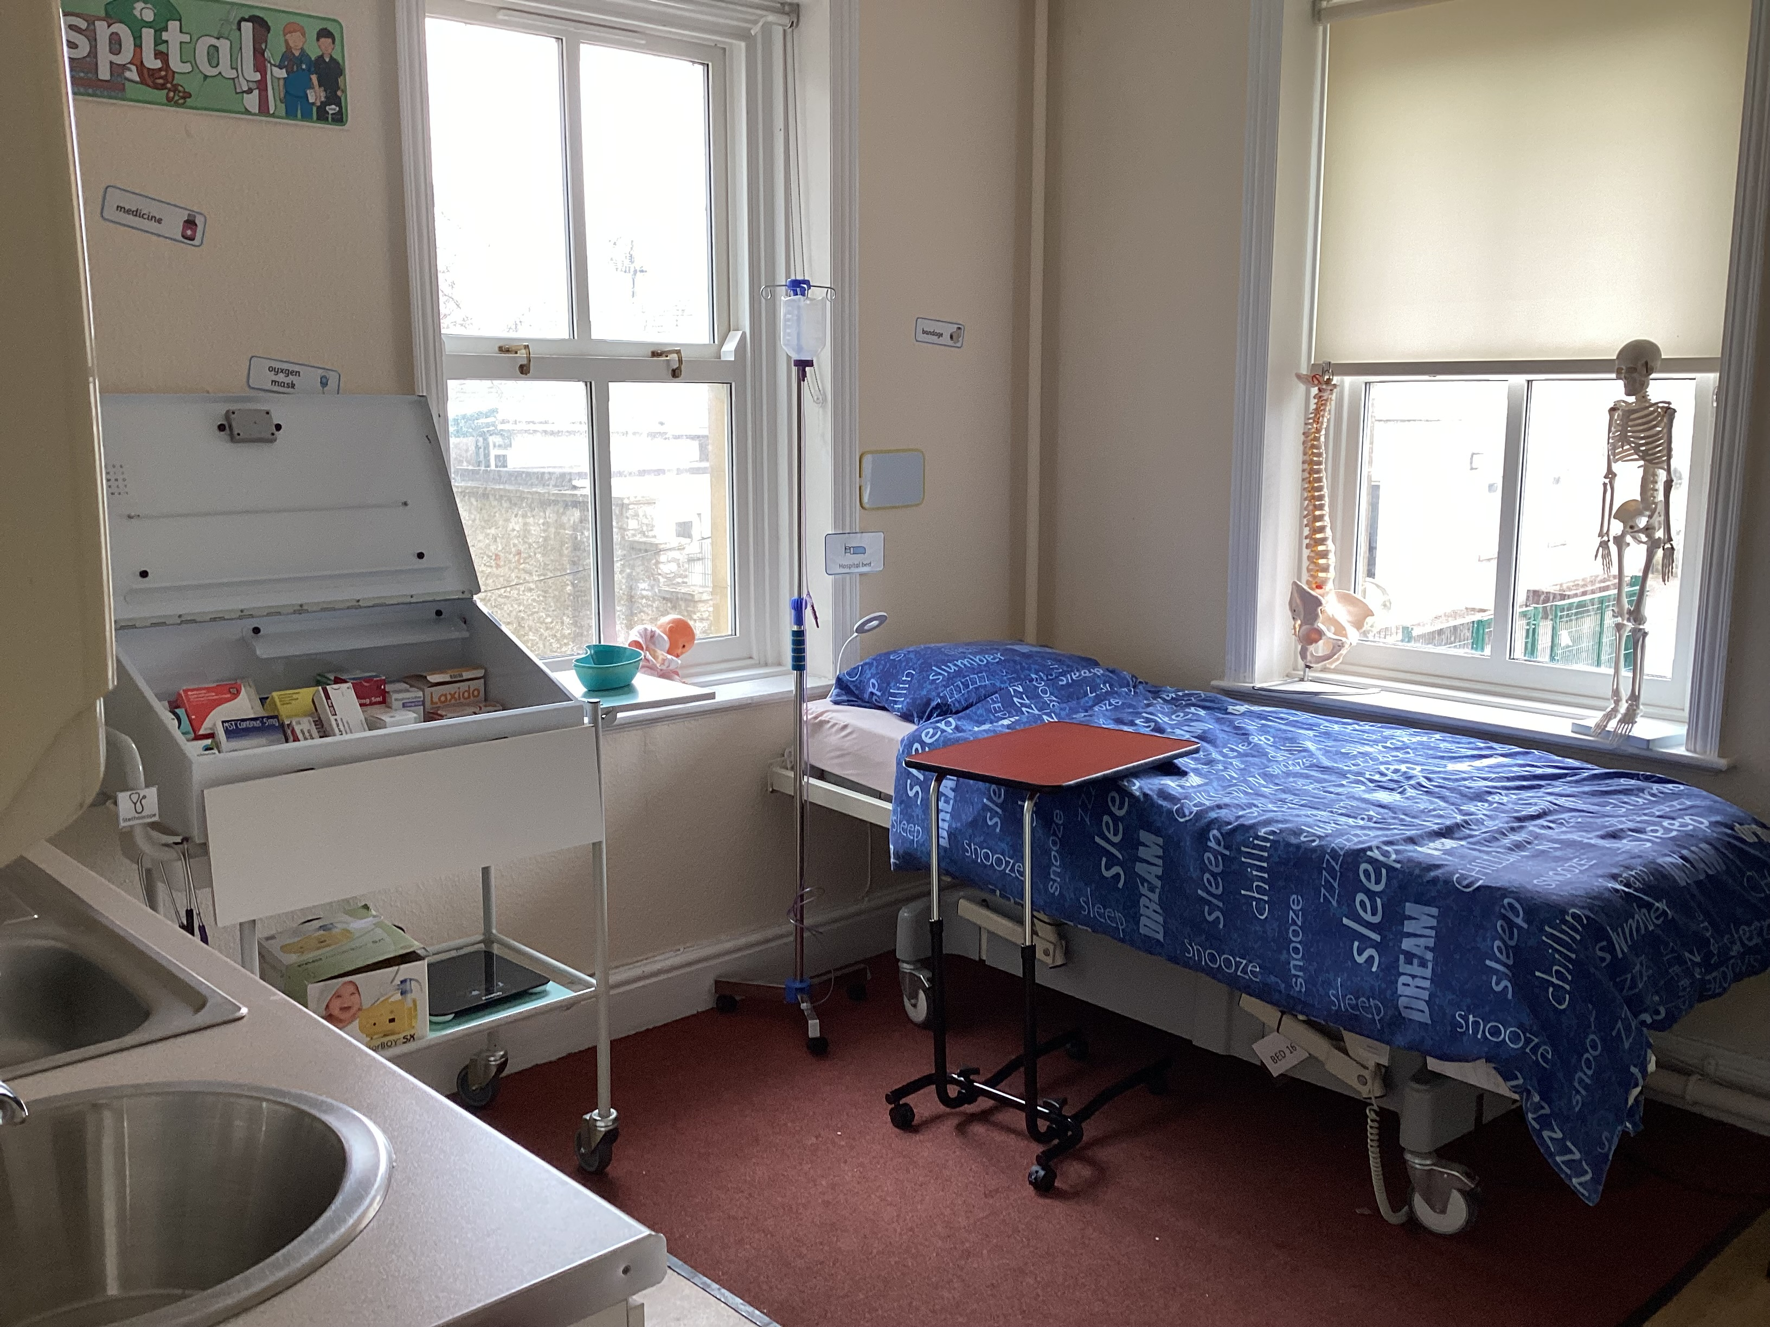
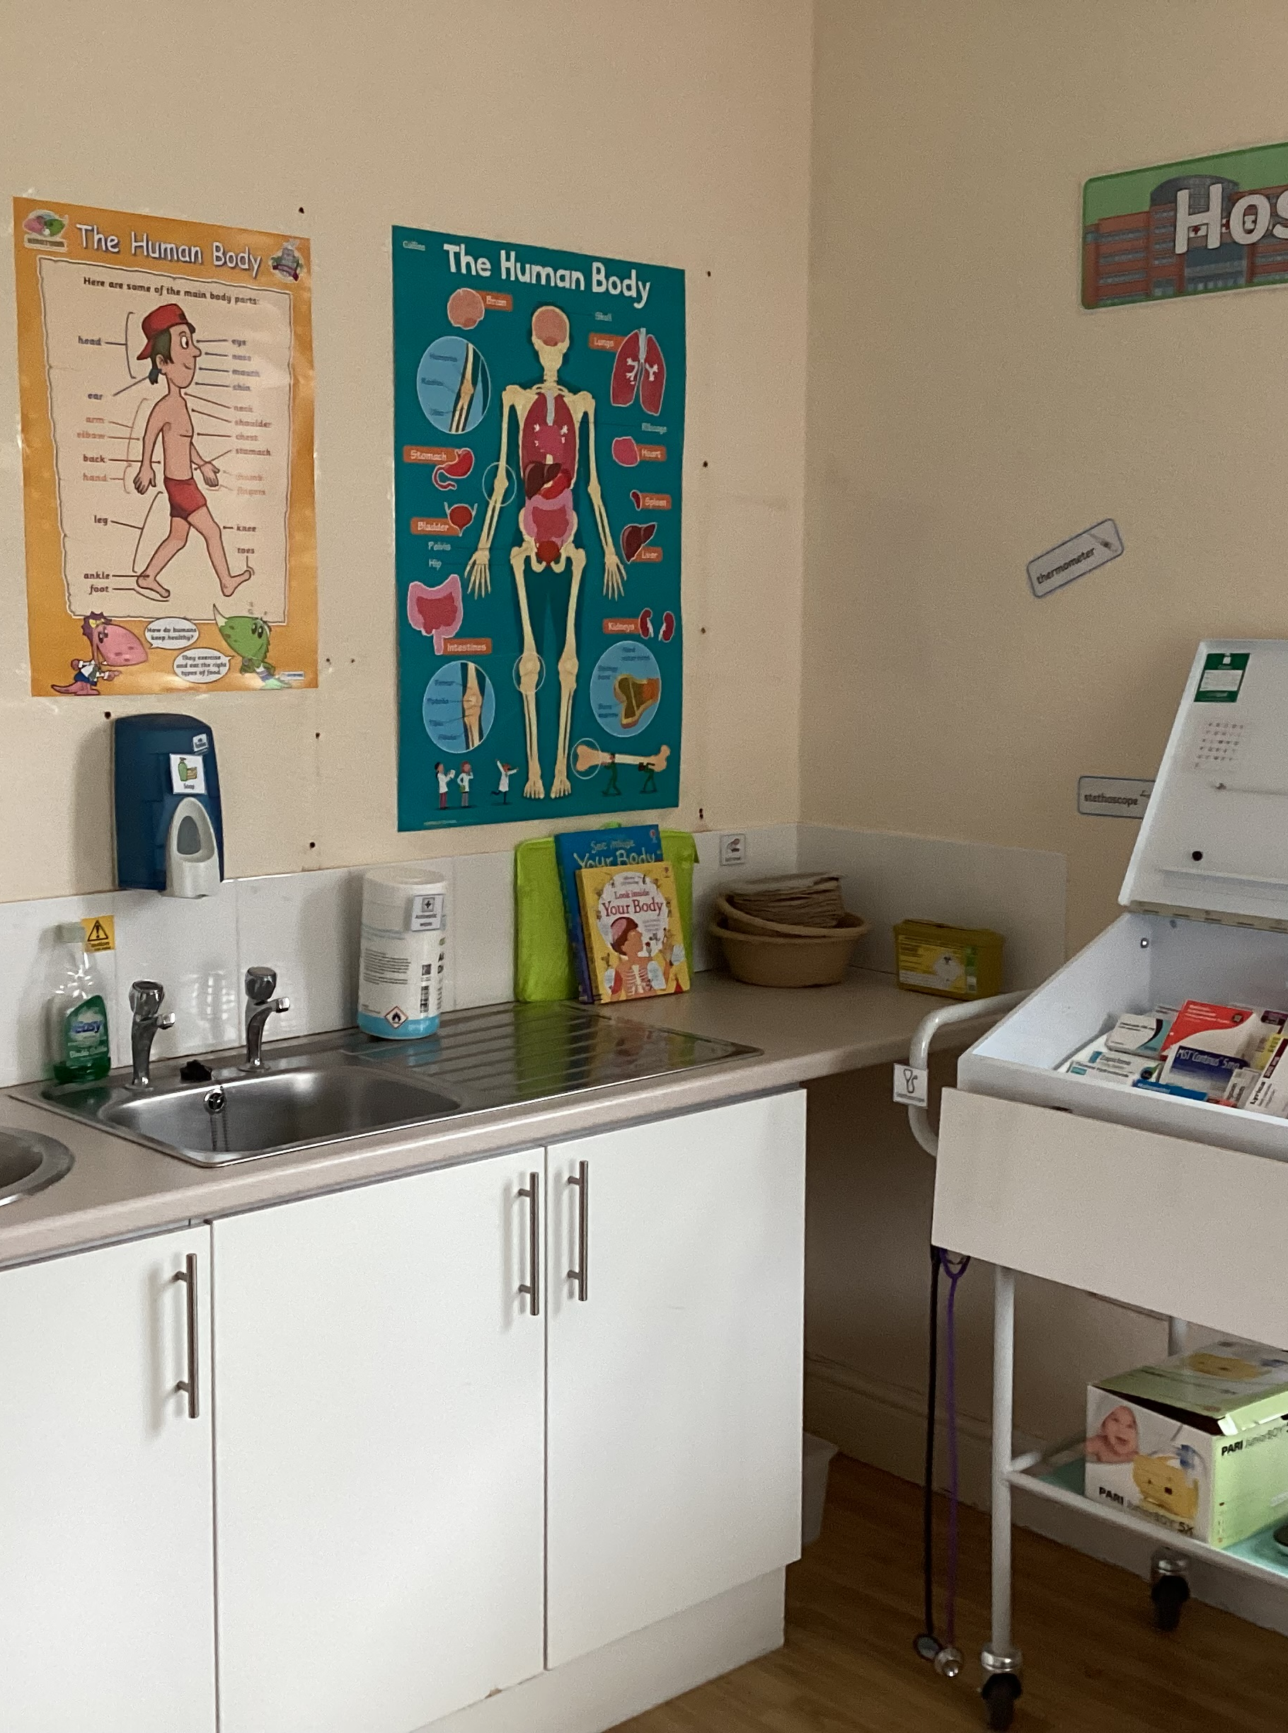
Hospital room

Slide 7
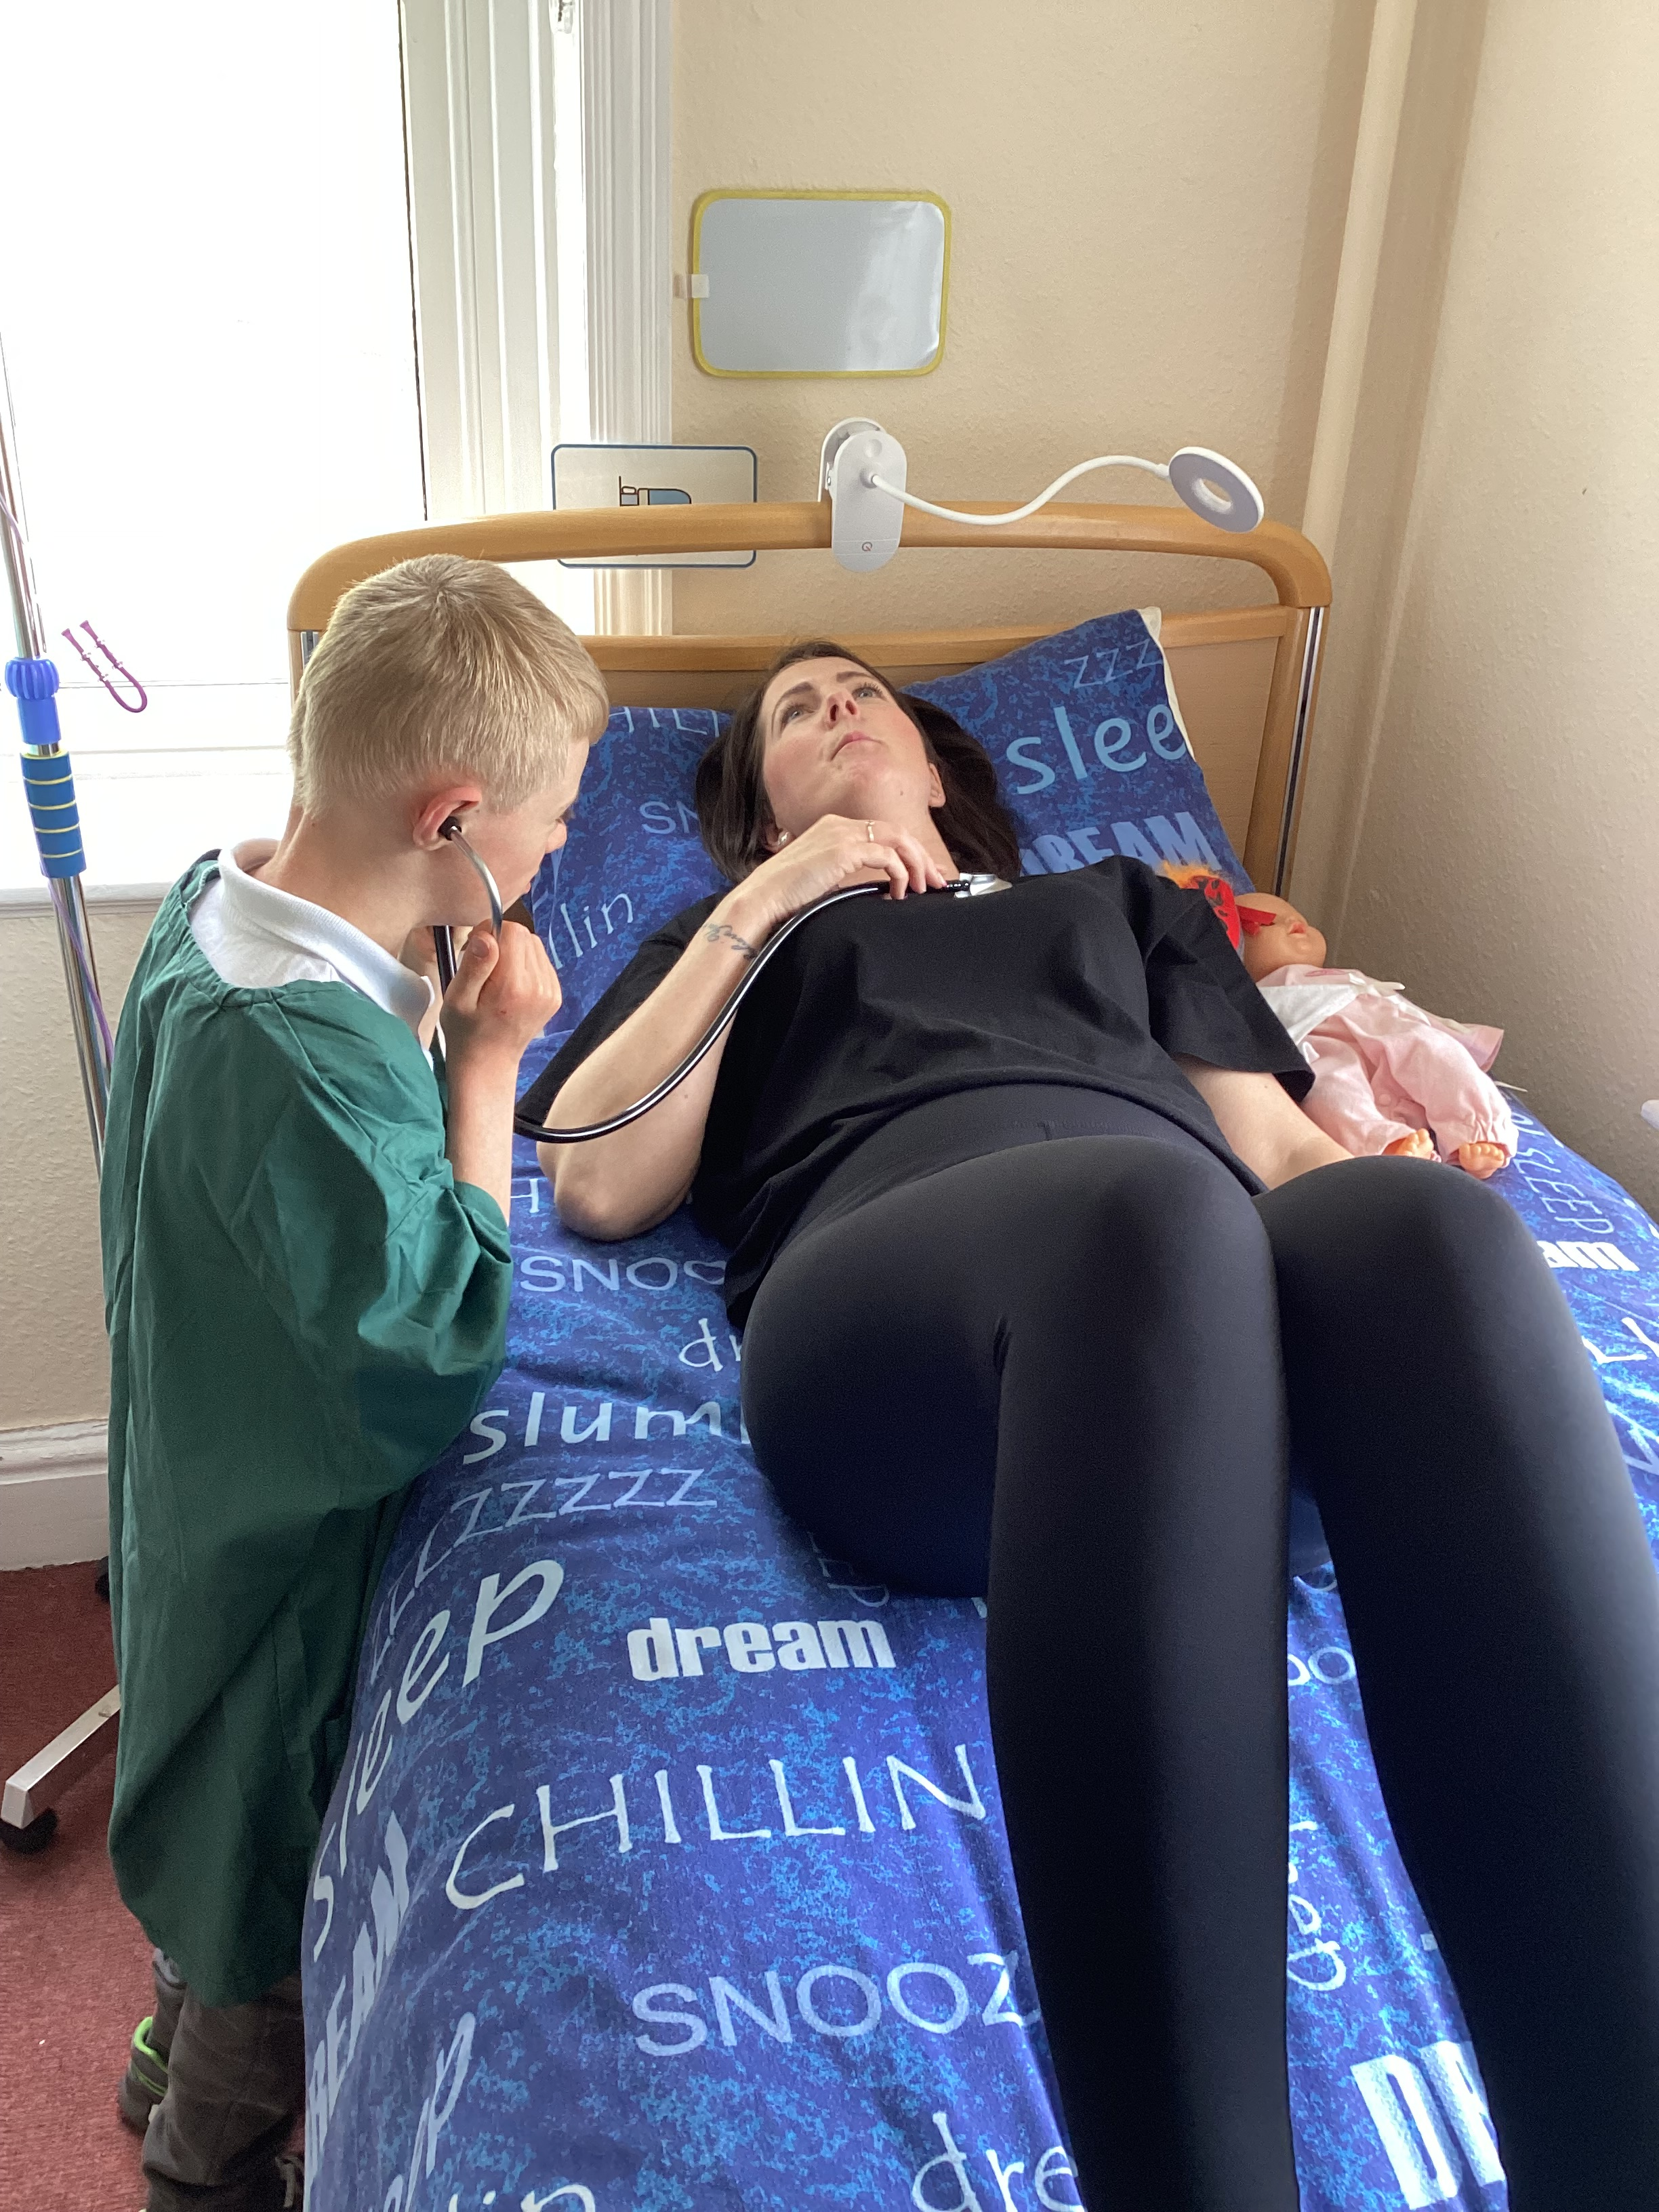
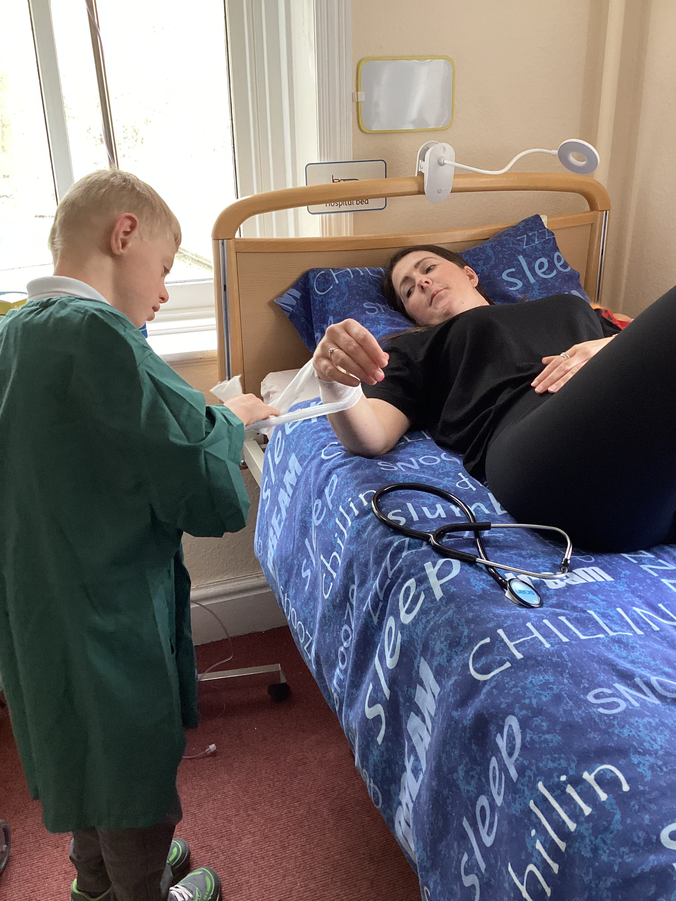
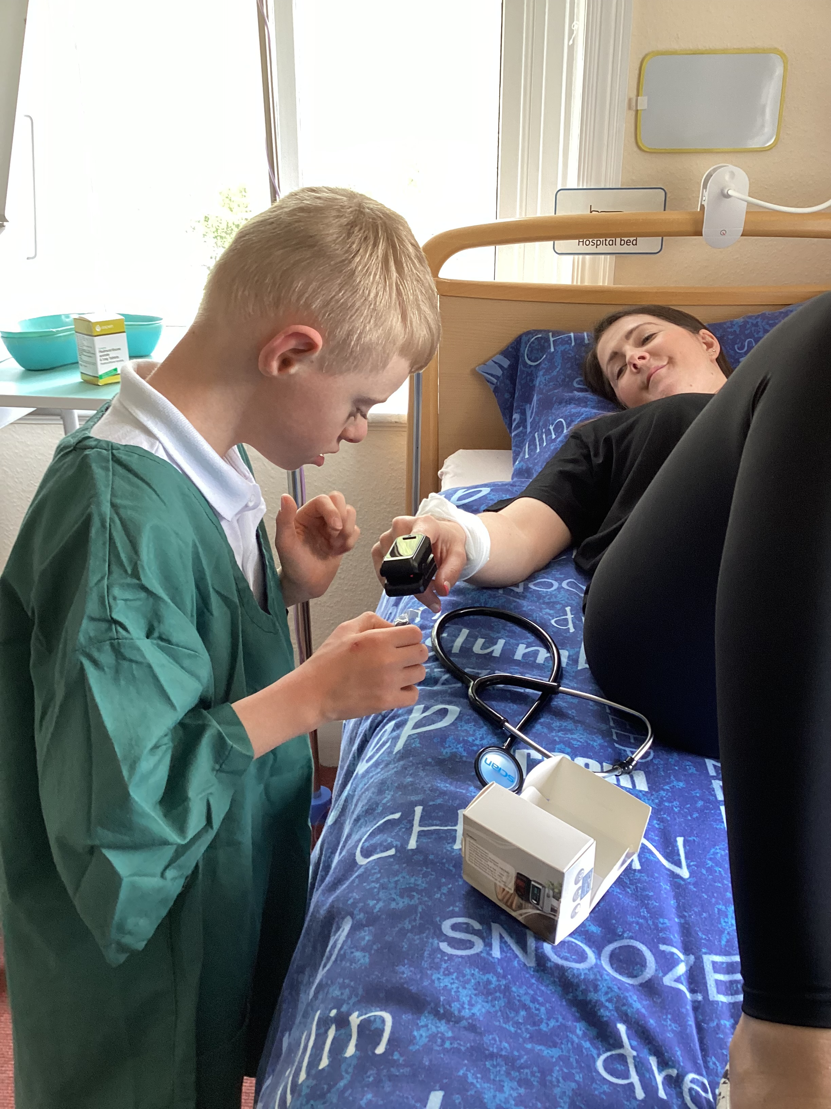

Slide 8
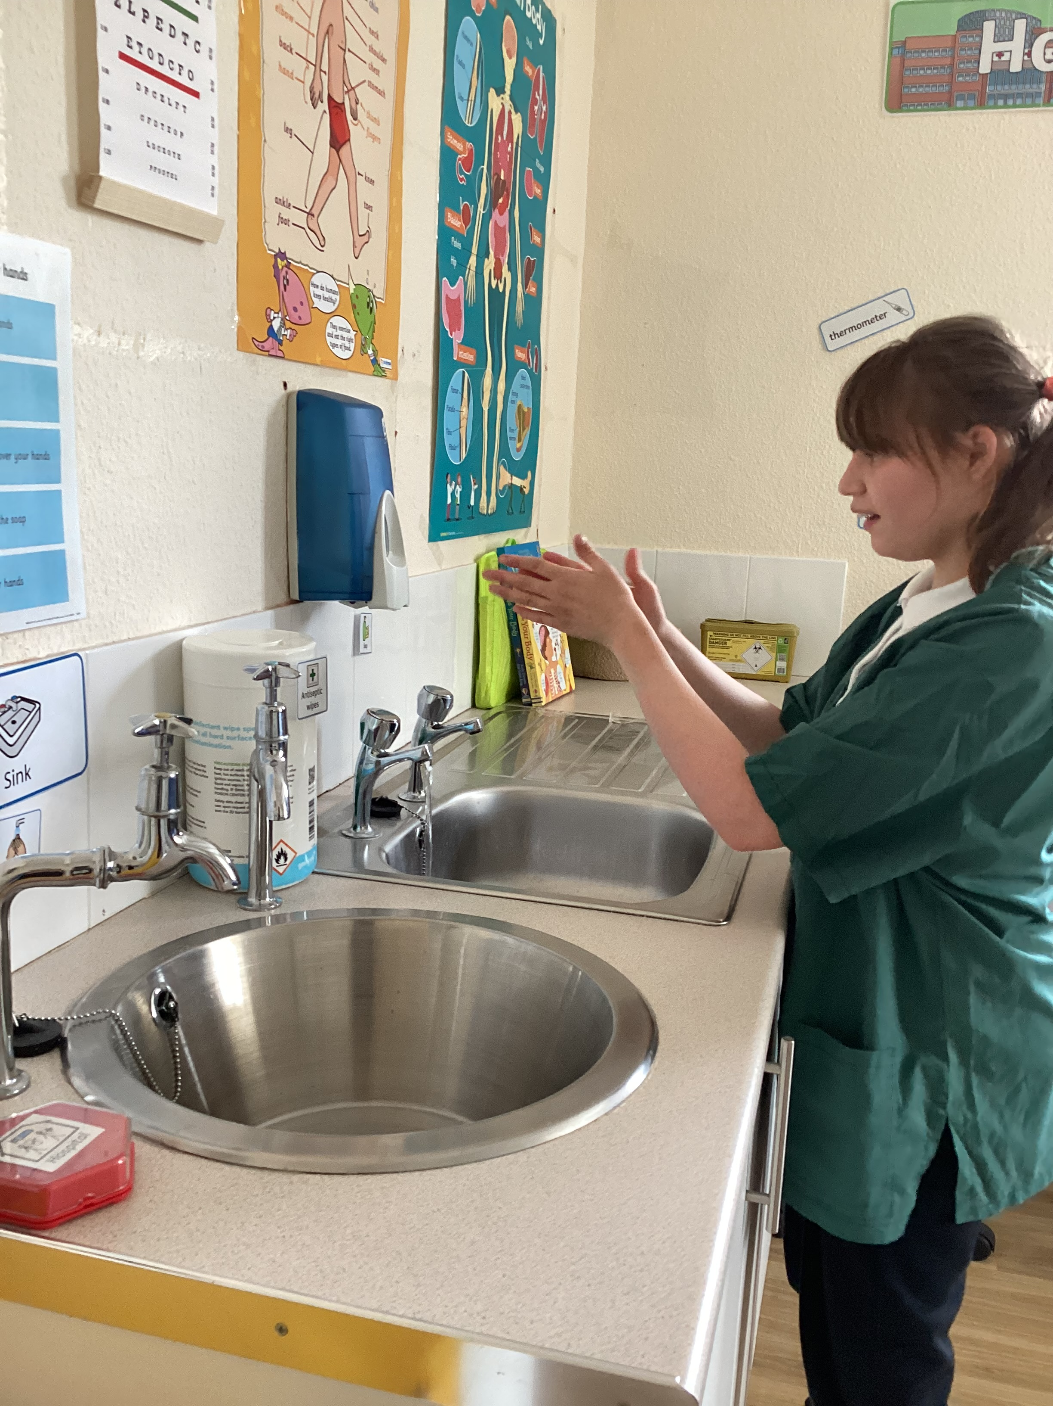
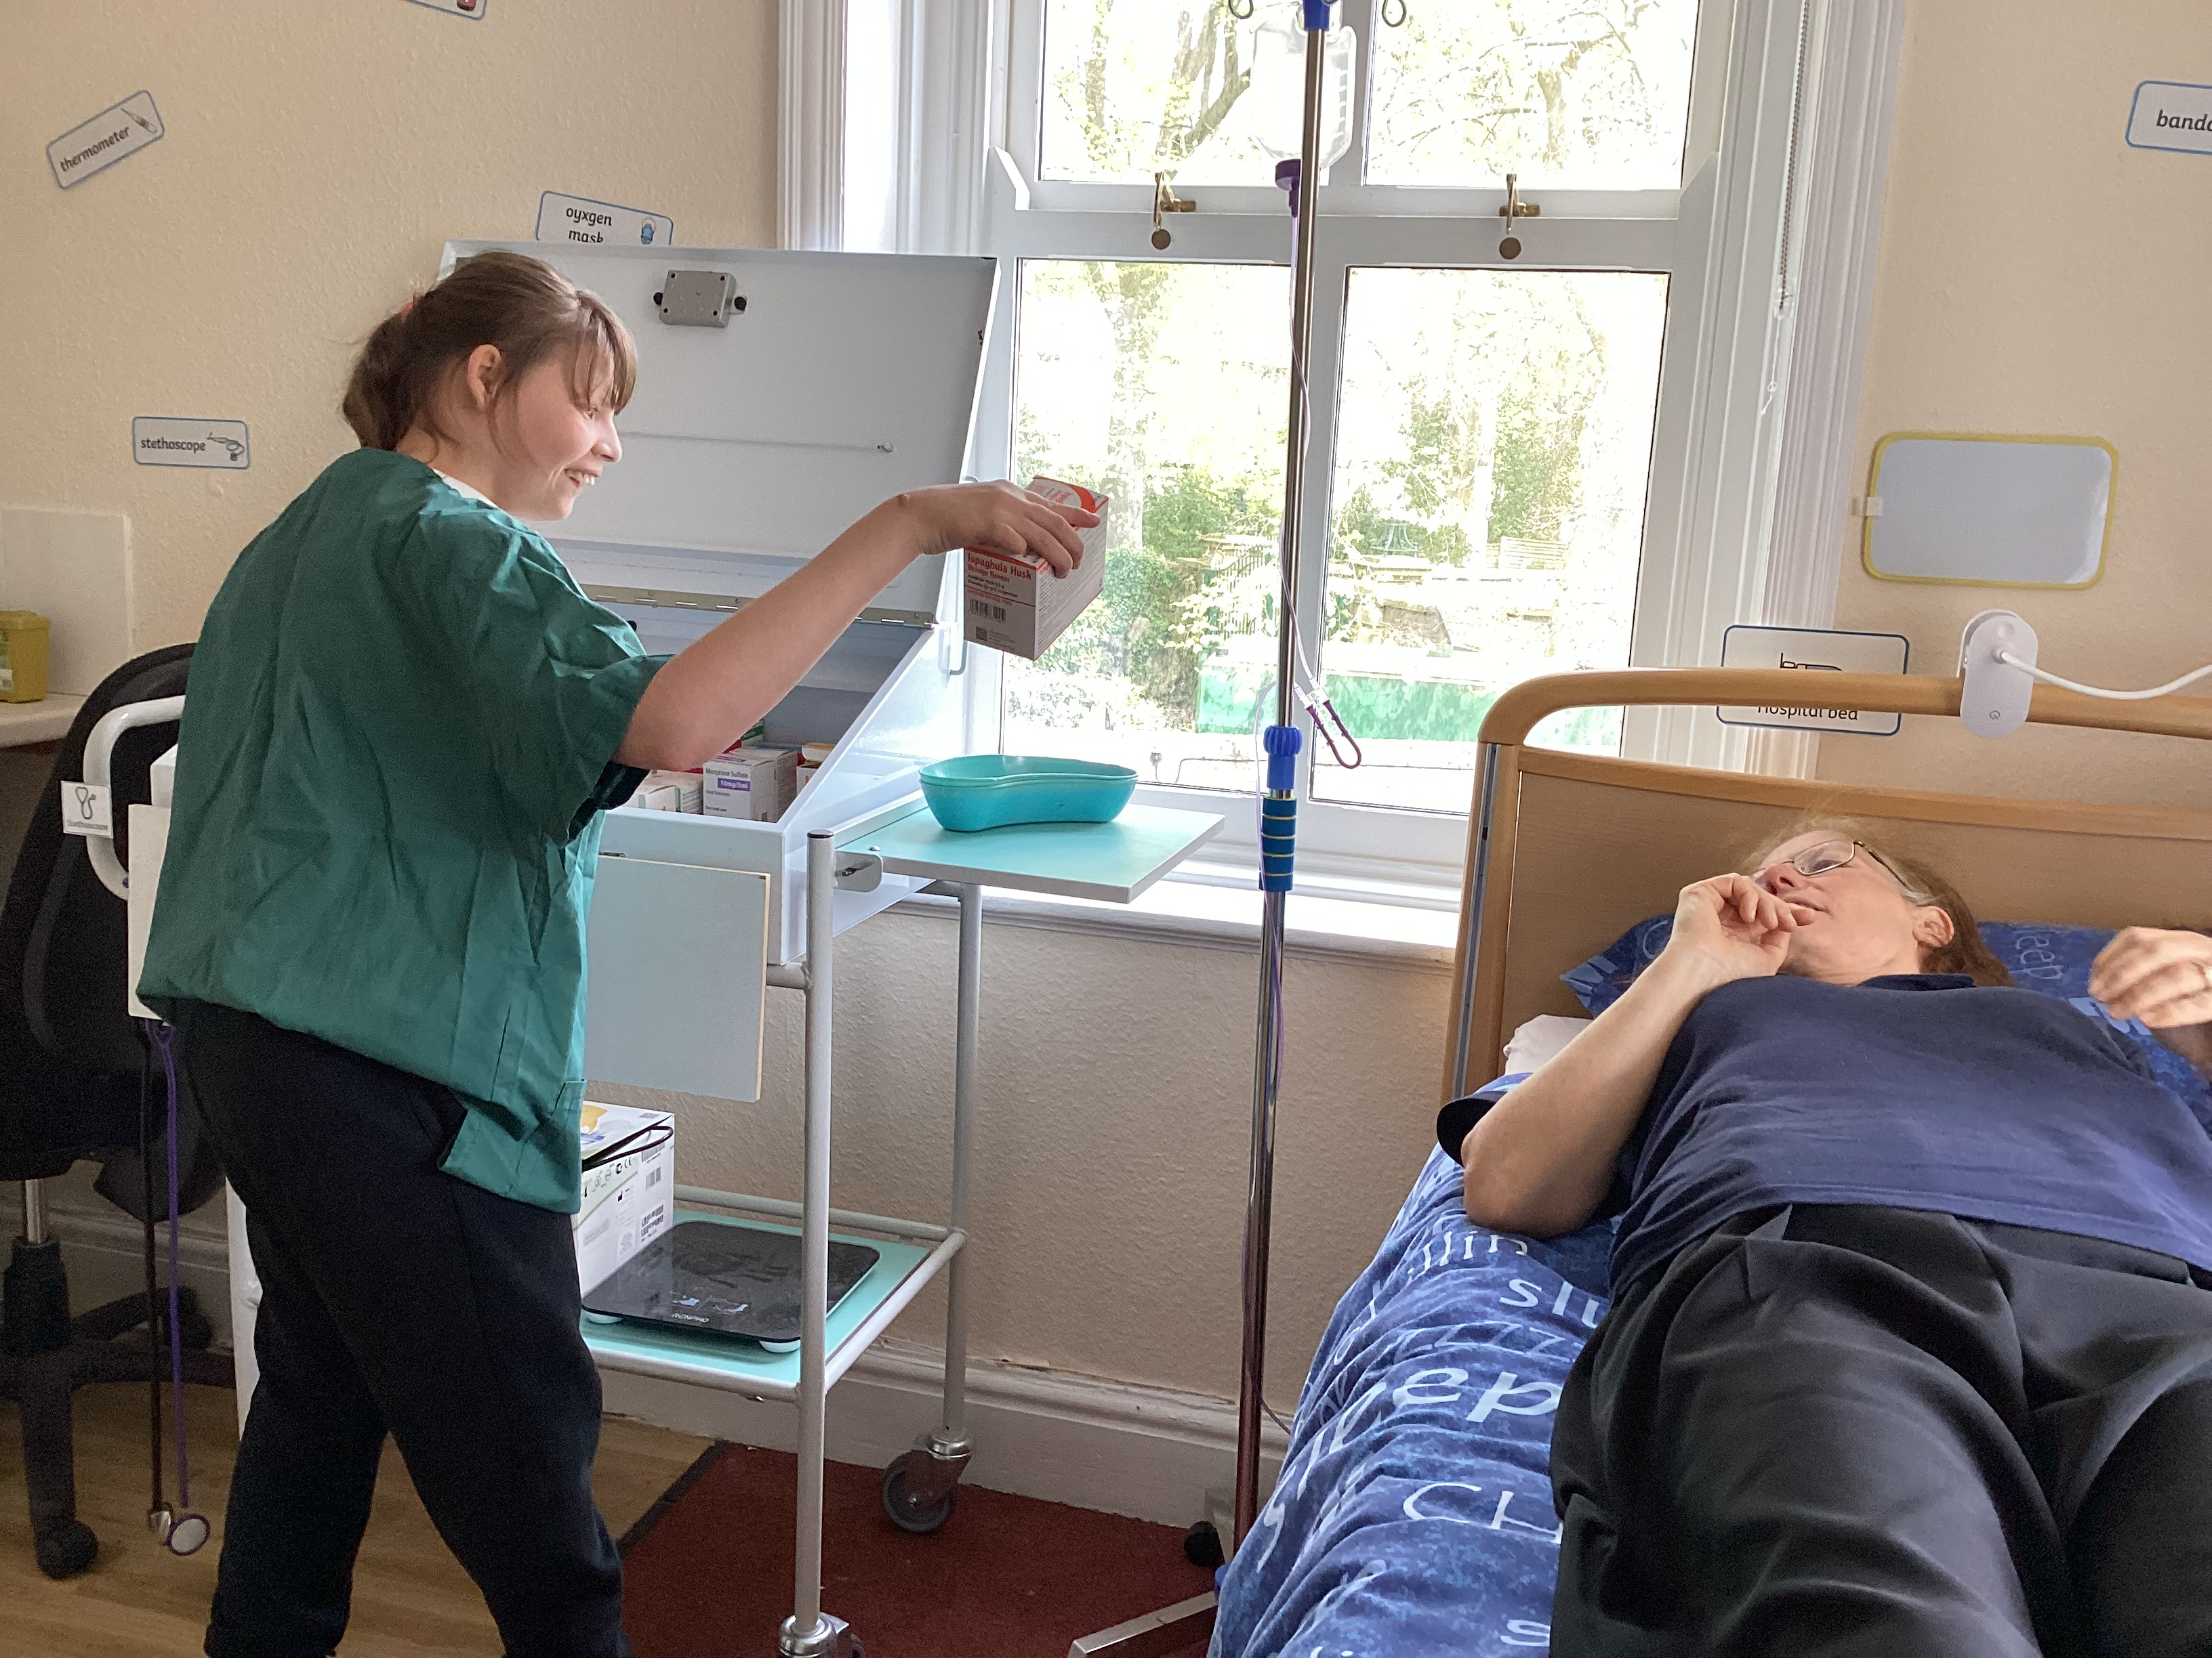
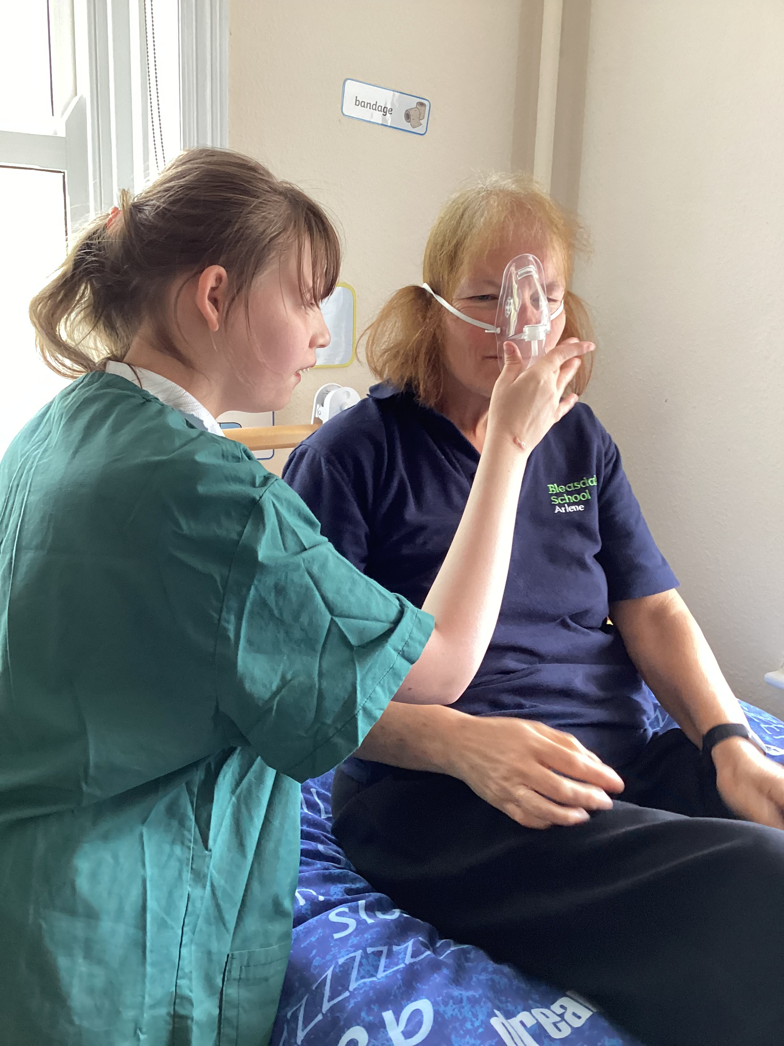

Slide 9
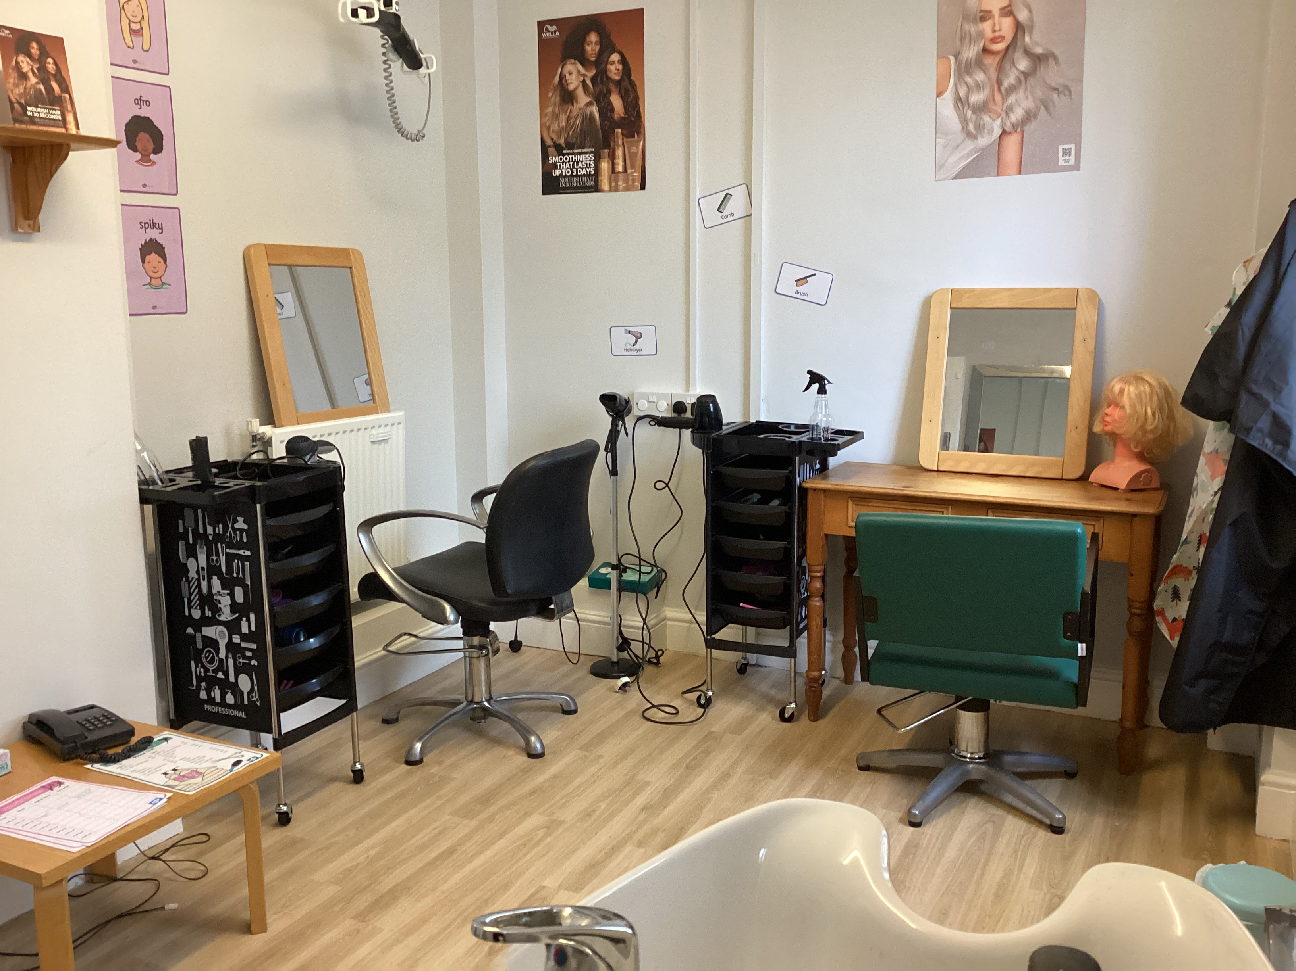
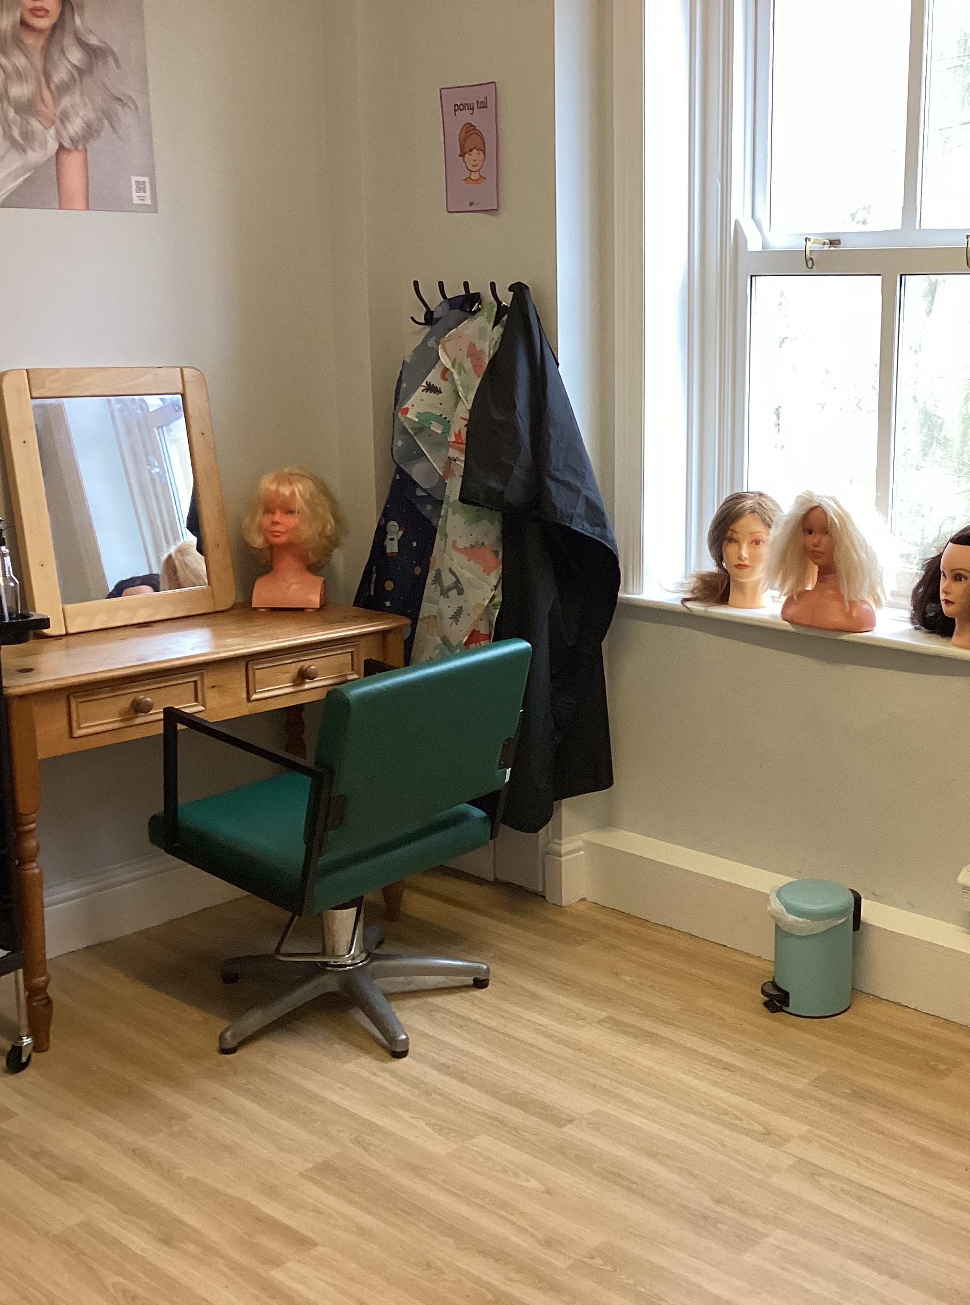
Hairdressing salon

Slide 10
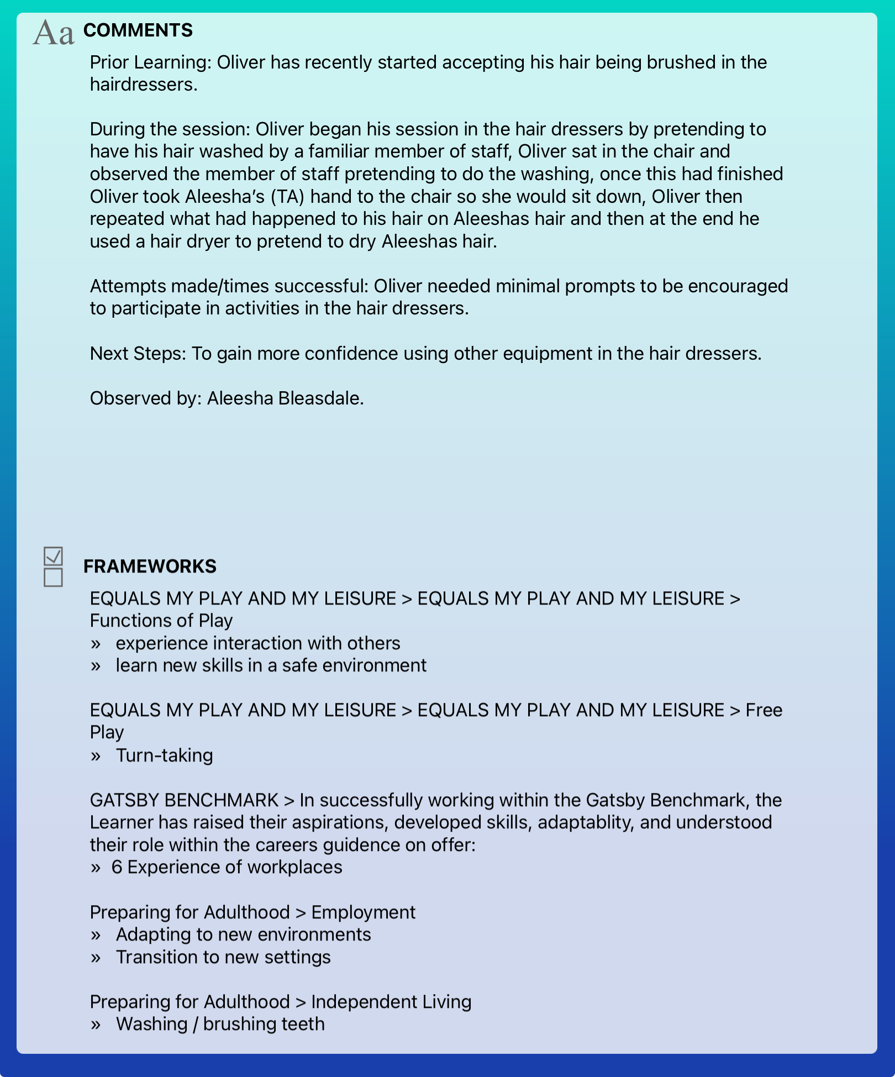
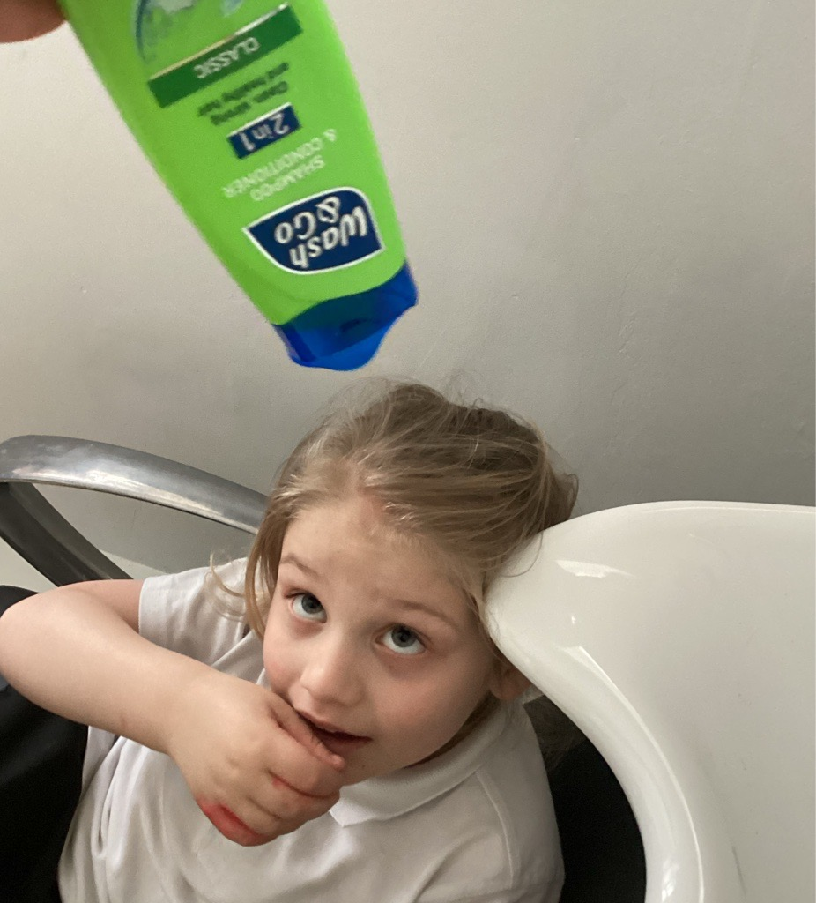
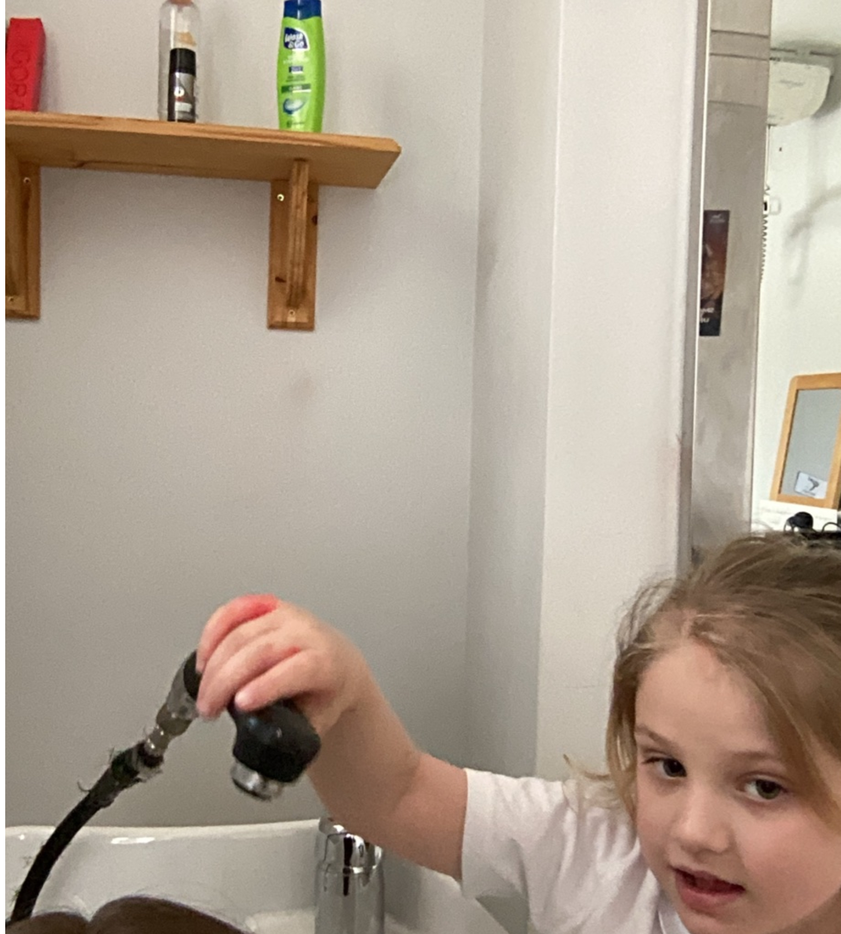

Slide 11
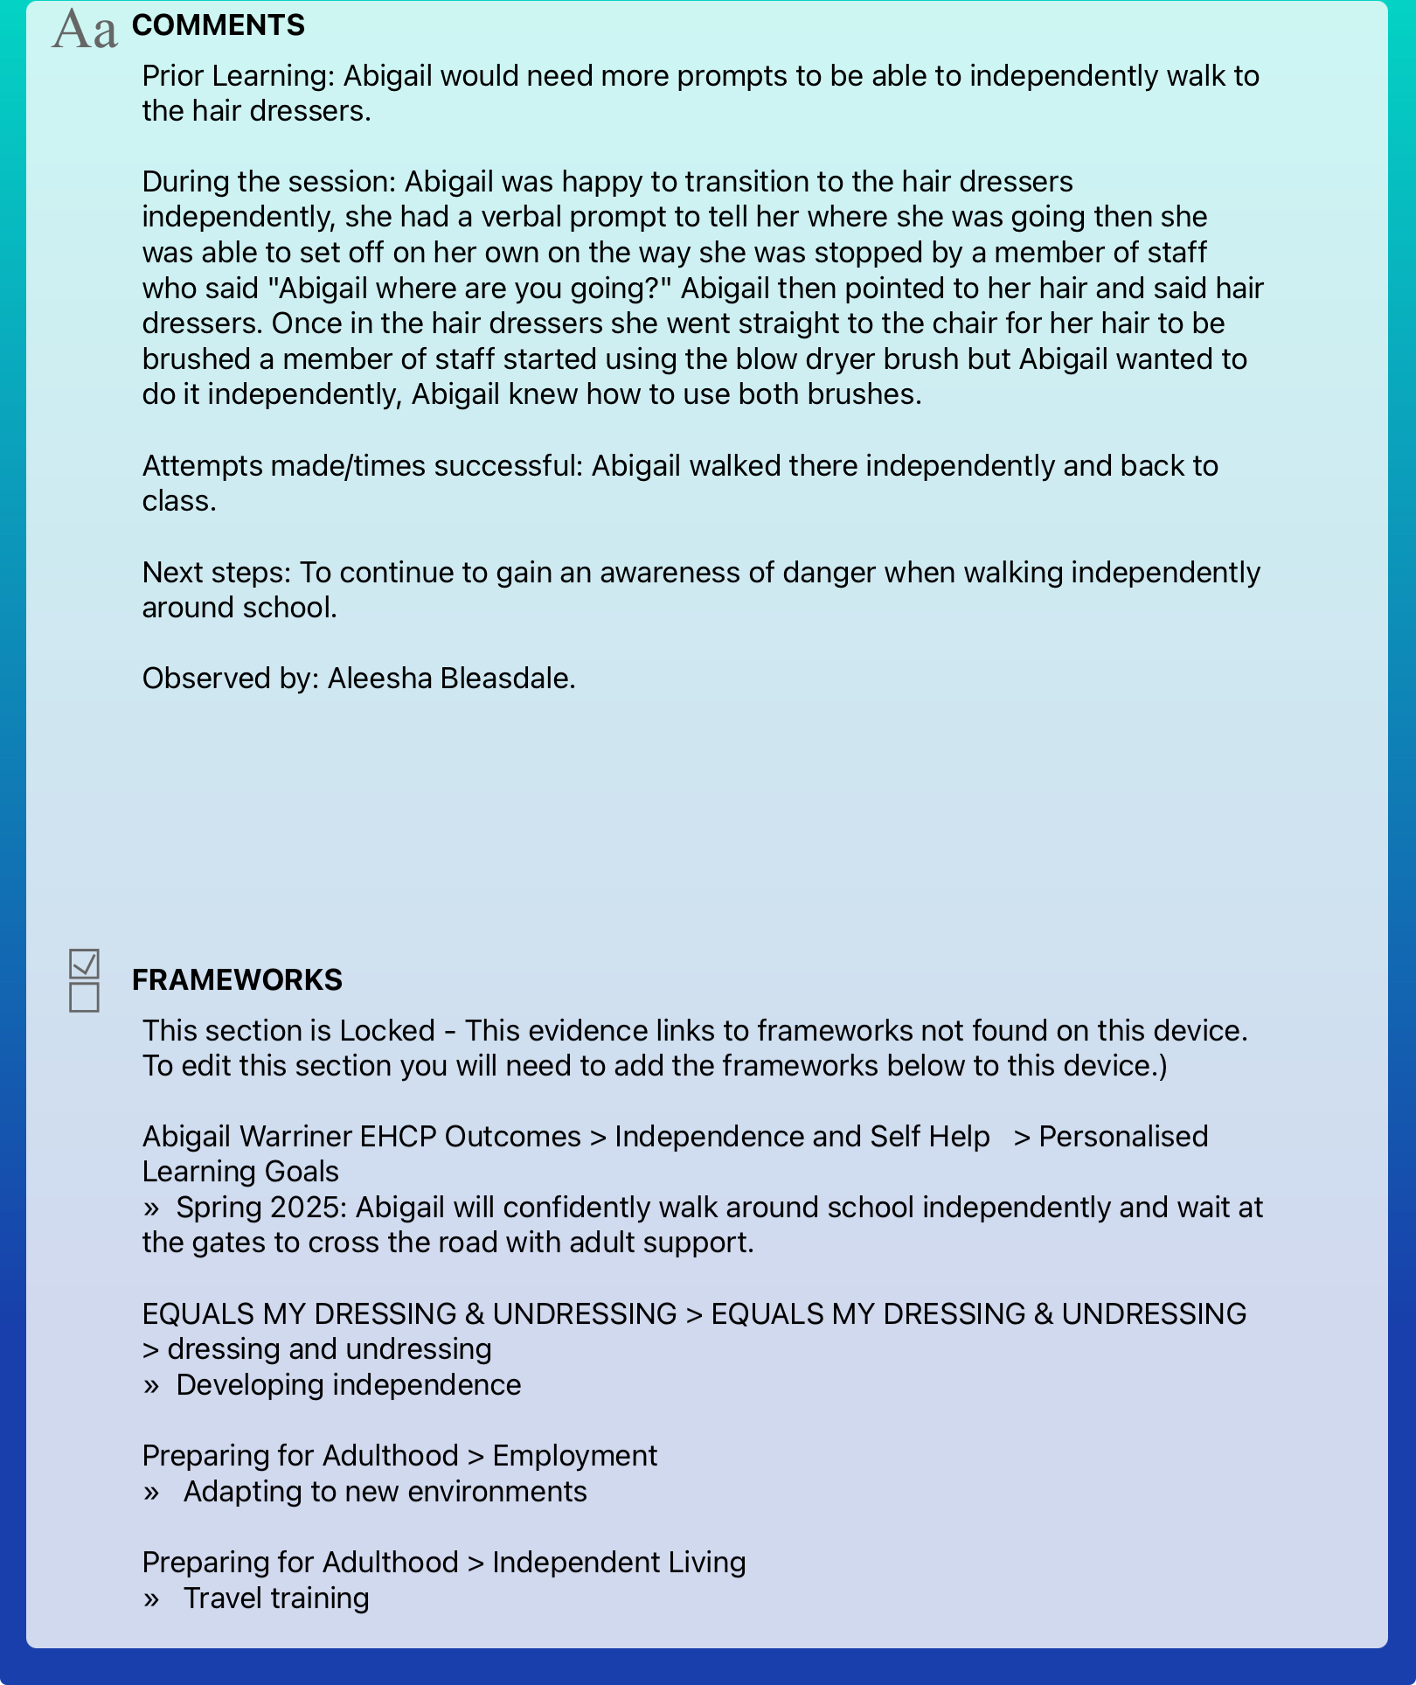
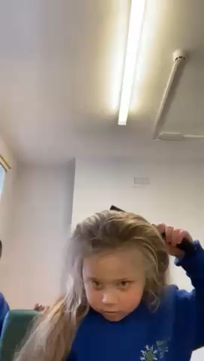


Slide 12
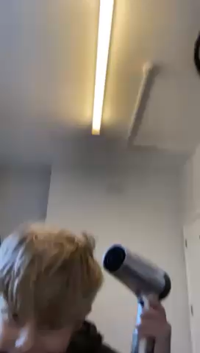
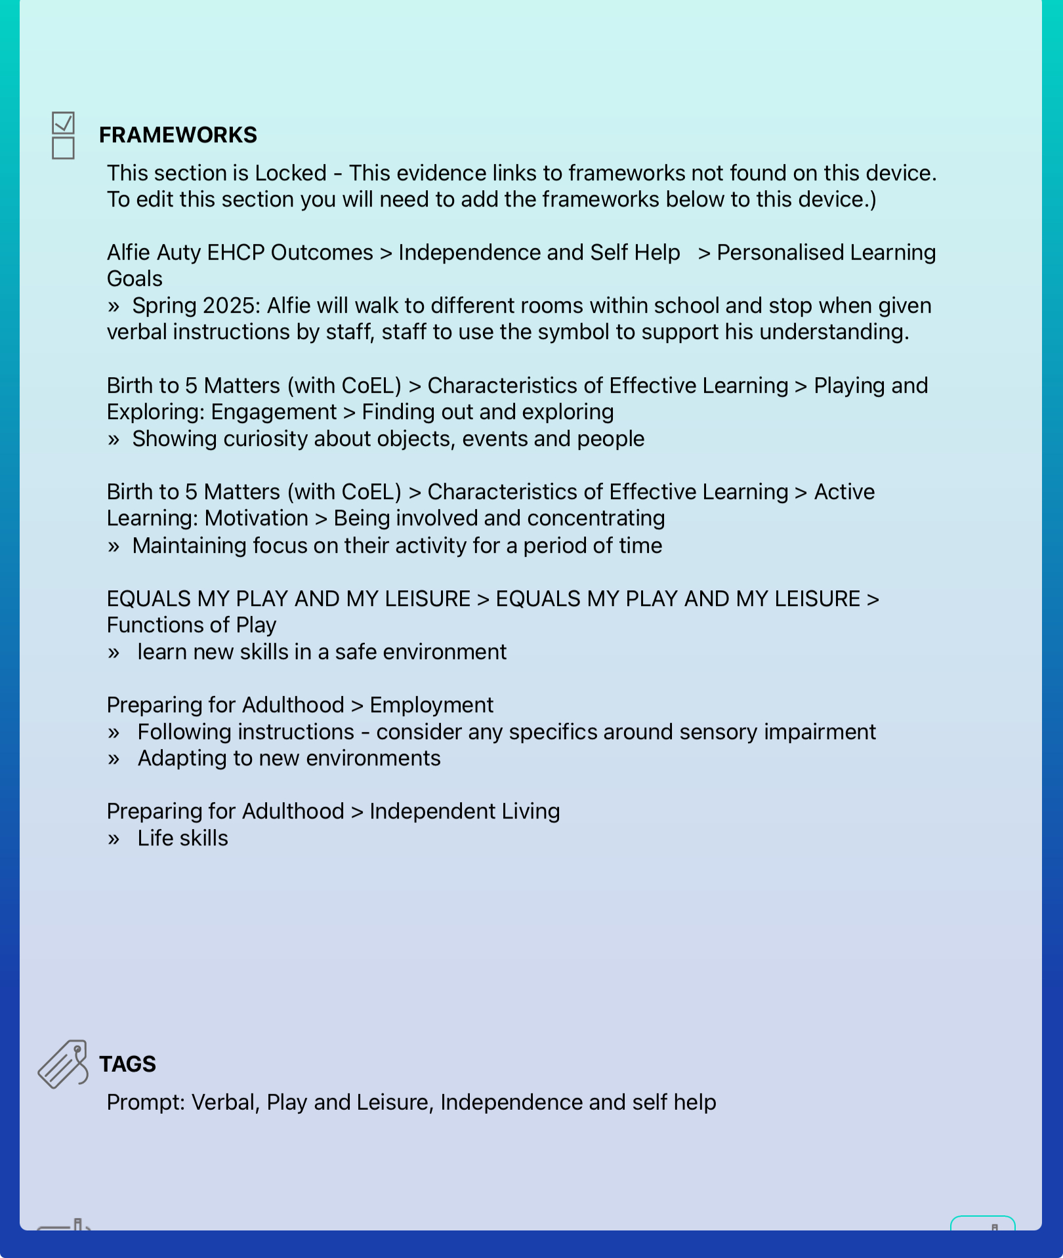

Slide 13
Now our innovative workspaces are ready, and classes are beginning to link these to curriculum learning the next step is to invite employers into school to facilitate workplace encounters for our learners.
Who will we invite?​
A Paediatric Consultant is hopefully going to run a clinic from the hospital room, this will also allow parents and carers the chance to see the impact of the workspace.​
Our Transition Coordinator/Roald Dahl Specialist Nurse who is part of the Ready Steady Go Programme has volunteered ​to spend a day with us.
We have two hairdressers who are willing to volunteer their time. Hopefully, school staff will volunteer to have their hair washed and styled.​
Booths Supermarket have also said that they will come and support our learners. ​
An Occupational Therapist has also expressed that they would like to spend time in the hospital room, developing functional skills.
When will the above take place?
We plan to have at least one employer visit during the second half of the summer term

Slide 14
If you would like to visit our workspaces, please get in touch via the website.
Thank you for listening.

