Slide 1
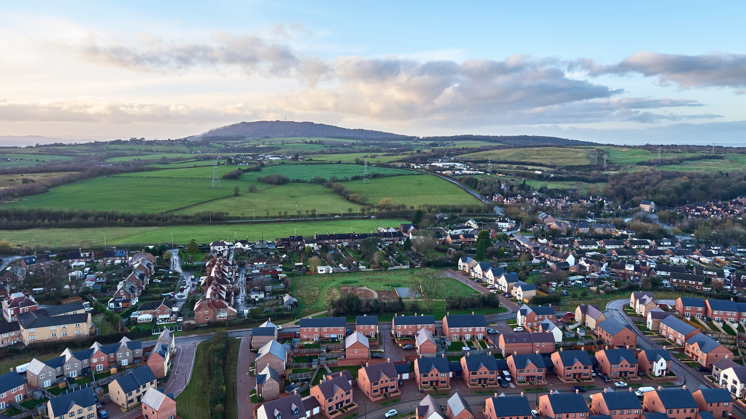



Impactful Connection at Inclusion Summit 2024
Julie Baker
Social Value Manager – Keepmoat Northwest
Lee Toulson
Assistant Head Teacher – Sir Tom Finney Community High School

Slide 2
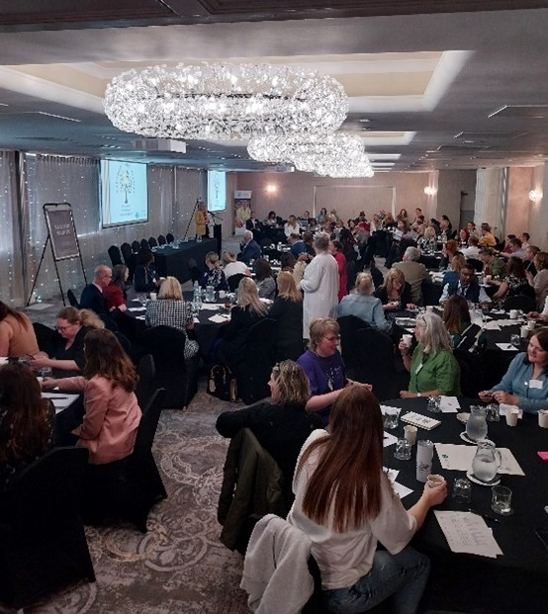

MEETING HIGHLIGHTS FROM LAST YEAR'S EVENT
Key Interaction: Assistant Head from Sir Tom Finney Community High School, Preston in audience at 2024’s Inclusion Summit – saw my presentation – noted my contact details and got in touch.
Significance: Subsequent meeting underscored the importance of collaboration and networking in fostering inclusive opportunities
Notes:
Lee’s slide

Slide 3
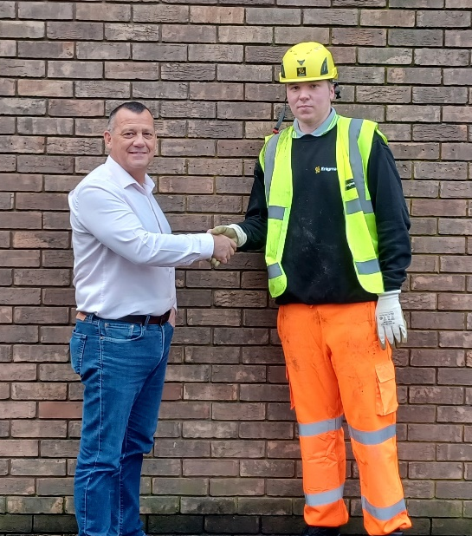


SUCCESS STORY
Outcome: A student from Sir Tom Finney Community High School gained employment at Keepmoat.
Details: The student's journey from education to employment was facilitated by the connections made at the summit.
Max, said
"I'm really enjoying what I'm doing and I'm really glad for the experience - I appreciate it. No-one has ever given me such a big chance to prove myself. I go to bed excited on Wednesday nights and wake buzzing on Thursday mornings ready for work. Thank you, Enigma & Julie."
Notes:
Julies slide

Slide 4
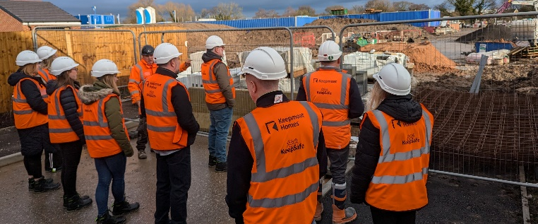

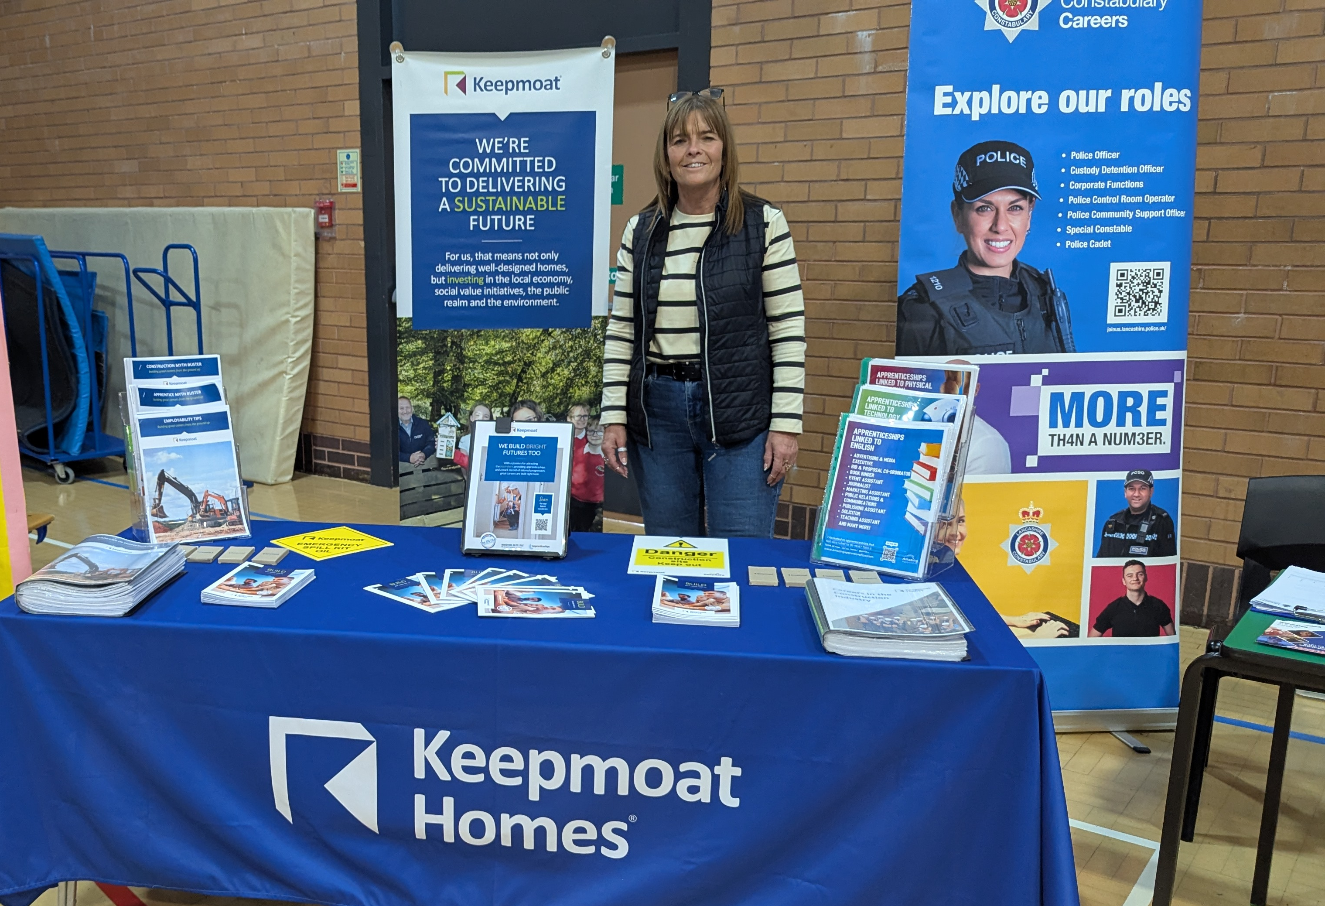
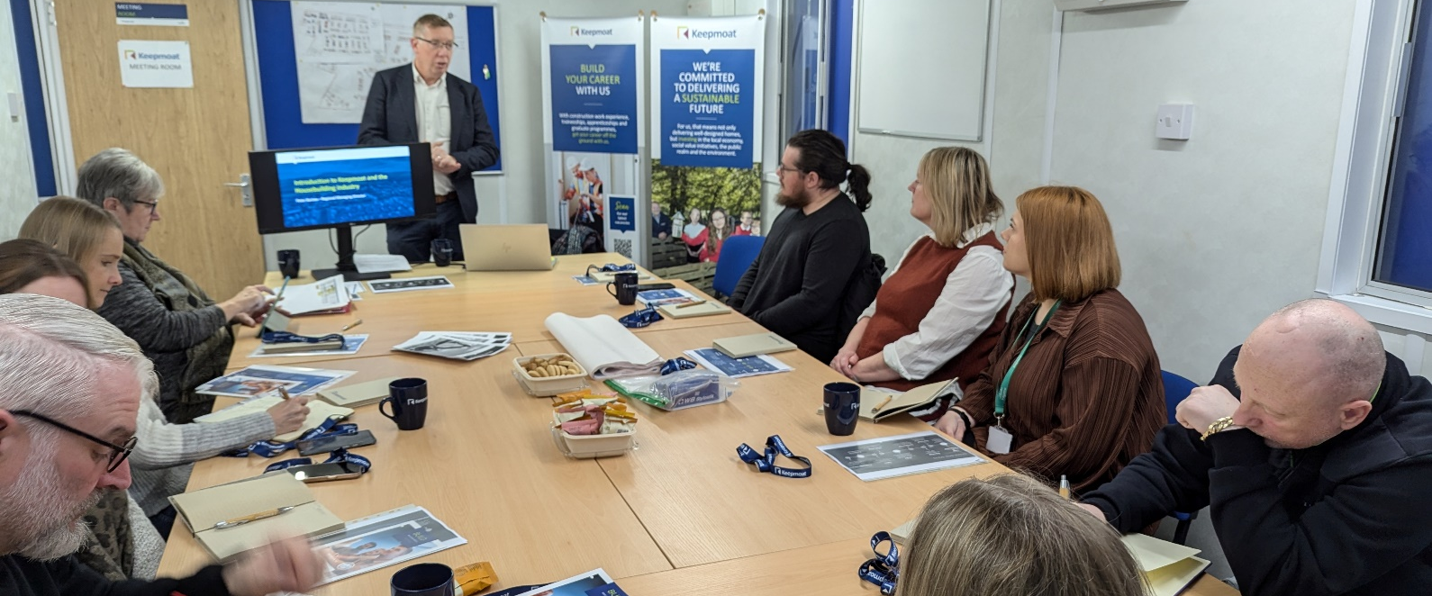




FUTURE PARTNERSHIP
Teacher Encounter day
Ongoing Collaboration: Strengthening the partnership between Sir Tom Finney Community High School and Keepmoat.
Goals:
Continue to create employment opportunities for pupils.
Develop joint initiatives to support inclusive education and career pathways.
Max
Careers event
Teacher Encounter day
Apprenticeships
Work placements T Levels
Careers sessions, site visits
Employability courses
Notes:
Lee to cover bullet point one
Julie to cover bullet point two

Slide 5
MAX
His journey into employment
Notes:
If Max does not want to speak, we can add a link to a video if he is happy to say a few words on camera.
Feel free to amend heading dependant on what Max says in the video

Slide 6
THANK YOU FOR LISTENING!
QUESTIONS?

