Slide 1
Pendle Community College
Lancashire Careers Hub SEND School Workplace Encounters Innovation Fund
Transport Grant

Slide 2
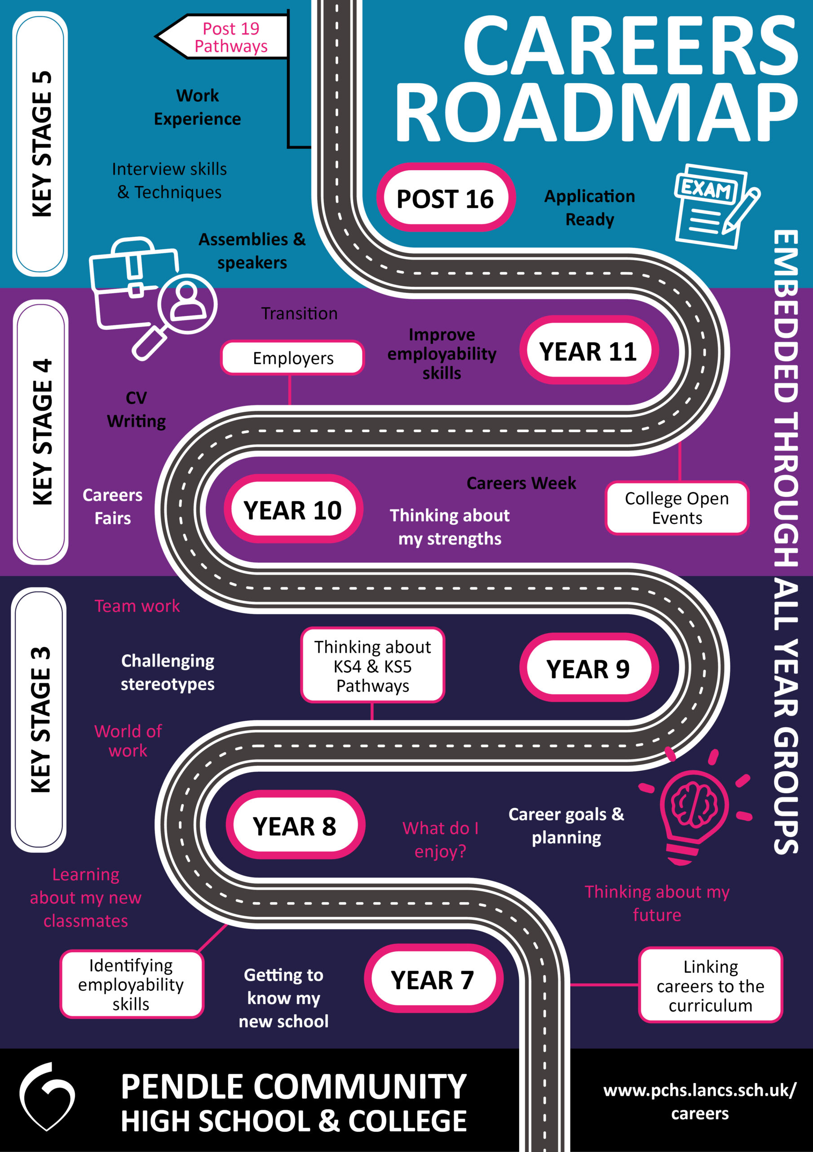
Introduction
The SEND School Workplace Encounters Innovation Fund aims to support young people attending SEND institutions to experience meaningful encounters of the workplace through new and innovative models.
Our school and college careers programme involves all students, from yr 7 – yr 14 but our coverage begins to grow in KS4 into a PFA focused, purposefully planned, KS5 college programme. It focuses on appropriate, innovative approaches towards students gaining relevant knowledge, in line with their destination pathways.

Slide 3
Impact
Developing the school’s careers provision, with the Vocational Education Centre Project as the hub of the development, has been planned with the sole purpose of facilitating pupils and students (with varied SEND requirements) to access appropriate, safe and meaningful employment experiences.
The impact is that all our students will have access to some form of work experience relevant to their future pathway which is safe, supported and externally accredited at their appropriate level.

Slide 4
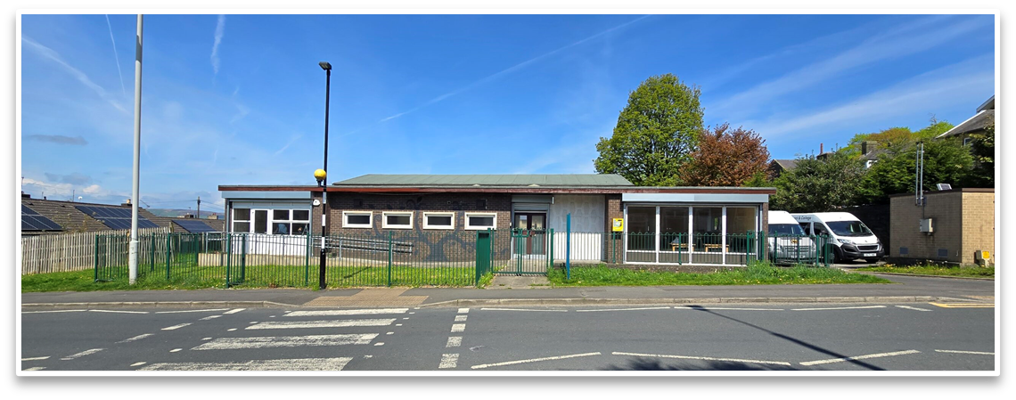
The vocational Education Centre - AKA Williams hall
By PCC Students

Slide 5
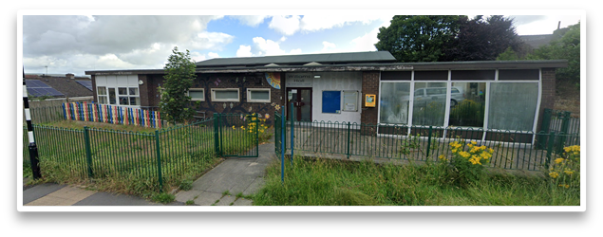

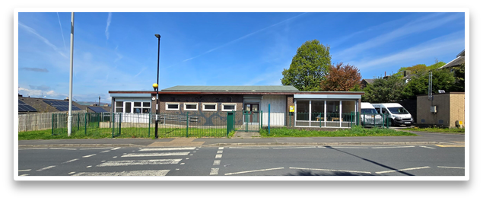

The Brief.
Our project brief was to renovate the building previously known as Williams Hall into a Vocational Education Centre/Bay Leaves Café.
The goal was to provide a space to unlock potential for an array of different work experience opportunities.
Before we began our work on the building, it was a nursery, abandoned during the COVID-19 pandemic.
Both students and staff all across college worked together to begin transforming the site for its new purpose.
​

Slide 6
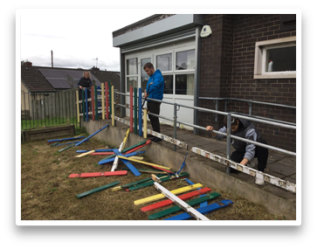
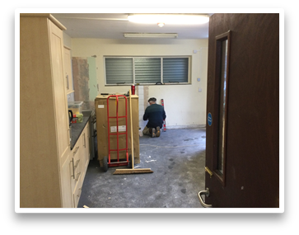


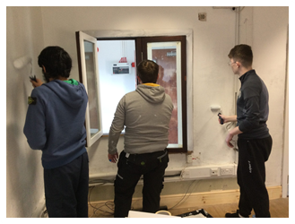
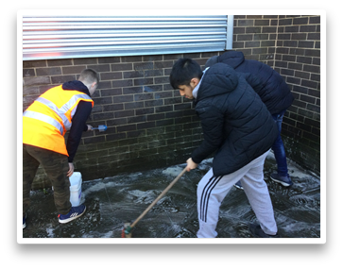


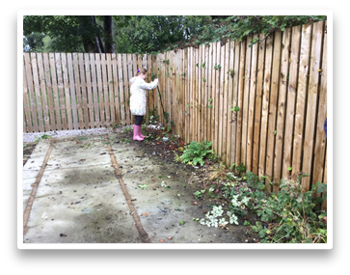
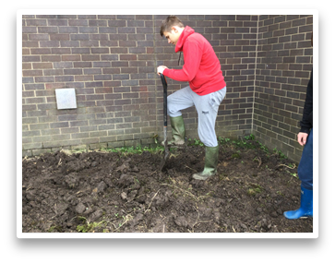


The Renovation
Students that attended Williams Hall utilized a wide range of different skills, many unfamiliar. Such skills included:
  Panting/coating
  Tiling work
  Installing new panels
  Landscaping work
  Cleaning (a lot of cleaning.)
  Removal/Disposal of rundown elements
We also secured a partnership with the Prince’s Trust to assist in helping with renovation of the site; furthering our collaborative efforts.
The renovation work is still ongoing; we’re still working very hard to fulfill our vision of opening our Vocational Education Centre.

Slide 7
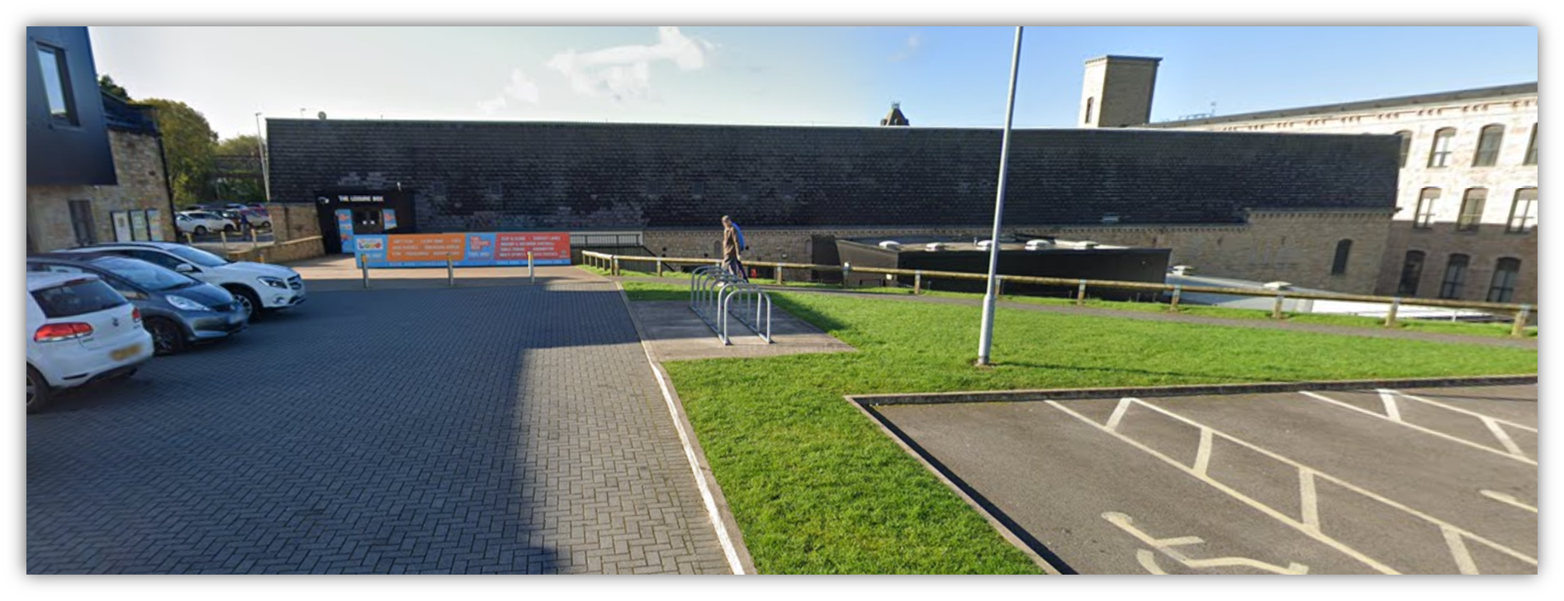
The Leisure Box
By PCC Students

Slide 8
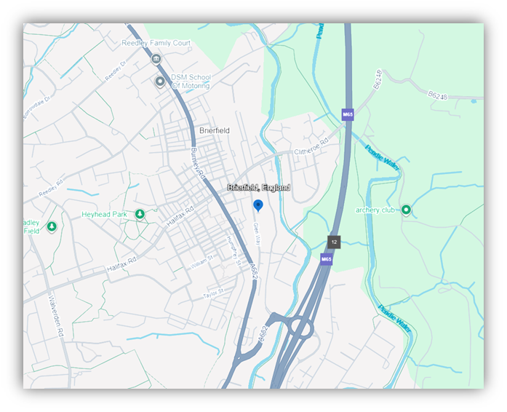
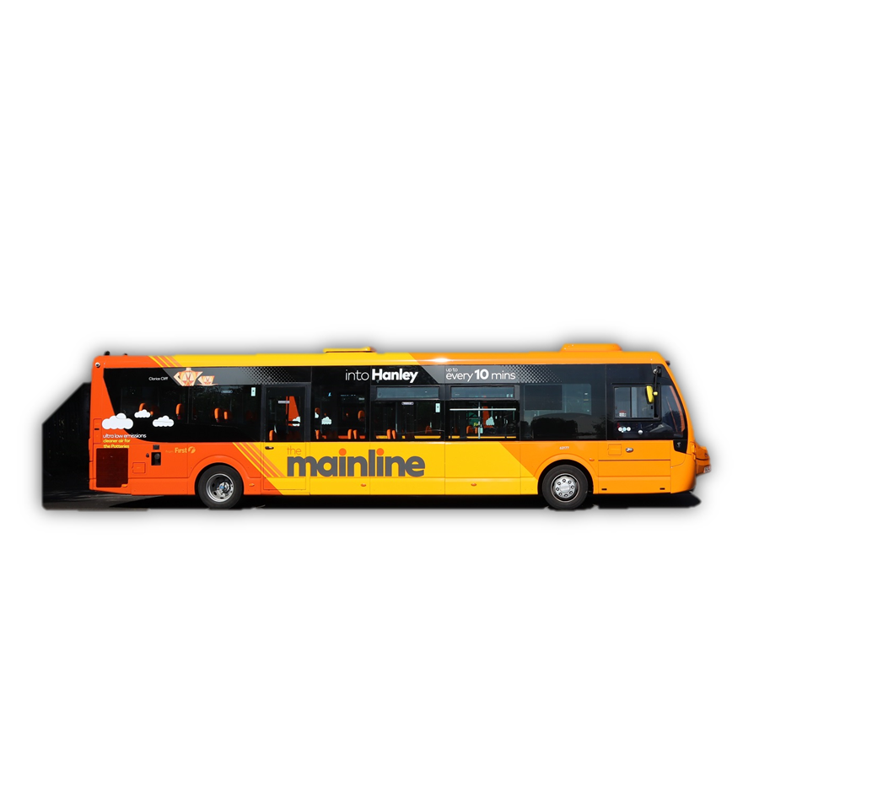
How Students Learned To Travel
Some Bowland students have increased their independence skills through, under staff supervision, students have been trained to enter the public transport to travel to Leisure Box.
Some students take the minibus in order for every and each students to take turns to train on their independence skills.

Slide 9


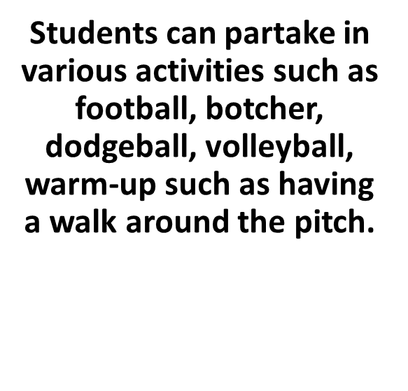
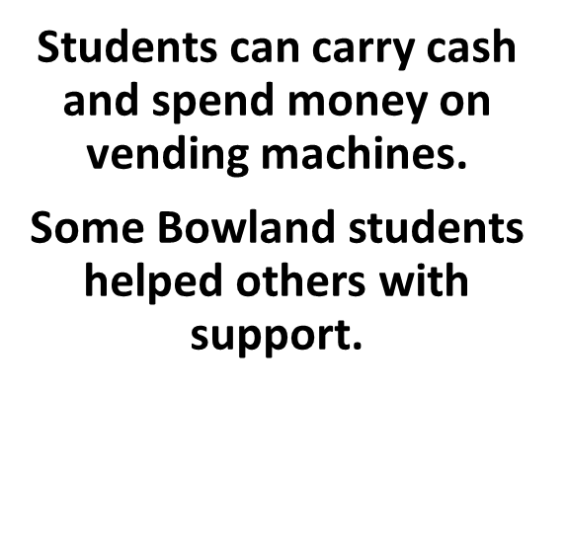
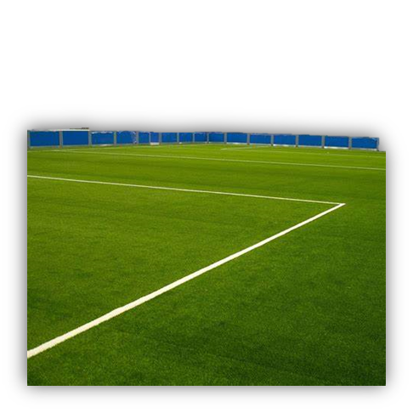
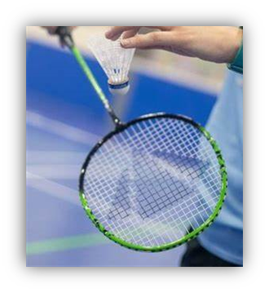
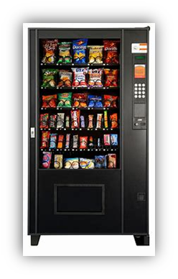
Partaking in Activities

Slide 10
Using AAC in the Community (building my confidence)
Abbie’s account:
I go to the Leisure Box with college. My Speech and Language therapist comes to work with me there. In the entrance level where we enter, we would sit at a white table and I would talk to her using the AAC iPad. We would also do activities like: would you rather or spot the difference. Then the next time we did go to the receptionist and I let my Speech and Language therapist use my AAC iPad to ask for a pen, then the next week I did use my AAC iPad to ask for a pen at the reception.
We worked on using my AAC iPad at the reception at the Leisure Box for a few weeks.
When I felt more confident, we went down to the cafeteria to order different types of drinks like Sprite, Water, Coffee, Slushy, Pepsi, Coca-Cola and different types of juice and we would talk about stuff using the AAC iPad or play games together whist I had a drink.
I feel more confident when I use my AAC iPad in places that I know, I still find using it in new places challenging. I think using it in the Leisure Box has helped me because it was new place.

Slide 11
Challenges and Issues
Renovation
Timelines
Funding
Logistics

Slide 12
Thank you and any questions?
Pendle Community High School and College

