Slide 1

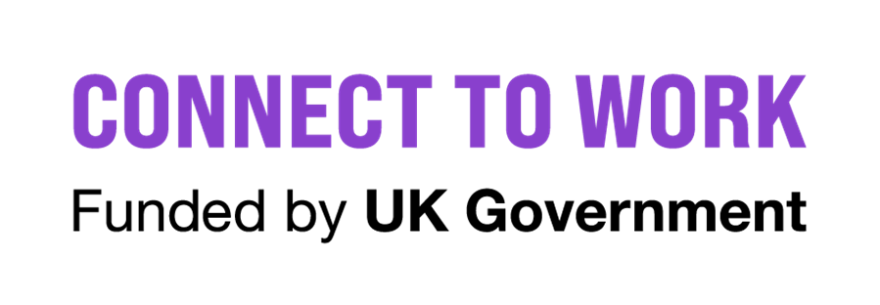
Connect to Work - Lancashire
Dan Dixon, Strategic Programme Manager

Slide 2
Connect to Work - Lancashire
Will primarily help disabled people, people with health conditions, and those with more complex barriers to work who are economically inactive who wish to be in employment, to find a suitable job and sustain work. It will also help those in work but at risk of falling out of the labour market (and who will struggle to get back into work if they lose their job) to retain their employment.
5 Year Programme, looking to support just over 11,000 participants across Lancashire
Voluntary programme to help tackle economic inactivity by providing a specific form of support targeted at the right people at the right time, based on their individual circumstances. Participants must be both Eligible and Suitable for the provision.
85% Out of Work – 12 Months of Support
15 % In-Work Retention – 4 Months of Support
Model of Support – IPS 75% SEQF 25%

Slide 3
Why 2 Supported Employment Models?
Individual Placement and Support (IPS)
IPS integrates employment support into primary and secondary health services, and other support services and aims to embed work as a health outcome within the health system. This integration ideally occurs at a physical level. Care Integrated Support. Up to 25 participant caseloads.
Supported Employment Quality Framework
SEQF offers a deeper level of support to both the participant and employer due to the more complex needs of the participant group. In delivery terms, this may mean that a participant will receive more contact and support from their Employment Specialist; particularly in work support for both employer and employee. Community Integrated Support. Up to 20 participant caseloads.

Slide 4
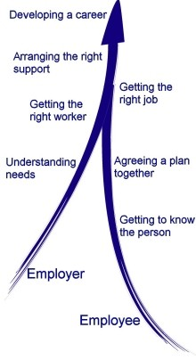
SEQF 5 Steps
Engagement:
Many potential jobseekers are using traditional day services or receiving support from health and social care agencies. Maintain close links with referring agencies and seek to encourage people to explore employment as a way of improving their quality of life. Explain the support offer.
Vocational Profiling:
Vocational profiling or "getting to know you" process. Here we identify the aspirations, learning needs, individual skills, past experiences and job interests of the jobseeker. Working with families and support workers, we gather the information needed to develop a good job match.
Employer Engagement:
Our aim is to secure 'employment and training' rather than 'training then employment'. This means that a participant gets a job from the beginning. We know that most people learn skills better in situ rather than in artificial environments. By doing this we overcome the "job readiness" obstruction where people can get stuck in permanent training.
Job Matching:
Look at all aspects of the job and the work place, including health and safety, to make sure we have the right job for the right candidate.
Determine whether extra assistance or alterations to working practice or the environment are needed. This helps to produce a better job match. The job analysis might point towards ways of carving together parts of job descriptions that suit the workers' talents, or creating new job descriptions that suit the worker and are cost effective for the employer.
In-work Support and Career Development:
Individual development plans are usually used to plan and monitor the employee’s learning.
Goals should include actions to encourage the social inclusion of the participant within the workplace.
Notes:
Expand upon the steps and how this looks in practice.

Slide 5
Connect to Work –
Opportunity for Lancashire
Delivery & Procurement – LCC Portal
View tender opportunities - Lancashire County Council
Referrals
Integration
Employment
Employers
Education
Providers

