Slide 1


Empower – Thrive - Achieve
Advocating for every young person's right to progress
Joanne Spurgeon – Representative for North West BASE members
7th May 2025

Slide 2

Landscape
Commissioning quality
Localised approach
Evidence based models

Slide 3
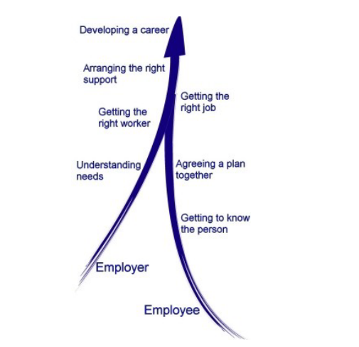
Values
5 stage model – Engagement, Vocational Profiling, Employer Engagement, Job Matching & In Work Support & Career Progression
SEQF (Supported Employment Quality Framework)
SIQAF (Supported Internship Quality Assessment Framework)

Slide 4
How are you ensuring your provision -
Empowers EVERY young person to achieve and thrive?
There is a lasting impact?

