Slide 1
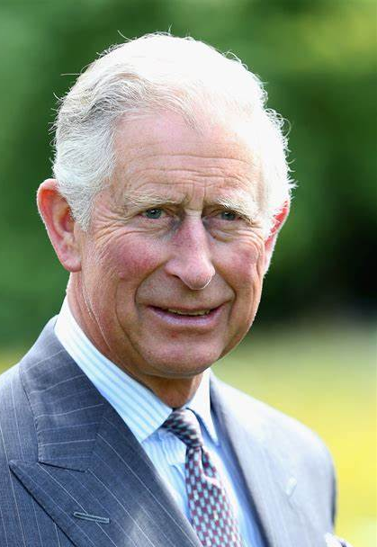

THE KINGS’S TRUST
UK’s leading youth employment charity.
In 1976 King Charles III established the charity with a commitment of improving the lives of young people.
Programmes delivered nationwide, targeted to help young people live, learn & earn.
Key focus areas:
11-19: Engage and succeed in education with employability skills and world-of-work experience.
16-25: Develop personal, social & professional skills and access routes into work.
18-30: Support new Enterprise via self-employment and business-start training, funding and mentorship.

Slide 2
THE KINGS’S TRUST
Aims
Engage young people aged 11-19 years in education and world-of-work skills.
Enable young people to investigate their own potential and set goals.
Encourage young people to take responsibility for their own learning outcomes.
Support young people into positive outcomes in education, employment and training.
Support partners to deliver:
  Ofsted Behavioural & Personal Development
  Careers, Employability and Enterprise Education
  RSE & Health Education

Slide 3
THE KINGS’S TRUST
Benefits
The benefits of working with The King's Trust
Our flexible education programmes can be delivered across a variety of settings depending on your location.
Access to teaching resources
Explore our tailored and adaptable session plans, worksheets, presentations, videos and more.
Receive dedicated support
Your local King's Trust team is available to provide you with the guidance and support you need.
Flexible programme
Our education programme is designed to cater to a range of learner needs.

Slide 4

THE KINGS’S TRUST
How The King's Trust works in Education
Notes:
How The King's Trust works in Education

Slide 5
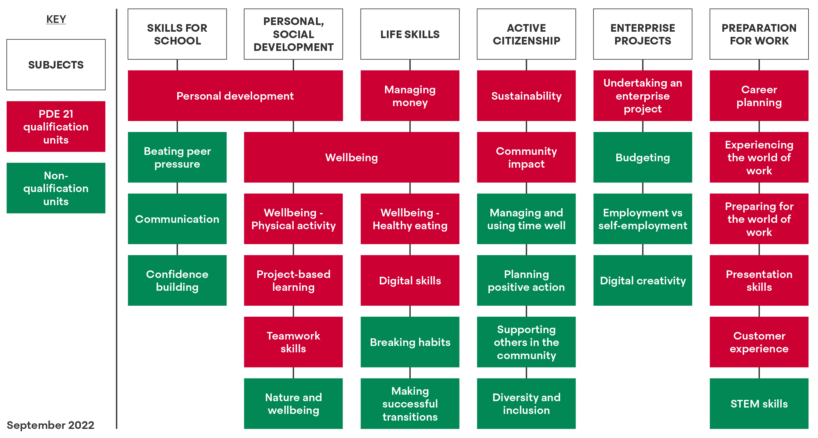
THE KINGS’S TRUST
Notes:
Education Hub log in…
Skills for School
Personal & Social Development Skills
Mental Health & Wellbeing
Active Citizenship
Project Based Learning & Enterprise Skills
Employability & World of Work
Any 16 red units be picked, combined and are available in different levels of difficulty.
When you click PDE unit…

Slide 6
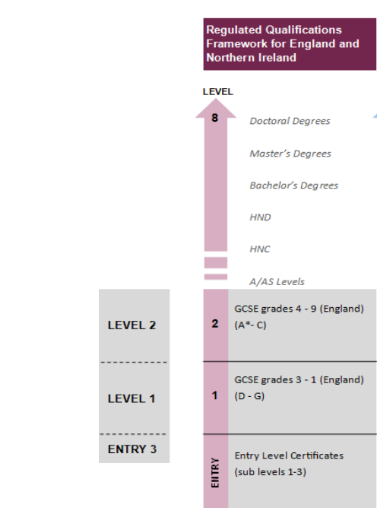
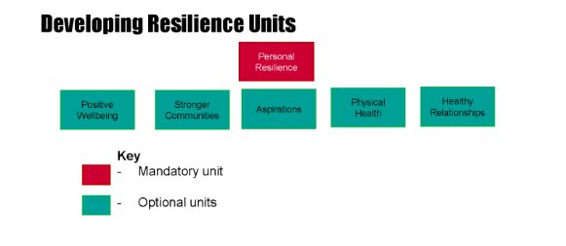
THE KINGS’S TRUST
Developing Resilience Qualification Overview
Level 1 Award
3 units (Personal Resilience unit is compulsory)
£15 per pupil to enter for the qualification
Notes:
Dev Res unit is separate from the PDE it’s a level 1 only qualification and has 3 units to complete. Mandatory Personal Resilience

Slide 7
THE KINGS’S TRUST
Benefits
How does achieve support SEMH?
Two qualification options: Personal Development Employability and Developing Resilience. All with modules and lesson plans to support both young people and staff.
Content offered through the Achieve programme is supported by subject specialists such as young minds.
Links to outside bodies for support outside of education.
Creates an environment for young people to develop their own skills. Engaging with content, get to do the work themselves rather than just teacher led.
Support through transition periods particularly the DEV RES resources.
Variety of ways to evidence towards their portfolio completion.
Notes:
Social, emotional and mental health
Outside bodies – respected and vetted charities that can provide support to young people when you aren’t always available.
The young people can take ownership of their work, EG personal project. The project can be tailored to what they are interested in but all the criteria is still the same for the qualification.

Slide 8










SOFT SKILLS
Greater awareness of world of work, careers, employment sectors
Knowledge of how to prepare for work & the practical steps for finding a job
Developing personal and social skills
Raised aspirations
Confidence and resilience
Team-work and communication
Problem-solving
Mental wellbeing
Attitude to learning
Digital skills

Slide 9
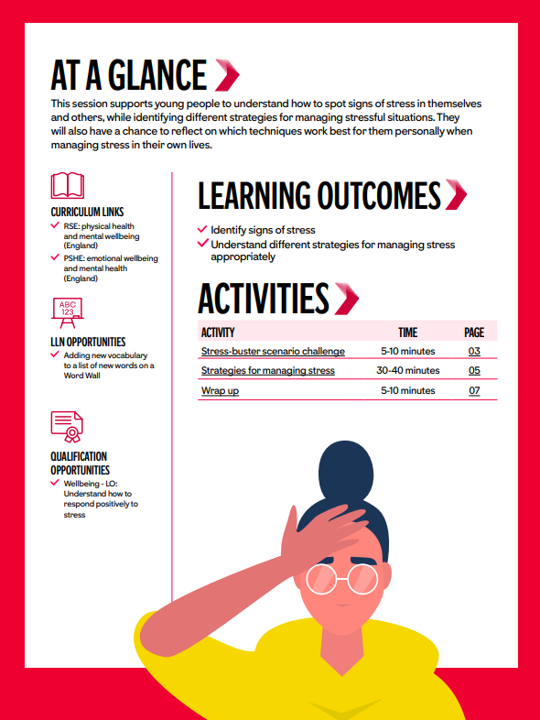
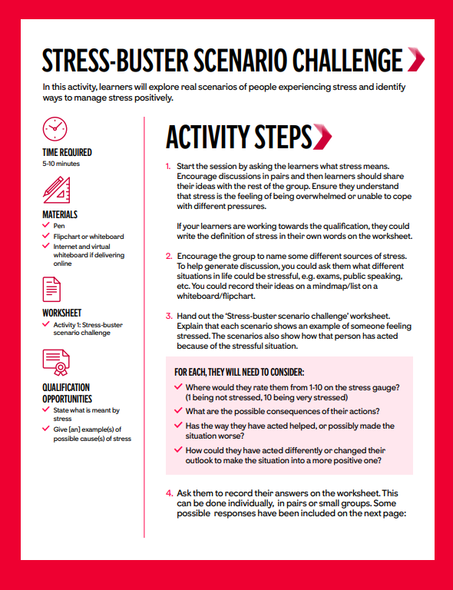
Notes:
Takes the time out of planning for teaching.
Curriculum links to pshe
LLN (Language, Literacy and Numeracy) opportunities
Engaging content
All though not on this particular lesson plan, the GATSBY benchmarks are listed on career content.
Clear learning outcomes
Quals opportunities

Slide 10

Notes:
Links to worksheets which provides interactive learning opportunities

Slide 11
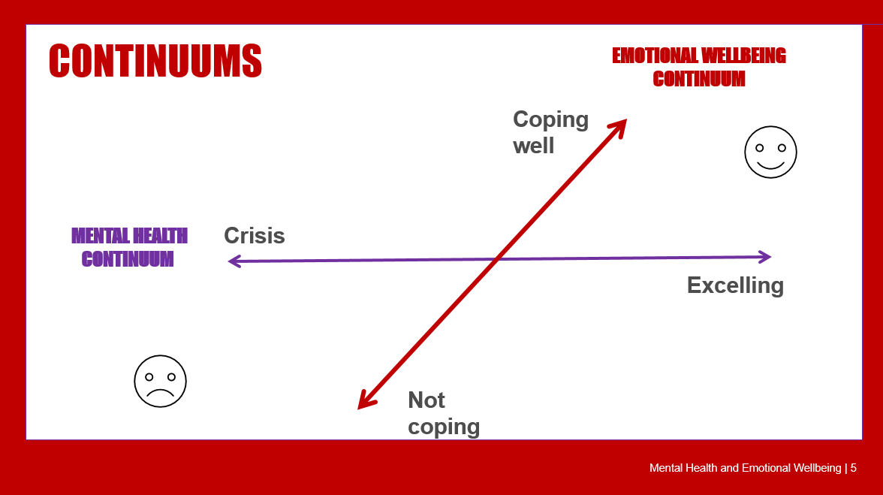
Notes:
Links to worksheets which provides interactive learning opportunities

Slide 12
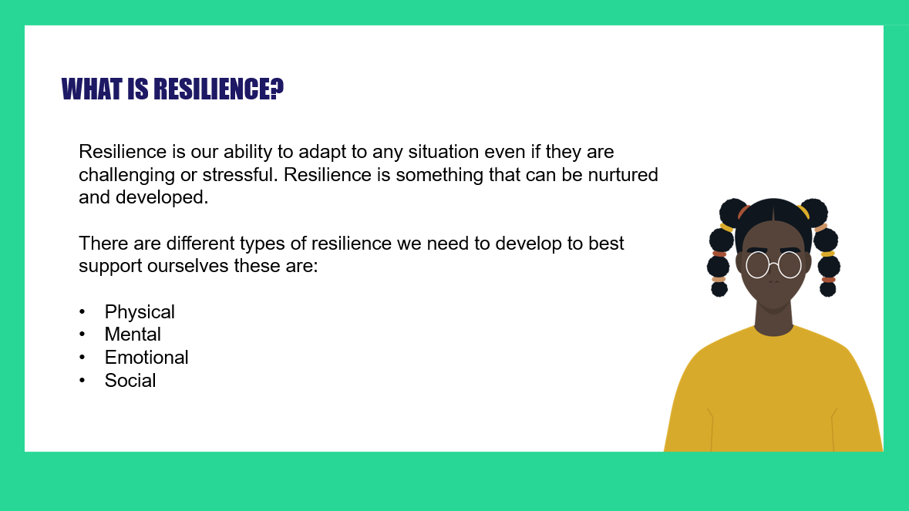
Notes:
We all know how important resilience is. Lots of opportunities to develop resilience with our content

Slide 13
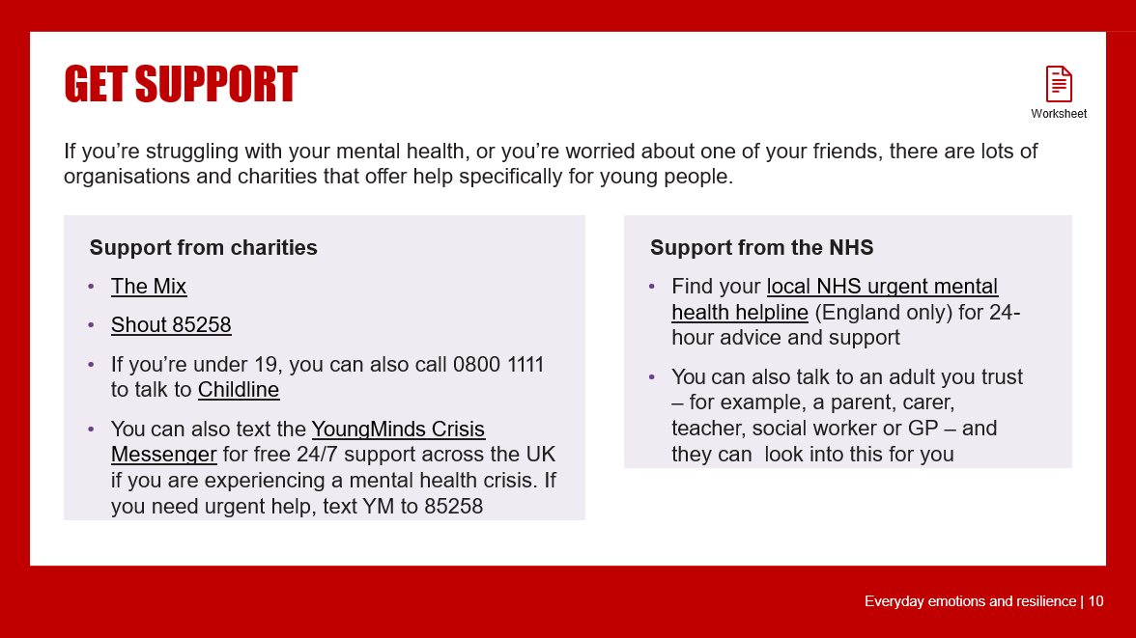
Notes:
Extra support outside of school from vetted sources

Slide 14
Personal Development & Employability Skills (PDE) Qualifications
Difficulty levels available:
Entry Level 3 (Functional Skills)
Level 1 (GCSE - grades 1-3)
Level 2 (GCSE - grades 4-9)
Award
Qualification size: 2 units
Certificate
Qualification size: 6 units
Level differentiation: min 4 units at same level (66%)
Extended Certificate
Qualification size: 9 units
Diploma
Qualification size: 13 units
GLH 54 / TQT 60
Level differentiation: min 6 units at same level (66%)
Level differentiation: min 9 units at same level (69%)
Both units must be at the same level
GLH 162 / TQT 180
GLH 246 / TQT 270
GLH 366 / TQT 390
Available Levels: Entry 3, L1 & L2
Available Levels: Entry 3, L1 & L2
Available Levels: Entry 3, L1 & L2
Available Levels: Entry 3, L1 & L2
£20
£60
£90
£90
Notes:
Personal Development & Employability Skills Qualifications:
4 qualification sizes, offered in different levels of difficulty
Level of difficulty comparable to predicted grade – you decide app level for your student
Talk through qualification sizes
Explain generous GLH, only an indicator for your planning
Accrue qualification size
Ability to step up a level

Slide 15
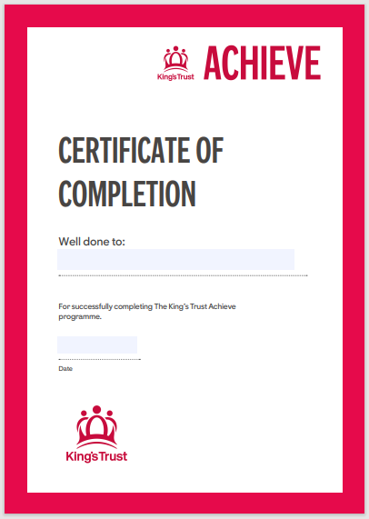
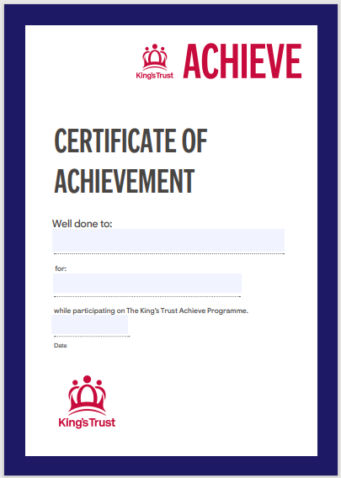
THE KINGS’S TRUST
AWARDING RECOGNITION
Zero Cost
Great for learners to still achieve during their time on the programme.
Notes:
Internal Certificates awarding Completion & Achievement to learners who may not complete as much work as others or work not quite meeting the standards required at Moderation.

Slide 16





THE KINGS’S TRUST
Evidence
Photo
Learner to be clearly evidenced
Video/
Audio
Short, succinct and specific to AC
Witness Statement
Include explanation of event
Engaging in project
Time specified on tracking sheet
Learner clearly/easily identified
Personalised to the learner
Explicitly state how learner met AC
Retrospective account of activity
Worksheet
Personalised to the learner
Explicitly state how learner met AC
Retrospective account of activity
Individualised
Group Work
Notes:
Vary methods of capturing evidence:
photographs, videos, audio
witness statements peer or staff
Ultimately any way that evidences the completion of AC for external moderation that suits your students needs (and is engaging!).
Understand command words.

Slide 17

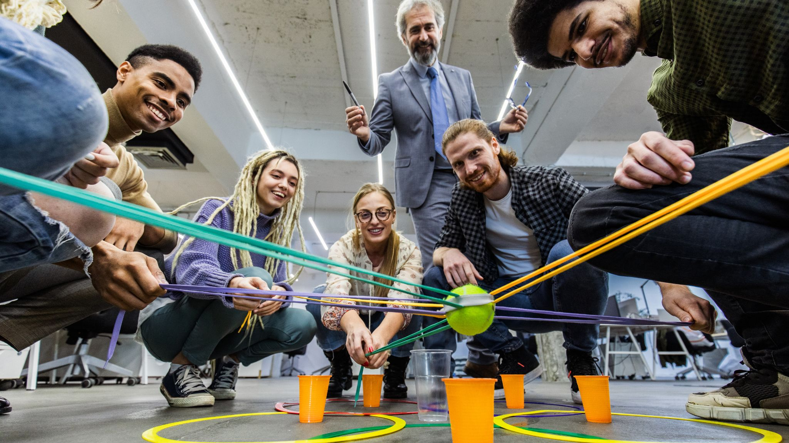
THE KINGS’S TRUST
Enrichment
Lancashire Team Building
Amazon Enrichment
Notes:
Amazon offer:
30 min - 2-hour talks are delivered by experts from Amazon. Your learners will explore exciting technology careers and learn what they need to do to pursue them
You could also take part with Kahoot! Career Tours with Amazon too, which are available for learners aged 11 - 16. These virtual tours explore the computer science, robotics and machine learning involved in Amazon’s fulfilment process. Choose either a tour for primary or secondary students. You have the option to do a full tour (45 - 60 min) or split in half to tour over multiple days (25 - 30 min). Visit their website to find out more and play a tour
/ Tesco schools/ world at work/ Lancs Team Building enrichment / potential opportunities with some of our Corp Vols

Slide 18
Becoming a Delivery Partner
Complete and return our Delivery Partner Agreement Form.
DocuSign Contract Sent Out
Access Granted To Education Hub
Complete and Return Enrolment Form
Begin Delivery
Arrange Adviser Training
Notes:
Our sign-up process.
Compete the DPA and return it to us.
Then docusign is issued.
Granted access to education hub.
Enrolment form completed and returned.
Advisor training booked part 1 & 2
Set up access to the quals hub complete centre approval.

Slide 19
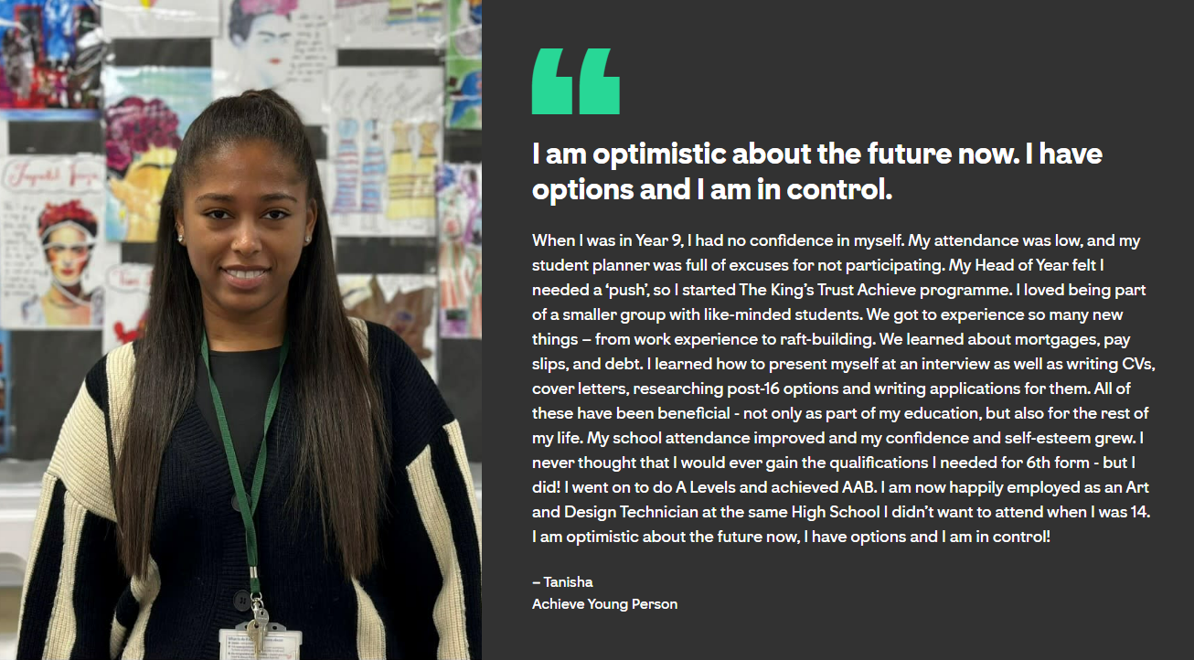
THE KINGS’S TRUST
Enrichment

Slide 20


Notes:
Development Awards

