Slide 1

Careers & Inclusion
Empower – Thrive – Achieve
Notes:
Introduce school, where we are based, 11-19 SEND and our ambition to raise aspiration and ambition for all our young people through our careers programme.

Slide 2
Careers at West Lancashire Community high school
Committed to make a difference
Promoting inclusivity
An embedded careers programme from Y7 – Y11
Providing opportunities and experiences to learn and develop the 8 essential skills as part of the Skill Builder Programme
NCW 25
Notes:
Talk about each of areas
Committed to make a difference – careers programme from Year 7
Promoting Inclusivity – Generic learning difficulties school – providing valuable opportunities for all/student voice
Careers programme – using a programme tailored to students needs – raising aspiration, CDI framework, ASDAN programmes
Opportunities – work experience, educational visits, work placements, work exposure, student voice, guest speakers, reverse careers fair
NCW – full week of workshops – careers & transitions fair, parent events, students workshops, immersive reality experiences, social care and education experiences

Slide 3
Commitment
As a school we are committed in building relationships with all our stakeholders to ensure that our students have the best opportunities and outcomes to help them be prepared for adulthood and fulfil their future ambition.
Providing information to parents and carers through parent events, open evenings, transition & careers fair and 1:1 parent meetings.
Notes:
Working closely with businesses – KS4/5 works experience, business breakfast, information events, transition support

Slide 4
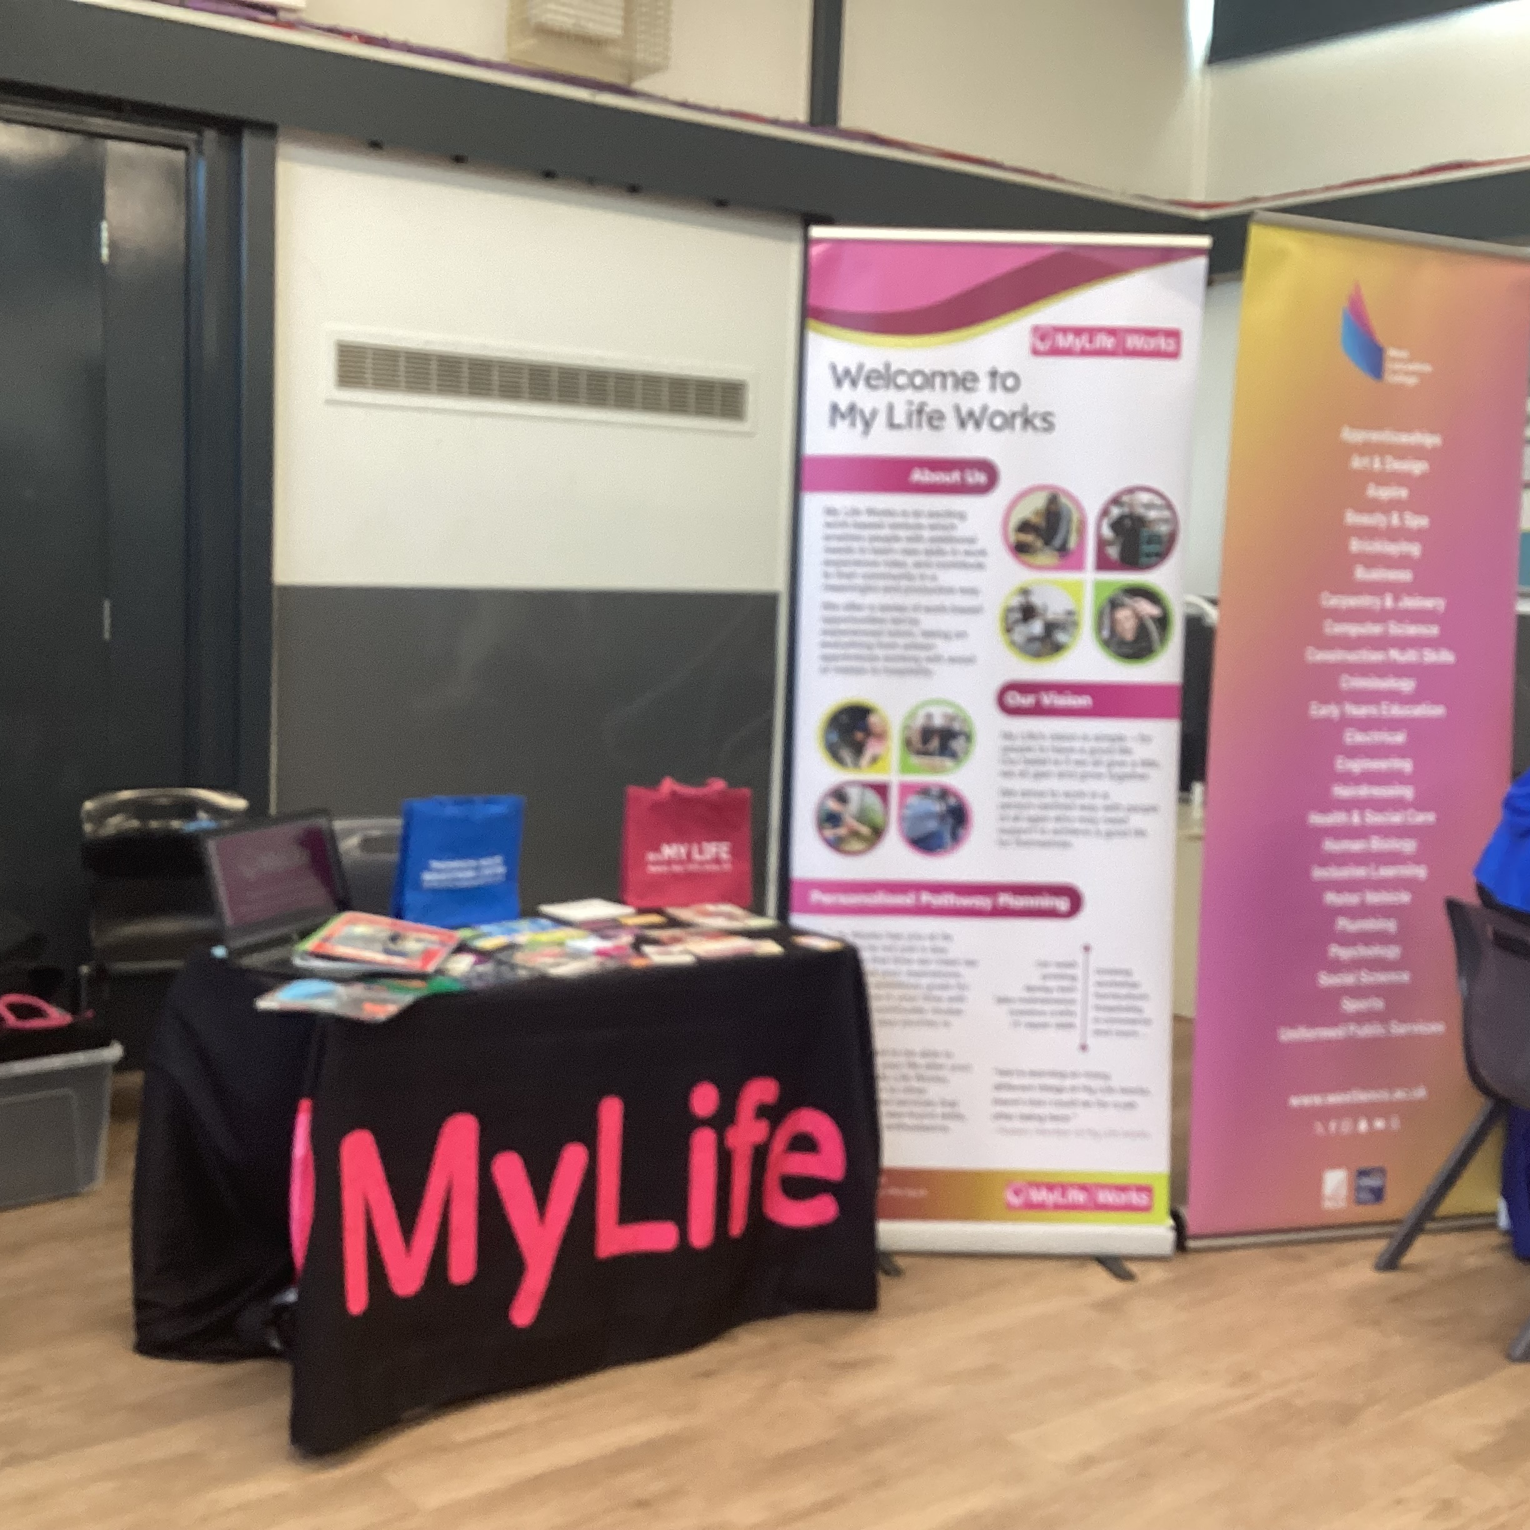
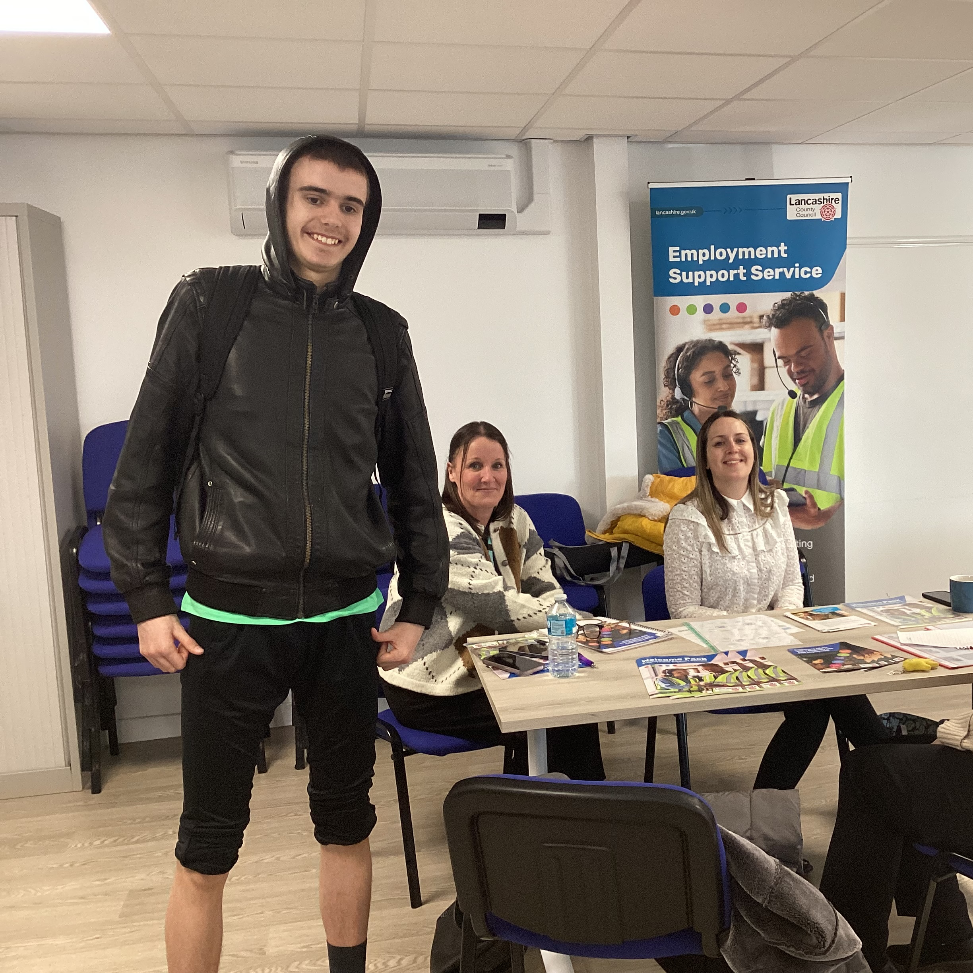
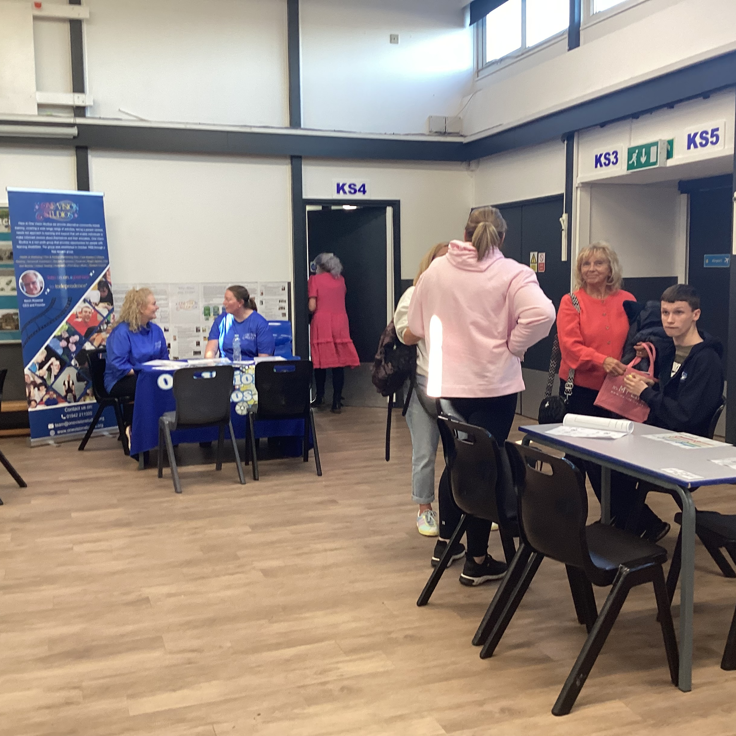
Transition & Careers Fair
Notes:
Talk about the recent events planned for parents and students as part of NCW and impact/success of this.

Slide 5
NCW 2025 – Showcase
Planned workshops
Parent events
Immersive reality experiences
Community visits
Reverse Careers Fair
Notes:
Recap

Slide 6
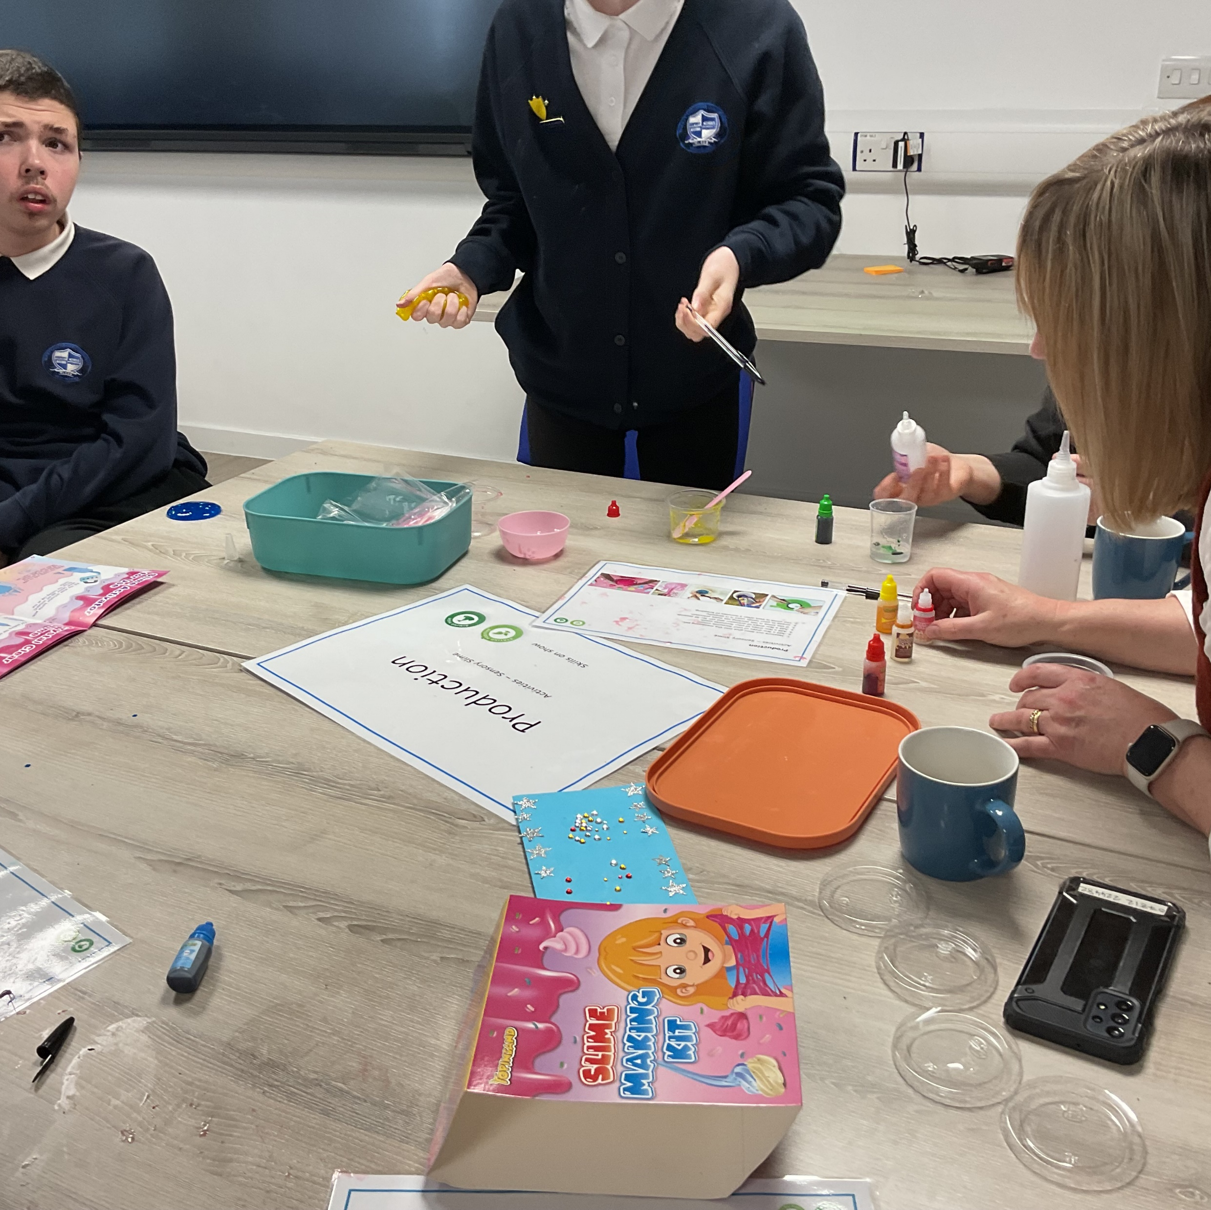
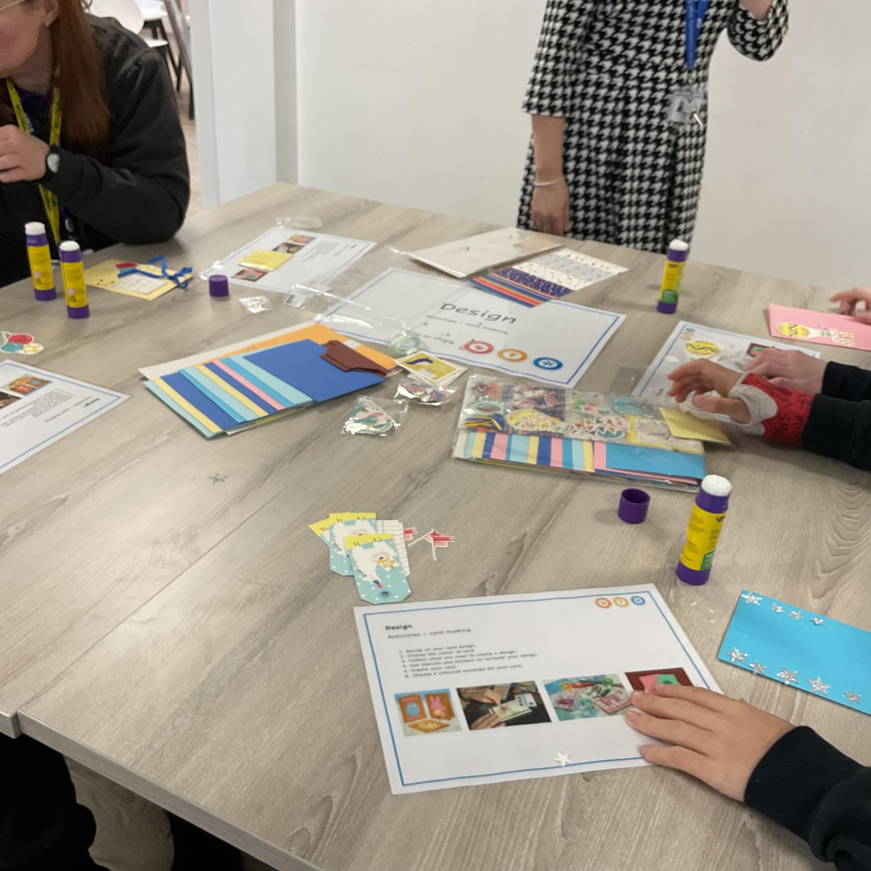
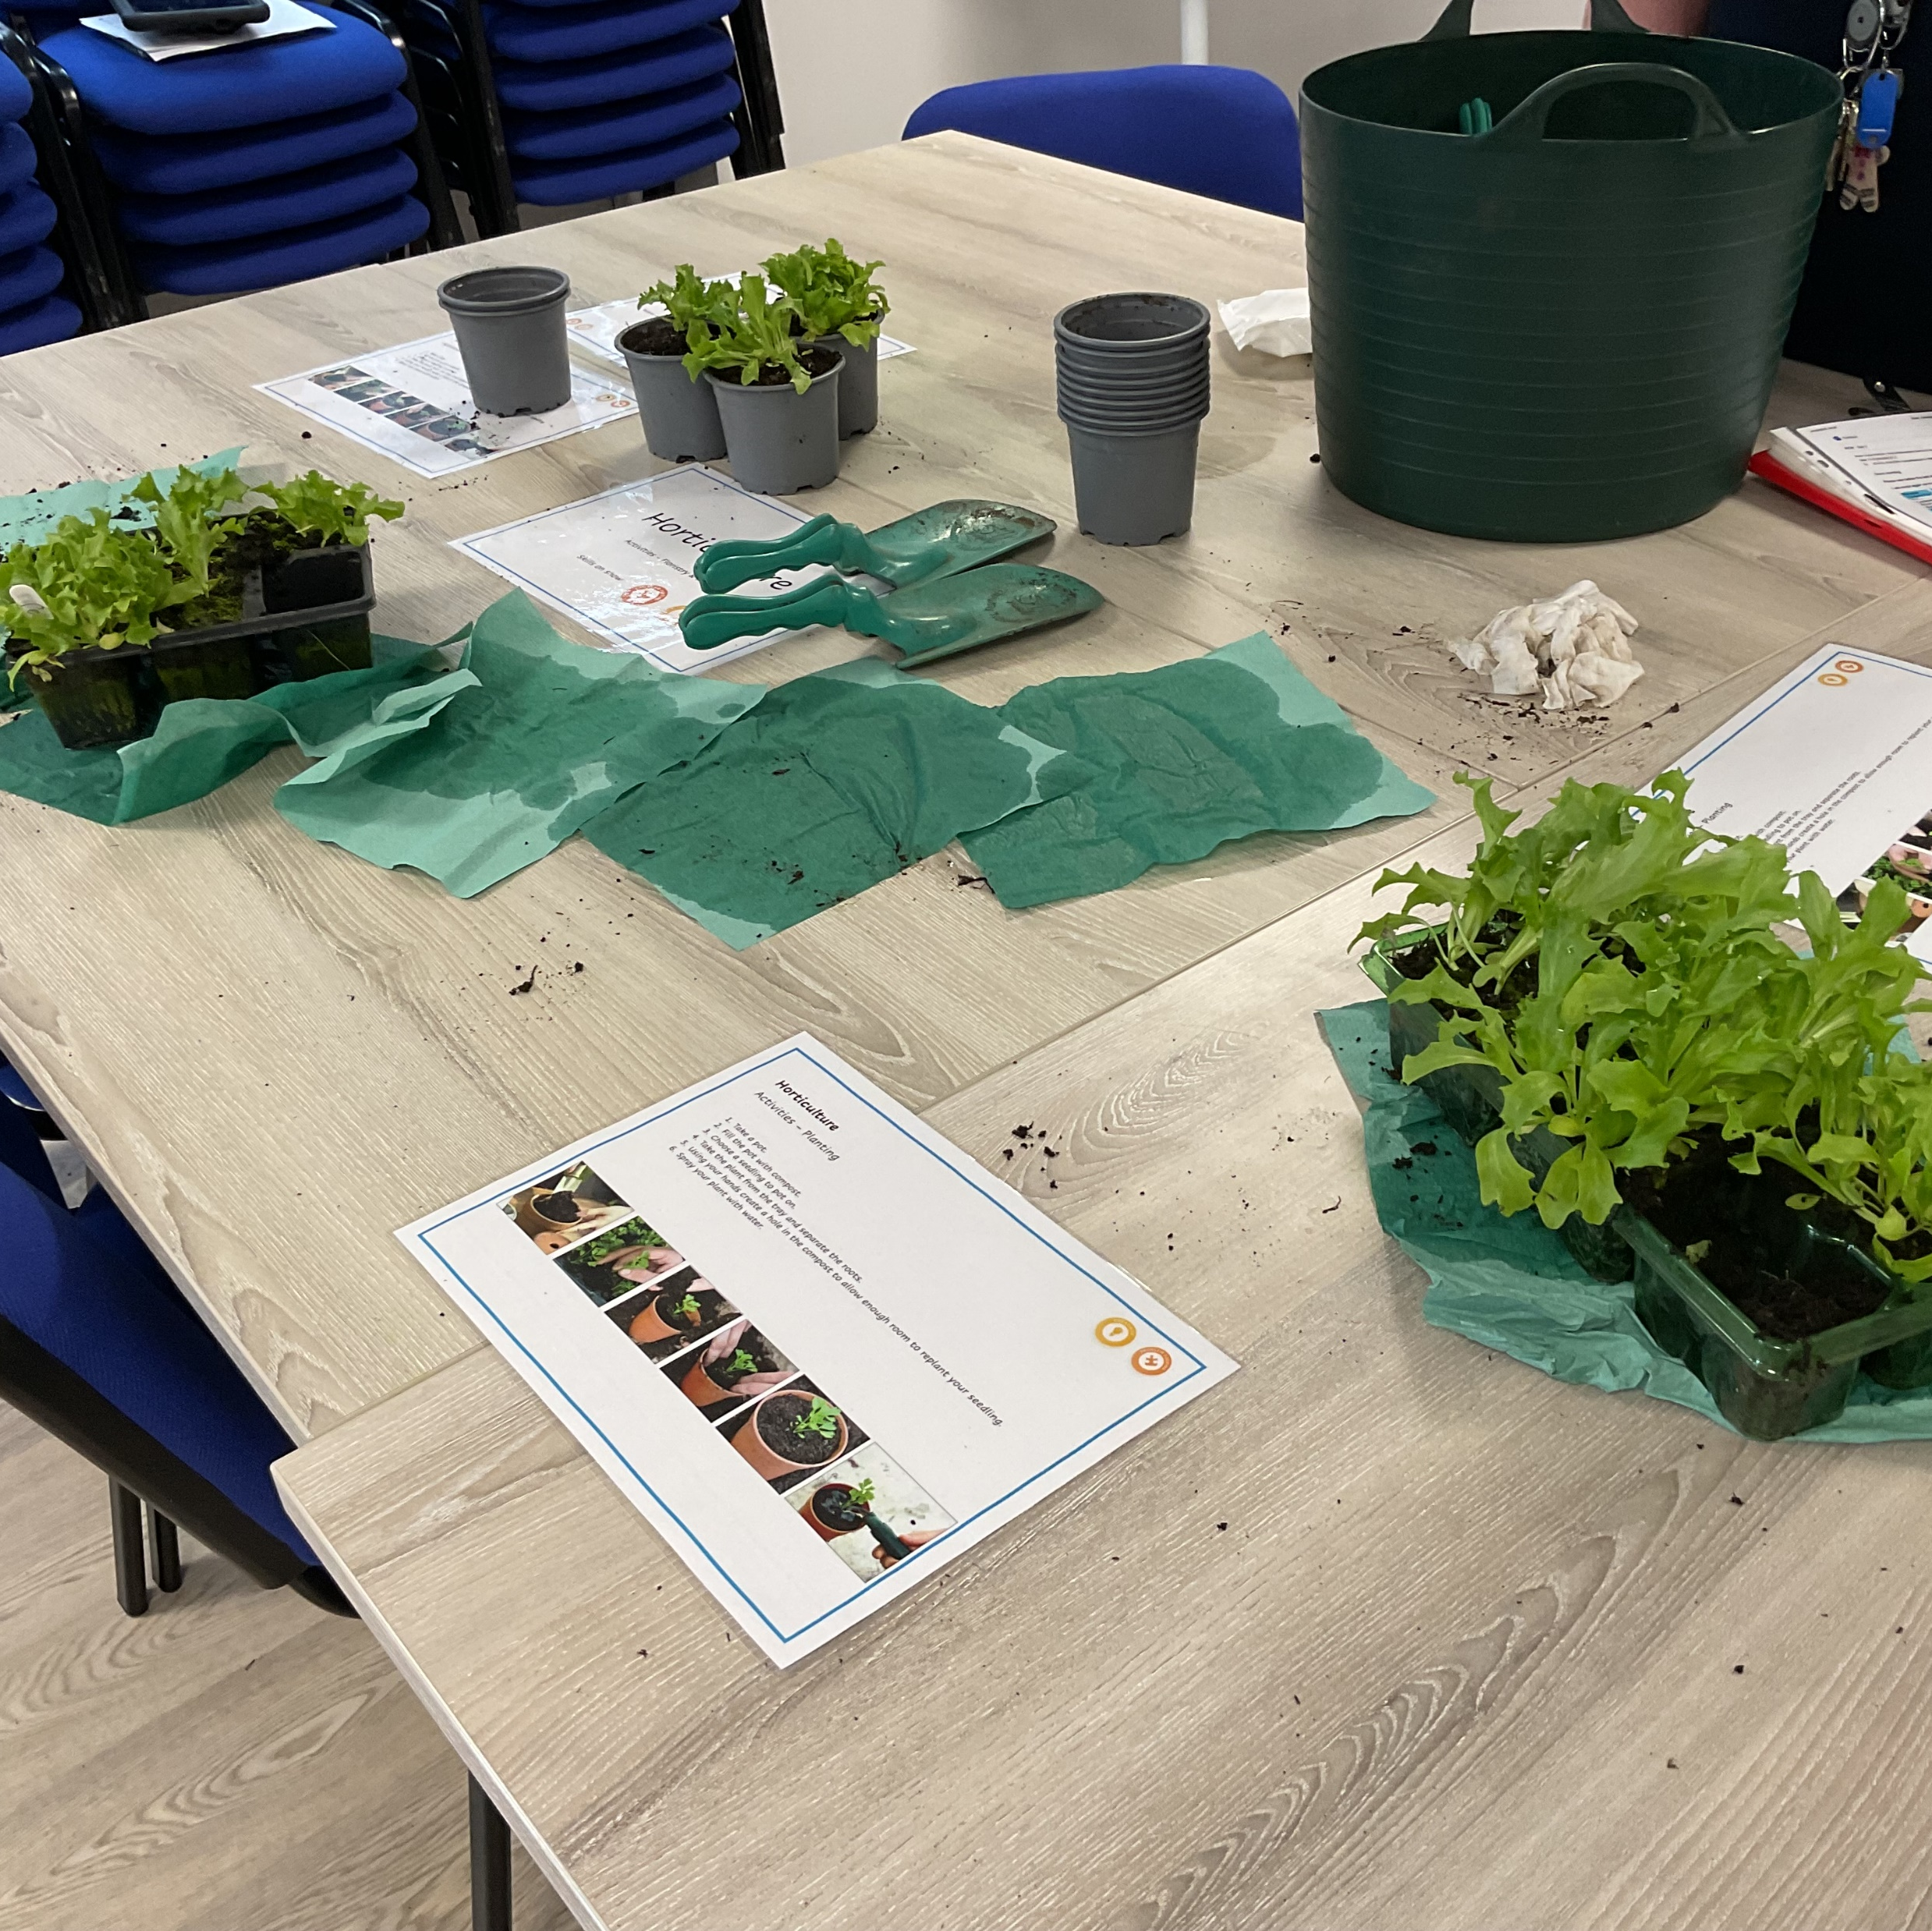
Skills Builder
Notes:
Talk about Skills Builder – students showcasing their skills as part of the reverse careers fair. Workshops build around Skills Builder, students demonstrating their skills.
Talk about each of the stations – impact
Inclusivity – building confidence – sharing skills in a familiar environment with unfamiliar people

Slide 7
INclusivity
All students are taught discrete careers lessons using a blend of approaches.
Ensuring every opportunity is used to gain information about ‘careers’ including student voice.
Working with the local community to develop relationships to promote inclusivity
Notes:
Talk about how we do this. What does this look like?
Importance of educational visits and the value these hold.
Form 5 adaptation to capture Gatsby benchmarking
Working in the community – developing strong community links - cafe

Slide 8
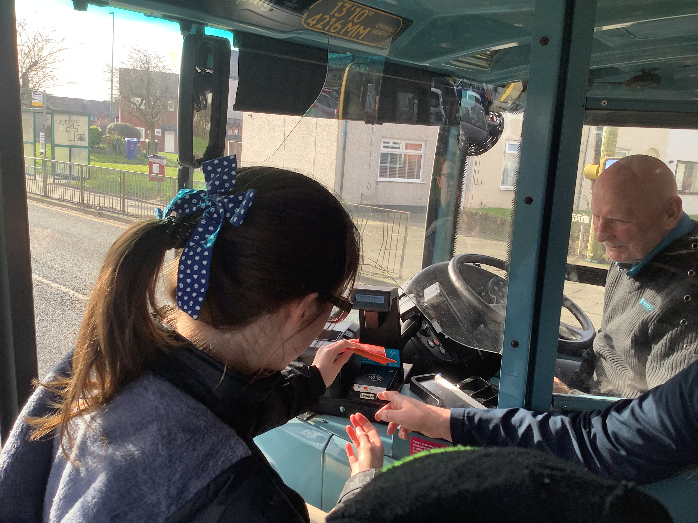
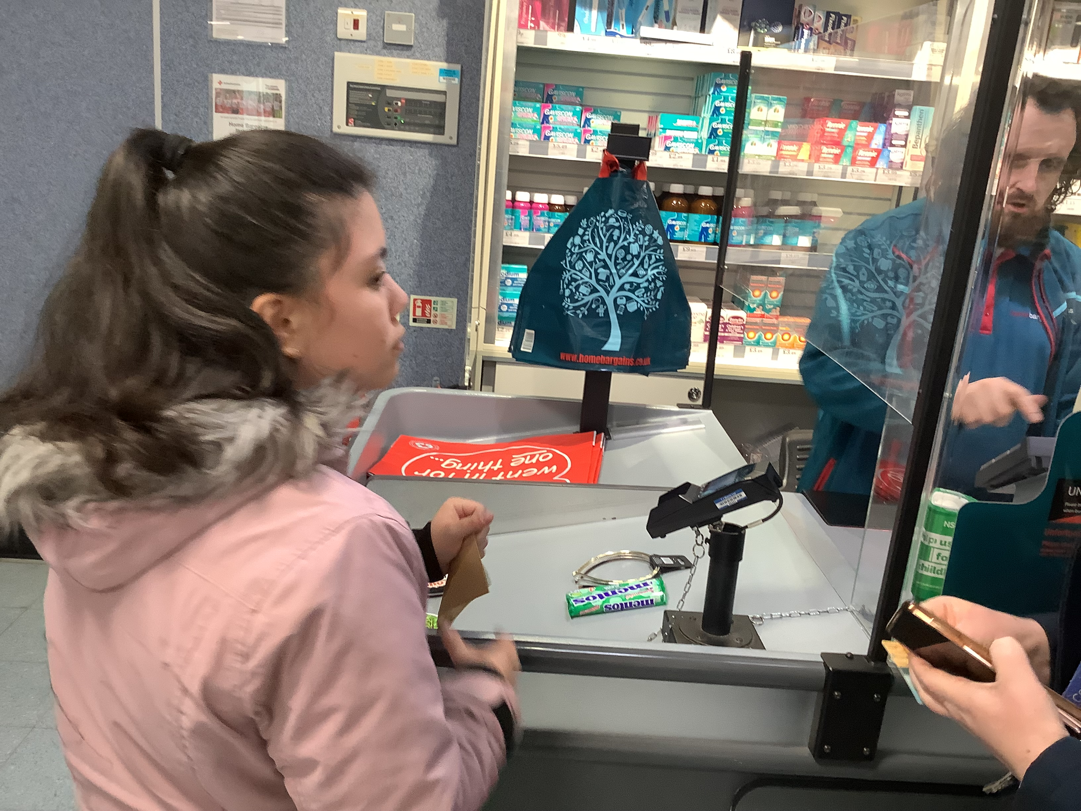
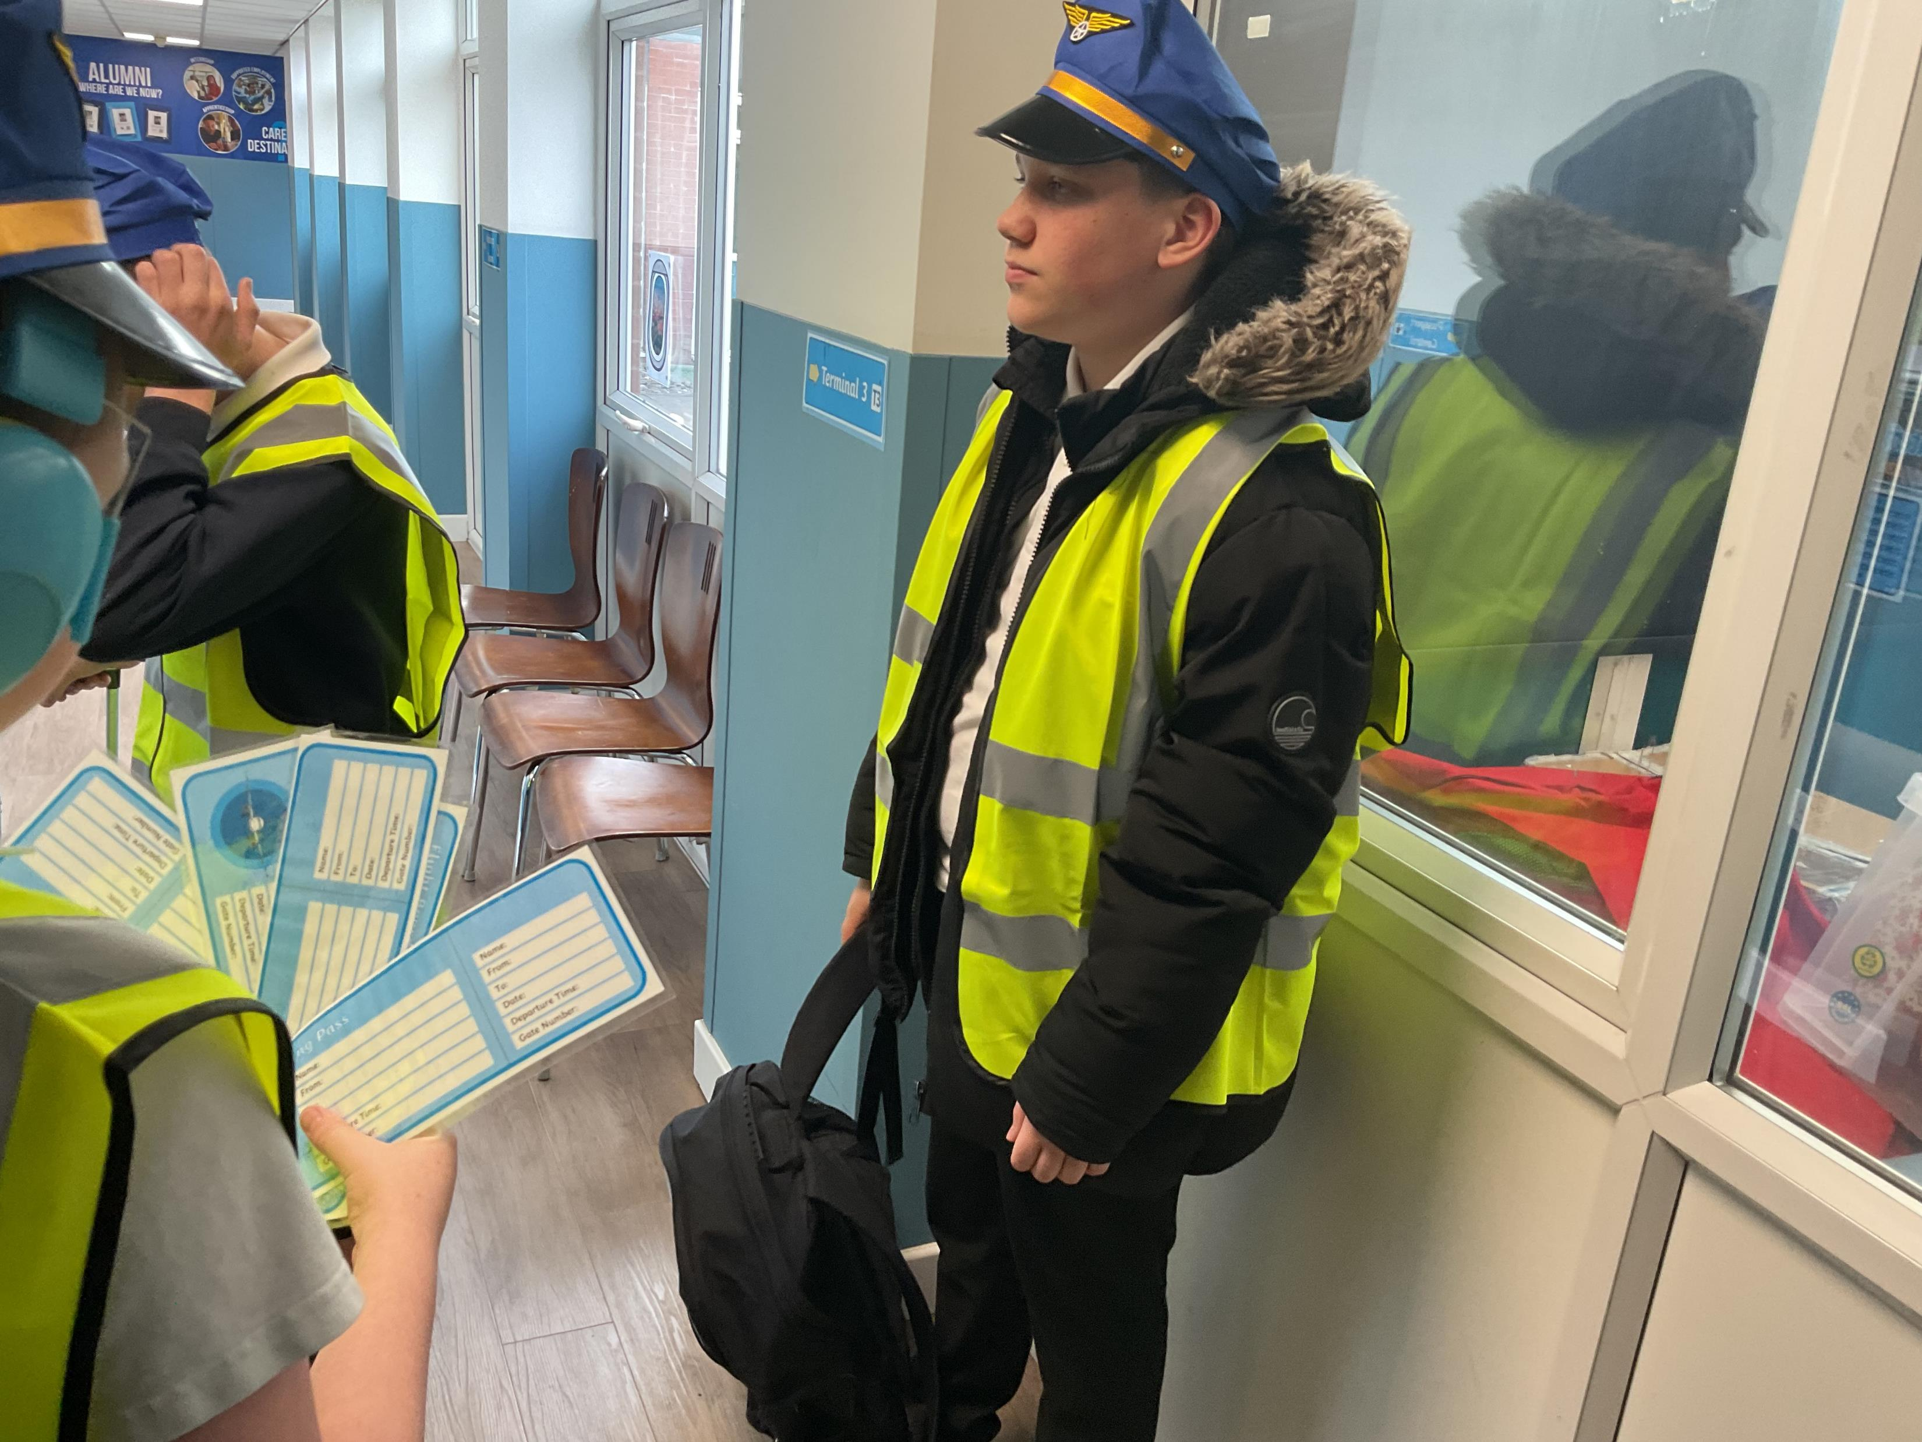
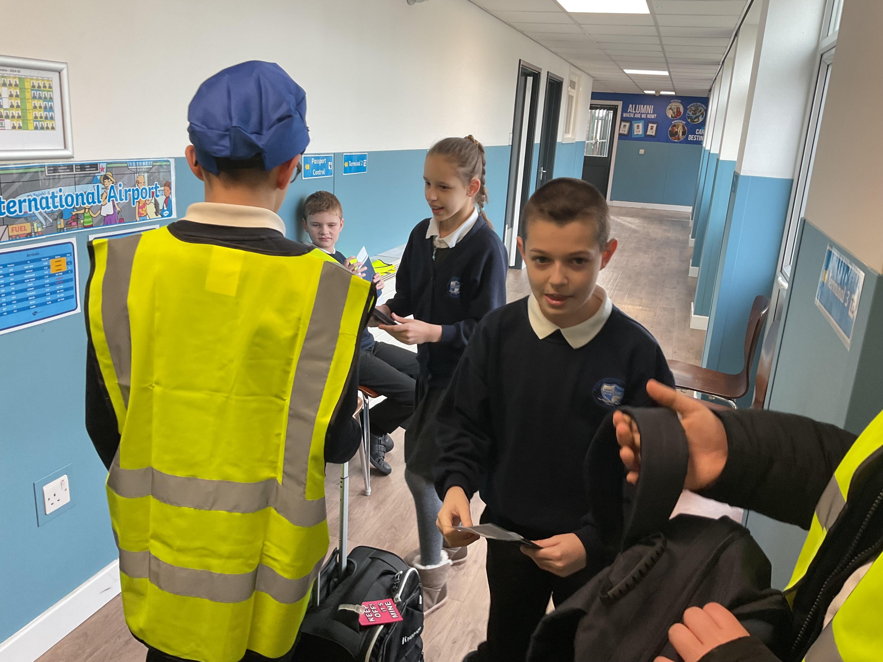
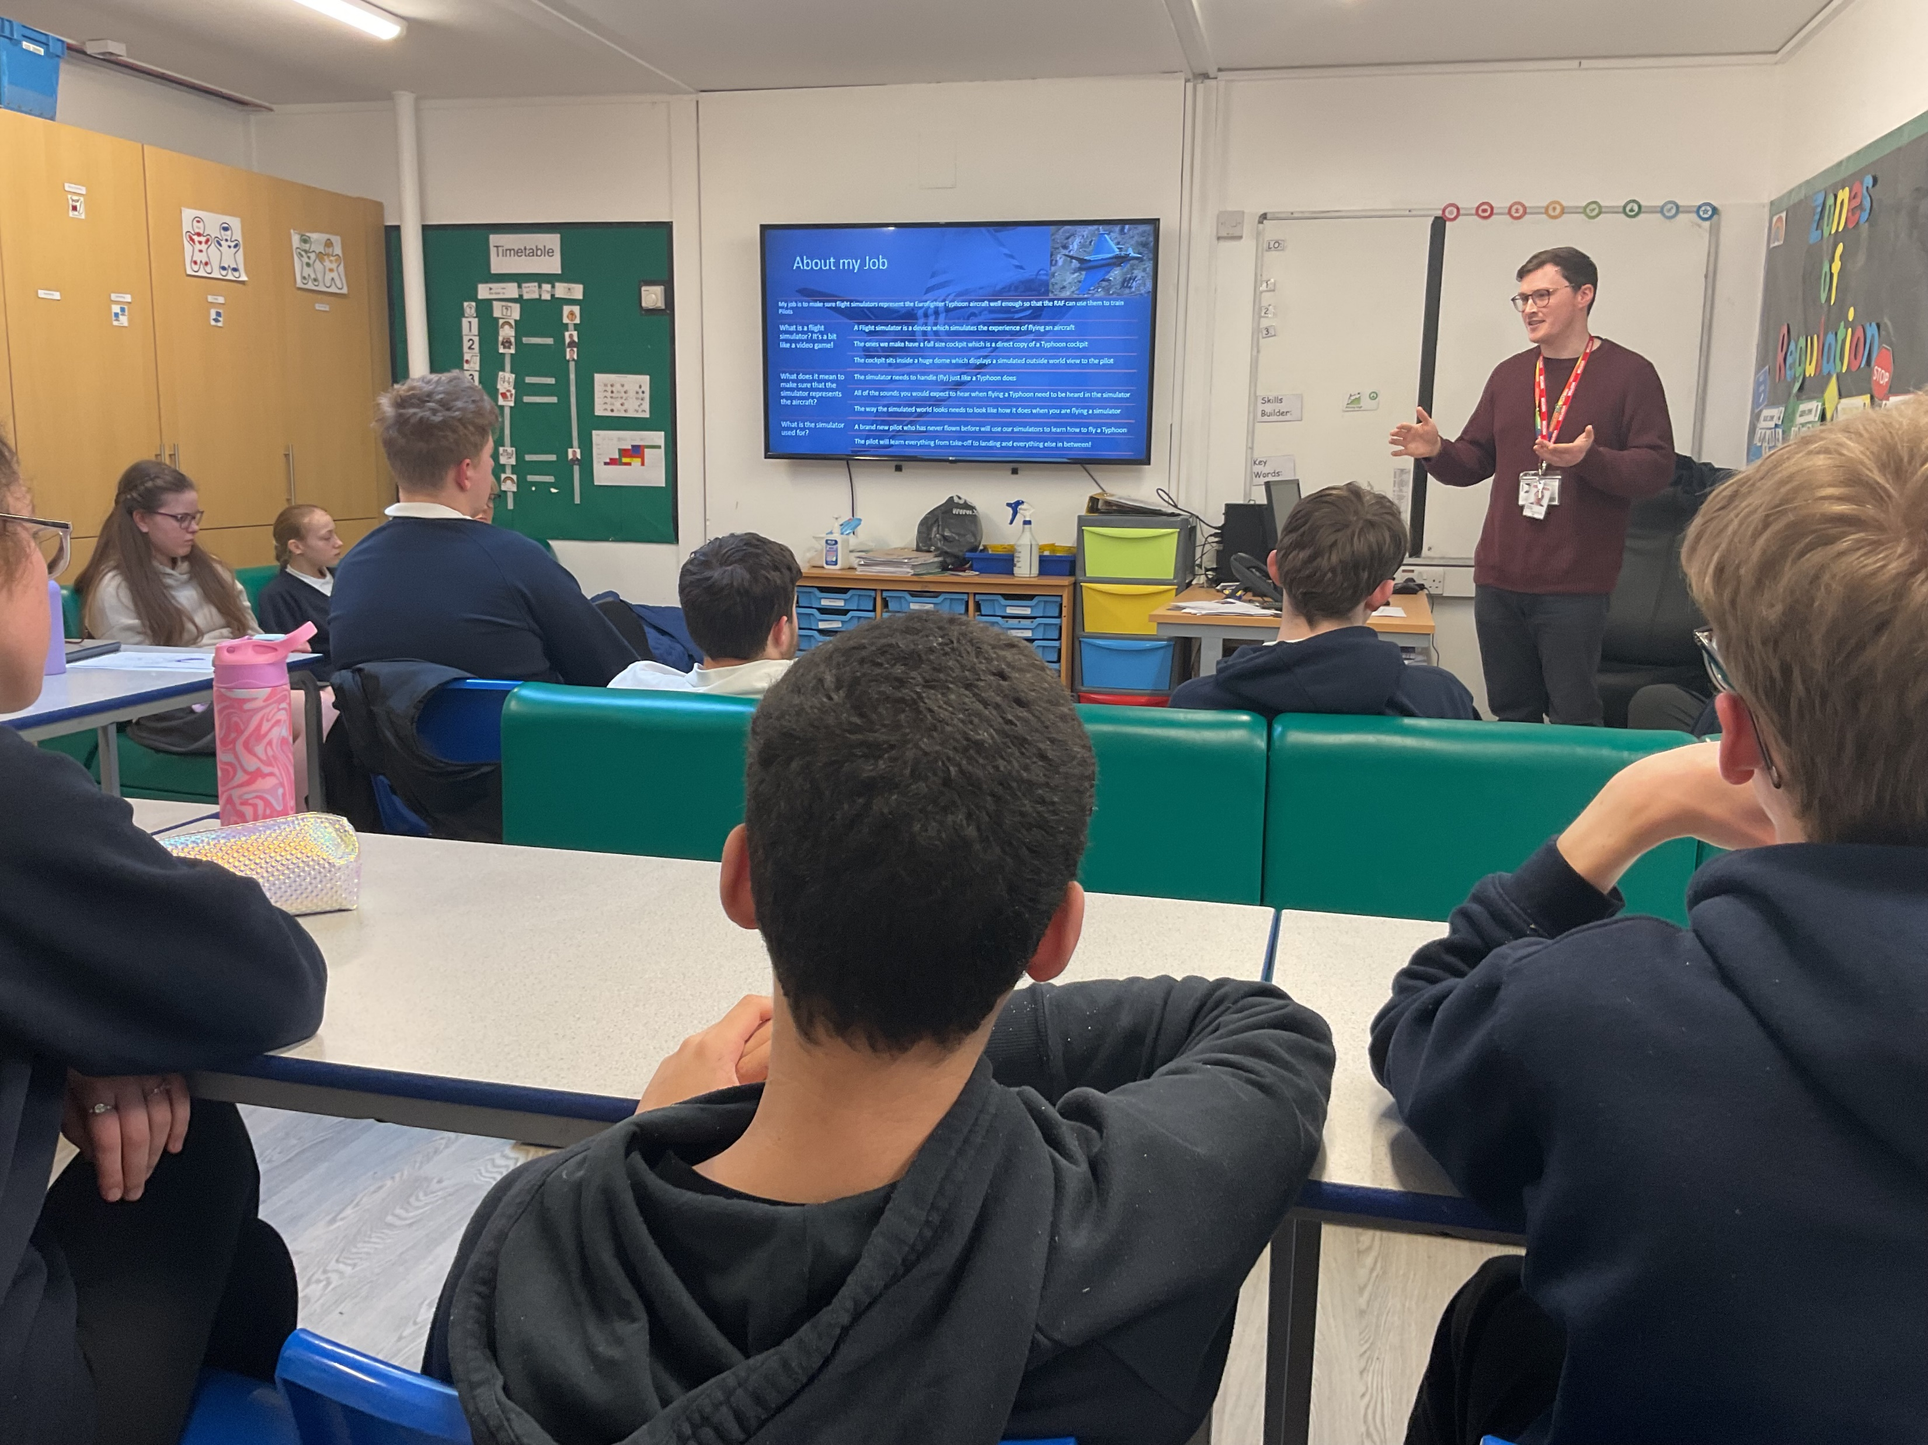
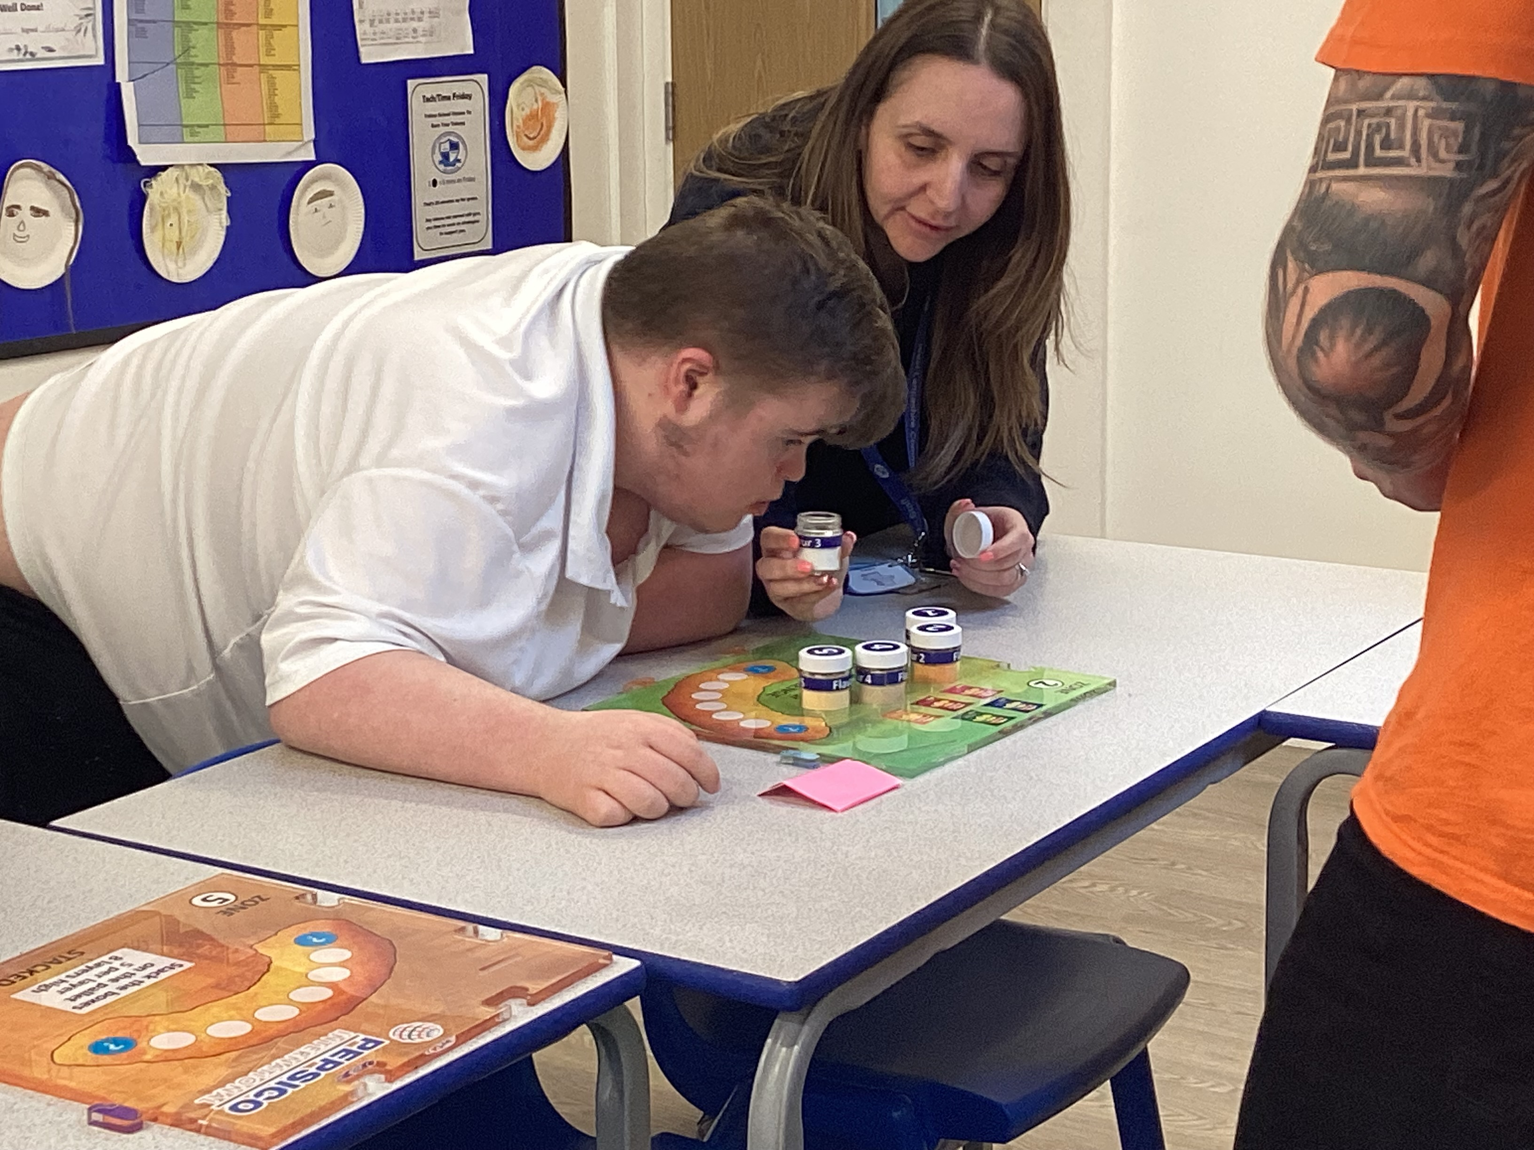
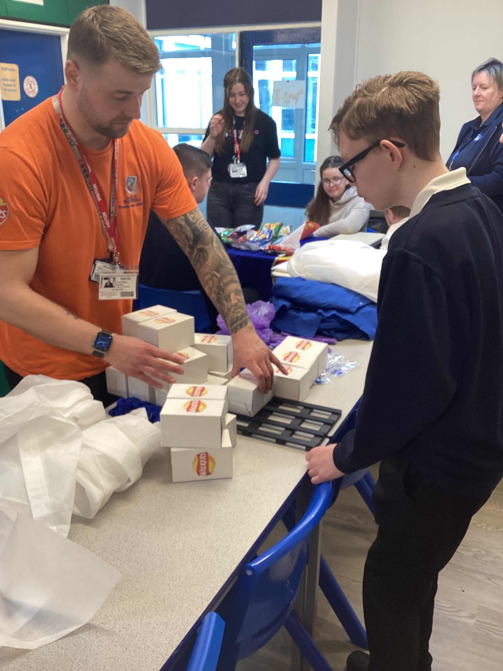
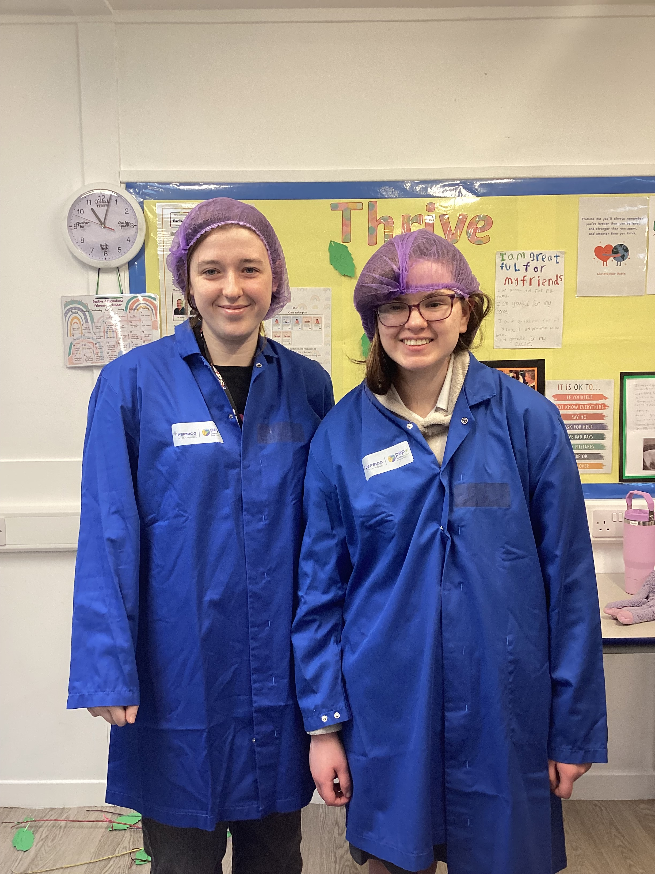
Bringing careers to Life

Slide 9
Careers Programme
Skills Builder
Asdan Raising Aspirations
CDI Framework
ASDAN Towards Independence
ASDAN Personal Development Programme
ASDAN Careers and Experiencing Work
Educational Visits
Notes:
Recap

Slide 10
Students & Working in the workplace
Respect
Success
Friendship
Achieve
Notes:
Pictures of students to be uploaded.
Talk about different sectors of work students work in and how this can differ in regards to support etc.
Introduce the students who will talk about their work placements, the skills they are developing, the jobs that they do and how it has helped them in building employability skills and what support looks like for them.
Recap on school values

Slide 11
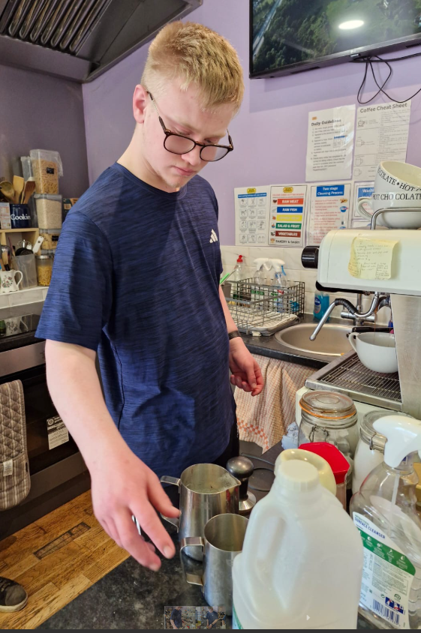
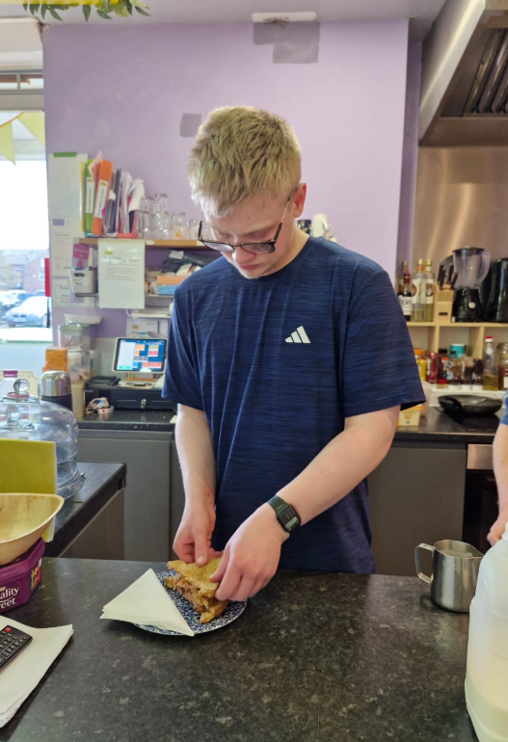
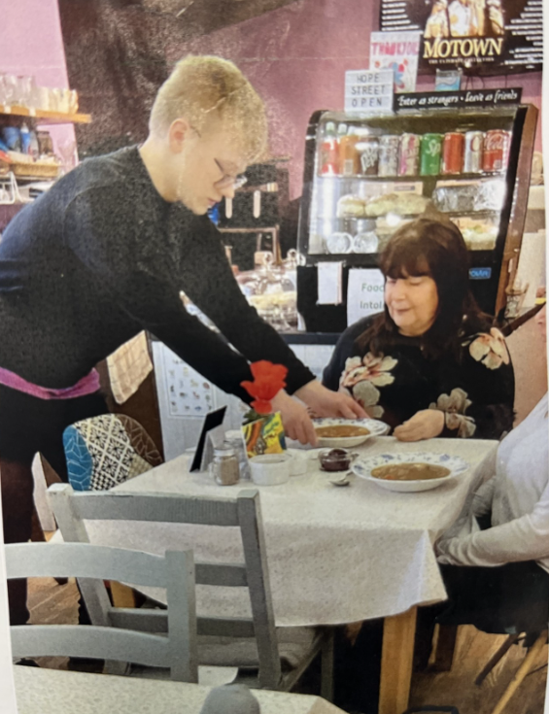
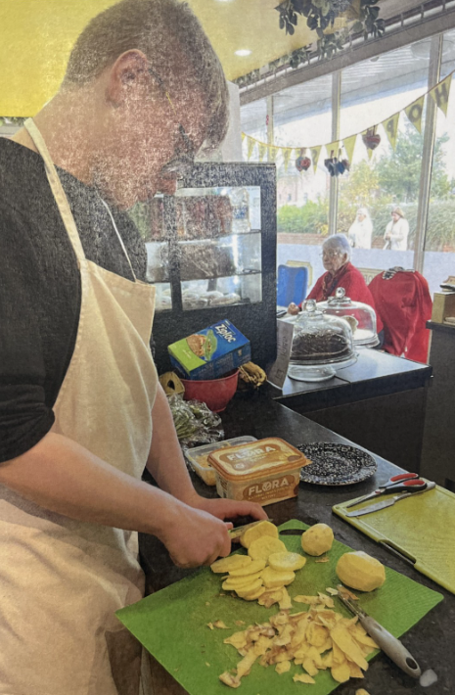
Harry
Notes:
Student with support to talk through their own experiences.

Slide 12
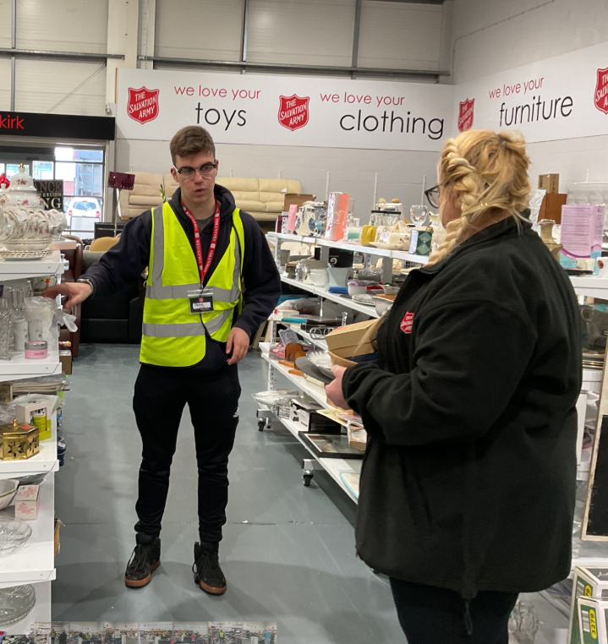
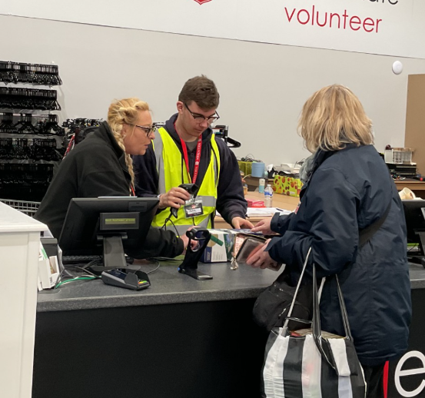
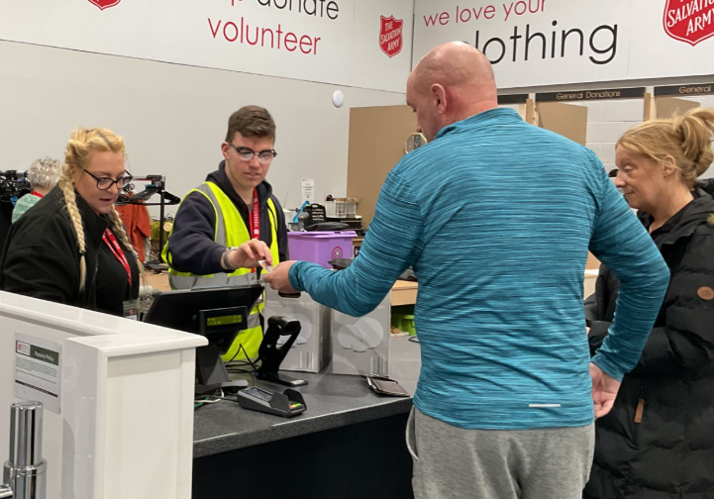
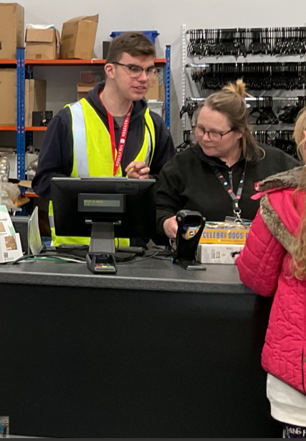
Jake
Notes:
Student with support to talk through their own experiences.

Slide 13
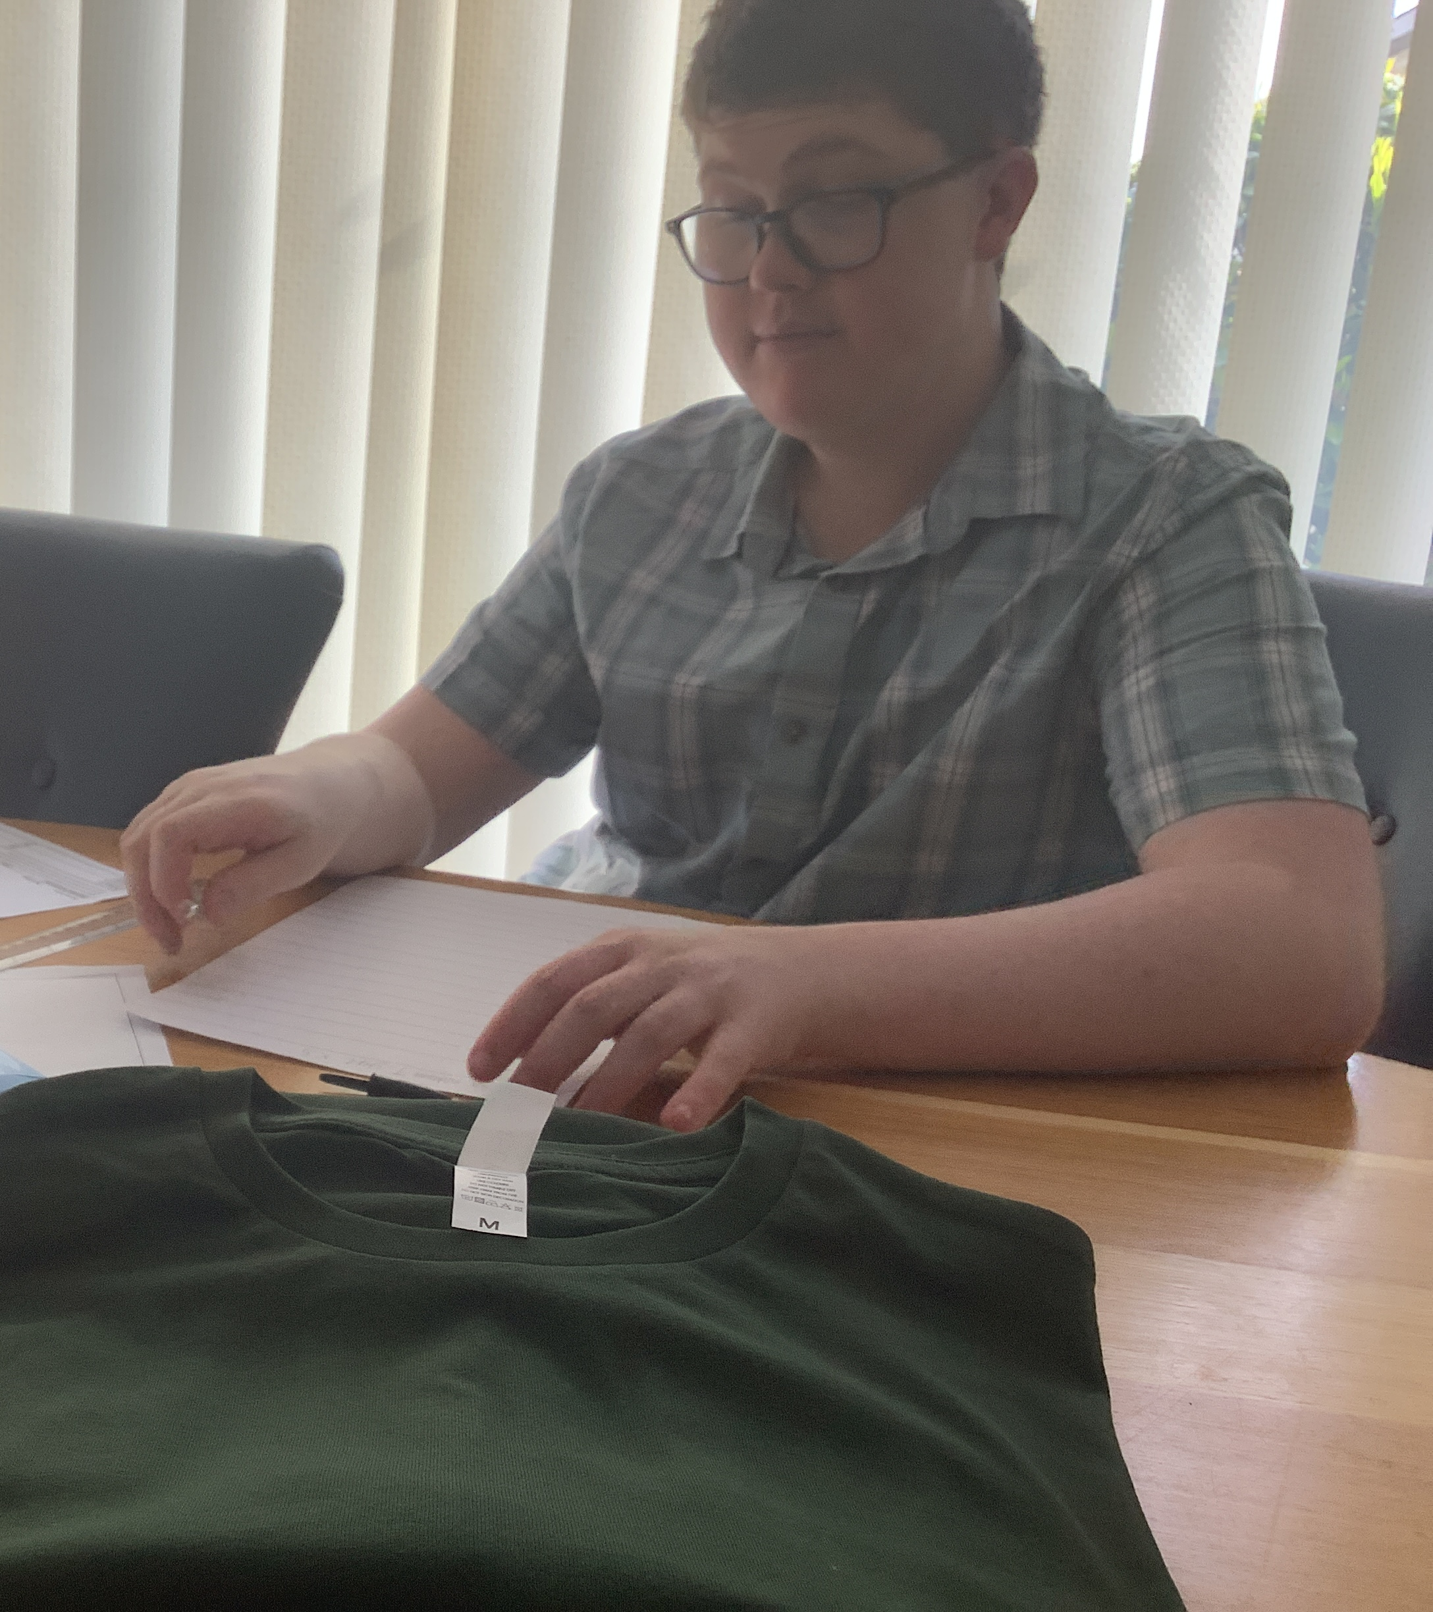
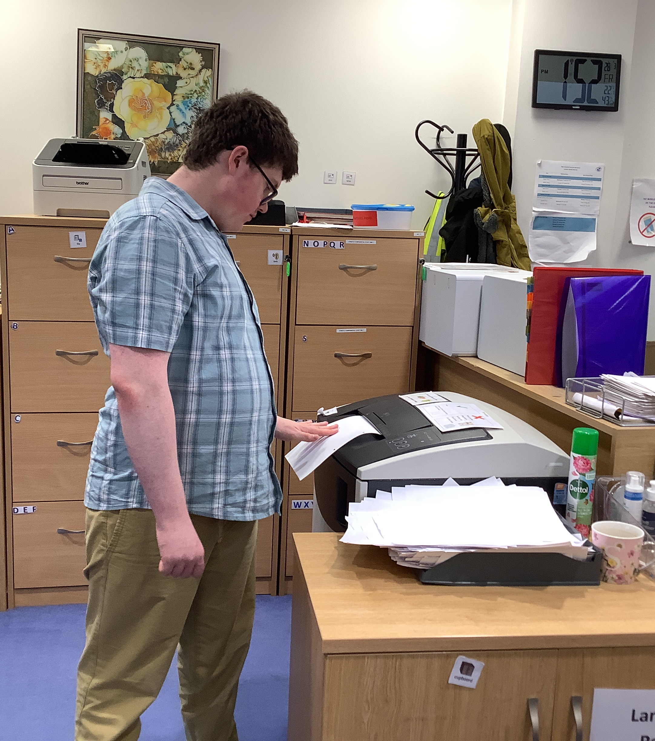
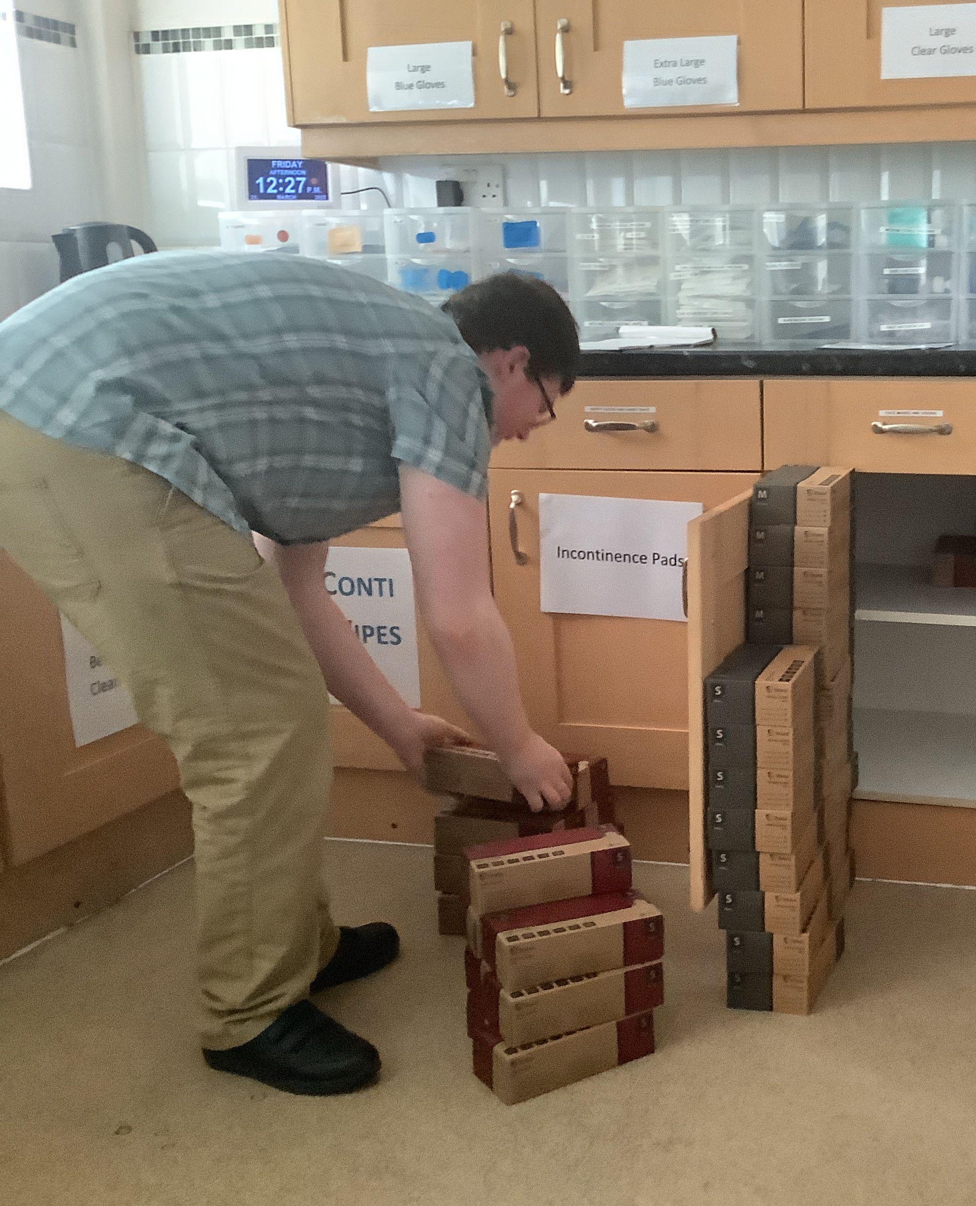
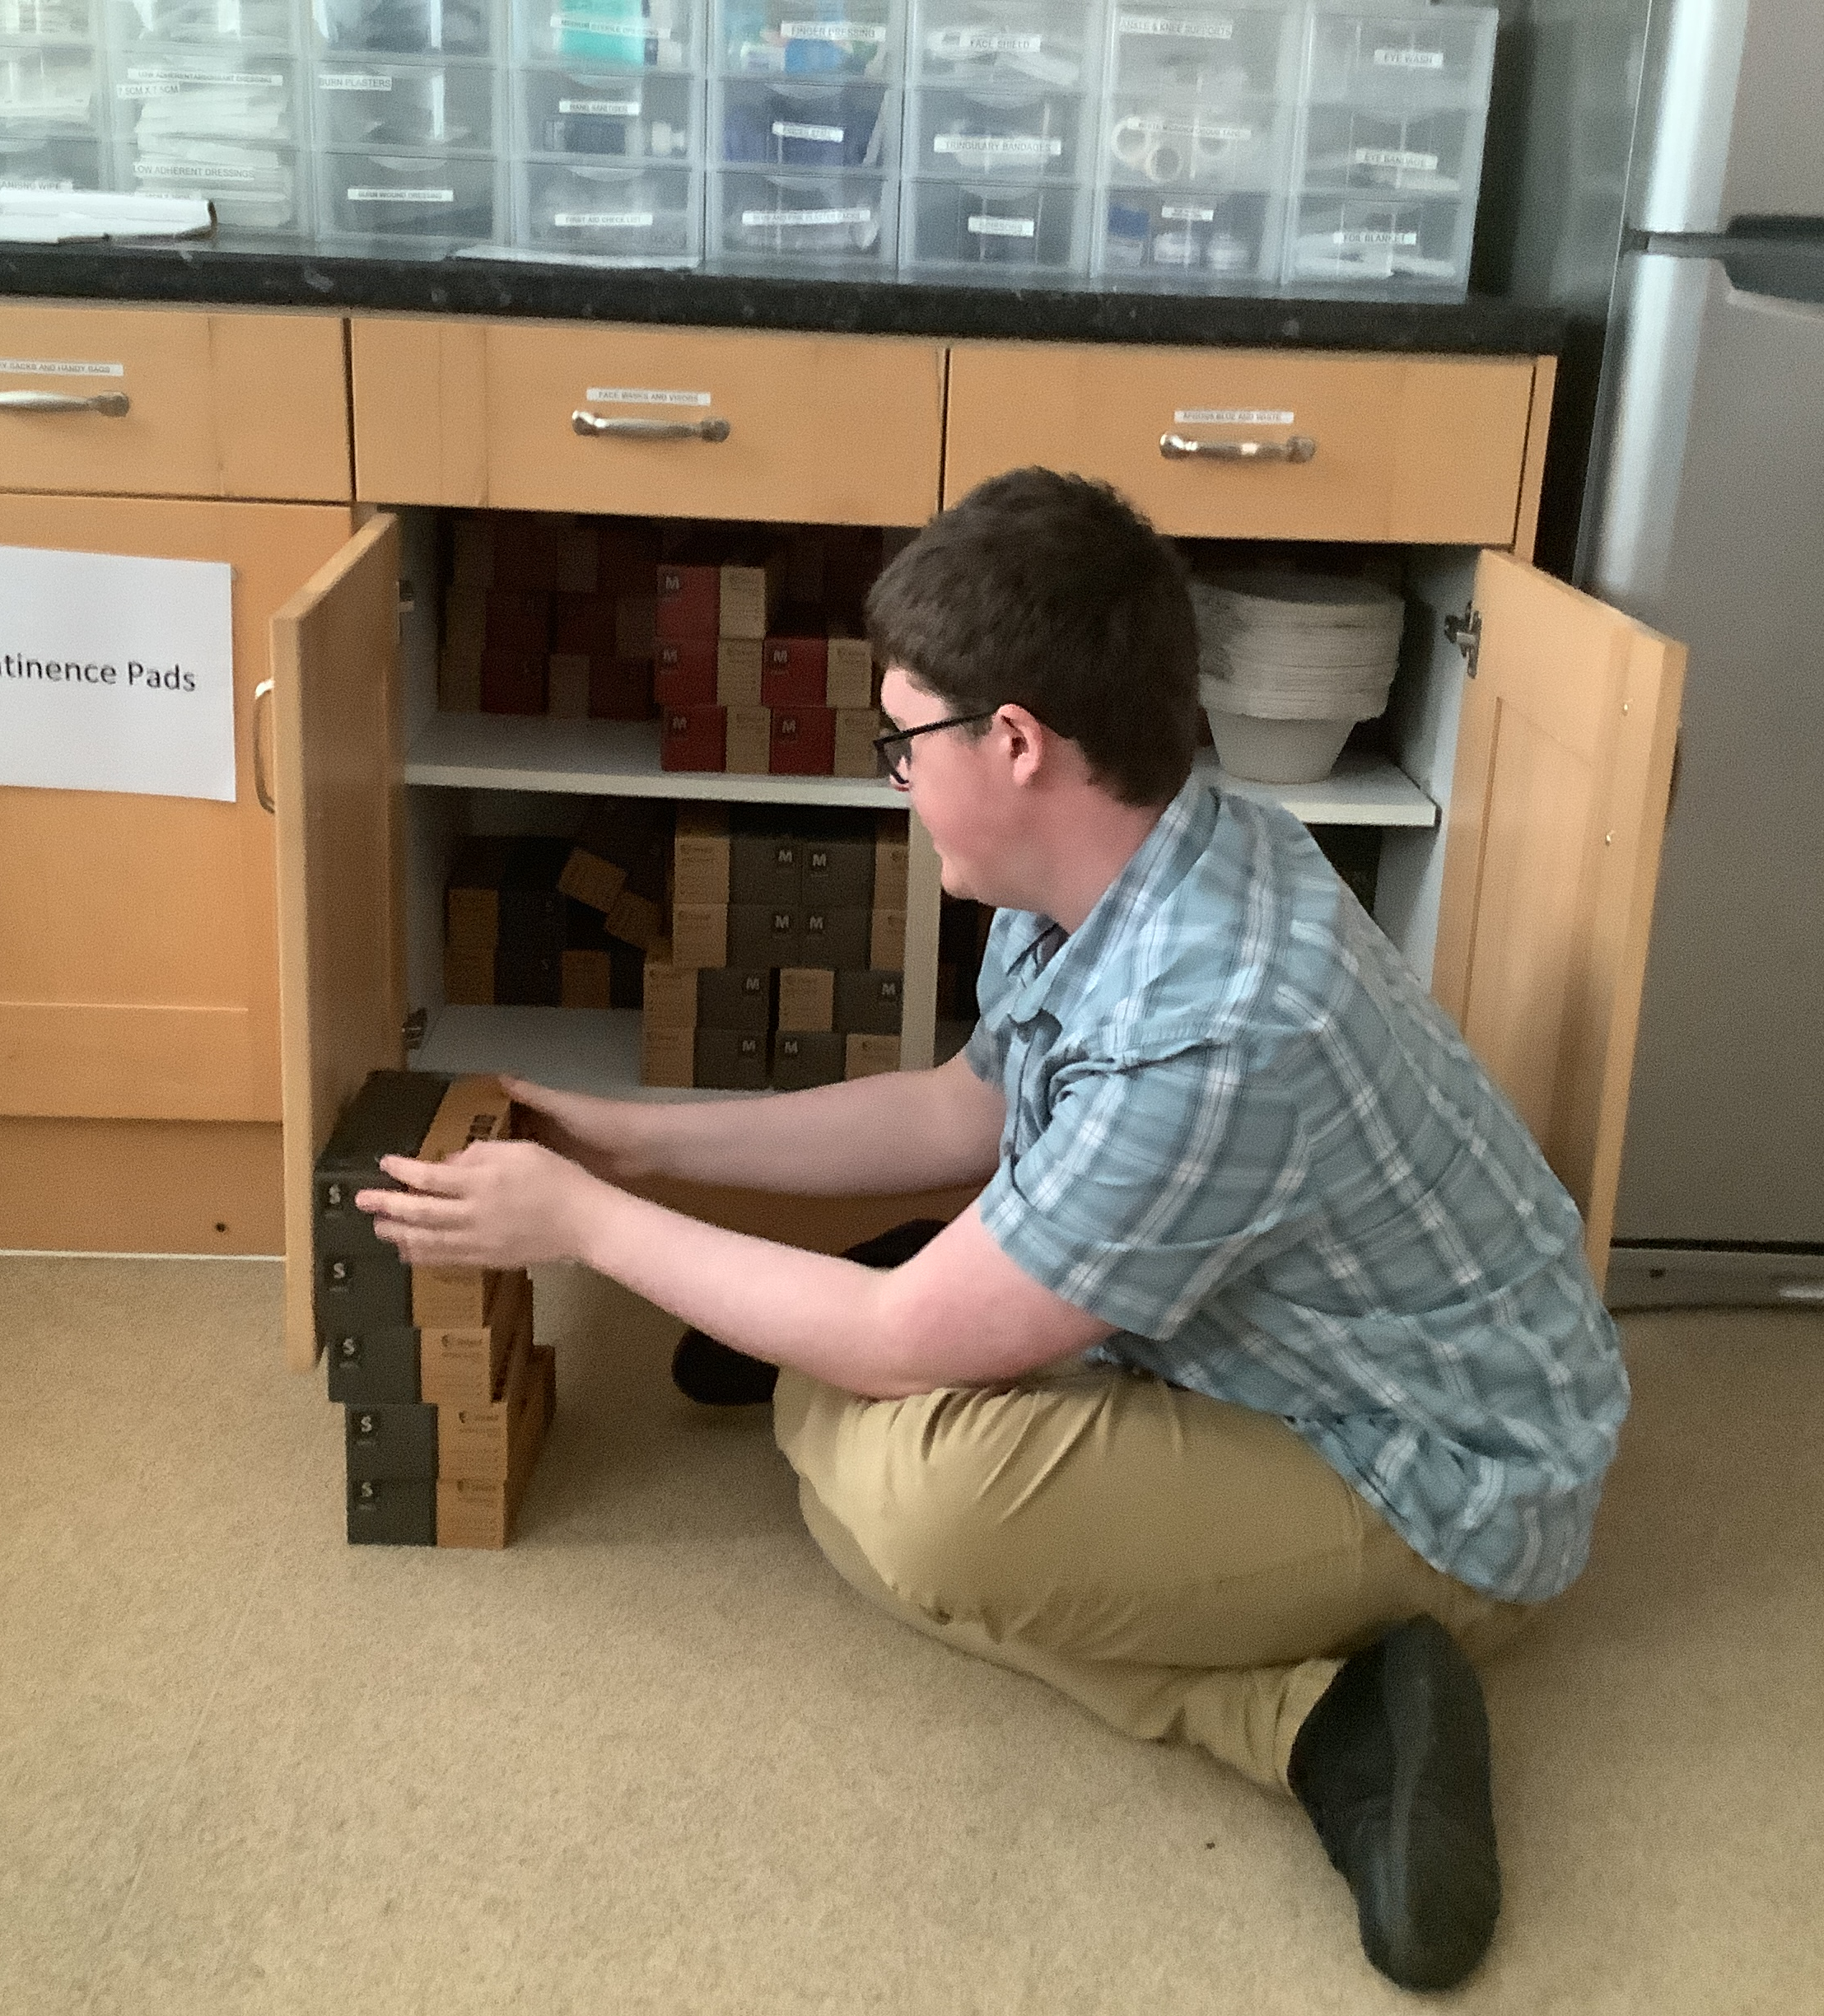
Oliver
Notes:
Student with support to talk through their own experiences.

Slide 14
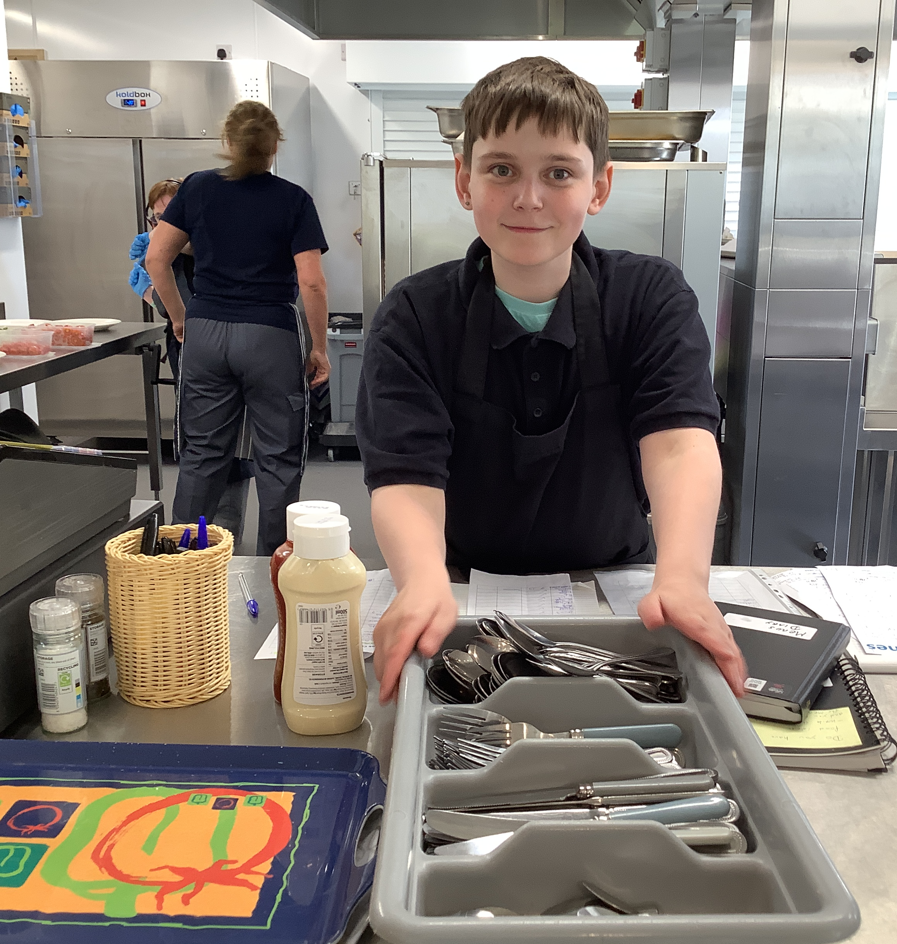
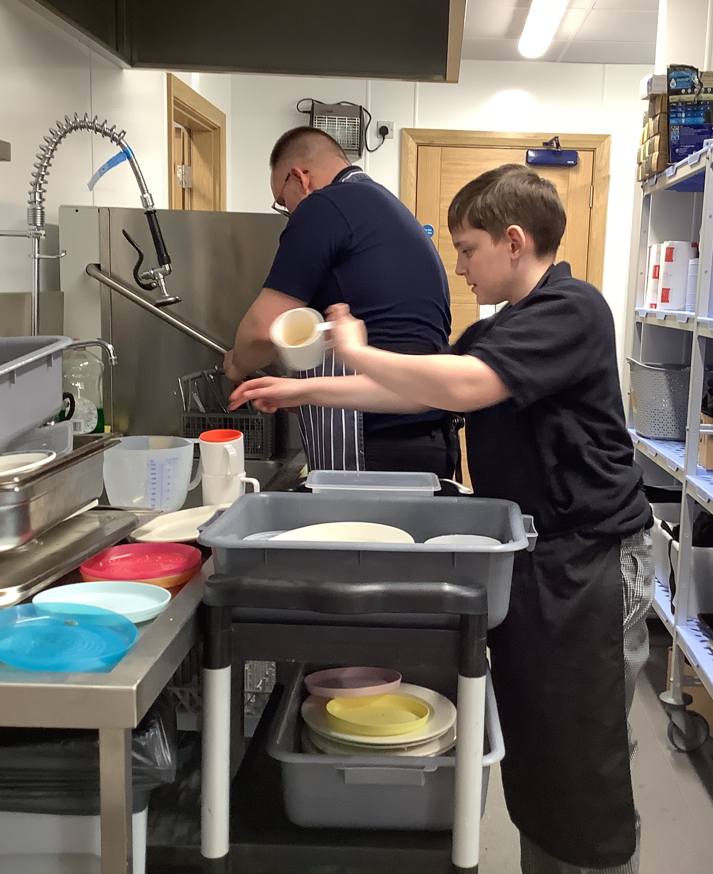
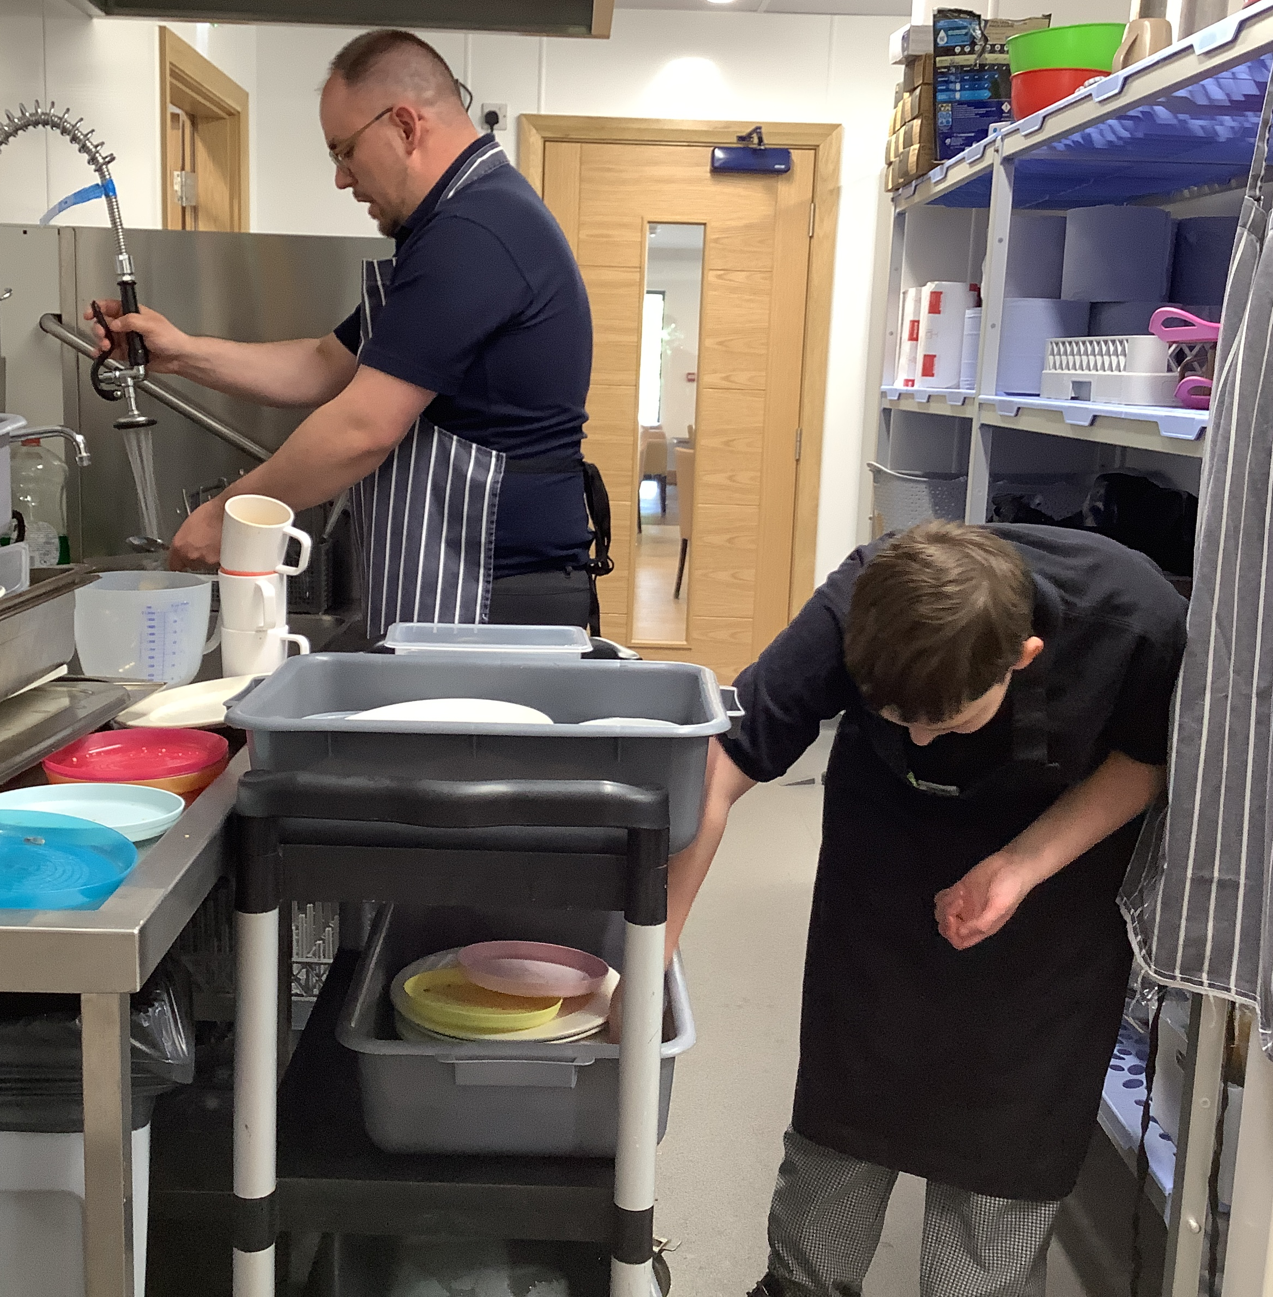
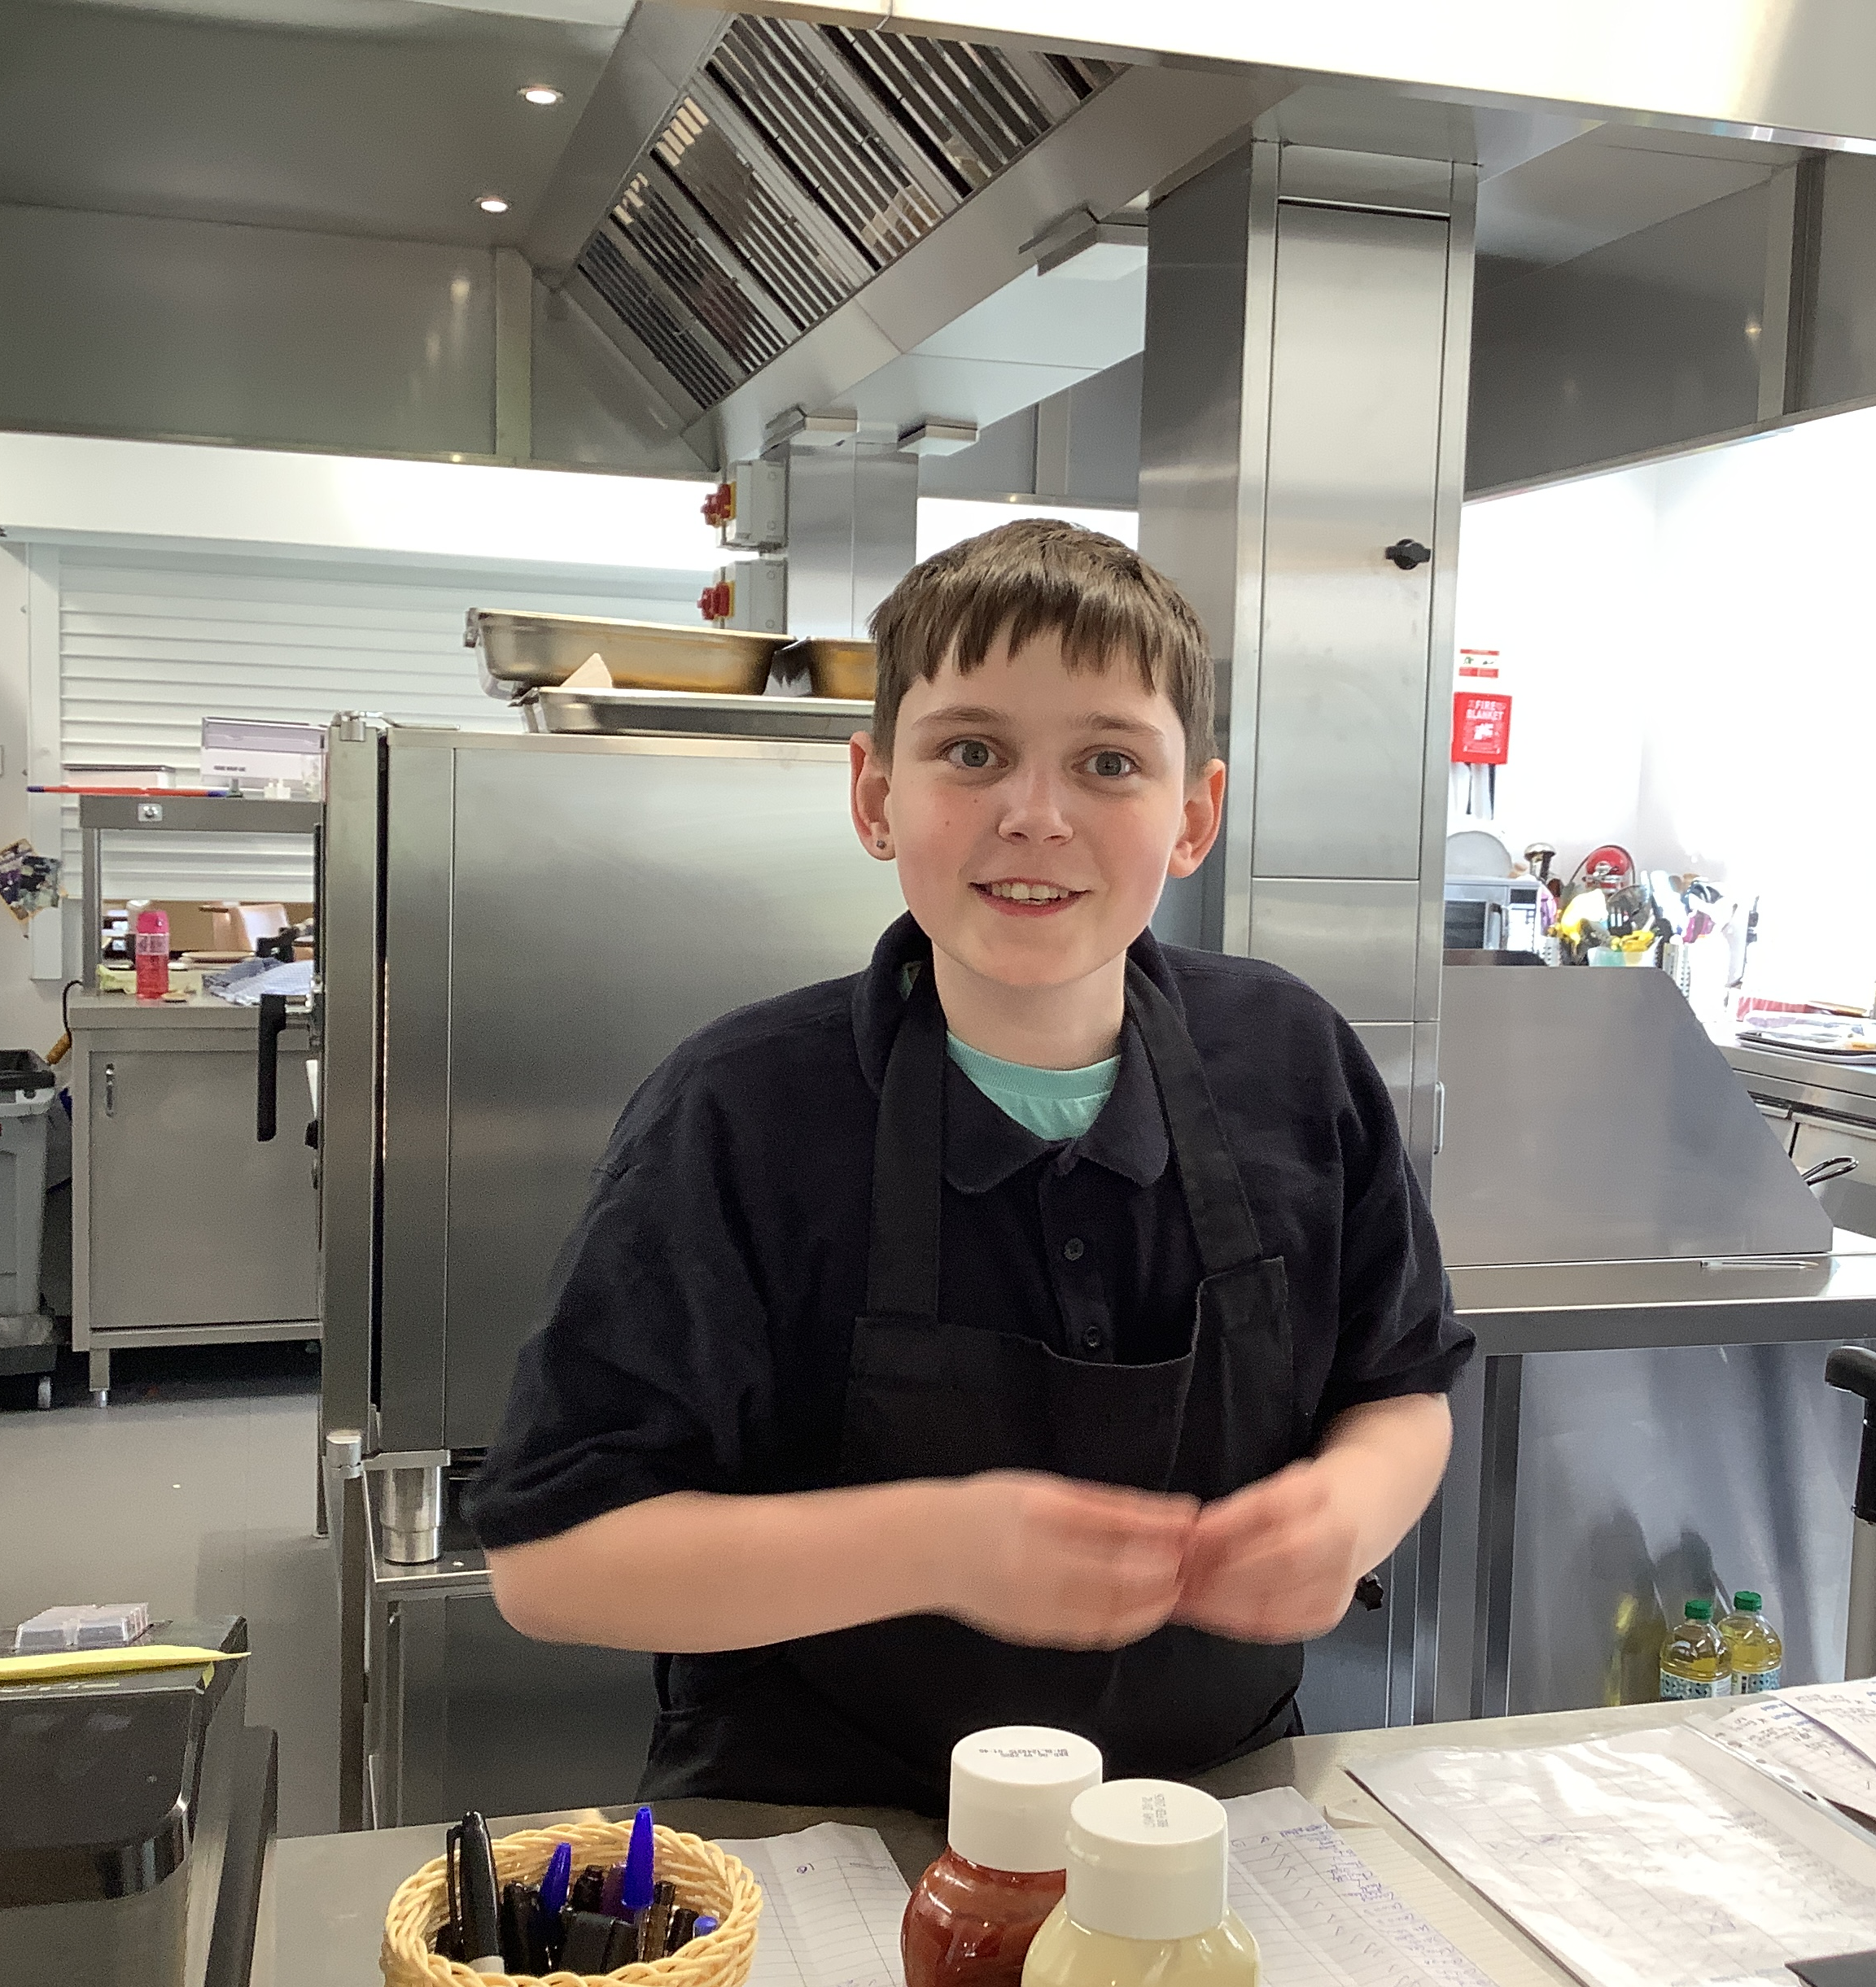
Harvey
Notes:
Student with support to talk through their own experiences.

Slide 15
Work opportunities
KS3 – KS5 – Employer and Employee Encounter sessions
Y11 – 2-week work placement
Guest speakers
Linking careers to educational visits
KS5 – Work Placement opportunities
Notes:
Introduce the students who will talk about their work placements, the skills they are developing, the jobs that they do and how it has helped them in building employability skills and what support looks like for them.

Slide 16
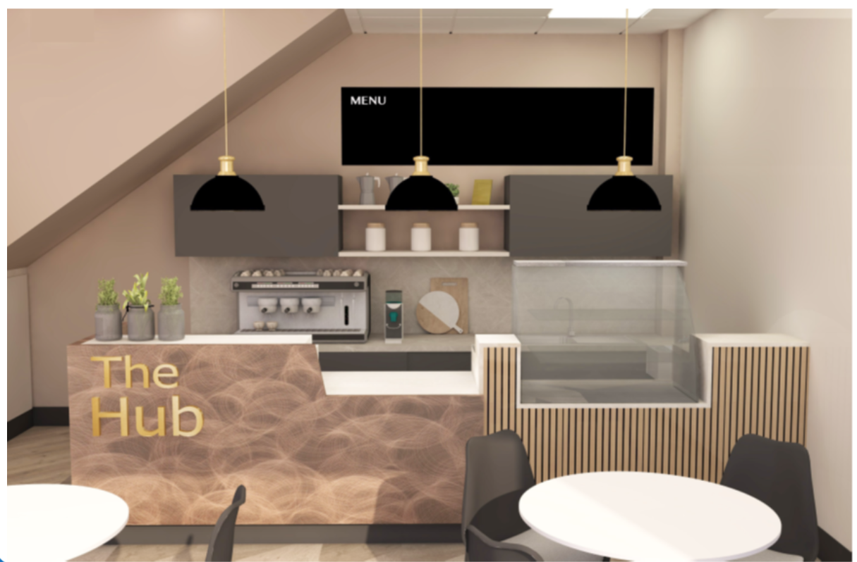
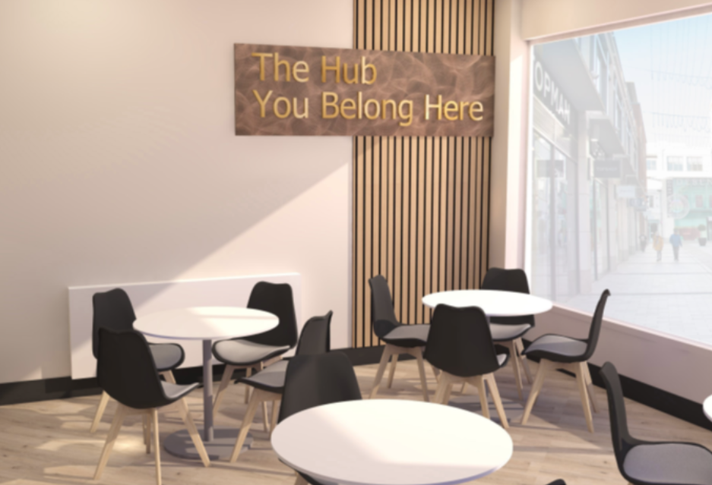
Future ambition
The Hub
Notes:
Talk about the school’s future project and what this will mean to the students – bringing everything together.

