Slide 1
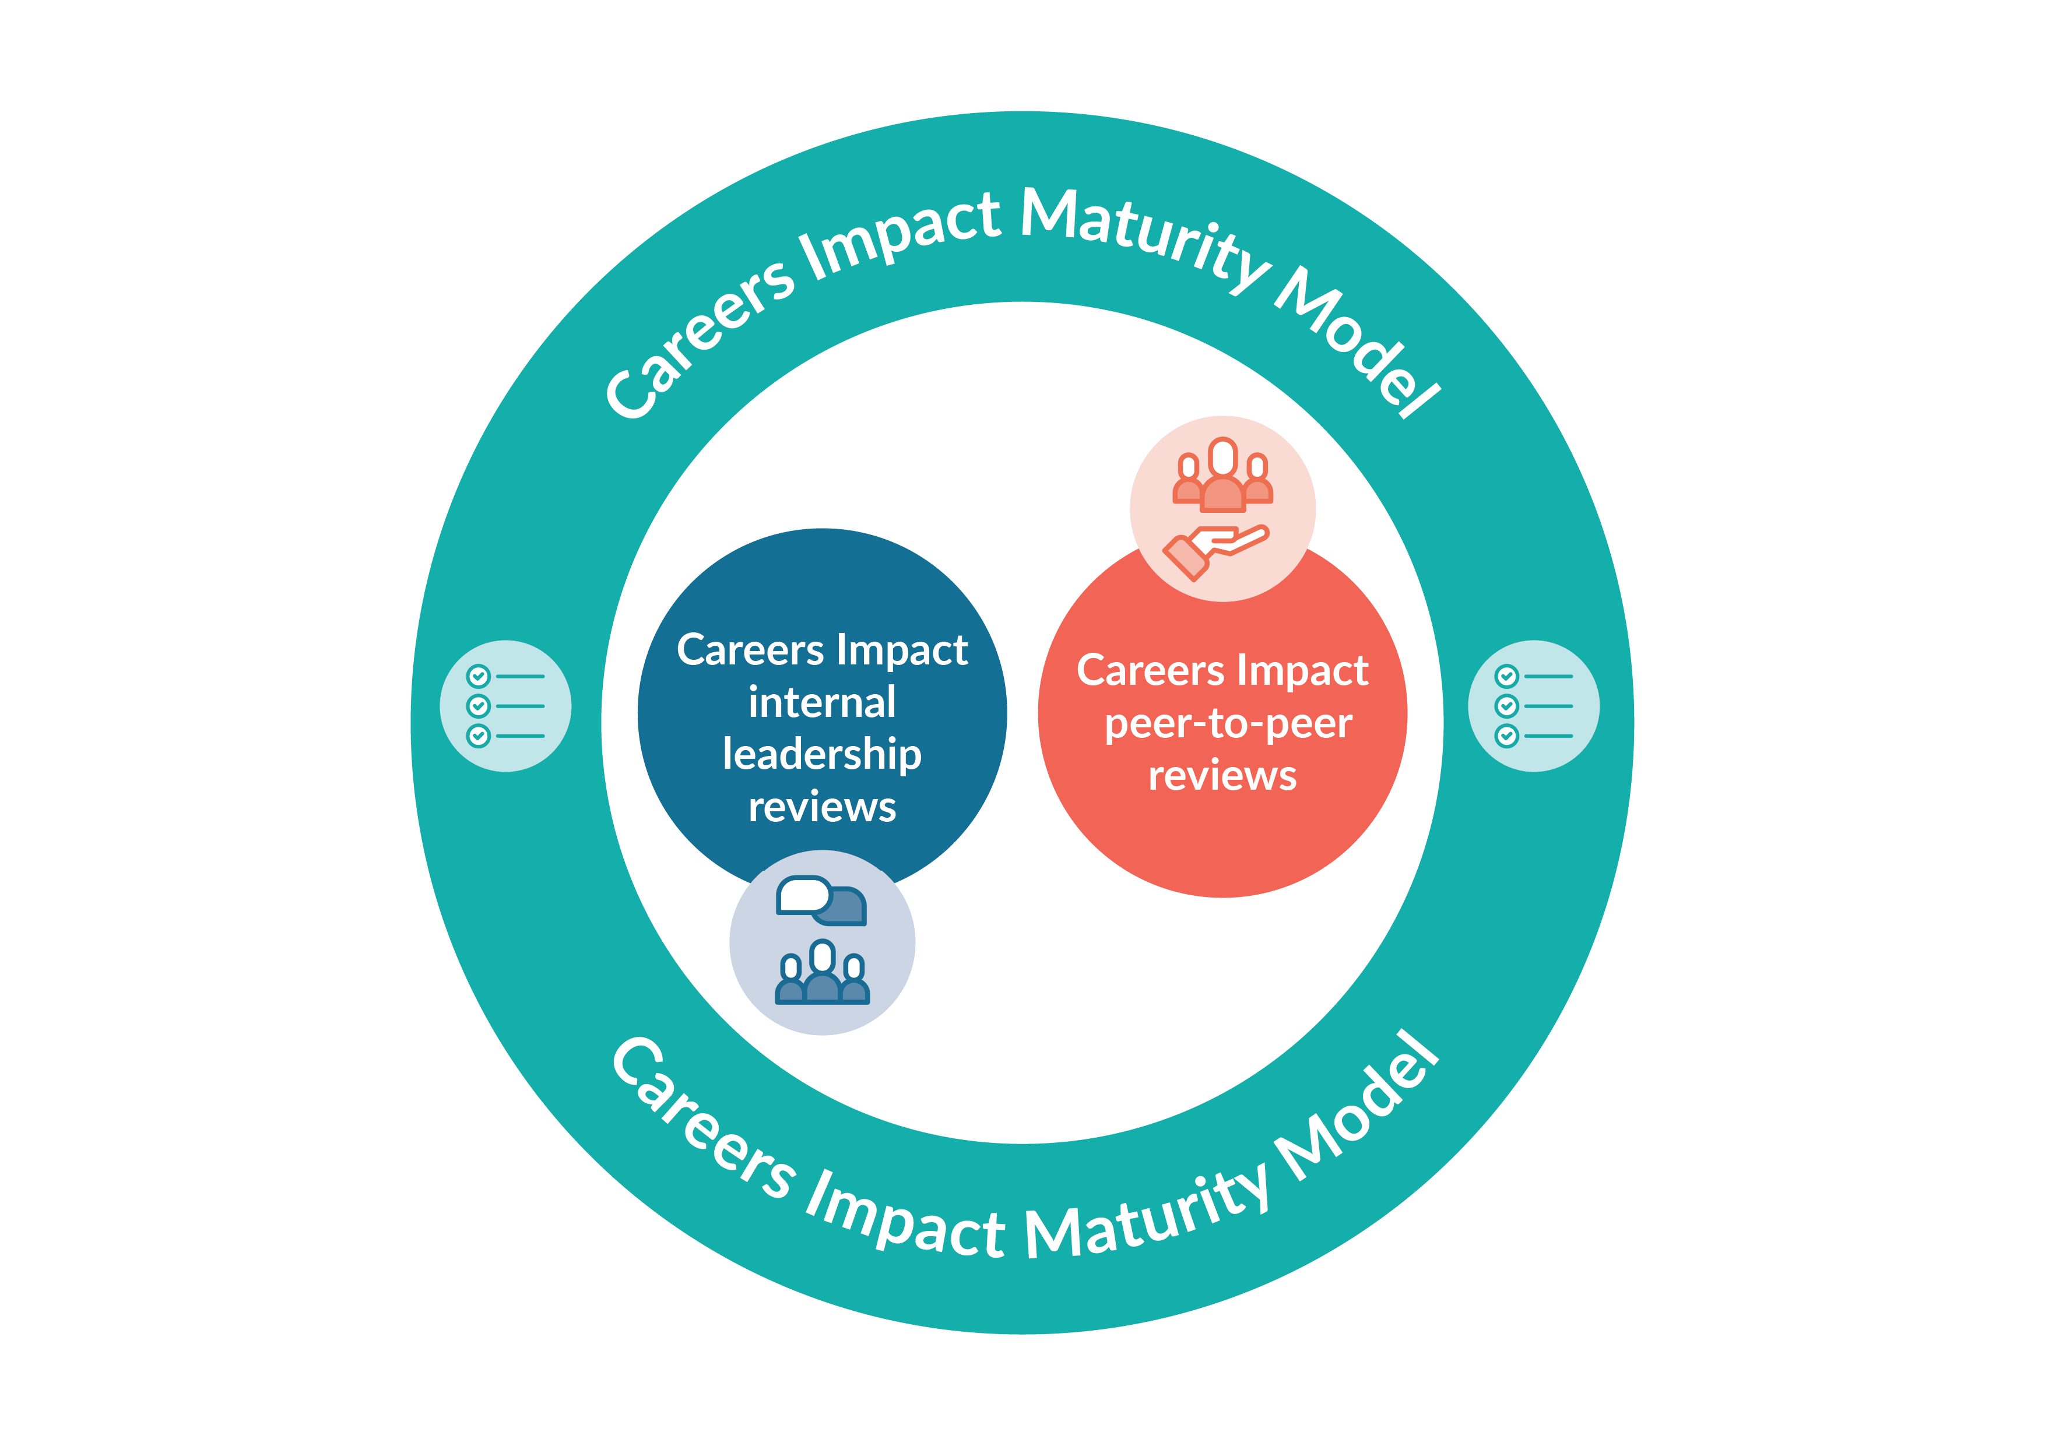

Careers Impact internal leadership and peer-to-peer reviews
Careers as a driver for school, special school and college improvement

Slide 2
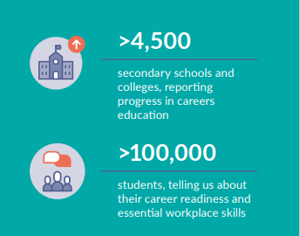
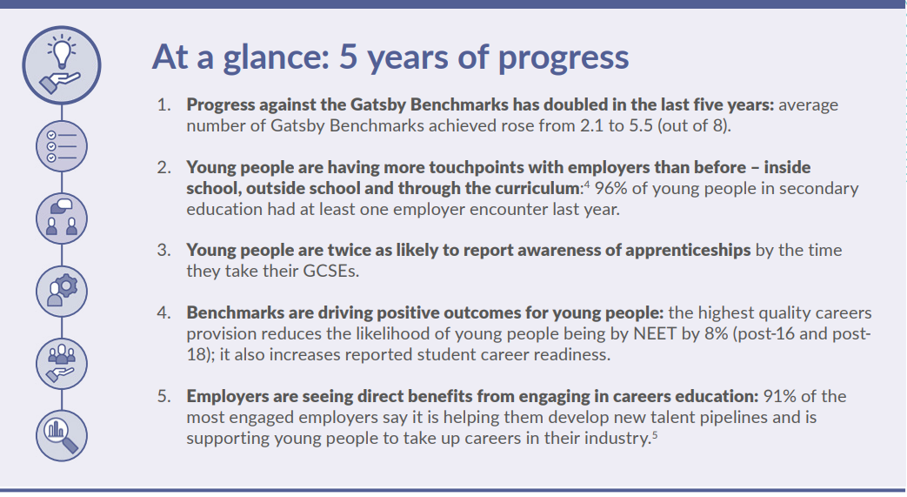

cec-now-next-report.pdf (careersandenterprise.co.uk)
Notes:
We now have deep insight across the careers landscape - from employers, Careers Hubs, schools and young people themselves.
Four years’ worth of data on student destinations gives us an opportunity to accurately describe how the current system impacts businesses and young people.
We can also begin to pinpoint the impact of specific activities on specific students.
Whilst there is undoubtedly more that can and should be done, this data allows us to say, with confidence, that young people and employers in England are benefitting from the systemic reinvention of careers education
A national careers system is now in place in England, having been scaled significantly over the past five years.
The system has been overseen – with a full range of partners – by The Careers & Enterprise Company, the national body for careers education.
• 92% of schools and colleges are part of a local Careers Hub.
• More than 3,000 Careers Leaders have been trained and all of them are supported by digital tools and resources.
• The eight Gatsby Benchmarks of good career guidance are well embedded and guide the work of educators and employers across the system
We have an established and coherent system where the Benchmarks are driving positive outcomes for young people – the highest quality careers provision reduces the likelihood of young people being NEET by 8%, it also increases reported student career readiness
Our commitment is to continue to drive standardised continuous improvement of career leadership and careers provision and to ensure quality assurance of careers leadership and careers provision across England
The Careers Impact System is how we are doing this

Slide 3
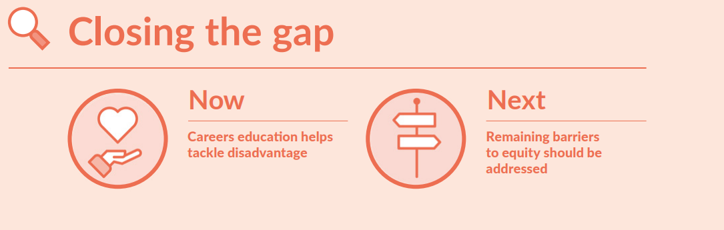
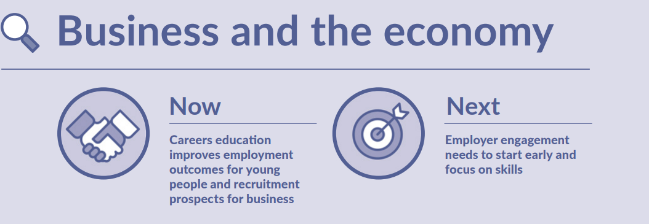
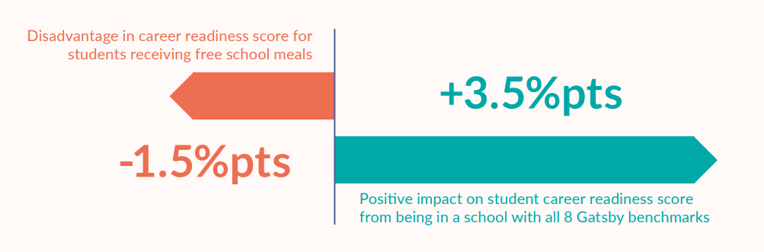
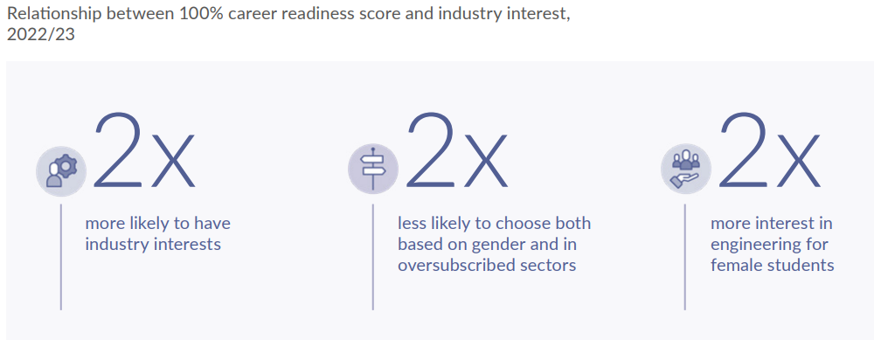
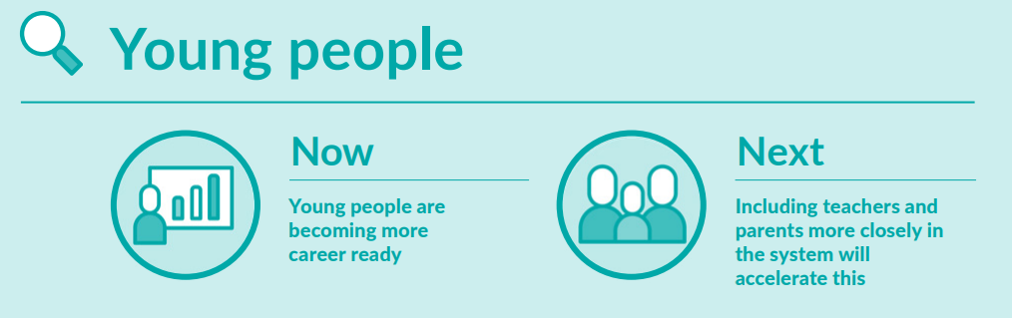
cec-now-next-report.pdf (careersandenterprise.co.uk)
Notes:
cec-now-next-report.pdf (careersandenterprise.co.uk)
Click 1 Careers education helps tackle disadvantage
Good careers provision improves students’ career readiness and can outweigh the disadvantage associated with being in receipt of FSM .
A student in a school providing the highest quality career provision (as measured by achieving all eight Gatsby Benchmarks) would have a career readiness score 3.5%pts higher than a student in a school achieving only one Gatsby Benchmark
Closing the gap requires equity in careers provision, providing young people facing additional barriers with tailored experiences, learning from positive experience with SEND institutions. Evidence shows us that high quality careers education improves students’ career readiness and can overcome disadvantage. The central mission of raising the quality of provision in all institutions remains paramount. However, closing the gap also requires tailored support to groups experiencing additional barriers. We are seeing some progress here. 95% of schools and colleges reported they were challenging stereotypical thinking relating to careers; 97% were actively seeking to raise the aspirations of all their students; and 97% were working proactively with their Local Authority and career advisers around the career guidance and progression of vulnerable and SEND students.49 It is also encouraging that the schools serving the most disadvantaged cohorts are deploying careers advisors to deliver more personal guidance for young people (82% fully achieving Gatsby Benchmark 8 - Personal Guidance, compared to an average of 75% for all institutions)
Click 2 Young people are becoming more career ready; including teachers and parents more closely in the system will accelerate this
Good quality careers education, underpinned by empowered Careers Leaders and engaged employers, is helping young people become more career ready
Last year, using the Future Skills Questionnaire (FSQ), Careers Leaders asked more than 100,000 students a range of age-tailored questions to understand their level of careers knowledge and skills. Taken together the answers give us an age-appropriate career readiness score for each learner.
As students advance through secondary school, the data shows their overall career readiness grows
This pattern has been observed at overall cohort level and sustained over two years
Sustained engagement with Careers Hubs, training and resources improves the quality and quantity of careers education in schools and colleges
Progress in careers provision has more than doubled in the last five years.
Between 2018 and 2023, the average number of Gatsby Benchmarks achieved by schools and colleges rose from 2.1 to 5.5 (out of 8)
Including parents and teachers in the system can support students to further develop their career readiness At its best, careers education is anchored in wider school improvement strategies and plans – a core part of school and college life. In practice this means broadening careers engagement to all key influencers of young people, both in and out of education, and using the curriculum as a reference site for careers learning. Encouragingly, the system is acknowledging and responding to the role of parents and teachers in developing student career readiness. The Gatsby Benchmarks show that schools and colleges are increasingly engaging with parents and carers and wider teaching staff
Click 3 Careers education improves employment outcomes for young people and recruitment prospects for business; employer engagement needs to focus on skills and early intervention
High quality careers education creates value for business and the economy.
Employers are telling us how their engagement with schools and colleges positively influences young people to pursue careers in their sectors, creating a more informed and skilled talent pool.
The careers system is helping young people find sustained destinations for learning, work and training after school. Careers education benefits business and society, reducing NEET rates and improving talent pipelines
Last year, we reported an analysis of post-16 destinations which showed students in schools and colleges that achieved all eight Gatsby Benchmarks were 8% less likely to be not in education, employment or training (NEET)
This year, for the first time, we have been able to explore the impact of high-quality careers education on young people’s destinations post-18
On average, post-18 NEET rates decrease from 15.1% to 13.9% for students in schools and colleges achieving all eight Gatsby Benchmarks.
These students were 8% less likely to be NEET than those in institutions at the lower end of careers provision
Good careers education helps young people effectively navigate career choices – balancing personal wants with labour market needs
High quality careers education has the power to impact young people’s industry understanding and interests.
Analysis of student data shows that improved career readiness is strongly linked to improved alignment with the labour market.
Students with the highest career readiness (responding positively to all questions) were more than twice as likely to have ideas about the industries they want to work in.
These interests were both less likely to be influenced by gender-bias (e.g. girls were keener to choose engineering) and less likely to be in over-subscribed sectors

Slide 4
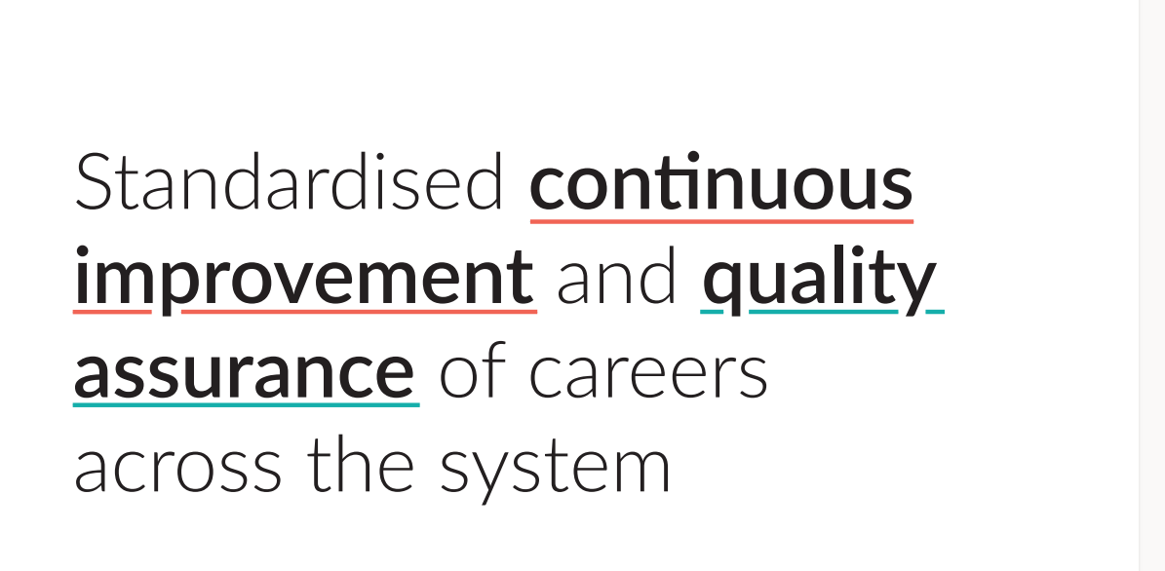
Notes:
To further improve the impact of our infrastructure and to support our strategic shift from coverage to quality, we are launching the Careers Impact System
By focusing on coverage to quality, we hope to achieve greater impact: By delivering quality for everyone, everywhere we will make progress in closing the disadvantage gap. Our evidence-based Careers Impact System – an internal and peer review process – will help schools and colleges improve quality and will allow policy makers to be confident that this improvement is continuing.
The Careers Impact System is rooted in the Gatsby Benchmarks and other evidence about best practice in careers and careers leadership
The Careers Impact System aims to continue to drive positive student outcomes by:
Providing assurance of quality of careers leadership and careers provision as a driver for school, special school and college improvement
Improving careers leadership and careers provision across the country
Elevating the status of Careers Leadership within wider school and college development priorities

Slide 5
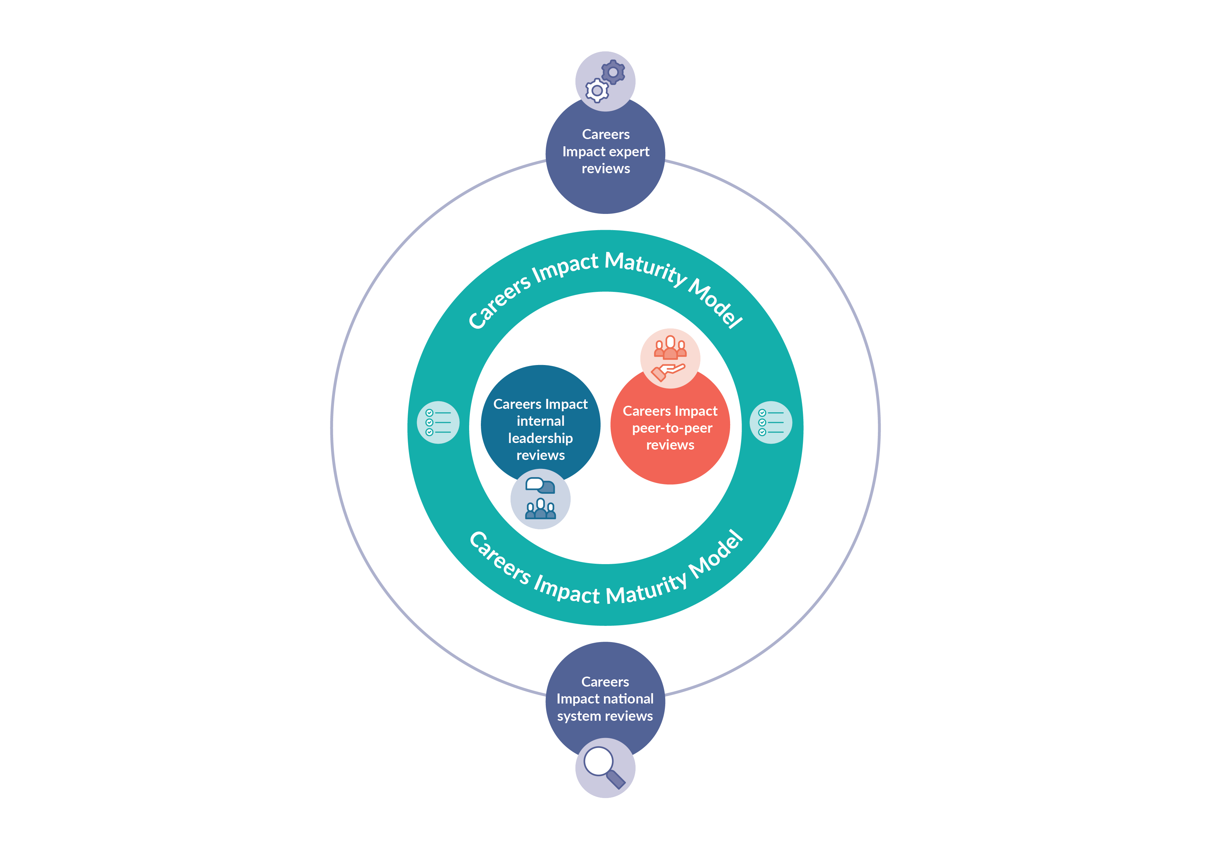
Careers Impact System
Notes:
The Careers Impact System, which is encapsulated by a maturity model:​
Enables Careers Leaders to approach achievement of the Gatsby Benchmarks through a lens of continuous improvement​.
Supports education leaders and Careers Leaders to achieve the Gatsby Benchmarks and strategically and meaningfully link to school, special school and college improvement priorities​
Uses a scaled and systemic approach which enables robust judgements and confidence to be made and assures confidence in the quality of careers leadership and the provision of careers across Careers Hubs and nationally

Slide 6
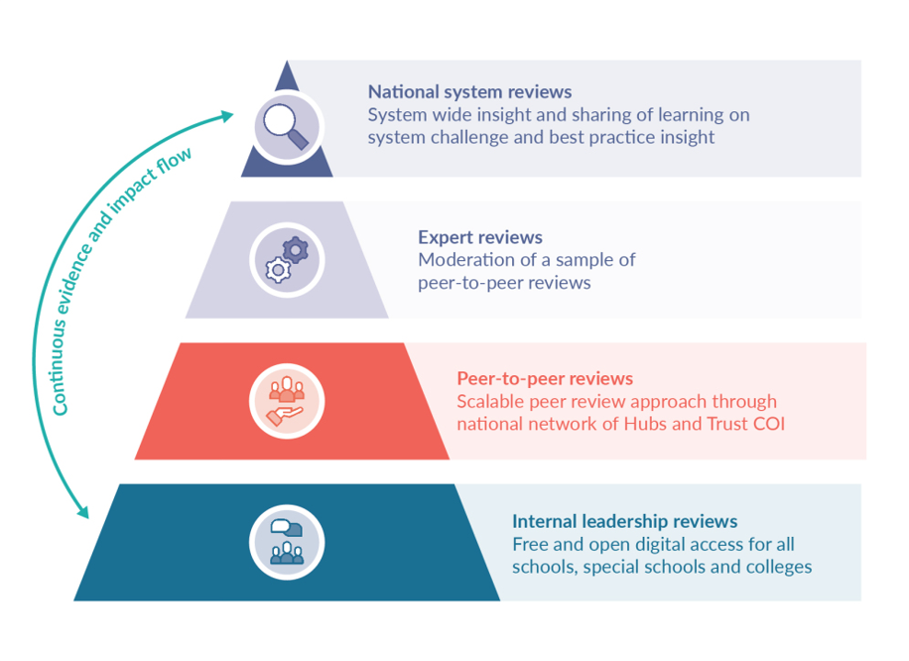
Notes:
This slides highlights the different elements and interconnectivity of all the component parts of the Careers Impact System
The bottom two tiers are how we are standardising continuous improvement nationally by taking internal leadership reviews and P2P reviews based on the maturity model to scale across our national networks of hub and through our trust Community of Improvement
The reciprocal flow of the system means that while we have established proven and impact lead methodologies for reviews, we also have the infrastructure to harvest the learning from all levels and to have confidence in assurance of all components of the full system
At the peak of the pyramid are the national system reviews – our way to understand the challenges and the solutions to barriers to meaningful achievement of the BMs through focused and enquiry based reviews on key themes
Key learning about conditions for success on BM1 as a driver for school, special school and college improvement and as a driver for positive student outcomes underpins the Careers Impact System and our offer of support to you to be part of the solution to improving student outcomes

Slide 7
School, special school and college level impact
96 % of respondents said that it was likely or highly likely that taking part in a review would lead to improved careers provision in their school, special school or college
94% respondents said that it was likely or highly likely that taking part in a review would lead to more effective careers leadership
86% respondents said that it was likely or highly likely that taking part in a review would lead to improved student outcomes
Notes:
This impact data is taken from our pilot of this work and tell us that process of internal review works, and P2P works and they both drive our company impact model
Through supporting schools, special schools and colleges to undertake an internal review and engage in P2P we will drive improved quality of careers provision which will drive better outcomes for young people

Slide 8
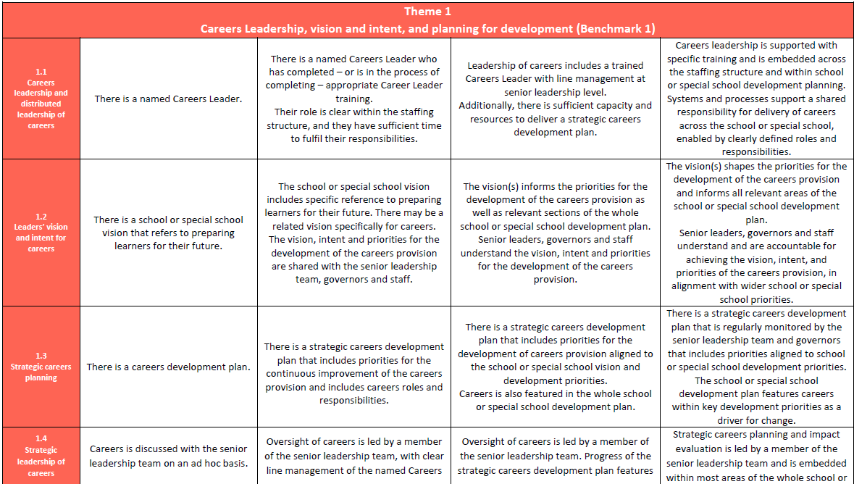
Careers Impact Maturity Model: Layout

Slide 9
1
2
Represents indicators of intentional provision with conscious decision making, moving towards a more strategic and progressive provision that has elements of continuous improvement
3
Starts to move into a whole school, special school or college approach that is more responsive to data and cohort needs… leading to stability and sustainability of provision
4
Is where careers is a golden thread to school, special school and college improvement...where careers is hardwired as part of the solution to the key strategic priorities of the institution
Generally represents indicators of a standalone provision with ad hoc activity that may of course bring value yet potentially more from happenstance than design
Language of the columns – what do we notice?
Notes:
We resisted calls to label the columns as the process is self-reflective for an institution and is non-judgemental - we however can notice what each column represents
We will focus more on the core elements of Theme 1 & 2 in a moment but the elevations to maturity emerge from core rows of the model that allow institutions to move through maturity from well-meaning but potentially ad hoc practice into more progressive and planned provision through to responsive and sustainable practice that ultimately is threaded through school, special school or college improvement

Slide 10
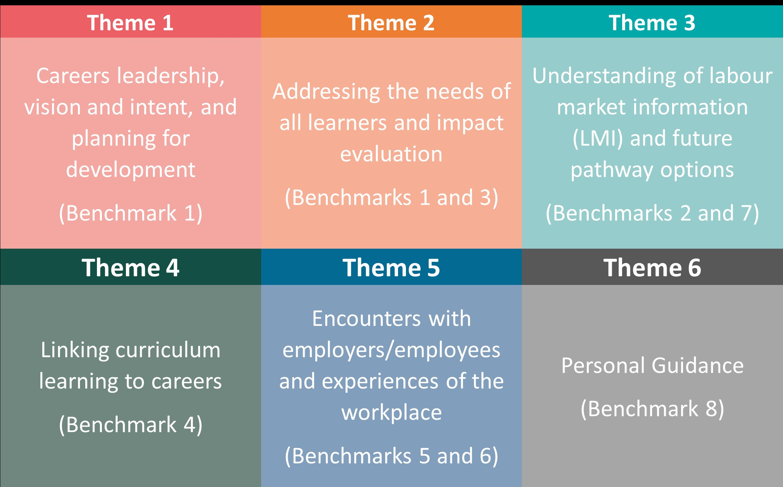
Notes:
In another nod to the quiz – here is a reminder of the 6 themes of the Maturity Model!
This makes the links to the BMs explicit – it is interesting to hover here and think about some of the language we use about BMs - I sometimes hear colleagues talking about ‘going beyond the BMs’ – the BMs are a world class standard that we are supporting all schools, special schools and colleges to meet – the Maturity Model supports us in that work to get underneath the BMs and to really focus on meaningful practice, impact led practice – to focus on the ‘so what’ and to embed practice that is sustainable and strategic and that is aligned to priorities of the schools, special schools and colleges and therefore that is in the improvement fabric of institutions but that is also aligned to measurable positive student outcomes
The maturity model allows us to position careers leadership and the Gatsby BMs in the language of school, special school and college improvement

Slide 11
What is careers?
Careers is everything young people need to know, understand and be able to do in order to:
Make aspirational and informed decisions
Make effective and sustained transitions
Develop career readiness/
prepare for adulthood
Notes:
When we say that the model unpacks what good looks like in careers leadership it starts with defining what we mean when we think of careers itself – it can mean many things to different people and the model includes a definition that is repeated as a thread about what is meant by careers and therefore what the leadership of careers seek s to achieve
In the maturity model careers is described as everything that young people, need to know, understand and be able to do in order to:
- make aspirational and informed decisions
- make effective and sustained transitions
- develop career readiness
There is a lot to unpack in preparing young people to be able to do all these things as leavers from your schools, special schools and colleges
Essentially ‘careers’ allows us to consider what it is that we are preparing learners for and what provision they need to get there.
Reflect on vision or mission statements of institutions in your network . Does they include words like: aspiration, skills, potential, prepare, achieve, etc.?
Careers provision is the scaffolding towards such visions and allows education colleagues to scaffold measurable learning and experiences towards the vision and ambition they have for learners.
Our role is to embed clarity of meaning and clarity of intent – one of the benefits of the maturity model is the specificity it provides us to sharpen our language and to maintain focus on the ‘so, what’

Slide 12
Challenges
Conditions for Success
A sustainable and strategic approach to careers leadership
Turnover of staff
Leaders' Vision
G|
Changing cohort needs/contexts
Strategic Careers Planning
Insufficient prioritisation
Distributed Leadership
Absence of mechanism for effective
impact evaluation
Student Career Learning Journeys
Lack of strategic approach
Impact Evaluation
Notes:
CL time, churn of CLs,, increases in persistent absence and other competing priorities may often feel like barriers and this is how challenge manifests and presents on the surface
All of these are manifestations of careers not being embedded in wider school, special school or college improvement
They can all be mitigated or overcome by what we describe as conditions for success

Slide 13
Conditions for Success:
Careers leadership as a driver for school, special school and college improvement
Impact evaluation with robust and regular monitoring (by SLT and governance) and celebration of success
Allocating relevant resource and distributed leadership of careers (inc SLT)
Strategic approach to planning of careers provision with clearly articulated vision and priorities (link to overall development planning)
Intentionally planned student career learning journeys that are responsive to need and that include clear measurable milestones
Clear vision from leaders with definition of intended impact and identification of relevant success criteria shared with SLT and governance
Notes:
An ambitious and comprehensive vision from leaders that is clearly articulated and measurable and widely shared and understood
A strategic approach to planning for careers with articulated priorities and clear and distributed lines of accountability/robust monitoring of progress by SLT/Govs
Definition of what impact they wanted to see for learners with intentional careers learning journeys that were responsive to need and underpinned by: LOs and progressive learning experiences and encounters
Finally, we also saw robust monitoring of success and impact of this towards school vision and intent for learners as leavers – this was strongest where there was a clear articulation of vision and specific priorities and related learning outcomes
There is a video to follow highlighting the 5 conditions for success

Slide 14

Leaders’ Vision
Clear vision from leaders with definition of intended impact and identification of relevant success criteria shared with SLT and governance
Notes:
The overwhelming majority schools, special schools and colleges have a vision statement that talks about their learners’ futures, using vocabulary such as excellence, potential, skills and aspiration.
In the most mature institutions, what makes leaders’ vision, ambition and intent for careers successful and impactful?
It is more than just having it written down. The common features of this factor as seen in the most mature institutions are
Leaders’ vision for careers stating the current and future objectives, aligned to the whole institutions overarching vision.
This vision is widely shared and understood by all stakeholders.
Leaders justify and explain their intent for careers, responding to the contextual needs of learners and setting high aspirations within and beyond their institution.

Slide 15
“Strategic careers planning enabled institutions to outline their vision and long-term priorities for developing their careers provision.
They stated how their careers provision development priorities aligned with wider improvement agenda and provided a clear implementation plan for each priority, including specifying learning outcomes for different cohorts of students at each key stage of education”
Strategic approach to planning of careers
Strategic approach to planning of careers provision with clearly articulated vision and priorities (link to overall development planning)​
Notes:
The second condition for success to consider is strategic approach to planning of careers
This is the articulation and detail for the vision – what are the priorities for your careers provision as aligned to wider school or college priorities
When we consider the vision to Empower Families for example – we can articulate a strategic priority here to be to “Broaden and inform learner, parent & community expectations and to challenge stereotypes”
This vision and priority starts to give shape to the careers provision that would implement and deliver that priority

Slide 16
“There was strong evidence to conclude that defining strategic priorities for careers, with a clear implementation and monitoring plan for each, was important for realising a school, special school or college vision”
Notes:
The clarity of vision is strengthened by clear and measurable priorities that then inform the intent and learning outcomes of your careers provision and wider curriculum
This is about not leaving anything to chance – if your aim is to transform lives or raise aspiration– this requires intent and clear priorities that can be measurably implemented

Slide 17
“…connecting the Benchmarks into the whole school or college strategy – at the most senior level – is essential, and provision should be tailored to the needs of every student, including those who are most vulnerable.”
Good career guidance: the next 10 years (Interim briefing)
good-career-guidance-the-next-10-years-interim-briefing-shared-external.pdf (gatsby.org.uk)
Notes:
Key to highlight here the alignment to the literature review and findings underpinning Gatsby next 10 work and how they articulate the ongoing importance of aligning careers leadership and provision to whole school, special school or college strategy

Slide 18
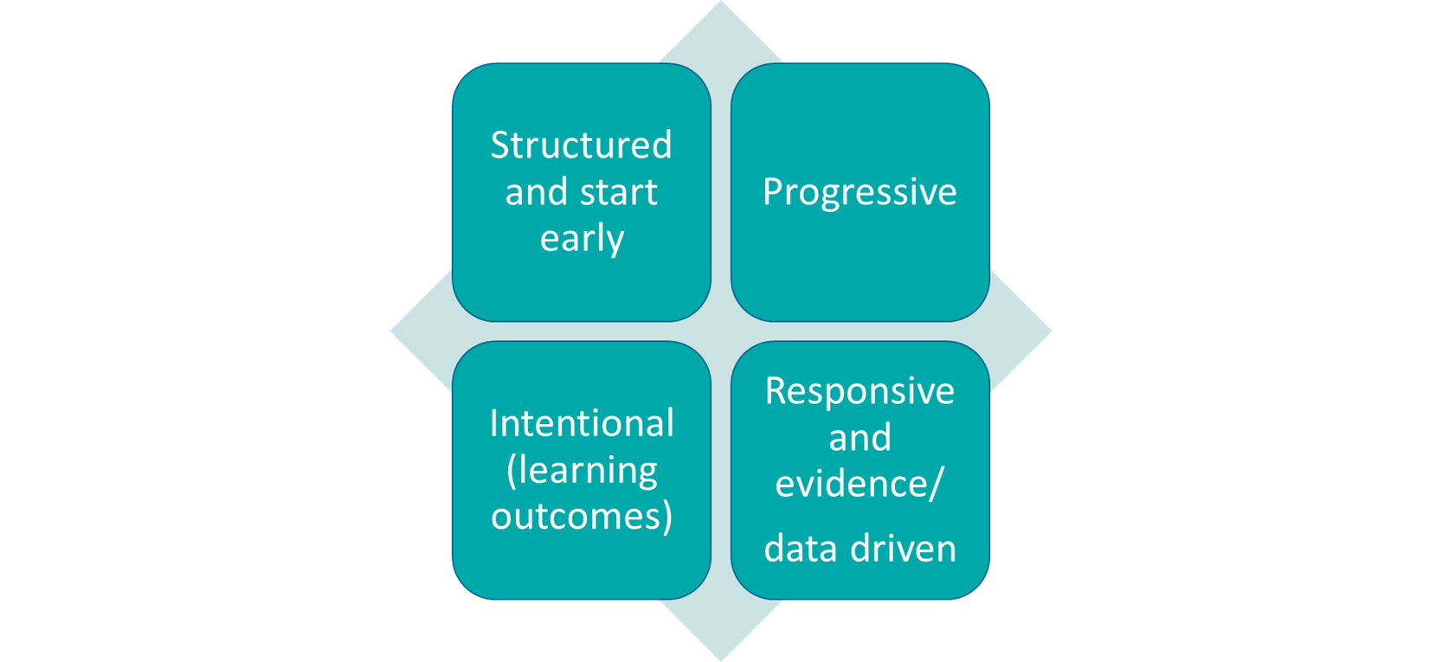
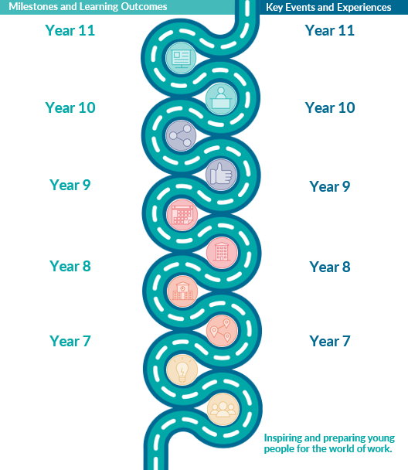
Career Learning Journey
Notes:
That implementation is another condition of success
All of your learners are on a ‘careers learning journey’ at your school, special school or college – they are on a journey if you plan your careers provision or not or if you have a vision and strategic priorities or not
An intentional careers learning journey, underpinned by learning outcomes are how you will be able to deliver on the strategic priorities that make up your vision and ambition for leavers as learners
Careers learning journeys should start early and be progressive
They should also be responsive to what specific cohorts and your learners need to know, understand and be able to do
Tools such as the future skills questionnaire support education and Careers Leaders in understanding gaps in learner knowledge and abilities and learner journeys can also be responsive to regional priorities and skills gaps
There is also a link here to how you may approach parent and carer engagement as their journey can mirror that which you plan for learners to ensure that they are equipped and confident to have careers conversations at home

Slide 19
Trained CL
SLT and Governor backing
Link to leaders’ vision in supporting a whole institution approach
Link to institution strategic priorities
Distributed leadership of careers
Allocating relevant resource and distributed leadership of careers (inc SLT)
Notes:
The scale of ambition for leavers as learners cannot sit as the responsibility of one individual and a further identified condition for success was in distributed leadership of careers across a school, special school or college
This starts with ensuring that there is a named and trained Careers Leader who has the backing of SLT
Backing of SLT can be defined through the conditions for success, which provide tangible direction to how careers can be positioned in the schools, special school or college as a driver for improvement
The identification of a vision and priorities with a scaffolded careers learning journey provides opportunity for robust milestone progress monitoring and support and challenge from both SLT and Govs
A clearly articulated vision also supports a whole school, special school or college approach where all staff understand their roles and responsibilities within achieving the vision for learners as leavers of that institution

Slide 20
Formative and impact evaluation
Range of evidence and data
Monitoring (SLT & Govs)
Importance of other conditions for success
Impact Evaluation
Impact evaluation with robust and regular monitoring (by SLT and governance) and celebration of success​
Notes:
The final condition for success completes the cycle as clear impact articulation depends on clear articulation, definition and planning of measurable intent
It links to how SLT and Govs are engaged in milestone and impact data either to inform conontuous improvement or to telling the story of success of learners as leavers from schools, special schools and colleges
Feedback from events and initiatives can inform development of specific events as formative evaluation and the range of insight and data that can be used for overall impact includes learner destinations, learner career readiness (FSQ) and stakeholder voice
This is the so what of your careers provision and is the proof of concept of your vision and strategic priorities

Slide 21
Careers Impact System

Slide 22
Careers Hubs: Careers Impact System
Key Areas of Focus
In order to efficiently drive accelerated and meaningful achievement of the Gatsby Benchmarks:
Do you have a trained Careers Leader and do all staff understand the full training offer
Engage in a Careers Impact internal leadership review
Participate in a Careers Impact peer-to-peer review
Careers Leader Training
Internal leadership reviews
Peer-to-peer reviews
Notes:
We can boil down the Careers Impact System to 3 areas of focus for schools, special schools and colleges
The first element is fundamental – in planning for September, do you have a trained CL and do all staff in your schools, special schools and colleges understand the free and open access training offer from the CEC (inc teacher encounters)
Careers Leaders with training adopt the principles of good leadership, are able to implement an effective strategic careers plan, accelerate towards achieving the Gatsby Benchmarks and ultimately improve student outcomes
Careers Leaders can enrol and register for the funded training with bursary via Careers Leader training | The Careers and Enterprise Company
We want HLs to consider the internal leadership reviews at scale across each region as a way to drive accelerated and meaningful achievement of the BM with SLT engagement – this is critical. The Internal Leadership Reviews are also a high impact and low intensity approach for Hubs. These are almost a trojan horse approach to spark momentum for a strategic and sustainable approach to careers to come from WITHIN schools, special schools and colleges. It is low intensity from Hub perspective as they are intended to be conducted and driven by the institution not the Hub and they will reap the rewards. They will be available as open access on Compass and Compass+ with guidance available. It should be part of Hub strategic planning how they are positioning these and how they are engaging schools. Special schools and colleges in the internal review. There are no specific KPIs and so we want the value of this to drive Hub approach. If Internal leadership reviews are done well at scale, we all get the cumulative value of the standardised continuous improvement – you as aMs and HLs also get another data set that can inform differentiation of offer, resource and support
Finally and this is a high impact yet high intensity action for Hubs…there is the P2P approach to careers. The positioning of this is critical – one HL recently noted the efficient of P2P for their team. Colleagues no longer have to go out and introduce or engage CLs in umpteen initiatives/resources…the reviews…internal and p2p are a vehicle for all of our resource and support. For example, I cannot stress strongly enough how FSQ emerges consistently from reviews as a no brainer to ensure tat provision is responsive and impact driven. There are KPIS attached to this, yet we are ambitious about thinking about the scale of what is possible with this and I do not wish to see this as a compliance task alone. This work is transformational and should be considered within a strategic planning and ways of working approach.

Slide 23




Value & Purpose
Careers Leaders with training...​
Adopt the principles of good leadership​
​
Careers Leadership secures SLT, Governor and parent engagement and support. It develops a whole school or college approach that will make a difference.​
​
Implement an effective strategic careers plan​
​
Careers Leaders are able to develop their plan by reflection, impact evaluation and new evidence to ensure a progressive programme that will contribute towards school or college improvement​.
Accelerate towards achieving the Gatsby Benchmarks​
​
A better understanding of the key aspects of career theory and how these apply to their learners enables Careers Leaders to implement more meaningful application of all the Gatsby Benchmarks.
Improve student outcomes​
​
Careers Leaders gain insight into relevant policies and frameworks applicable to their local context that support positive student outcomes.
Sign up for funded training at Careers Leader training | The Careers and Enterprise Company​
Notes:
(Script repeated from previous slide)
Do you have a trained CL and do all staff in your schools, special schools and colleges understand the free and open access training offer from the CEC (inc teacher encounters)
Careers Leaders with training adopt the principles of good leadership, are able to implement an effective strategic careers plan, accelerate towards achieving the Gatsby Benchmarks and ultimately improve student outcomes
Careers Leaders can enrol and register for the funded training with bursary via Careers Leader training | The Careers and Enterprise Company
Sign up for funded training at Careers Leader training | The Careers and Enterprise Company

Slide 24
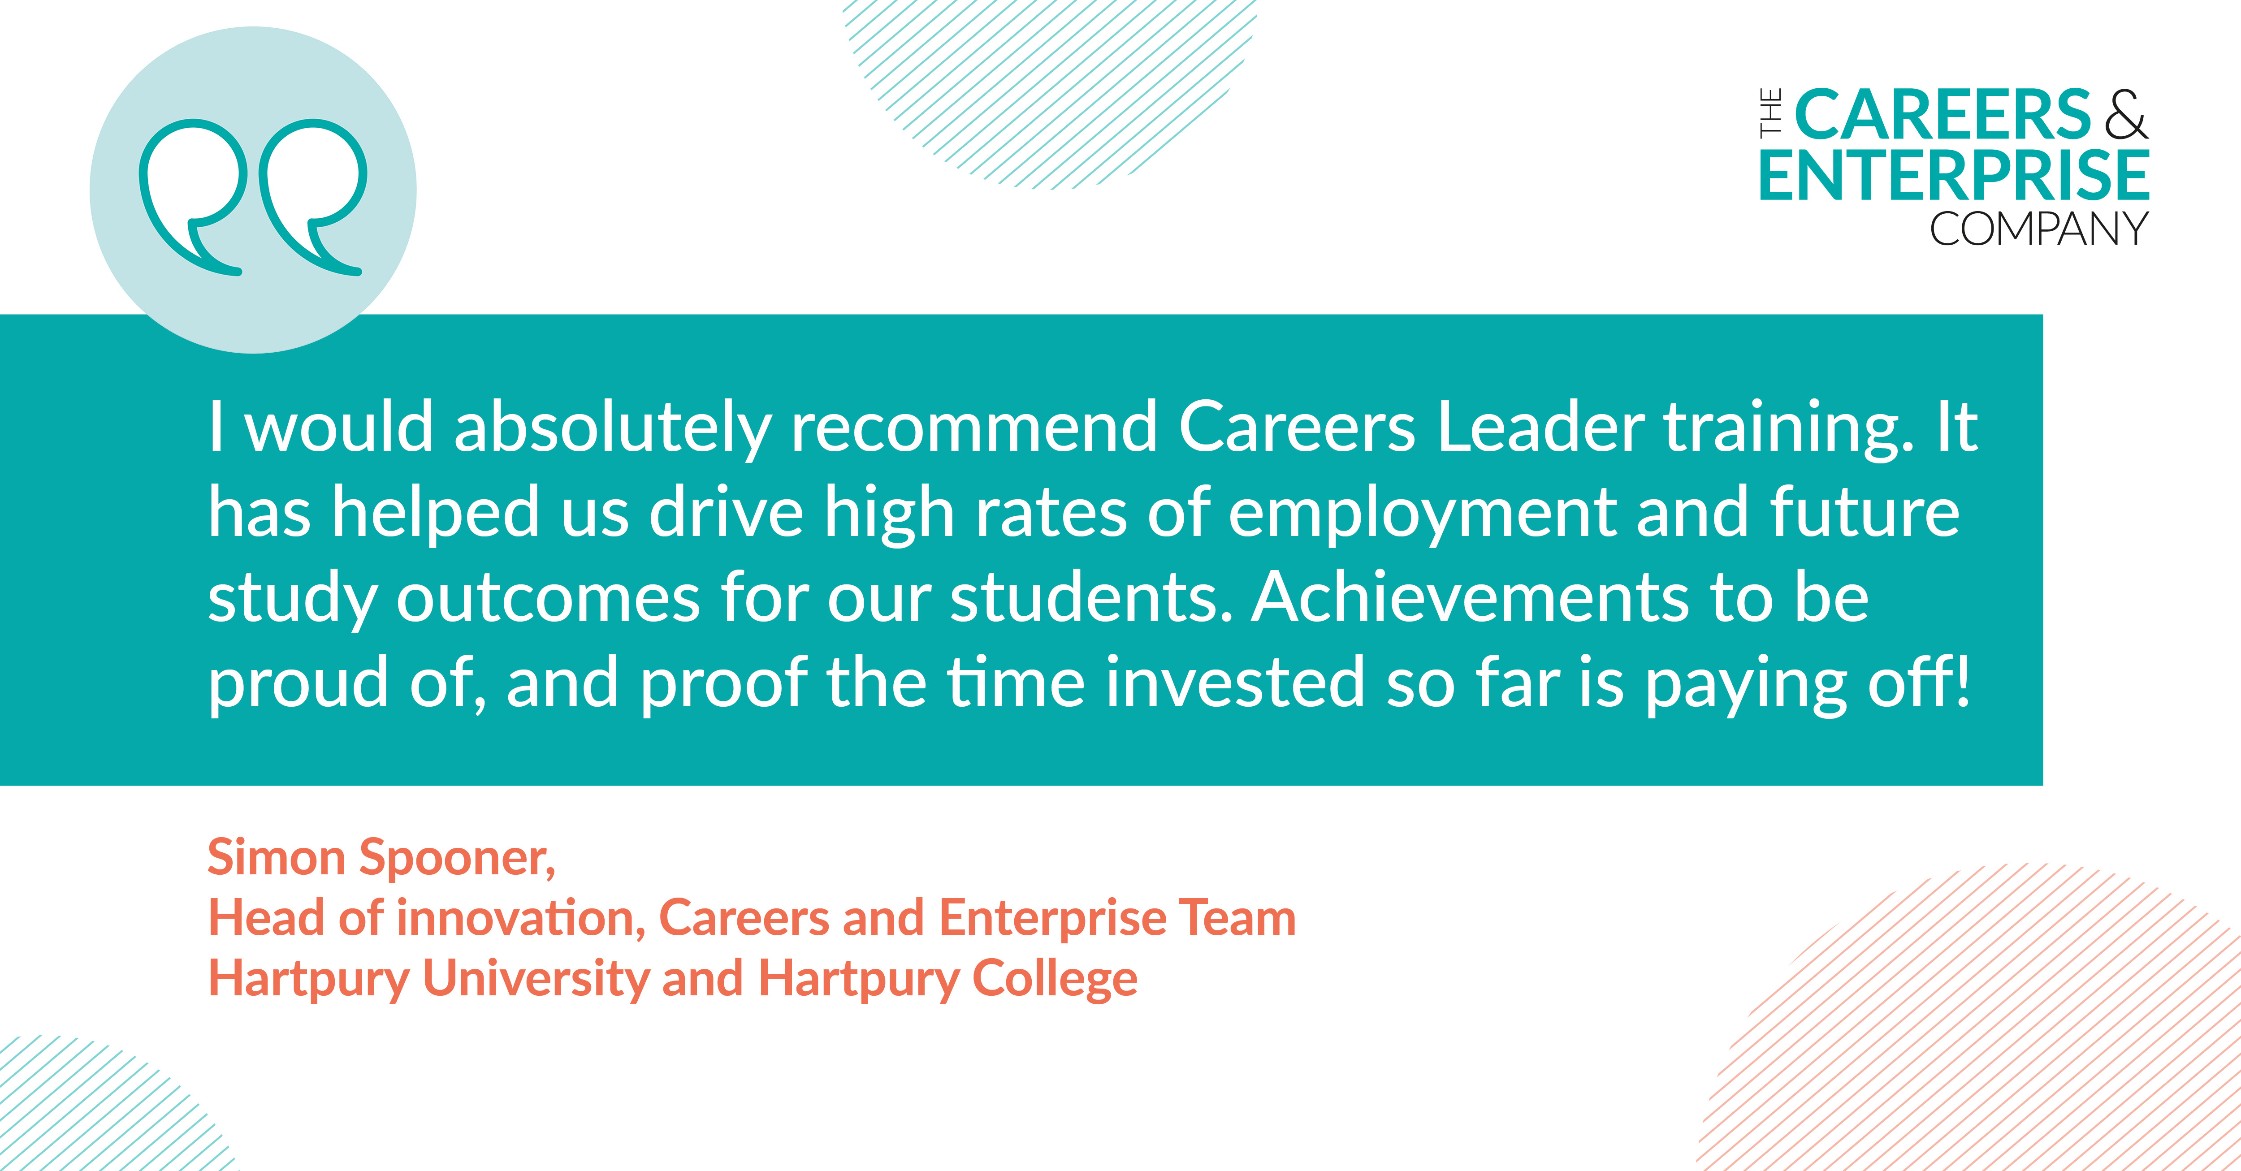
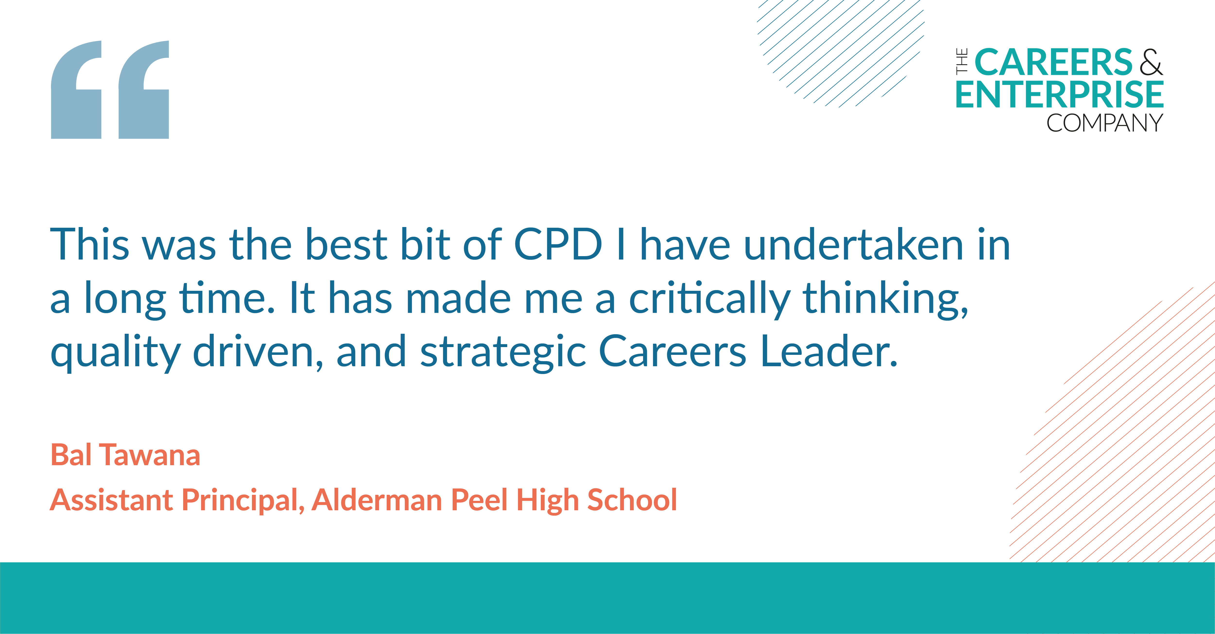

Differentiated Training Routes 23/24
A course for all Careers Leaders
Online Induction – Free, 2-4 hours, full overview of the role and intro to Careers Leadership
Core funded training offer – Accredited, L6 & L7 – Virtual, face to face or blended learning. Distanced Learning now available.
Senior Leaders – Whole School Improvement through Careers Leadership
Enhanced CL Training – Top-up Course – for those who trained previously pre-2020.
On-going CPD Modules and Opportunities
Sign up for funded training at careersandenterprise.co.uk/careers-leader-training ​

Slide 25
Engage leaders through informed and impactful SLT and governor engagement in and vision for sustainable and strategic careers leadership
Align priorities through intentional distributed leadership of careers as a driver for whole institution improvement
Embed best practice through improved understanding of best practice in careers leadership and of meaningful; and sustained achievement of the Gatsby Benchmarks
Celebrate Success through recognitions of strengths in and impact of careers leadership and provision
Sustain quality and impact through internal quality assurance and impact evaluation of carers leadership and provision
Embedding Careers Impact internal leadership reviews institutions will:
Notes:
These are some of the key and proven ways that the Careers Impact internal leadership reviews can add value to schools, special schools and FE provisions
These are the core elements that came through strongly in pilot and early roll out
What are your reflections on these and does anyone have anything to add?

Slide 26
Internal leadership reviews
Convene
All those involved in the distributed leadership of careers should be involved in the review process
Agree
The review involves colleagues reflecting on which statements in the Maturity Model best describe the practice their institution
Record
The digital feature allows institutions to record the responses collaboratively agreed during an institution’s internal review. Colleagues will have access to a summary of institution's insights, showing a snapshot of indicated areas of strength and priority action areas
Act
Institution identification of highest leverage actions to drive school, special school or college improvement and to support improved student outcomes
Careers Impact
Self-evaluation tool
Notes:
Ambition that every school, special school and college undertakes a careers impact internal leadership review annually within their impact evaluation process
The key steps to a review are highlighted on this slide
All those involved in distributed leadership of careers within an institution should convene in the review process
Those convened then consider the maturity model and agree the best ft statements on each line that describes practice in their institutions
We then encourage colleagues to return to the digital tool to record their responses – crucial that this lands as an offline review/discussion process where responses are recorded online through compass/Compass+
The digital functionality allows institutions to see data visualisations of their strengths and areas for focus and recommendations for improvement
The data that institutions see will inform next steps and action planning and will likely inform your ways of working as a Hub…this is straying into value and purpose to Hubs so let’s go back to a focus on value and purpose to schools, special schools and colleges!

Slide 27
Who should take part in an internal leadership review?
All those involved in the distributed leadership of careers should be involved in the review process​
Notes:
The naming of the review is intentional – it is internal to the institutions and should be lead internally. This is critical – there is not the expectation that you or colleagues from the hub lead this review. That commitment and capacity is for your approach to the P2P – that is where our value can be added
This is about the institution themselves kickstarting a deep reflection on the maturity of the careers leadership
The review should and could involve an array of colleagues from with a school, special school or college – it is at your discretion if you offer your own views within the internal review.
The role of Eas is also a very interesting one – an EA who is strategic may be the one to bring this to SLT, or a Careers Link Governor may suggest the review and play a key role?
Those involved may include: Link Governor, Enterprise Adviser, SENCo/Head of SEND/Head of Inclusion, Central Strategic Careers Leader, Wider SLT colleagues, Vice Principal/Assistant Principal, PSHE Lead, Student Support/Student Services, Careers Adviser, Head(s) of Year, Head(s) of Department, etc
The Careers Leader and HT should be involved as a pre-requisite

Slide 28
The review involves colleagues reflecting on which statements in the Maturity Model best describe the practice their institution. ​
They should consider the statements and the responses which indicate progressive maturity within each of the six themes. ​
Colleagues should do this ahead of coming together to discuss and agree a final response for each statement that represents their institution. ​
What does a review involve?
Notes:
As I referenced earlier – the whole process is underpinned by the maturity model and includes colleagues reflecting on each row to decide their best fit
Consider for a moment how you imagine colleagues would convene to do to agree the best fit responses?

Slide 29
Approaches to completing an internal leadership review
1. HT Confirmation of CL View
3. Governor Collaboration
“As the Careers Leader, I completed the process and then met with the Headteacher to discuss this.
Where there was a difference of opinion, I was able to explain my judgement and we discussed and were then able to agree on the ‘best-fit’ response.”
“A core group of us met together (Careers Leader, Trust Central Strategic Careers Leader, Careers Link Governor) and we agreed the ‘best-fit’ statements through discussion and debate, with elements requiring us to refer to evidence to justify our decisions with each other. These were then signed off by the headteacher.”
2. SLT Collaboration
4. Collaboration and SLT Confirmation
“We initially completed the self-evaluation process as a team of two (CL and SLT CL).
We then discussed with the wider Senior Leadership team which has helped to raise the profile of careers and gain further buy-in from the Headteacher and SLT.”
“We took a 3-stage approach to complete and QA the process”
Review by Careers Team (CL and SLT CL)
Feedback on our responses from wider SLT, including SENCo
Final agreement by Headteacher and SLT Careers Leader of best-fit responses
Notes:
How do these match with the ideas that you had in your head?
What do you notice and what reflections do you have?
You will notice that this activity is offline ☺

Slide 30
The digital feature allows colleagues to record the responses collaboratively agreed during the institution's internal leadership review. ​
There is instant access to a summary of the institution's insights, including a graphic showing a snapshot of the institution’s indicated areas of strengths and priority action areas​
These can be shared with you as EC​
The digital feature also signposts to support and resources for each theme area to drive continuous improvement​
How to use the Careers Impact internal leadership review feature on Compass/ Compass+ to get the most out of your review process
Notes:
This makes the digital feature unique amongst our suite of tools as the main action is conducted online
Colleagues go online to access the guidance and download the maturity model and then convene with colleagues to agree their best fit
The usp of returning to record responses are the data visualisations and the signposting – which is primarily to the CL and wider workforce CPD offer

Slide 31
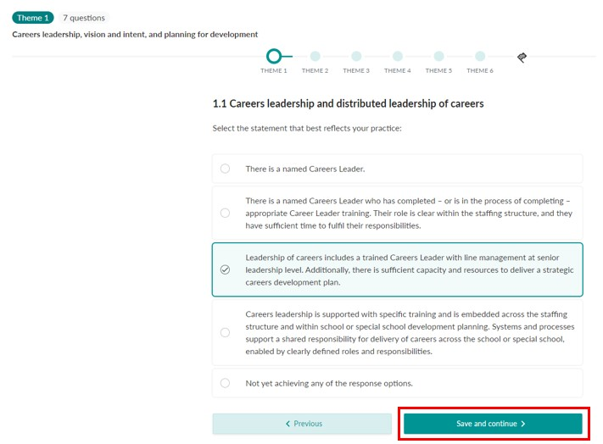
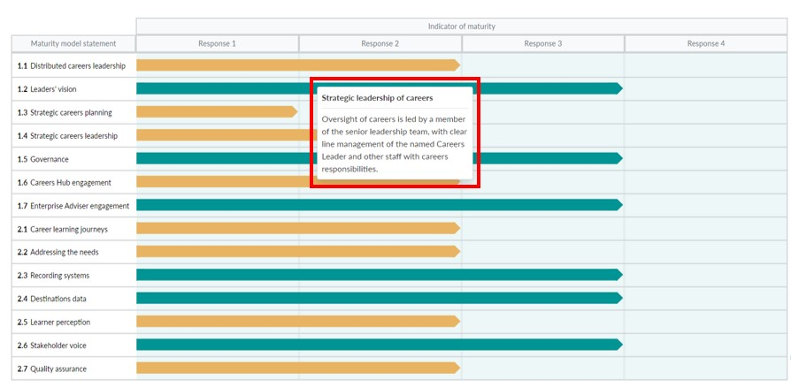
Internal leadership reviews:
Recording responses and gaining insight via Compass & Compass+ (from Sept 24)
Support from Help Centre articles on how to prepare for an internal leadership review, how to complete the process using the digital feature and how to find your institution’s responses and recommended actions.
Compass+ Help Centre
Compass Help Centre (by institution type)
Notes:
The RECORD stage is facilitated by a new feature in Compass and Compass+ available to all from September 24.
Digital version of the maturity model so once an institution has CONVENED and AGREED, a representative is ready to use the feature to record their responses so they have central record and can see progress year on year. It also sets them up for the final stage, ACT, by providing them with recommended actions, highlighting areas to focus on. Key recommended actions include CLT training, and other modules on the Digital Hub for educators, plus content such as My Learning, My Future and Talking Futures.
The Help Centre articles support users through every step of the process, including providing examples of how pilot institutions effectively carried out the CONVENE/AGREE stage, and how to get the most out of the new digital functionality.

Slide 32

  ​
  “Careers is the cornerstone of education, and the internal leadership review showed us how much we haven’t thought about yet.
  The maturity model takes a lot of that thinking work away – it enables us to work out where we are and what we need to do next because it’s written down for us – so we can focus on strategy and implementation.”
  Senior Leader, (May 2024)
  Careers Impact P2P Early Roll-out
Notes:
P2P participant quote

Slide 33
  “Never felt so empowered by a process.
  It was supportive, non-judgemental and positive.
  As a school are also going to adapt this across the trust to improve the results meetings process in our schools”
  Careers Leader, (April 2024)
  Careers Impact Early Roll-out
Notes:
P2P participant quote

Slide 34
Visit our Resources Directory to get started with the
Careers Impact internal leadership review
Notes:
This is the main page for internal leadership reviews via resource directory – there are also a plethora of guidance and help centre articles to support colleagues in the process
Your schools can get started on this today
Find out more: Careers Impact Internal Leadership Review | CEC Resource Directory (careersandenterprise.co.uk)
Following this session, you will receive a copy of these slides, a link to an animation, an engagement deckyou can deliver to your CLs and pdf of an overview briefing about the reviews that you can share vai email with Careers and Education Leaders

