Slide 1
Connect to work
Lancashire

Slide 2
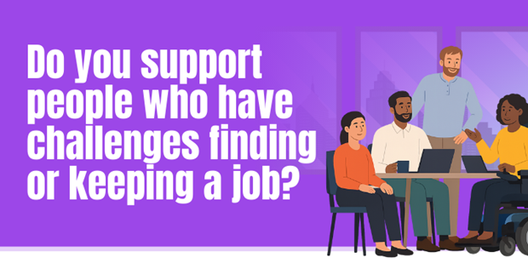
What is Connect to Work?
New DWP project, funded until March 2030
Part of national plan to get more people into work
Supported employment model
Helps people to overcome barriers to find meaningful, sustainable employment
Support for people in work but at risk of losing their job
Voluntary programme
Right support, at the right time, in the right place

Slide 3
Who is Connect to Work for?
Age 18 years or older
Right to live and work in the UK
Not on another employment programme (Restart, WorkWell, another IPS programme)
People with disabilities, long-term health conditions, or complex barriers to employment
Want to work
Eligible groups include:
Offenders serving community sentences
Ex-offenders who have completed custodial or community sentences
Carers or ex-carers
Homeless individuals
Care-experienced young people or care leavers
Individuals with drug or alcohol dependency
Refugees, resettled Afghans or on Ukrainian scheme
Victims / survivors of domestic abuse
Victims of modern slavery
Former members of HM Armed Forces, reserves, or their partners
Young people at risk of serious violence

Slide 4
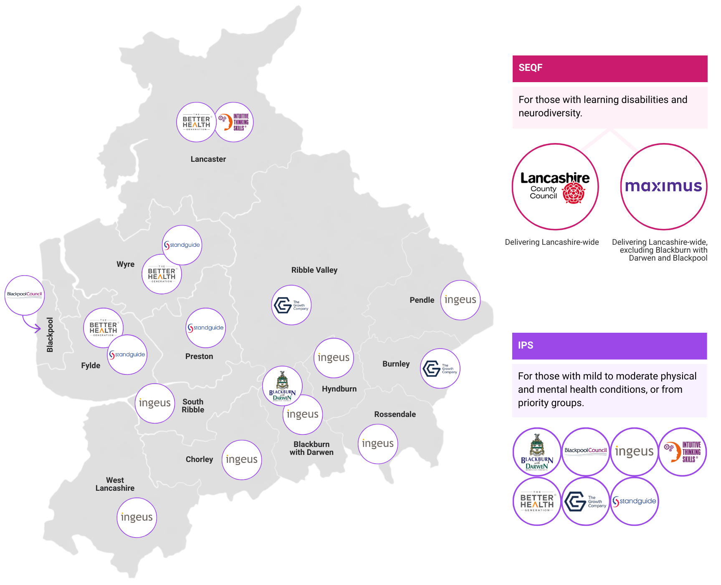
Delivery partners
Connect to Work operates via a central referral system
Participants triaged by need (delivery model) and location

Slide 5

What is Supported Employment?
Supported Employment
Everyone has the potential to do real, paid work with the right support
Personalised support based preferences and strengths
Start looking for work as soon as possible, then continue to support the individual and the employer
Focus on real, paid work, not volunteering or other outcomes
Includes clinical integration where required​
People’s readiness for work depends on their barriers, including health conditions
Spend an extended period preparing for work before starting to look for jobs. No / limited support in work
Focus on a range of outcomes, with volunteering / training more often achieved than real work
Independent of clinical support, even for those with health conditions.

Slide 6
Connect to Work models
Two supported employment models
Reach a wider population with diverse needs
Ensure flexibility and effectiveness in support
Connect to Work
Individual Placement and Support (IPS)
Supported Employment Quality Framework (SEQF)

Slide 7
What do the models mean?
Individual Placement and Support (IPS)
Supported Employment Quality Framework (SEQF)
Evidence-based approach
Integrates employment support at a physical level - primary / secondary health services, other support services
Embeds work as a health outcome within the health system
Small caseloads of up to 25 participants
Based on “place, train, maintain”
More intensive support for participant and employer
Complex needs of participant group
More contact and support from Employment Specialist, particularly in work support for both employer and employee
Small caseloads of up to 20 participants

Slide 8





5 Stages of Supported Employment
Client engagement
Potential participant learns about supported employment and decides whether it’s right for them
2. Vocational profiling
Planning process enabling a participant to identify their goals and develop a plan for getting there
3. Job matching
Participant is supported to find vacancies that align with their employment goals
4. Employer engagement
Participant learns about the role and develops a plan with the employer on how they will be supported through the recruitment process and in the workplace
5. On and off the job support
Participant learns the job and sustains employment. Support may include coaching, mentoring, and workplace reviews.

Slide 9
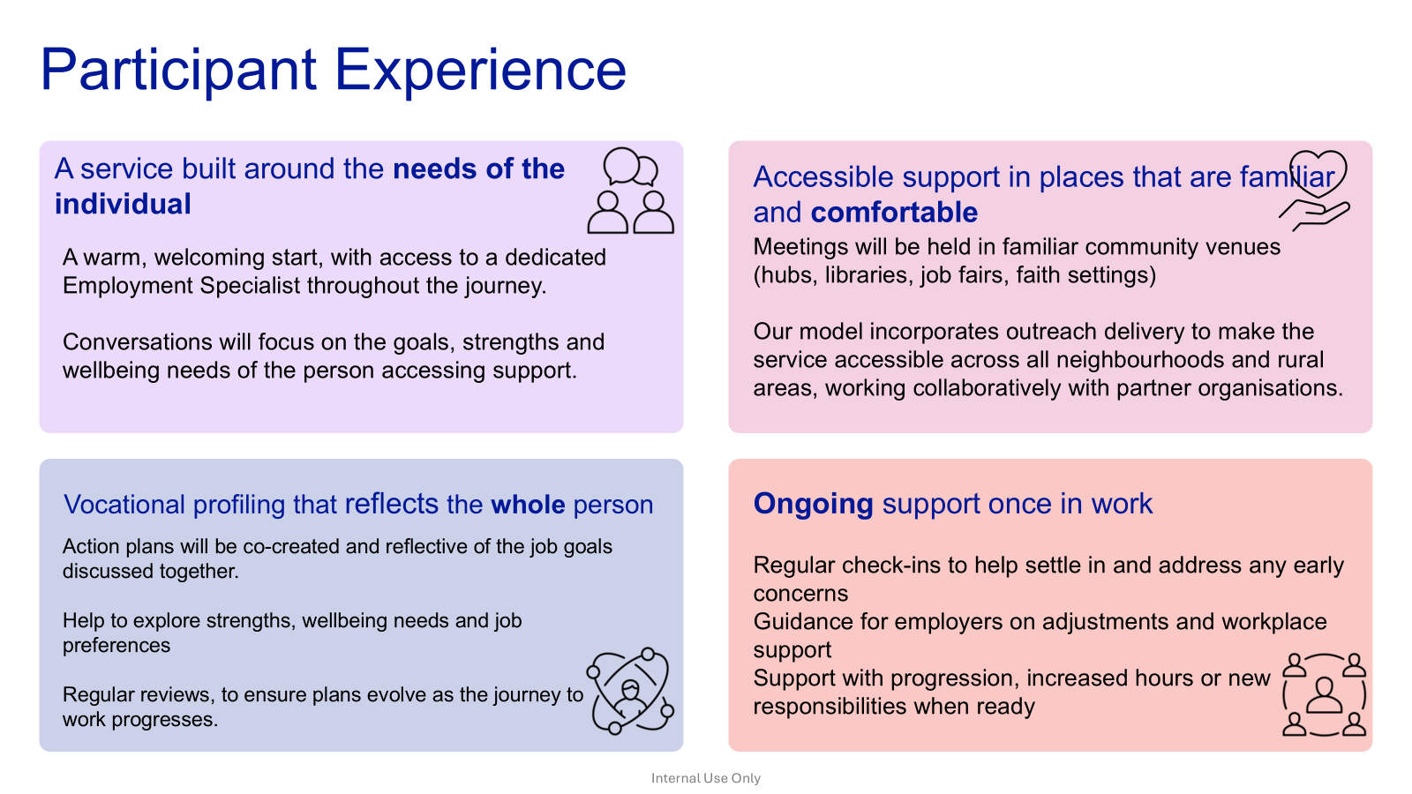

Slide 10


What Stakeholders can expect
A high‑quality, evidence‑based service
A structured approach to generating referrals
Delivery aligned with the SEQF Fidelity Model
Experienced teams who understand Lancashire’s communities
Training for employers on adjustments, recruitment and workplace inclusion
Job carving and vacancy tailoring to meet participant needs
We will actively engage with organisations across Lancashire.
Collaborating with community organisations, faith groups, housing providers, and local authorities to support the needs of the individuals referred.
Regular presence at local networking event, attending community venues and groups
Sharing feedback where appropriate – with consent – to celebrate success and share progress updates and collaborative actions.

Slide 11
In Work Retention –Employee & Employer Experience
Tailored in-work Support Plans
Regular Proactive check-ins
Help with workplace adjustments
Plans developed jointly with the employer and employee
1:1 coaching for the employee to support in sustaining their job or possibly help to transition into a new role
Encouragement to build skills and independence
Employment specialists will conduct in person visits with employers and employees to assess and provide support
Strong communication with managers to ensure clear communications, offer solutions promptly
Advise employers on career development pathways
Guidance on workplace adjustments
Support with role modification, hours, workload, training needs
Advice on assistive technology where needed
Access to training offers through Maximus Workplace Inclusion Network (WIN)
Advise on inclusive practices and building supportive culture

Slide 12
Group Activity
“What would help?” Reasonable adjustments in practice

Slide 13
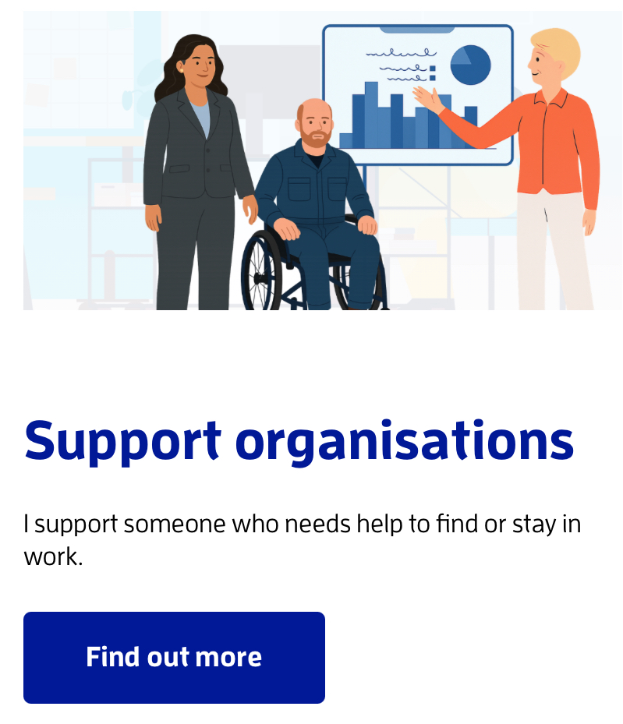
Referrals
Multi-platform referrals
Fastest referrals via website
You’re helping someone:
  ‎Get personalised support
  Build skills and confidence
  ‎Find and keep a job that works for them
  Improve their wellbeing and independence

Slide 14
Any
Questions?

