Slide 1
Modern Work Experience for SEND
What “Meaningful” Really Means
Building behaviours, confidence and pathways — not just placements
Notes:
“Thank you for joining this session on Modern Work Experience for SEND.
Today we’re focusing on one key question:
What does ‘meaningful’ actually look like for SEND learners within Gatsby Benchmark 6?
This session isn’t about perfect placements or increasing workload.
It’s about understanding what really makes a difference — particularly around confidence, behaviour, and progression.”

Slide 2
WHY THIS MATTERS
Why rethink work experience?
Work experience is no longer just one week at 16
Employers value behaviours as much as technical skills
SEND learners need earlier, clearer, personalised experiences
The ideal employee is built over time
Meaningful experiences build future‑ready behaviours
Notes:
Why This Matters
Speaker notes:
“For a long time, work experience has been thought of as one week at 15 or 16.
But when we think about what employers actually value — things like reliability, communication, attitude, routine — those behaviours take years to build.
SEND learners often need:
experiences earlier
experiences that are clearer
experiences that are more intentionally designed
That’s why meaningful matters so much.”
Optional question (hands up):
“What behaviours matter most in your workplace?”

Slide 3
What “Meaningful” Means for SEND
Gatsby Benchmark 6 – Experiences of the Workplace
In a SEND setting, a meaningful Gatsby 6 experience:
✅ Has a clear purpose
Focused on learning, not just attendance or time spent.
✅ Builds behaviours as well as skills
Confidence, communication, routines and understanding expectations.
✅ Is personalised, not identical
Equal value experiences, adapted to individual needs and strengths.
✅ Supports decision‑making about pathways
Helps students understand what suits them, what doesn’t, and what comes next.
✅ Is progressive over time
Early exposure → short, regular experiences → readiness for next steps.
✅ Is planned and reflective
Delivered with the school, reviewed, and used to inform future planning.
For SEND learners, a meaningful Gatsby 6 experience builds confidence, understanding and readiness — even where employment is not the immediate outcome.
Notes:
“This slide is the anchor for today.
For SEND learners, a meaningful Gatsby Benchmark 6 experience is not defined by length or productivity.
It is defined by:
purpose
learning
behaviour development
personalisation
progression over time
Importantly, a Gatsby 6 experience can be meaningful even if employment is not the immediate outcome.
That matters — for SEND learners, confidence and readiness often come first.”
Key emphasis:
“Focused on learning, not just attendance.”

Slide 4
MEET JO
Meet Jo
Jo is 21
Jo is your ideal employee
  Reliable
  Communicates well
  Understands workplace expectations
Jo also has SEND needs
How did Jo get from Year 7 to here?
Notes:
Let me introduce Jo.
Jo is 21. Jo is reliable, communicates well, and understands workplace expectations.
Jo also has SEND needs.
The question isn’t can SEND learners become good employees?
The question is:
What meaningful experiences helped Jo get from Year 7 to here?”
(Pause briefly — don’t rush.)

Slide 5
REFRAMING SEND OUTCOMES
Two important truths
Work experience is about how to be at work, not just tasks
Not every SEND learner has the same destination
Some may:
Enter paid employment
Access entry‑level roles
Need supported pathways
Become leaders in industry
Equal value experiences — not identical outcomes
Notes:
“One of the most important shifts we need to make when talking about SEND and Gatsby 6 is around outcomes.
Not every SEND learner will:
move straight into employment
work full‑time
follow the same route
Some will access entry‑level roles.
Some will need supported pathways.
Some may become leaders in their industry.
All of these outcomes are valid.
Gatsby 6 is about supporting progression, not forcing comparison.”
Optional question:
“Have you seen someone succeed through a non‑traditional pathway?”

Slide 6
EQUALEX + JO’S JOURNEY
Jo’s Journey Through EQUALEX
Introduce & Inspire (Age 11–13)
  What is work?
  How do people behave at work?
Investigate & Explore (Age 14–16)
  What suits me?
  What roles and pathways exist?
Apply & Demonstrate (Age 16–21)
  Can I apply what I’ve learned?
  What pathway works for me?
  Confidence → Choice → Consistency
Notes:
“This is where EQUALEX really helps us.
EQUALEX means equal value experience, not identical experience.
Jo’s journey didn’t begin with a placement.
It began with understanding what work is, feeling safe in workplaces, and learning behaviours.
Then came:
small experiences
supported exploration
decision‑making
and eventually, application
This is how SEND learners build readiness — gradually and intentionally.”
Key phrase:
“Confidence → Choice → Consistency.”

Slide 7
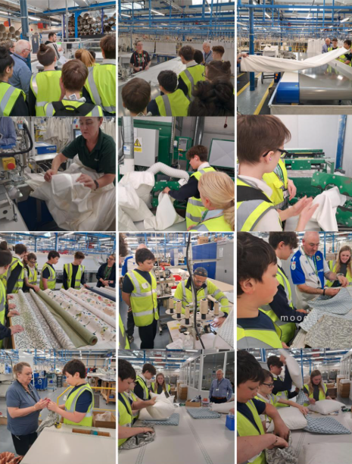
CASE STUDY: WHAT MEANINGFUL LOOKS LIKE
Eden School × Herbert Parkinson
Year 7–8 SEND students
Real workplace visit
Hands‑on, sensory‑aware activities
Clear purpose — no pressure
What students learned
Workplace behaviours
Confidence and self‑belief
“I can do this”
It wasn’t about cushions —
it was about capability
Notes:
“This case study demonstrates meaningful Gatsby 6 in practice.
These Year 7–8 students weren’t there to be productive.
They were there to:
experience a real workplace
try safe, supported tasks
practise behaviours
and build confidence
The success wasn’t the cushion.
The success was self‑belief.
This is a textbook example of meaningful SEND employer engagement.”
Optional question:
“What made this meaningful — the task, or how it was delivered?”

Slide 8
MEANINGFUL = CLEAR LEARNING OUTCOMES
Meaningful experiences are intentional
Before any experience, ask:
What should the student gain?
Confidence
Behaviour understanding
Self‑awareness
What does the school need?
Insight for pathways
Evidence of progress
What does the employer gain?
Inclusive staff skills
Future talent insight
Community impact
Notes:
“Meaningful experiences don’t happen by chance.
Before any Gatsby 6 activity, three questions should be answered:
What should the student gain?
What does the school need?
What does the employer gain?
When all three are clear, the experience becomes:
intentional
inclusive
and genuinely meaningful”
Key message:
“Time spent does not equal impact — learning does.”

Slide 9
SHORT & REGULAR WORKS BEST
One size doesn’t fit all
Many SEND learners benefit from:
✅ Short experiences
✅ Regular exposure
✅ Familiar routines
✅ Gradual progression
Often more effective than:
❌ One‑off block placements
Confidence grows through repetition
Notes:
“For many SEND learners, short and regular experiences work far better than one‑off block placements.
Why?
anxiety is reduced
familiarity builds confidence
behaviours are reinforced over time
This is still Gatsby Benchmark 6 — and often better Gatsby 6.”
Optional check‑in:
“Does this feel more achievable for employers?”

Slide 10
HOW EMPLOYERS CAN GET INVOLVED
You don’t need to do everything
Employers can offer:
Workplace insight (20–30 minutes)
School or workplace talks
Company visits
Short work tasters
Skills sessions or mock interviews
Regular short placements
Any one of these can be meaningful — if planned well
Notes:
“Meaningful does not mean doing everything.
Workplace insights, talks, visits, tasters, skills sessions, short placements — all of these count when they’re planned and purposeful.
SEND Gatsby 6 is about quality of experience, not quantity.”

Slide 11
EMPLOYER MEANINGFUL EXPERIENCE PLANNER
Designing a meaningful experience
1️⃣ Which EQUALEX phase?
2️⃣ What will the student learn? (behaviours & confidence)
3️⃣ What does the school need? (pathways & insight)
4️⃣ What will your business gain?
5️⃣ How will it be accessible? (short, clear, supported)
You don’t need SEND expertise — just clarity and partnership
Notes:
Employer Meaningful Experience Planner
Speaker notes:
“This slide gives employers a simple way to check if what they’re offering is meaningful.
You don’t need SEND expertise.
You don’t need a perfect plan.
You need:
clarity
partnership with schools
and a focus on learning and behaviour.”
Optional reflective question:
“Which of these would your organisation feel confident offering?”

Slide 12
Your role as an employer
Open your doors
Start small
Work with schools and the Careers Hub
Focus on learning, not productivity
You might change a young person’s future —
and enrich your own workplace
Notes:
“Meaningful Gatsby Benchmark 6 experiences for SEND learners don’t start with recruitment.
They start with:
intention
understanding
and small, thoughtful interactions
You might open a door.
You might build confidence.
You might change a future — and enrich your workplace at the same time.”
Thank the audience.

