Slide 1
Youth Futures
Stephanie Kenyon

Slide 2
Youth Futures – Introduction
We are a small team of 3 people working across Lancashire to support young people.
  Anna Wolnik – North Lancashire
  Imtiaz Shah – East Lancashire
  Steph Kenyon – Central Lancashire
We work with young people who live in Lancashire, if they are
  16 or 17
  Not in Education, Employment or Training
  We DO NOT support young people who are working with another professional service (including EHCPs). If a professional is involved, we can offer signposting careers information.

Slide 3
Current NEET Figures
1,883 young people (6.0%) are NEET or Not Known across Lancashire 2025/26
Down from 1,961 (6.4%) compared to 2024/25
NEET numbers have reduced county‑wide
NEET rate down from 3.9% to 3.7%
Not Known figures have also fallen From 2.5% to 2.4%
Progress is being made, but NEET remains a significant issue across all districts
Challenges are not evenly distributed
Transitions at 16–18 continue to be a pressure point, particularly for young people facing confidence, engagement or access barriers
Notes:
Highest combined rates seen in:
Burnley (7.9%)
Hyndburn (6.8%)
Preston (6.7%)
Lowest combined rate:
Ribble Valley (3.2%)

Slide 4
Quick Question Task
In small groups, you have 2 minutes to jot down as many quick answers as you can to these questions:
What tends to derail post‑16 transitions for the young people you support?
Where do things most often break down?
Notes:
Anxiety / confidence
Disengagement
Poor fit with provision
Lack of clarity about options
Young people feeling rushed into decisions
Lack of qualifications
Bridge
Not all of these young people have SEND or EHCPs
Many fall into a gap between systems
This is often where Youth Futures becomes involved

Slide 5
Youth Futures – How We Work?
One‑to‑one, relationship‑based guidance
Understanding why a young person is disengaged
Helping them make sense of realistic options
Supporting movement towards positive steps
We are not a statutory service, and we don’t replace school, college or EHCP‑based support.
Youth Futures sits between systems
Focused on re‑engagement, confidence and next steps, not diagnostics or assessments

Slide 6
Case Study
In your small groups, read the case study and see if you can answer these questions.
“A 16‑year‑old finishes school with inconsistent attendance, one pass at GCSE RE, a 2 in Maths and a 3 in English. Starts college but leaves within weeks they say that it is due to anxiety and low confidence. No EHCP. Currently at home and disengaged.”
What barriers are present?
What often happens next for young people like this?
Who usually holds responsibility at this point, or where can a young person access support?
Notes:
Building a relationship first
Slowing things down where needed
Exploring readiness, confidence and interests
Clear discussion around real barriers and squiggly pathways
Mapping options across:
FE re‑engagement
Training or employability routes
Apprenticeships
Volunteering or confidence‑building provision
Gatsby: personalised guidance; realistic understanding of pathways
Ofsted: coherent transition planning and preparation for adulthood

Slide 7
Youth Futures – What Works For Us
Relationship-based practice – no targets
Personalised action planning – small, achievable steps
Partnership working - schools, colleges, voluntary sector, families
Sustained and consistent encouragement – squiggly pathways
Keeping up to date – constantly changing landscape

Slide 8
Youth Futures – How to Use
We are a very small team – 3 people, 12 districts, 1000 young people (ish)
What this means
We cannot provide intensive long‑term support for every young person
We cannot replace existing statutory or SEND provision
What we will always try to do
Take time to talk things through with professionals
Offer informed, realistic signposting
Share local knowledge and resources
Help sense‑check options before young people disengage further
Even when we can’t take a young person on directly, we’ll try to support the adults around them.

Slide 9
Youth Futures - Referrals
Good reasons to get in touch
A young person is NEET
Transitions feel stuck
There’s uncertainty about suitable provision
You need insight into local post‑16 options
Ways we support professionals
Consultation and advice
Provision mapping
Liaison where appropriate
Shared problem‑solving
Youth Futures works best when we’re part of the conversation early, not the last resort.

Slide 10
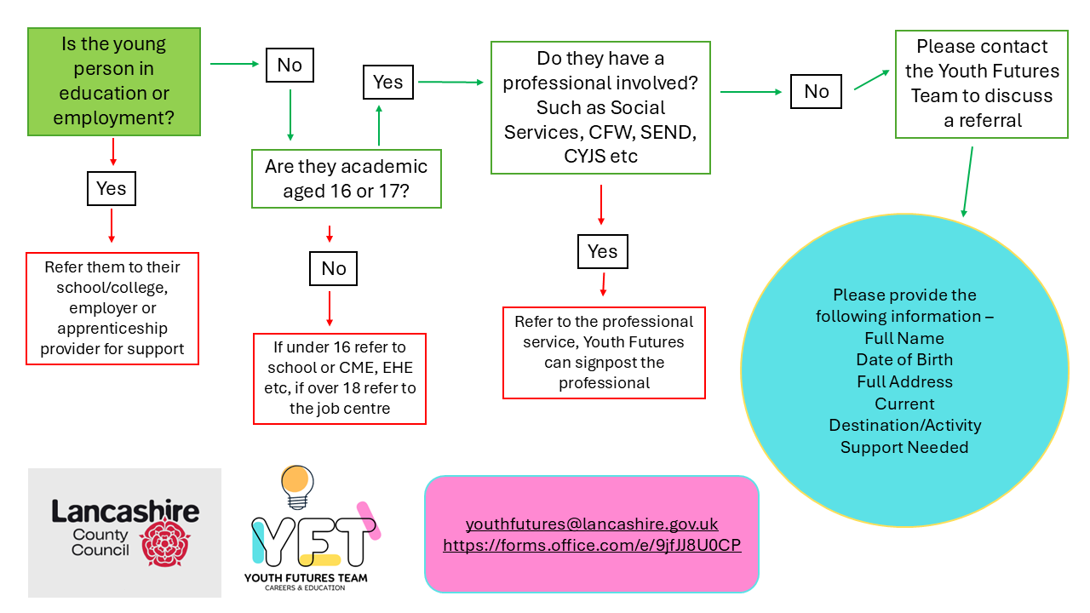
Youth Futures - Referrals

Slide 11

To Finish
What’s one thing you might take away from this session?
You can contact us via phone, text, email or completing our form. Whichever works easiest for you.
Call –
Team Number: 01772 531 044
Call or text -
Central Lancashire: 07917 534459
East Lancashire: 07729 081094
North Lancashire: 07354 167290
Email –
youthfutures@lancashire.gov.uk
Form –
Youth Futures Form – Fill in form

