Slide 1
T Levels and the Impact of Placements
Wednesday 1 July 2026
Lancashire Careers Hub Conference
Sarah Myers
Cath Robinson
Jayne Bennett
Ami Snape

Slide 2
Future Skills Questionnaire
T Level Placements
July 2026

Slide 3
T Level knowledge
Year 7 - 16% of young people felt they understood T levels
End of KS3 - 28% of young people felt they understood T levels
GCSE Years – 56% of young people felt they understood T levels

Slide 4
A Level knowledge
Year 7 - 42% of young people felt they understood A levels
End of KS3 - 56% of young people felt they understood A levels
GCSE Years – 81% of young people felt they understood A levels

Slide 5
Apprenticeship knowledge
Year 7 - 40% of young people felt they understood Apprenticeships
End of KS3 - 61% of young people felt they understood Apprenticeships
GCSE Years – 81% of young people felt they understood Apprenticeships

Slide 6

Notes:
The next option we are going to discuss today is T Levels.
You will have almost certainly heard of A-levels, but there is a brilliant technical option you can take after your GCSEs called T Levels.

Slide 7
Key facts about T Levels
Two year
course
Alternative
to
A-levels
80%
study /
20% work
45-day
industry placement
T LEVELS
1 T Level
=
3 A-levels
Designed
by
employers
Get
work
ready
20 subjects
Notes:
(Speaker note: Please click for animation – circles will appear individually)
T Levels are a two-year course for people aged 16-19, designed as a technical alternative to A-levels.
T Levels are really unique compared to other post-16 options, because you spend 80% of your time in the classroom, but 20% of your course is spent on an industry work placement – around 45 days.
You take one T Level, but it’s equivalent in size to 3 A-levels and when you complete it, you get allocated UCAS points in the same way.
T Levels have the real career focus and industry alignment we spoke about earlier because they have been designed with employers from all the relevant industries to ensure they teach students exactly the right skills they need to be work ready. And the industry placement means T Level students gain valuable workplace experience, adding to their employability.
There are currently 20 different T level subjects you can take, and you can see these on the next slide.
After finishing your T Level, you could go straight into a job, start an apprenticeship, go onto an HTQ, or apply to university.

Slide 8
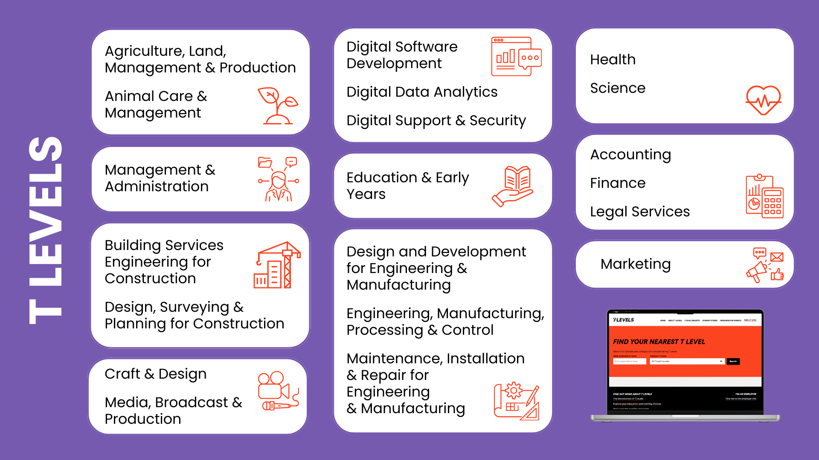
Notes:
There are 20 different T Level subjects you can take and you can see them on the screen.
You can also hopefully see that they span a wide range of subjects and sectors – from animal care and agriculture, through to accounting and marketing.
It is really important to check which are available at providers local to you. T Levels were launched in 2020 so are still rolling out in schools and colleges across the country. You can check by looking on the Find a T Level page on the T Levels website by putting in your postcode.
We’re going to watch a short film(s) now, so you can hear directly from T Level students about their experience.

Slide 9


Notes:
(Speaker note: There are five T Level student films on these slides - select one or more options that best suit your students and learning environment.
These slides could also be left out and the links shared with students to explore independently.
Please note that Joseph’s film also includes an HTQ student, Harrison.)
Sydney (Construction, Design, Planning and Surveying T Level): https://vimeo.com/1123908385
Dawn (Design and Development for Engineering and Manufacturing T Level): https://vimeo.com/1123911126
Katy (Education and Early Years T Level) & Dina (Health T Level): https://vimeo.com/1124852290
Joseph (Digital T Level): https://vimeo.com/1124852577
Fernanda (Digital T Level): https://vimeo.com/1129099098/ee0c031ae6?fl=pl&fe=sh

Slide 10

Notes:
(Speaker note: There are five T Level student films on these slides - select one or more options that best suit your students and learning environment.
These slides could also be left out and the links shared with students to explore independently.
Please note that Joseph’s film also includes an HTQ student, Harrison.)
Sydney (Construction, Design, Planning and Surveying T Level): https://vimeo.com/1123908385
Dawn (Design and Development for Engineering and Manufacturing T Level): https://vimeo.com/1123911126
Katy (Education and Early Years T Level) & Dina (Health T Level): https://vimeo.com/1124852290
Joseph (Digital T Level): https://vimeo.com/1124852577
Fernanda (Digital T Level): https://vimeo.com/1129099098/ee0c031ae6?fl=pl&fe=sh

Slide 11

Notes:
(Speaker note: There are five T Level student films on these slides - select one or more options that best suit your students and learning environment.
These slides could also be left out and the links shared with students to explore independently.
Please note that Joseph’s film also includes an HTQ student, Harrison.)
Sydney (Construction, Design, Planning and Surveying T Level): https://vimeo.com/1123908385
Dawn (Design and Development for Engineering and Manufacturing T Level): https://vimeo.com/1123911126
Katy (Education and Early Years T Level) & Dina (Health T Level): https://vimeo.com/1124852290
Joseph (Digital T Level): https://vimeo.com/1124852577
Fernanda (Digital T Level): https://vimeo.com/1129099098/ee0c031ae6?fl=pl&fe=sh

Slide 12

Notes:
(Speaker note: There are five T Level student films on these slides - select one or more options that best suit your students and learning environment.
These slides could also be left out and the links shared with students to explore independently.
Please note that Joseph’s film also includes an HTQ student, Harrison.)
Sydney (Construction, Design, Planning and Surveying T Level): https://vimeo.com/1123908385
Dawn (Design and Development for Engineering and Manufacturing T Level): https://vimeo.com/1123911126
Katy (Education and Early Years T Level) & Dina (Health T Level): https://vimeo.com/1124852290
Joseph (Digital T Level): https://vimeo.com/1124852577
Fernanda (Digital T Level): https://vimeo.com/1129099098/ee0c031ae6?fl=pl&fe=sh

Slide 13

Notes:
(Speaker note: There are five T Level student films on these slides - select one or more options that best suit your students and learning environment.
These slides could also be left out and the links shared with students to explore independently.
Please note that Joseph’s film also includes an HTQ student, Harrison.)
Sydney (Construction, Design, Planning and Surveying T Level): https://vimeo.com/1123908385
Dawn (Design and Development for Engineering and Manufacturing T Level): https://vimeo.com/1123911126
Katy (Education and Early Years T Level) & Dina (Health T Level): https://vimeo.com/1124852290
Joseph (Digital T Level): https://vimeo.com/1124852577
Fernanda (Digital T Level): https://vimeo.com/1129099098/ee0c031ae6?fl=pl&fe=sh

Slide 14
Cath Robinson
Project Manager

Slide 15
Lancashire WBL Executive Forum
Established in 2006
Managed by a Board of Directors
Membership made up of the Lancashire colleges ITPs and universities offering work-based learning
Raise the profile of apprenticeships and technical education

Slide 16
Lancashire WBL Executive Forum
Lancashire Apprenticeship Ambassador Network
LLTN
Skills Pledge partner
Northern Skills Network

Slide 17

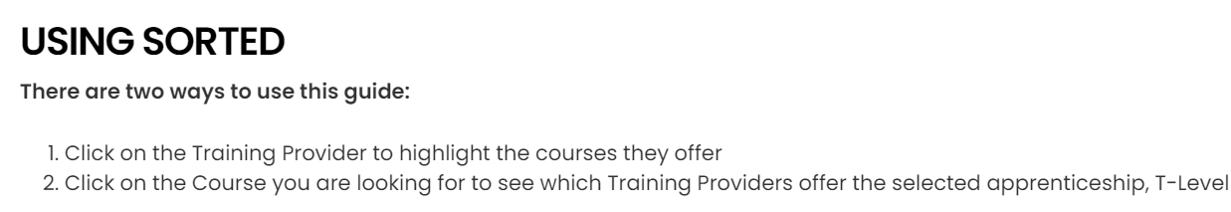
Lancashire WBL Executive Forum
SORTED online resource
  Apprenticeship education providers
  T-level providers

Slide 18
Lancashire WBL Executive Forum
ASK Delivery Partner for Lancashire and Cumbria 2016 - 2025
T-levels
  Placement
  Progression

Slide 19
T Level Ambassador network (TAN)

Slide 20



What is the T Level Ambassador Network?
Why we have a network to promote T Levels
Building awareness and reputation is critical to embedding T Levels into the educational landscape.
Who is in the network
Over 1,400 members who champion T Levels. Employers ranging from large businesses to SMEs, Providers, Universities, Students and others.
What ambassadors do
Storytelling
Signposting
Celebrating
Sharing insight
Sharing good practice
Promoting T Levels at events
And more…
Vision
T Levels are a qualification of choice by employers, education institutions, young people and those that influence them.
Mission
To advance the recognition, understanding and adoption of T Levels by building a vibrant community of trusted ambassadors who champion the transformative power of technical education.
Join the network
Notes:
The T Level Ambassador Network (TAN) aims to raise awareness of T Levels with a focus on (1) increasing the availability of industry placements through the advocacy of employers who host placements and (2) promoting the benefits of T Levels to young people and parents as a post-16 option.

Slide 21
Support for Schools
Schools can request direct support from T Level Ambassadors who can:
Deliver assemblies, classroom talks or employer encounters that help students understand T Levels and technical pathways
Share real‑world industry insight, progression routes and career outcomes
Support balanced, informed post‑16 decision making, alongside academic options
Suitable for:
Secondary Schools, PRUs and SEND settings
Years 9-11
Parent Talks
Staff Talks
In School or virtual delivery
Book a Session or Find Out More
Email: hello@tlevelambassadors.co.uk
Who are TAN Ambassadors?
Employers who host T Level Industry Placements
T Level providers
Current and former T Level students

Slide 22

T Level Placements
Jayne Bennett
Ami Snape
Runshaw College

Slide 23

T Level Placement Agency

Slide 24
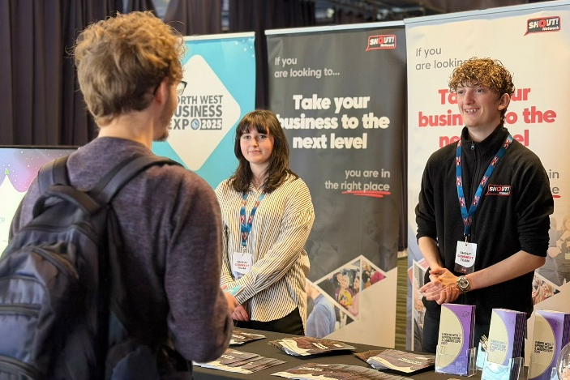
T Level Placement Agency
“My experience at Shout Connect has been incredibly positive. The encouragement, opportunities, and welcoming environment have played a huge role in my personal and professional growth, and I am so grateful to be part of such a supportive team.”
Ella – T Level Placement Agency Student
“Ella worked with Reay Associates to provide a new logo and branding for the business. Based on initial discussions, Ella produced excellent designs for the different branding elements required. ”
Reay Associates Representative

